Slide 1

我的心哪
（五）

Slide 2



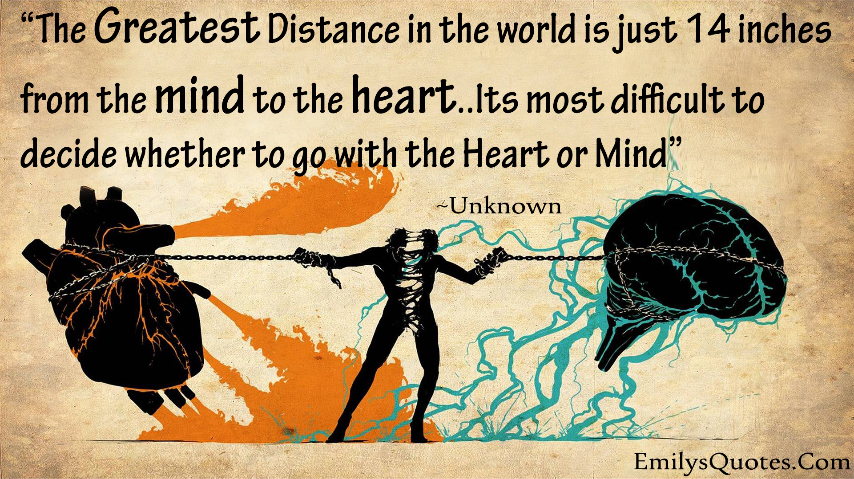


Slide 3


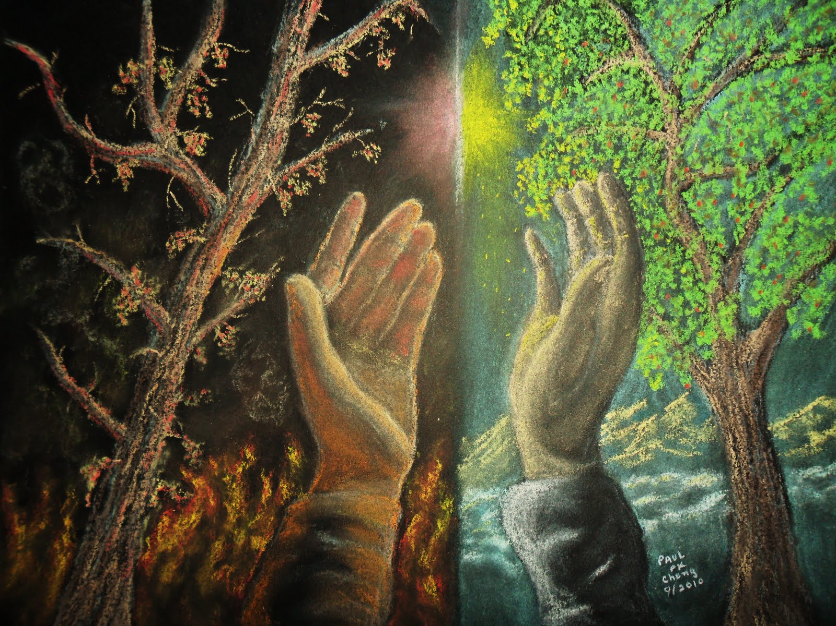
人的心(heart)
箴 4:23 你要保守你心，胜过保守一切（或译：你要切切保守你心），因为一生的果效是由心发出。

Slide 4
神通过人心工作
箴 23:26 我儿，要将你的心归我；你的眼目也要喜悦我的道路。My son, give me thy heart, and let thine eyes observe my ways.

Slide 5
神通过人心工作
撒上13:14 现在你的王位必不长久。耶和华已经寻着一个合他心意的人（the LORD hath sought him a man after his own heart），立他作百姓的君，因为你没有遵守耶和华所吩咐你的。

Slide 6
神通过人心工作
撒上16:7 耶和华却对撒母耳说：不要看他的外貌和他身材高大，我不拣选他。因为，耶和华不象人看人：人是看外貌；耶和华是看内心。

Slide 7
神通过人心工作
王上 8:39 求你在天上你的居所垂听赦免。你是知道人心的，要照各人所行的待他们（give to every man according to his ways）（唯有你知道世人的心）。

Slide 8

可以被神的灵感动

Slide 9
可以被神的灵感动
撒上 10:26-27 扫罗往基比亚回家去，有 神感动的一群人跟随他。 但有些匪徒说：这人怎能救我们呢？就藐视他，没有送他礼物；扫罗却不理会。
1Sam 10:26-27 And Saul also went home to Gibeah; and there went with him a band of men, whose hearts God had touched. But the children of Belial said, How shall this man save us? And they despised him, and brought him no presents. But he held his peace.

Slide 10
可以被神的灵感动
尼 2:12 我夜间起来，有几个人也一同起来；但 神使我心里要为耶路撒冷做甚么事，我并没有告诉人。除了我骑的牲口以外，也没有别的牲口在我那里。
Neh 2:12 And I arose in the night, I and some few men with me; neither told I any man what my God had put in my heart to do at Jerusalem: neither was there any beast with me, save the beast that I rode upon.

Slide 11
可以被神的灵感动
箴 21:1-2 王的心在耶和华手中，好象陇沟的水随意流转。 人所行的，在自己眼中都看为正；唯有耶和华衡量人心。
Prov 21:1-2 The king's heart is in the hand of the LORD, as the rivers of water: he turneth it whithersoever he will. Every way of a man is right in his own eyes: but the LORD pondereth the hearts.

Slide 12

邪灵想占据之地

Slide 13
邪灵想占据之地
申 29:18 惟恐你们中间，或男或女，或族长或支派长，今日心里偏离耶和华--我们的 神，去事奉那些国的神；又怕你们中间有恶根生出苦菜和茵蔯来， Deut 29:18 Lest there should be among you man, or woman, or family, or tribe, whose heart turneth away this day from the LORD our God, to go and serve the gods of these nations; lest there should be among you a root that beareth gall and wormwood;

Slide 14
邪灵想占据之地
王上 11:3 所罗门有妃七百，都是公主；还有嫔叁百。这些妃嫔诱惑他的心。 1Kgs 11:3 And he had seven hundred wives, princesses, and three hundred concubines: and his wives turned away his heart.

Slide 15
邪灵想占据之地
结 14:3 人子啊，这些人已将他们的假神接到心里，把陷于罪的绊脚石放在面前，我岂能丝毫被他们求问么？ Ezek 14:3 Son of man, these men have set up their idols in their heart, and put the stumblingblock of their iniquity before their face: should I be enquired of at all by them?

Slide 16
神的灵与人心

Slide 17
神的灵
亚4:6 他对我说：这是耶和华指示所罗巴伯的。万军之耶和华说：不是倚靠势力，不是倚靠才能，乃是倚靠我的灵方能成事。Then he answered and spake unto me, saying, This is the word of the LORD unto Zerubbabel, saying, Not by might, nor by power, but by my spirit, saith the LORD of hosts.

Slide 18
神的灵
诗 104:30 你发出你的灵，它们便受造；你使地面更换为新。
Thou sendest forth thy spirit, they are created: and thou renewest the face of the earth.

Slide 19
神的灵
赛 32:15 等到圣灵从上浇灌我们，旷野就变为肥田，肥田看如树林。
Until the spirit be poured upon us from on high, and the wilderness be a fruitful field, and the fruitful field be counted for a forest.

Slide 20
神的灵
珥 2:28 以后，我要将我的灵浇灌凡有血气的。你们的儿女要说预言；你们的老年人要做异梦，少年人要见异象。2:29 在那些日子，我要将我的灵浇灌我的仆人和使女。

Slide 21
神的话与神的灵
创 1:2-3 地是空虚混沌，渊面黑暗； 神的灵运行在水面上。神说：要有光，就有了光。And the earth was without form, and void; and darkness was upon the face of the deep. And the Spirit of God moved upon the face of the waters. And God said, Let there be light: and there was light.

Slide 22
神的话与神的灵
林后 3:3 你们明显是基督的信，藉着我们修成的。不是用墨写的，乃是用永生神的灵写的；不是写在石版上，乃是写在心版上。 2Cor 3:3 Forasmuch as ye are manifestly declared to be the epistle of Christ ministered by us, written not with ink, but with the Spirit of the living God; not in tables of stone, but in fleshy tables of the heart.

Slide 23
用心与神（的灵）相交
西 3:16 当用各样的智慧，把基督的道理丰丰富富的存在心里，（或作：当把基督的道理丰丰富富的存在心里，以各样的智慧），用诗章、颂词、灵歌，彼此教导，互相劝戒，心被恩感，歌颂神。
Col 3:16 Let the word of Christ dwell in you richly in all wisdom; teaching and admonishing one another in psalms and hymns and spiritual songs, singing with grace in your hearts to the Lord.

Slide 24
用心与神（的灵）相交
弗 5:18-19 不要醉酒，酒能使人放蕩；乃要被圣灵充满。 当用诗章、颂词、灵歌、彼此对说，口唱心和的赞美主。
Eph 5:18-19 And be not drunk with wine, wherein is excess; but be filled with the Spirit; Speaking to yourselves in psalms and hymns and spiritual songs, singing and making melody in your heart to the Lord;

