Slide 1

我的心哪
（四）

Slide 2

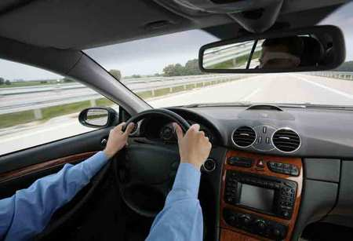
如何在信心道路上不偏左右？

Slide 3


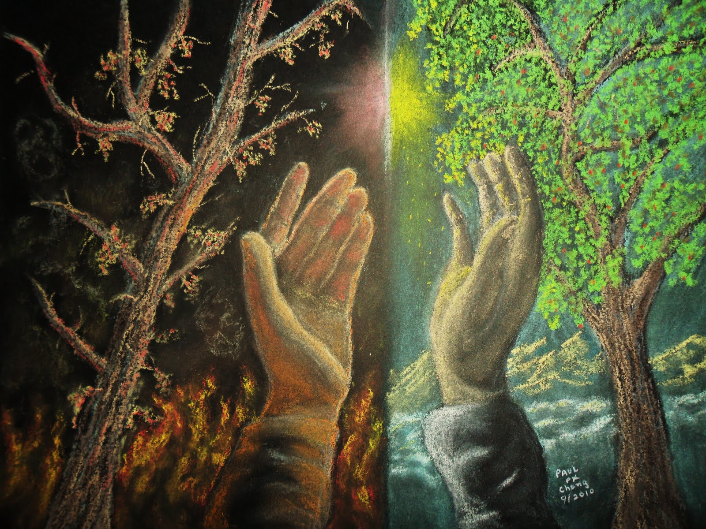
人的心(heart)
箴 4:23 你要保守你心，胜过保守一切（或译：你要切切保守你心），因为一生的果效是由心发出。

Slide 4

外面行为改变的关键

Slide 5
外面行为改变的关键
箴 14:14 心中背道的，必满得自己的结果；善人必从自己的行为得以知足。
Prov 14:14 The backslider in heart shall be filled with his own ways: and a good man shall be satisfied from himself.

Slide 6
外面行为改变的关键
路 6:45 善人从他心里所存的善就发出善来；恶人从他心里所存的恶就发出恶来；因为心里所充满的，口里就说出来。
Luke 6:45 A good man out of the good treasure of his heart bringeth forth that which is good; and an evil man out of the evil treasure of his heart bringeth forth that which is evil: for of the abundance of the heart his mouth speaketh.

Slide 7

意愿所在地

Slide 8
意愿所在地
出 25:2 你告诉以色列人当为我送礼物来；凡甘心乐意的，你们就可以收下归我。
Ex 25:2 Speak unto the children of Israel, that they bring me an offering: of every man that giveth it willingly with his heart ye shall take my offering.

Slide 9
意愿所在地
但 1:8 但以理却立志不以王的膳和王所饮的酒玷污自己，所以求太监长容他不玷污自己。 Dan 1:8 But Daniel purposed in his heart that he would not defile himself with the portion of the king's meat, nor with the wine which he drank: therefore he requested of the prince of the eunuchs that he might not defile himself.

Slide 10
意愿所在地
撒下 7:3 拿单对王说：你可以照你的心意而行，因为耶和华与你同在。
2Sam 7:3 And Nathan said to the king, Go, do all that is in thine heart; for the LORD is with thee.

Slide 11
意愿所在地
林后 8:16 多谢神，感动提多的心 (God, which put the same earnest care into the heart of Titus for you)，叫他待你们殷勤，象我一样。8:17 他固然是听了我的劝，但自己更是热心，情愿往你们那里去。

Slide 12
意愿所在地
林后9:7 各人要随本心所酌定的，不要作难，不要勉强，因为捐得乐意的人是神所喜爱的。 Every man according as he purposeth in his heart, so let him give; not grudgingly, or of necessity: for God loveth a cheerful giver.

Slide 13
让神来更新我们的意愿
腓2:12 这样看来，我亲爱的弟兄，你们既是常顺服的，不但我在你们那里，就是我如今不在你们那里，更是顺服的，就当恐惧战兢做成你们得救的工夫。2:13 因为你们立志行事都是神在你们心里运行，为要成就他的美意（For it is God which worketh in you both to will and to do of his good pleasure.）。

Slide 14

情感、态度所在之处

Slide 15
情感、态度所在之处
王上 8:66 第八日，王遣散众民；他们都为王祝福。因见耶和华向他仆人大卫和他民以色列所施的一切恩惠，就都心中喜乐，各归各家去了。
1Kgs 8:66 On the eighth day he sent the people away: and they blessed the king, and went unto their tents joyful and glad of heart for all the goodness that the LORD had done for David his servant, and for Israel his people.

Slide 16
情感、态度所在之处
创 45:26 告诉他说：约瑟还在，并且作埃及全地的宰相。雅各心里冰凉，因为不信他们。
Gen 45:26 And told him, saying, Joseph is yet alive, and he is governor over all the land of Egypt. And Jacob's heart fainted, for he believed them not.

Slide 17
情感、态度所在之处
民 32:9 他们上以实各谷，去窥探那地回来的时候，使以色列人灰心丧胆，不进入耶和华所赐给他们的地。
Num 32:9 For when they went up unto the valley of Eshcol, and saw the land, they discouraged the heart of the children of Israel, that they should not go into the land which the LORD had given them.

Slide 18
情感、态度所在之处
申 15:10 你总要给他，给他的时候心里不可愁烦；因耶和华你的 神必在你这一切所行的，并你手里所办的事上，赐福与你。
Deut 15:10 Thou shalt surely give him, and thine heart shall not be grieved when thou givest unto him: because that for this thing the LORD thy God shall bless thee in all thy works, and in all that thou puttest thine hand unto.

Slide 19
情感、态度所在之处
申 20:8 官长又要对百姓宣告说：谁惧怕胆怯，他可以回家去，恐怕他弟兄的心消化，和他一样。
Deut 20:8 And the officers shall speak further unto the people, and they shall say, What man is there that is fearful and fainthearted? let him go and return unto his house, lest his brethren's heart faint as well as his heart.

Slide 20
情感、态度所在之处
申 8:14 你就心高气傲，忘记耶和华你的 神，就是将你从埃及地为奴之家领出来的。
Deut 8:14 Then thine heart be lifted up, and thou forget the LORD thy God, which brought thee forth out of the land of Egypt, from the house of bondage;

Slide 21
如何应付负面的情绪
林后5:16 所以，我们从今以后，不凭着外貌（原文是肉体；本节同）认人了。虽然凭着外貌认过基督，如今却不再这样认他了。5:17 若有人在基督里，他就是新造的人，旧事已过，都变成新的了。

Slide 22
如何应付负面的情绪
腓 4:6 应当一无挂虑，只要凡事藉着祷告、祈求，和感谢，将你们所要的告诉神。4:7 神所赐、出人意外的平安必在基督耶稣里保守你们的心怀(hearts)意念(minds, noema,
i.e., perception)。

Slide 23
如何应付负面的情绪
罗 15:13 但愿使人有盼望的神，因信将诸般的喜乐、平安充满你们的心，使你们藉着圣灵的能力大有盼望。Now the God of hope fill you with all joy and peace in believing, that ye may abound in hope, through the power of the Holy Ghost.

