Slide 1
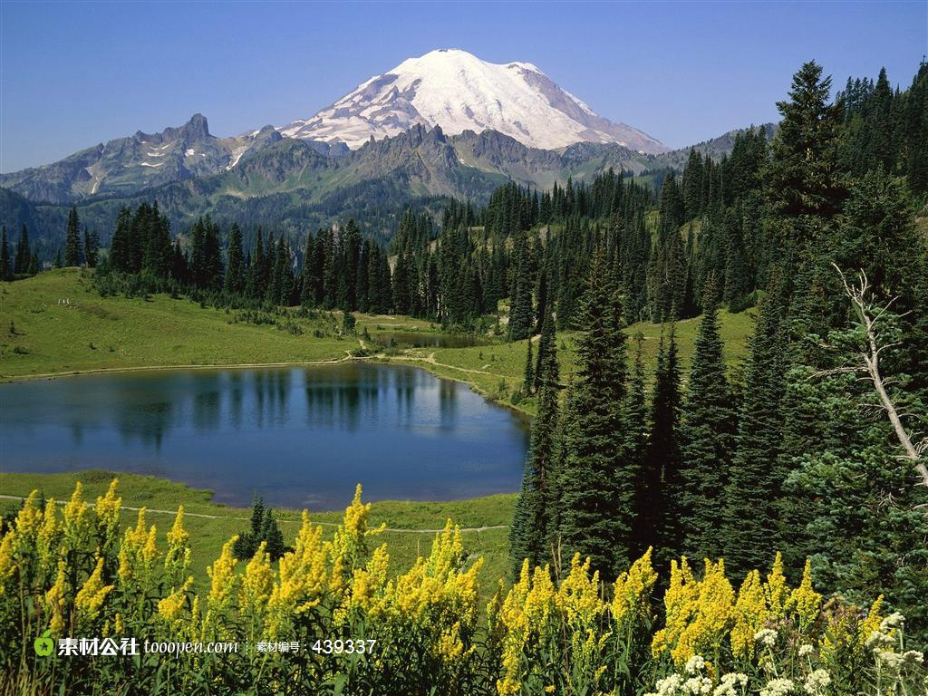
得那山地为业
（2）

Slide 2
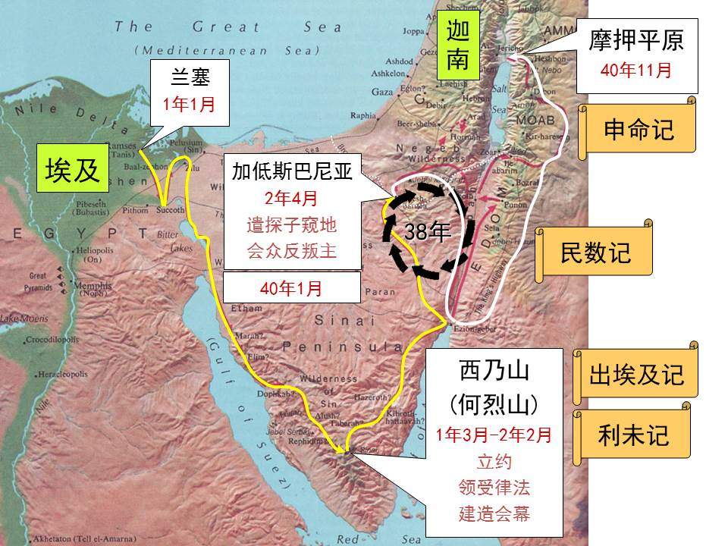
申1:2 从何烈山经过西珥山到加低斯巴尼亚有十一天的路程。1:3 出埃及第四十年十一月初一日，摩西照耶和华藉着他所吩咐以色列人的话都晓谕他们。

Slide 3
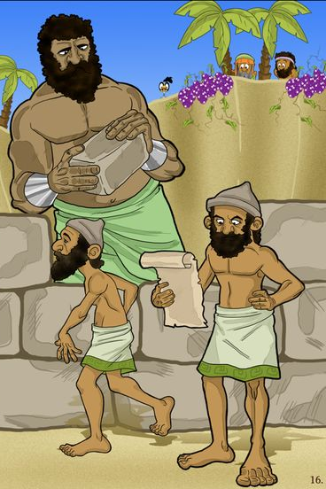
失败的原因
不信神的话
不顺服神
惧怕
亚摩利人 Amorite: bitter; a rebel; a babbler （Hitchcock's Bible Names）

Slide 4
你最怕什么？惧怕到底是怎么回事？
来2:14 儿女既同有血肉之体，他也照样亲自成了血肉之体，特要藉着死败坏那掌死权的，就是魔鬼，2:15 并要释放那些一生因怕死而为奴仆的人（might free those who through fear of death were subject to slavery all their lives）。
Top 10 fears of 2016 (USA Today):
Corruption of government officials (same top fear as 2015) — 60.6%
Terrorist attacks — 41%
Not having enough money for the future — 39.9%
Being a victim of terror — 38.5%
Government restrictions on firearms and ammunition — 38.5%
People I love dying — 38.1%
Economic or financial collapse — 37.5%
Identity theft — 37.1%
People I love becoming seriously ill — 35.9%
The Affordable Health Care Act — 35.5%
惧怕是内心接受或相信了负面的期待（话语），然后在恶性循环中加强这样的经历

Slide 5
你最怕什么？惧怕到底是怎么回事？
来2:14 儿女既同有血肉之体，他也照样亲自成了血肉之体，特要藉着死败坏那掌死权的，就是魔鬼，2:15 并要释放那些一生因怕死而为奴仆的人（might free those who through fear of death were subject to slavery all their lives）。
Top 10 fears of 2016 (USA Today):
Corruption of government officials (same top fear as 2015) — 60.6%
Terrorist attacks — 41%
Not having enough money for the future — 39.9%
Being a victim of terror — 38.5%
Government restrictions on firearms and ammunition — 38.5%
People I love dying — 38.1%
Economic or financial collapse — 37.5%
Identity theft — 37.1%
People I love becoming seriously ill — 35.9%
The Affordable Health Care Act — 35.5%
经济方面的损失
+
生命方面的损失
+
健康方面的损失
“己生命”的损失

Slide 6
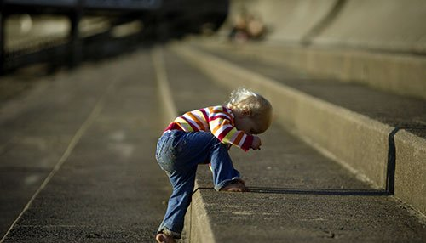
如何才能不怕“己生命”的损失？
路12:13 众人中有一个人对耶稣说：夫子！请你吩咐我的兄长和我分开家业。12:14 耶稣说：你这个人！谁立我作你们断事的官，给你们分家业呢？12:15 于是对众人说：你们要谨慎自守，免去一切的贪心，因为人的生命不在乎家道丰富。
Top 10 fears of 2016 (USA Today):
Corruption of government officials (same top fear as 2015) — 60.6%
Terrorist attacks — 41%
Not having enough money for the future — 39.9%
Being a victim of terror — 38.5%
Government restrictions on firearms and ammunition — 38.5%
People I love dying — 38.1%
Economic or financial collapse — 37.5%
Identity theft — 37.1%
People I love becoming seriously ill — 35.9%
The Affordable Health Care Act — 35.5%
经济方面的损失
+
生命方面的损失
+
健康方面的损失
认清方向

Slide 7
如何才能不怕“己生命”的损失？
路12:22 耶稣又对门徒说：所以我告诉你们，不要为生命忧虑吃甚么，为身体忧虑穿甚么；12:23 因为生命胜于饮食，身体胜于衣裳。12:24 你想乌鸦，也不种也不收，又没有仓又没有库，神尚且养活他。你们比飞鸟是何等的贵重呢！12:25 你们那一个能用思虑使寿数多加一刻呢？12:26 这最小的事，你们尚且不能作，为甚么还忧虑其余的事呢？12:27 你想百合花怎么长起来；他也不劳苦，也不纺线。然而我告诉你们，就是所罗门极荣华的时候，他所穿戴的，还不如这花一朵呢！12:28 你们这小信的人哪，野地里的草今天还在，明天就丢在炉里，神还给他这样的妆饰，何况你们呢！12:29 你们不要求吃甚么，喝甚么，也不要罣心；12:30 这都是外邦人所求(seek)的。你们必须用这些东西，你们的父是知道的。12:31 你们只要求他的国，这些东西就必加给你们了。
Top 10 fears of 2016 (USA Today):
Corruption of government officials (same top fear as 2015) — 60.6%
Terrorist attacks — 41%
Not having enough money for the future — 39.9%
Being a victim of terror — 38.5%
Government restrictions on firearms and ammunition — 38.5%
People I love dying — 38.1%
Economic or financial collapse — 37.5%
Identity theft — 37.1%
People I love becoming seriously ill — 35.9%
The Affordable Health Care Act — 35.5%
经济方面的损失
+
生命方面的损失
+
健康方面的损失

Slide 8

如何才能不怕“己生命”的损失？
提前6:12 你要为真道打那美好的仗，持定永生。你为此被召。Fight the good fight of faith; take hold of the eternal life to which you were called.
Top 10 fears of 2016 (USA Today):
Corruption of government officials (same top fear as 2015) — 60.6%
Terrorist attacks — 41%
Not having enough money for the future — 39.9%
Being a victim of terror — 38.5%
Government restrictions on firearms and ammunition — 38.5%
People I love dying — 38.1%
Economic or financial collapse — 37.5%
Identity theft — 37.1%
People I love becoming seriously ill — 35.9%
The Affordable Health Care Act — 35.5%
经济方面的损失
+
生命方面的损失
+
健康方面的损失
认清争战的性质和争夺点

Slide 9
如何才能不怕“己生命”的损失？
提前6:12 你要为真道打那美好的仗，持定永生。你为此被召。Fight the good fight of faith; take hold of the eternal life to which you were called.
Top 10 fears of 2016 (USA Today):
Corruption of government officials (same top fear as 2015) — 60.6%
Terrorist attacks — 41%
Not having enough money for the future — 39.9%
Being a victim of terror — 38.5%
Government restrictions on firearms and ammunition — 38.5%
People I love dying — 38.1%
Economic or financial collapse — 37.5%
Identity theft — 37.1%
People I love becoming seriously ill — 35.9%
The Affordable Health Care Act — 35.5%
经济方面的损失
+
生命方面的损失
+
健康方面的损失
认清争战的性质和争夺点

Slide 10
如何才能不怕“己生命”的损失？
撒上17:33 扫罗对大卫说：你不能去与那非利士人战斗；因为你年纪太轻，他自幼就作战士。17:34 大卫对扫罗说：你仆人为父亲放羊，有时来了狮子，有时来了熊，从群中啣一隻羊羔去。17:35 我就追赶它，击打它，将羊羔从它口中救出来。它起来要害我，我就揪
Top 10 fears of 2016 (USA Today):
Corruption of government officials (same top fear as 2015) — 60.6%
Terrorist attacks — 41%
Not having enough money for the future — 39.9%
Being a victim of terror — 38.5%
Government restrictions on firearms and ammunition — 38.5%
People I love dying — 38.1%
Economic or financial collapse — 37.5%
Identity theft — 37.1%
People I love becoming seriously ill — 35.9%
The Affordable Health Care Act — 35.5%
经济方面的损失
+
生命方面的损失
+
健康方面的损失
认清当下的那步

Slide 11
如何才能不怕“己生命”的损失？
着它的鬍子，将它打死。17:36 你仆人曾打死狮子和熊，这未受割礼的非利士人向永生 神的军队骂阵，也必象狮子和熊一般。17:37 大卫又说：耶和华救我脱离狮子和熊的爪，也必救我脱离这非利士人的手。扫罗对大卫说：你可以去罢！耶和华必与你同在。
Top 10 fears of 2016 (USA Today):
Corruption of government officials (same top fear as 2015) — 60.6%
Terrorist attacks — 41%
Not having enough money for the future — 39.9%
Being a victim of terror — 38.5%
Government restrictions on firearms and ammunition — 38.5%
People I love dying — 38.1%
Economic or financial collapse — 37.5%
Identity theft — 37.1%
People I love becoming seriously ill — 35.9%
The Affordable Health Care Act — 35.5%
经济方面的损失
+
生命方面的损失
+
健康方面的损失
认清当下的那步

Slide 12
如何才能不怕“己生命”的损失？
17:38 扫罗就把自己的战衣给大卫穿上，将铜盔给他戴上，又给他穿上铠甲。17:39 大卫把刀跨在战衣外，试试能走不能走；因为素来没有穿惯，就对扫罗说：我穿戴这些不能走，因为素来没有穿惯。于是摘脱了。
Top 10 fears of 2016 (USA Today):
Corruption of government officials (same top fear as 2015) — 60.6%
Terrorist attacks — 41%
Not having enough money for the future — 39.9%
Being a victim of terror — 38.5%
Government restrictions on firearms and ammunition — 38.5%
People I love dying — 38.1%
Economic or financial collapse — 37.5%
Identity theft — 37.1%
People I love becoming seriously ill — 35.9%
The Affordable Health Care Act — 35.5%
经济方面的损失
+
生命方面的损失
+
健康方面的损失
认清当下的那步

