Slide 1
因信称义(8）
Righteousness through faith
（罗马书1-5章）

Slide 2
到底什么是因信称义？
1. 信耶稣的人就在上帝面前称为义？
那也太便宜了吧！
2. 信耶稣的人就在上帝面前算为义人？
但实际上还是罪人！
3. 信耶稣的人，如果有好行为，就在上帝面前算为义人？
但什么样的好行为才算是够好的行为了呢？

Slide 3
罗马书第三章 Romans 3
21 但如今，神的义在律法以外已经显明出来，有律法和先知为證：22 就是神的义，因信耶稣基督加给一切相信的人，并没有分别。
21 But now the righteousness of God without the law is manifested, being witnessed by the law and the prophets;
22 Even the righteousness of God which is by faith of Jesus Christ unto all and upon all them that believe: for there is no difference:

Slide 4
罗马书第三章 Romans 3
21 但如今，神的义在律法以外已经显明出来，有律法和先知为證：22 就是神的义，因信耶稣基督加给一切相信的人，并没有分别。
21 But now the righteousness of God without the law is manifested, being witnessed by the law and the prophets;
22 Even the righteousness of God which is by faith of Jesus Christ unto all and upon all them that believe: for there is no difference:

Slide 5
罗马书第三章 Romans 3
23 因为世人都犯了罪，亏缺了神的荣耀； 24 如今却蒙神的恩典，因基督耶稣的救赎，就白白的称义。 23 For all have sinned, and come short of the glory of God; 24 Being justified freely by his grace through the redemption that is in Christ Jesus:

Slide 6
罗马书第三章 Romans 3
23 因为世人都犯了罪，亏缺了神的荣耀； 24 如今却蒙神的恩典，因基督耶稣的救赎，就白白的称义。 23 For all have sinned, and come short of the glory of God; 24 Being justified freely by his grace through the redemption that is in Christ Jesus:
相关概念
神通过基督已经称所有人为义，但每个人需要相信才能领受义（成为自己的、实际地经历到）
新约的真信心 = 基督的信心+人的相信

Slide 7
到底什么是因信称义？
1. 信耶稣的人就在上帝面前称为义？
那也太便宜了吧！
2. 信耶稣的人就在上帝面前算为义人？
但实际上还是罪人！
3. 信耶稣的人，如果有好行为，就在上帝面前算为义人？
但什么样的好行为才算是够好的行为了呢？

Slide 8
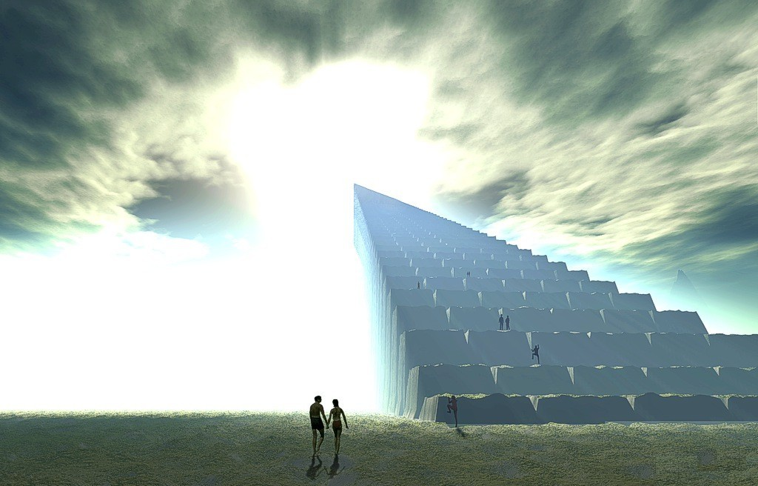
故事还没有完…

Slide 9
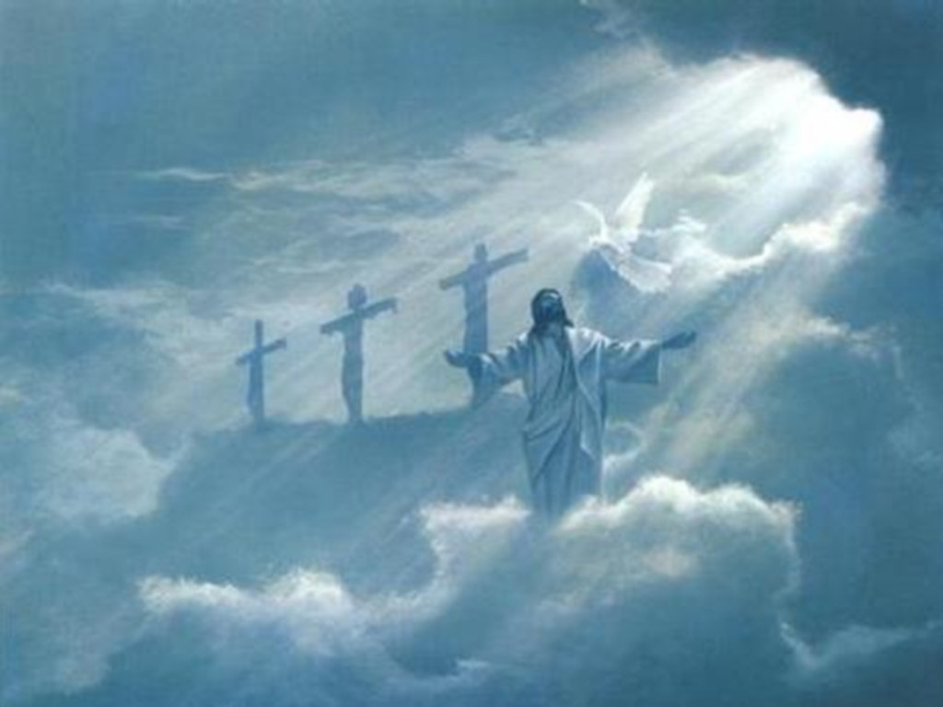
因为他如何，我们在这世上也如何。(约一 4:17)

Slide 10
罗马书第四章 Romans 4
13 因为神应许亚伯拉罕和他后裔，必得承受世界，不是因律法，乃是因信而得的义。
13 For the promise, that he should be the heir of the world, was not to Abraham, or to his seed, through the law, but through the righteousness of faith.
相关概念
加 3:2-3 我只要问你们这一件：你们受了圣灵，是因行律法呢？是因听信福音呢？ 你们既靠圣灵入门，如今还靠肉身成全么？你们是这样的无知么？

Slide 11
罗马书第四章 Romans 4
13 因为神应许亚伯拉罕和他后裔，必得承受世界，不是因律法，乃是因信而得的义。
13 For the promise, that he should be the heir of the world, was not to Abraham, or to his seed, through the law, but through the righteousness of faith.
林前 15:46-50 但属灵的不在先，属血气的(psuchikos, natural)在先，以后纔有属灵的。 头一个人是出于地，乃属土；第二个人是出于天。 那属土的怎样，凡属土的也就怎样；属天的怎样，凡属天的也就怎样。 我们既有属土的形状，将来也必有属天的形状。 弟兄们，我告诉你们说，血肉之体(flesh and blood)不能承受神的国，必朽坏的不能承受不朽坏的。

Slide 12
罗马书第四章 Romans 4
13 因为神应许亚伯拉罕和他后裔，必得承受世界，不是因律法，乃是因信而得的义。
13 For the promise, that he should be the heir of the world, was not to Abraham, or to his seed, through the law, but through the righteousness of faith.
路 5:36-39 耶稣又设一个比喻，对他们说：没有人把新衣服撕下一块来补在旧衣服上；若是这样，就把新的撕破了，并且所撕下来的那块新的和旧的也不相称。 也没有人把新酒装在旧皮袋里；若是这样，新酒必将皮袋裂开，酒便漏出来，皮袋也就坏了。 但新酒必须装在新皮袋里。 没有人喝了陈酒又想喝新的；他总说陈的好。

Slide 13
罗马书第四章 Romans 4
14 若是属乎律法的人纔得为后嗣，信就归于虚空，应许也就废弃了。
14 For if they which are of the law be heirs, faith is made void, and the promise made of none effect:
相关概念
加 3:12 律法原不本乎信，只说：行这些事的，就必因此活着。
加 3:18 因为承受产业，若本乎律法，就不本乎应许；但神是凭着应许把产业赐给亚伯拉罕。

Slide 14
罗马书第四章 Romans 4
15 因为律法是惹动忿怒的（或作：叫人受刑的）；那里没有律法，那里就没有过犯。
15 Because the law worketh wrath: for where no law is, there is no transgression.
相关概念
加 3:19 这样说来，律法是为甚么有的呢？原是为过犯添上的，等候那蒙应许的子孙来到，并且是藉天使经中保之手设立的。
加 3:24-25 这样，律法是我们训蒙的师傅，引我们到基督那里，使我们因信称义。 但这因信得救的理既然来到，我们从此就不在师傅的手下了。

Slide 15
罗马书第四章 Romans 4
16 所以人得为后嗣是本乎信，因此就属乎恩，叫应许定然归给一切后裔；不但归给那属乎律法的，也归给那效法亚伯拉罕之信的。16 Therefore it is of faith, that it might be by grace; to the end the promise might be sure to all the seed; not to that only which is of the law, but to that also which is of the faith of Abraham; who is the father of us all,

Slide 16
罗马书第四章 Romans 4
16 所以人得为后嗣是本乎信，因此就属乎恩，叫应许定然归给一切后裔；不但归给那属乎律法的，也归给那效法亚伯拉罕之信的。16 Therefore it is of faith, that it might be by grace; to the end the promise might be sure to all the seed; not to that only which is of the law, but to that also which is of the faith of Abraham; who is the father of us all,
相关概念
加 3:16 所应许的原是向亚伯拉罕和他子孙说的。神并不是说众子孙，指着许多人，乃是说你那一个子孙，指着一个人，就是基督。

Slide 17
罗马书第四章 Romans 4
17 亚伯拉罕所信的，是那叫死人复活、使无变为有的神，他在主面前作我们世人的父。如经上所记：我已经立你作多国的父。17 (As it is written, I have made thee a father of many nations,) before him whom he believed, even God, who quickeneth the dead, and calleth those things which be not as though they were.
相关概念
神总是通过祂的道做事（创造、救赎、拯救、祝福…），包括在地上
新约的真信心 = 基督的信心 + 人的相信(用心领受)

Slide 18
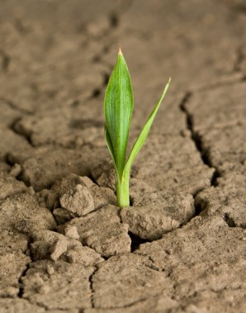
罗马书第四章 Romans 4
18 他在无可指望的时候，因信仍有指望，就得以作多国的父，正如先前所说，你的后裔将要如此。18 Who against hope believed in hope, that he might become the father of many nations; according to that which was spoken, So shall thy seed be.

Slide 19
罗马书第四章 Romans 4
18 他在无可指望的时候，因信仍有指望，就得以作多国的父，正如先前所说，你的后裔将要如此。18 Who against hope believed in hope, that he might become the father of many nations; according to that which was spoken, So shall thy seed be.

Slide 20
罗马书第四章 Romans 4
19 他将近百岁的时候，虽然想到自己的身体如同已死，撒拉的生育已经断绝，他的信心还是不软弱；
19 And being not weak in faith, he considered not his own body now dead, when he was about an hundred years old, neither yet the deadness of Sarah's womb:

Slide 21
罗马书第四章 Romans 4
20 并且仰望神的应许，总没有因不信心里起疑惑，反倒因信心里得坚固，将荣耀归给神，21 且满心相信神所应许的必能做成。
20 He staggered not at the promise of God through unbelief; but was strong in faith, giving glory to God;21 And being fully persuaded that, what he had promised, he was able also to perform.

Slide 22
罗马书第四章 Romans 4
22 所以，这就算为他的义。23 算为他义的这句话不是单为他写的，
22 And therefore it was imputed to him for righteousness.
23 Now it was not written for his sake alone, that it was imputed to him;

