Slide 1
因信称义(2）
Righteousness through faith
（罗马书1-5章）

Slide 2
罗马书第一章 Romans 1
16 我不以福音为耻；这福音本是神的大能，要救一切相信的，先是犹太人，后是希腊人。
16 For I am not ashamed of the gospel of Christ: for it is the power of God unto salvation to every one that believeth; to the Jew first, and also to the Greek.
相关概念
神对人的帮助完全通过福音（就是通过基督这唯一的神人中保）
人的责任就是领受（相信）

Slide 3
罗马书第一章 Romans 1
17 因为神的义正在这福音上显明出来；这义是本于信，以致于信。如经上所记：义人必因信得生。
17 For therein is the righteousness of God revealed from faith to faith: as it is written, The just shall live by faith.
相关概念
福音首要的目的就是让人通过基督领受神的义
基督徒的信是基于基督的信
靠信心生活就是靠基督生活，就是不再靠自己做而赚取

Slide 4
罗马书第一章 Romans 1
18 原来，神的忿怒从天上显明在一切不虔不义的人身上，就是那些行不义阻挡真理的人。
18 For the wrath of God is revealed from heaven against all ungodliness and unrighteousness of men, who hold the truth in unrighteousness;
相关概念
神的忿怒首先是针对“不虔不义”（里面从撒但而来抵挡神的东西）
人是话语的器皿，人的生活彰显内心接受的思想（话语）

Slide 5
罗马书第一章 Romans 1
19 神的事情，人所能知道的，原显明在人心里，因为神已经给他们显明。
19 Because that which may be known of God is manifest in them; for God hath shewed it unto them.
相关概念
每个人内心深处已经有神的启示
是人内心接受的、与神敌对的思想（话语）让人无法明白神的事情

Slide 6
罗马书第一章 Romans 1
20 自从造天地以来，神的永能和神性是明明可知的，虽是眼不能见，但藉着所造之物就可以晓得，叫人无可推诿。
20 For the invisible things of him from the creation of the world are clearly seen, being understood by the things that are made, even his eternal power and Godhead; so that they are without excuse:

Slide 7
罗马书第一章 Romans 1
21 因为，他们虽然知道神，却不当作神荣耀他，也不感谢他。他们的思念变为虚妄，无知的心就昏暗了。21 Because that, when they knew God, they glorified him not as God, neither were thankful; but became vain in their imaginations, and their foolish heart was darkened.
相关概念
人心是属灵的接收器
神从来没有将祂的生命、祝福向人收回，是人自己的心远离了神而无法领受

Slide 8
罗马书第一章 Romans 1
22 自称为聪明，反成了愚拙， 23 将不能朽坏之神的荣耀变为偶象，彷彿必朽坏的人和飞禽、走兽、昆虫的样式。22 Professing themselves to be wise, they became fools, 23 And changed the glory of the uncorruptible God into an image made like to corruptible man, and to birds, and fourfooted beasts, and creeping things.
相关概念
人的问题往往是我们会在一个错误的根基巧妙地建造
否认全能创造主会让人陷入明显的错误而不自知

Slide 9
罗马书第一章 Romans 1
24 所以，神任凭他们逞着心里的情慾行污秽的事，以致彼此玷辱自己的身体。
24 Wherefore God also gave them up to uncleanness through the lusts of their own hearts, to dishonour their own bodies between themselves:
相关概念
神是人内心生命、满足、喜乐、盼望、意义、、、的泉源
人内心（因拒绝神而产生）的缺乏感是外面一切罪行的原动力

Slide 10
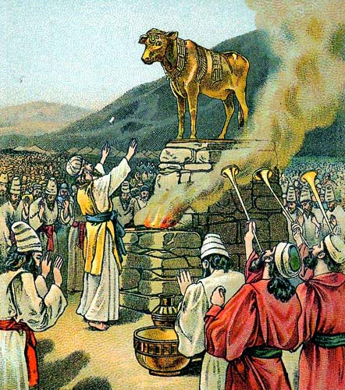
罗马书第一章 Romans 1
25 他们将神的真实变为虚谎，去敬拜事奉受造之物，不敬奉那造物的主；主乃是可称颂的，直到永远。阿们！
25 Who changed the truth of God into a lie, and worshipped and served the creature more than the Creator, who is blessed for ever. Amen.

Slide 11
罗马书第一章 Romans 1
26 因此，神任凭他们放纵可羞耻的情慾。他们的女人把顺性的用处变为逆性的用处；
26 For this cause God gave them up unto vile affections: for even their women did change the natural use into that which is against nature:
相关概念
人对神执意的抵挡会使内心更加刚硬
用违背神旨意的方法（罪行）去解决内心的缺乏必然让人陷入更深的捆绑

Slide 12
罗马书第一章 Romans 1
27 男人也是如此，弃了女人顺性的用处，慾火攻心，彼此贪恋，男和男行可羞耻的事，就在自己身上受这妄为当得的报应。27 And likewise also the men, leaving the natural use of the woman, burned in their lust one toward another; men with men working that which is unseemly, and receiving in themselves that recompence of their error which was meet.
相关概念
用违背神旨意的方法（罪行）去解决内心的缺乏必然让人陷入更深的捆绑
(雅 1:15) 私慾既怀了胎，就生出罪来；罪既长成，就生出死来。

Slide 13
罗马书第一章 Romans 1
28 他们既然故意不认识神，神就任凭他们存邪僻的心，行那些不合理的事；
28 And even as they did not like to retain God in their knowledge, God gave them over to a reprobate mind, to do those things which are not convenient;
相关概念
人心要有正确观念必须先有神的知识（认知)
内心错误的观念是外面错误行为的根本原因

Slide 14
罗马书第一章 Romans 1
29 装满了各样不义、邪恶、贪婪、恶毒（或作：阴毒），满心是嫉妒、凶杀、争竞、诡诈、毒恨；29 Being filled with all unrighteousness, fornication, wickedness, covetousness, maliciousness; full of envy, murder, debate, deceit, malignity; whisperers,
相关概念
人心拒绝神就会被其它（不好的）东西充满
(箴 4:23) 你要保守你心，胜过保守一切因为一生的果效是由心发出。

Slide 15
罗马书第一章 Romans 1
30 又是谗毁的、背后说人的、怨恨神的（或作：被神所憎恶的）、侮慢人的、狂傲的、自夸的、捏造恶事的、违背父母的。
30 Backbiters, haters of God, despiteful, proud, boasters, inventors of evil things, disobedient to parents,

Slide 16
罗马书第一章 Romans 1
31 无知的，背约的，无亲情的，不怜悯人的。
31 Without understanding, covenantbreakers, without natural affection, implacable, unmerciful:
相关概念
人心拒绝神就会被其它（不好的）东西充满
(箴 4:23) 你要保守你心，胜过保守一切因为一生的果效是由心发出。

Slide 17
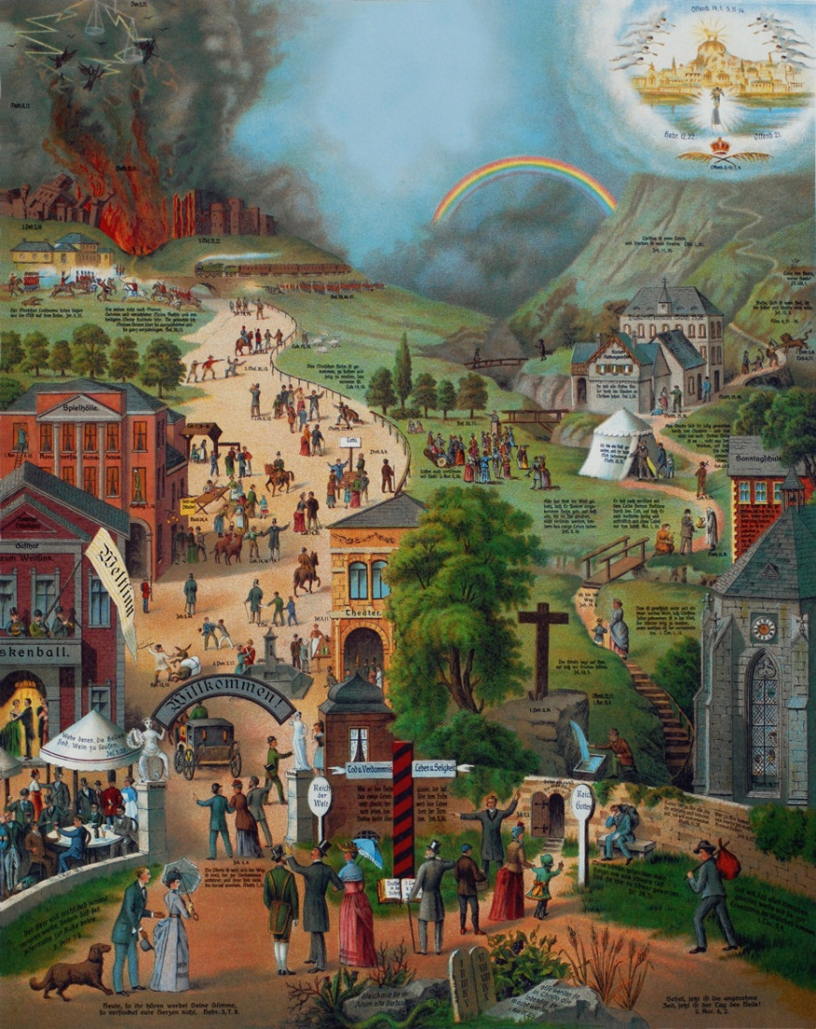
罗马书第一章 Romans 1
32 他们虽知道神判定行这样事的人是当死的，然而他们不但自己去行，还喜欢别人去行。
32 Who knowing the judgment of God, that they which commit such things are worthy of death, not only do the same, but have pleasure in them that do them.

