Slide 1

死里复活(7）
Resurrection from the dead
（罗马书5-8章）

Slide 2

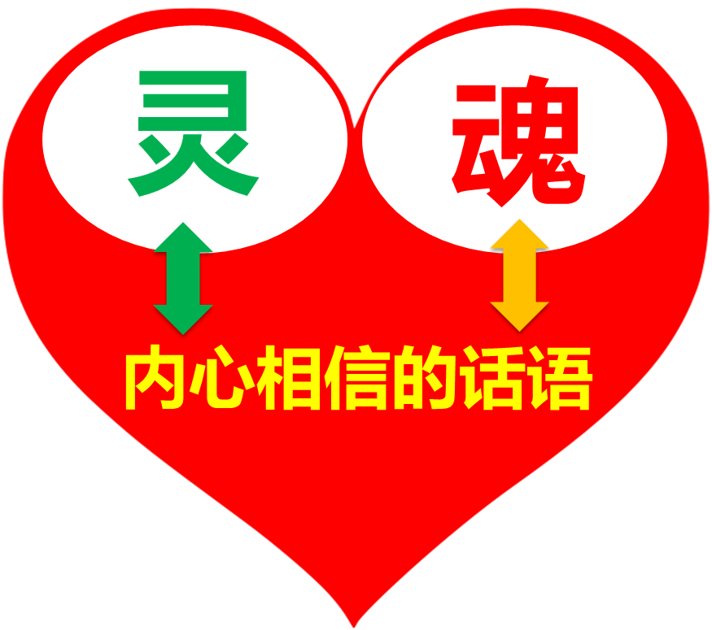
基督
我

Slide 3

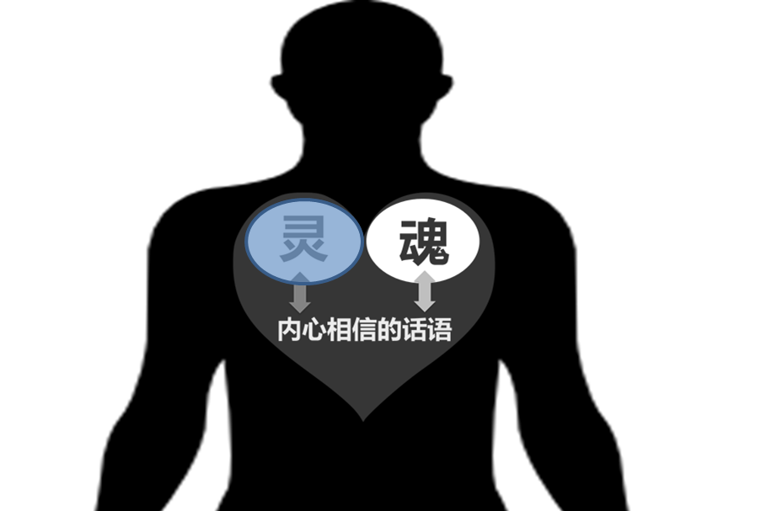
基督
我
林后5:21 神使那无罪（无罪：原文是不知罪）的，替我们成为罪，好叫我们在他里面成为神的义。
赛53:5 哪知他为我们的过犯受害，为我们的罪孽压伤。

Slide 4
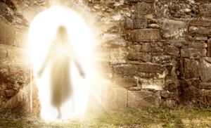
基督
我
vs 我
罪的信息
罪的信息
罪的信息
林后5:21 神使那无罪（无罪：原文是不知罪）的，替我们成为罪，好叫我们在他里面成为神的义。
赛53:5 哪知他为我们的过犯受害，为我们的罪孽压伤。

Slide 5
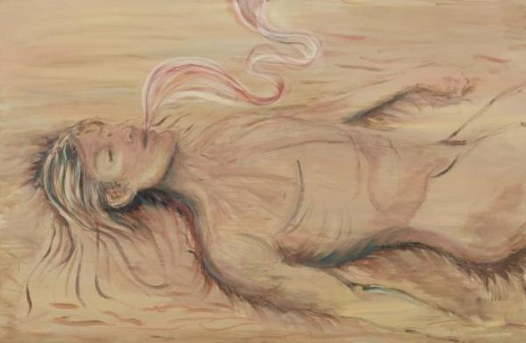

罗马书第7章 Romans 7
⁷ 这样，我们可说甚么呢？律法是罪么？断乎不是！只是非因律法，我就不知何为罪。非律法说不可起贪心，我就不知何为贪心。⁸ 然而罪趁着机会，就藉着诫命叫诸般的贪心在我里头发动；因为没有律法，罪是死的。⁹ 我以前没有律法是活着的；但是诫命来到，罪又活了，我就死了。
⁷ What shall we say then? Is the Law sin? May it never be! On the contrary, I would not have come to know sin except through the Law; for I would not have known about coveting if the Law had not said, “YOU SHALL NOT COVET.” ⁸ But sin, taking opportunity through the commandment, produced in me coveting of every kind; for apart from the Law sin is dead. ⁹ I was once alive apart from the Law; but when the commandment came, sin became alive and I died;

Slide 6
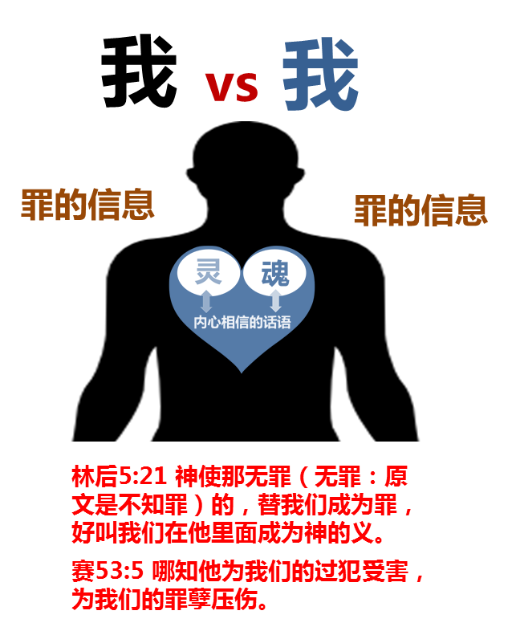
罗马书第7章 Romans 7
¹⁰ 那本来叫人活的诫命，反倒叫我死；¹¹ 因为罪趁着机会，就藉着诫命引诱我，并且杀了我。¹² 这样看来，律法是圣洁的，诫命也是圣洁、公义、良善的。¹³ 既然如此，那良善的是叫我死么？断乎不是！叫我死的乃是罪。但罪藉着那良善的叫我死，就显出真是罪，叫罪因着诫命更显出是恶极了。
¹⁰ and this commandment, which was to result in life, proved to result in death for me; ¹¹ for sin, taking an opportunity through the commandment, deceived me and through it killed me. ¹² So then, the Law is holy, and the commandment is holy and righteous and good. ¹³ Therefore did that which is good become a cause of death for me? May it never be! Rather it was sin, in order that it might be shown to be sin by effecting my death through that which is good, so that through the commandment sin would become utterly sinful.
律法
罪的信息

Slide 7
罗马书第7章 Romans 7
¹⁴ 我们原晓得律法是属乎灵的，但我是属乎肉体的，是已经卖给罪了。¹⁵ 因为我所做的，我自己不明白；我所愿意的，我并不做；我所恨恶的，我倒去做。¹⁶ 若我所做的，是我所不愿意的，我就应承律法是善的。¹⁷ 既是这样，就不是我做的，乃是住在我里头的罪做的。
¹⁴ For we know that the Law is spiritual, but I am of flesh, sold into bondage to sin. ¹⁵ For what I am doing, I do not understand; for I am not practicing what I would like to do, but I am doing the very thing I hate. ¹⁶ But if I do the very thing I do not want to do, I agree with the Law, confessing that the Law is good. ¹⁷ So now, no longer am I the one doing it, but sin which dwells in me.
律法
罪的信息

Slide 8
罗马书第7章 Romans 7
¹⁸ 我也知道在我里头，就是我肉体之中，没有良善。因为，立志为善由得我，只是行出来由不得我。¹⁹ 故此，我所愿意的善，我反不做；我所不愿意的恶，我倒去做。²⁰ 若我去做所不愿意做的，就不是我做的，乃是住在我里头的罪做的。²¹ 我觉得有个律，就是我愿意为善的时候，便有恶与我同在。
¹⁸ For I know that nothing good dwells in me, that is, in my flesh; for the willing is present in me, but the doing of the good is not. ¹⁹ For the good that I want, I do not do, but I practice the very evil that I do not want. ²⁰ But if I am doing the very thing I do not want, I am no longer the one doing it, but sin which dwells in me. 21 I find then the principle that evil is present in me, the one who wants to do good.
律法
罪的信息

Slide 9
罗马书第7章 Romans 7
²² 因为按着我里面的意思（原文是人），我是喜欢神的律；²³ 但我觉得肢体中另有个律和我心中的律交战，把我掳去，叫我附从那肢体中犯罪的律。²⁴ 我真是苦阿！谁能救我脱离这取死的身体呢？²⁵ 感谢神，靠着我们的主耶稣基督就能脱离了。这样看来，我以内心顺服神的律，我肉体却顺服罪的律了。
²² For I joyfully concur with the law of God in the inner man, ²³ but I see a different law in the members of my body, waging war against the law of my mind and making me a prisoner of the law of sin which is in my members. ²⁴ Wretched man that I am! Who will set me free from the body of this death? ²⁵ Thanks be to God through Jesus Christ our Lord! So then, on the one hand I myself with my mind am serving the law of God, but on the other, with my flesh the law of sin.
律法
罪的信息

Slide 10

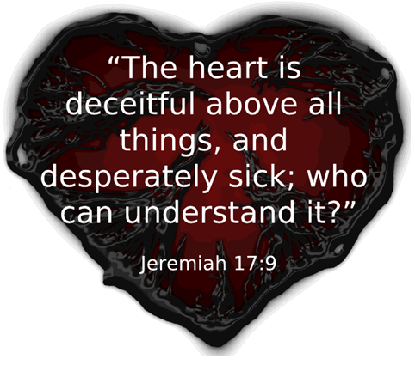

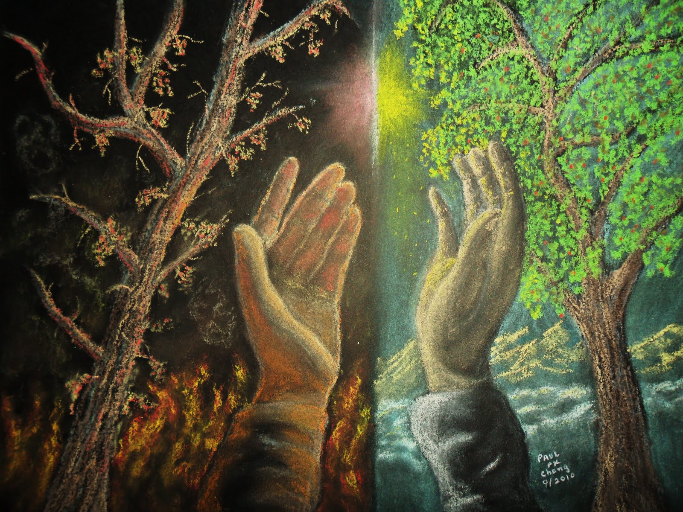
人的心(heart)
箴 4:23 你要保守你心，胜过保守一切（或译：你要切切保守你心），因为一生的果效是由心发出。
耶17:9 人心比万物都诡诈，坏到极处，谁能识透呢？

Slide 11
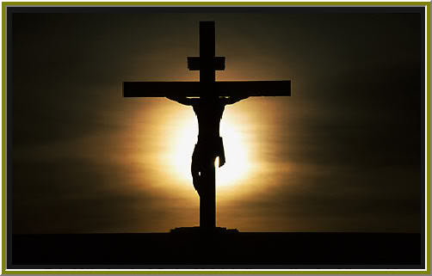
新心的获得
罗6:6 因为知道我们的旧人和他同钉十字架，使罪身灭绝，叫我们不再作罪的奴仆。
林后5:21 神使那无罪的，替我们成为罪，好叫我们在他里面成为神的义。
加2:20 我已经与基督同钉十字架，现在活着的不再是我，乃是基督在我里面活着。

Slide 12

旧心 vs 新心
结36:24 我必从各国收取你们，从列邦聚集你们，引导你们归回本地。36:25 我必用清水灑在你们身上，你们就洁净了。我要洁净你们，使你们脱离一切的污秽，弃掉一切的偶象。36:26 我也要赐给你们一个新心，将新灵放在你们里面，又从你们的肉体中除掉石心，赐给你们肉心。 And I have given to you a new heart, And a new spirit I give in your midst, And I have turned aside the heart of stone out of your flesh, And I have given to you a heart of flesh (YLT).
肉体
新我
内心相信的谎言
内心相信的真理

Slide 13
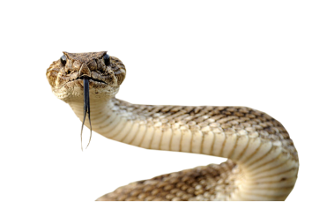
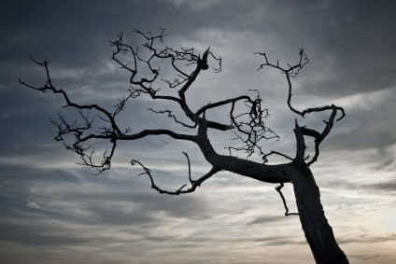


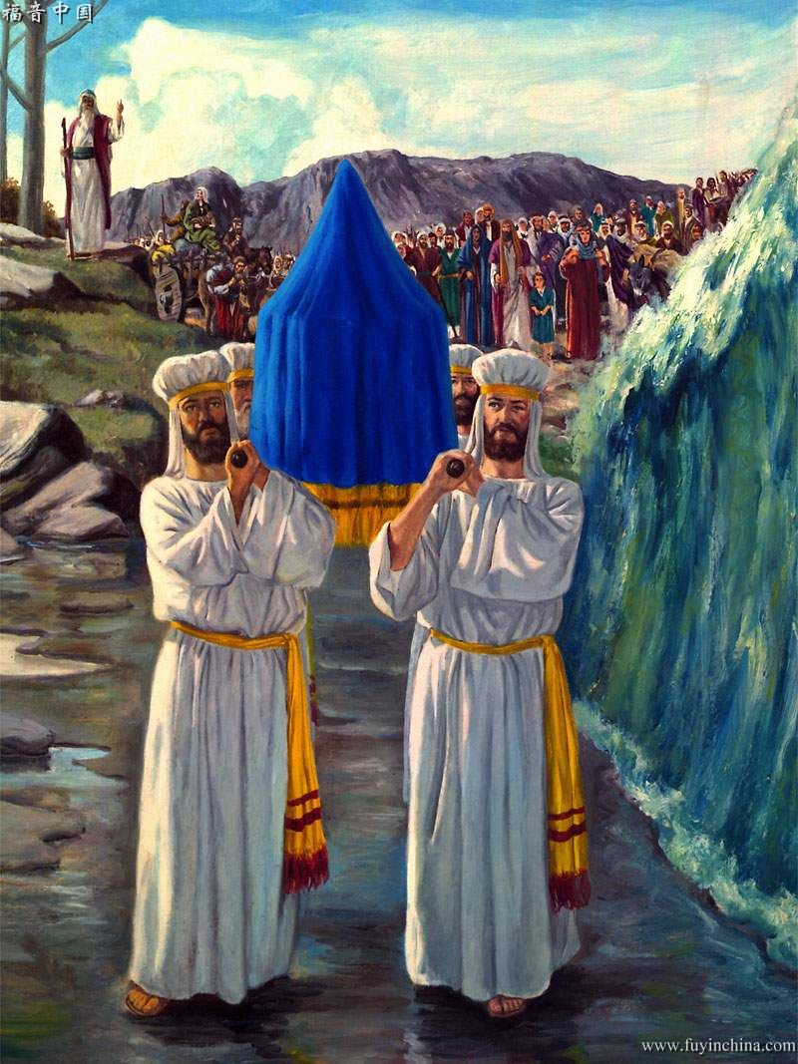
自我的迁移或转换
我
内心相信的谎言
内心相信的真理
耶31:33 耶和华说：那些日子以后，我与以色列家所立的约乃是这样：我要将我的律法放在他们里面，写在他们心上。

Slide 14
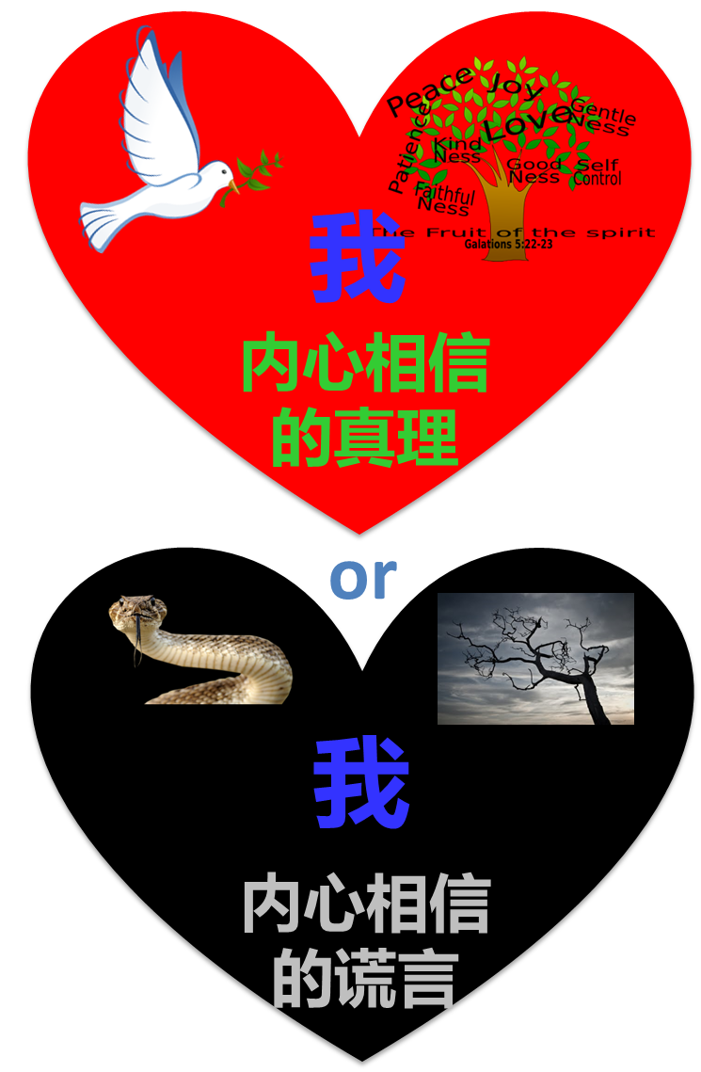
罗马书第8章 Romans 8
¹ 如今，那些在基督耶稣里的就不定罪了。² 因为赐生命圣灵的律，在基督耶稣里释放了我，使我脱离罪和死的律了。³ 律法既因肉体软弱，有所不能行的，神就差遣自己的儿子，成为罪身的形状，作了赎罪祭，在肉体中定了罪案，
⁴ 使律法的义成就在我们这不随从肉体、只随从圣灵的人身上。
¹ Therefore there is now no condemnation for those who are in Christ Jesus. ² For the law of the Spirit of life in Christ Jesus has set you free from the law of sin and of death. ³ For what the Law could not do, weak as it was through the flesh, God did: sending His own Son in the likeness of sinful flesh and as an offering for sin, He condemned sin in the flesh, ⁴ so that the requirement of the Law might be fulfilled in us, who do not walk according to the flesh but according to the Spirit.
重生基督徒得胜的关键

Slide 15
罗马书第8章 Romans 8
⁵ 因为随从肉体的人体贴肉体的事，随从圣灵的人体贴圣灵的事。⁶ 体贴肉体的，就是死；体贴圣灵的，乃是生命、平安。⁷ 原来体贴肉体的，就是与神为仇；因为不服神的律法，也是不能服，⁸ 而且属肉体的人不能得神的喜欢。
⁵ For those who are according to the flesh set their minds on the things of the flesh, but those who are according to the Spirit, the things of the Spirit. ⁶ For the mind set on the flesh is death, but the mind set on the Spirit is life and peace, ⁷ because the mind set on the flesh is hostile toward God; for it does not subject itself to the law of God, for it is not even able to do so, ⁸ and those who are in the flesh cannot please God.
重生基督徒得胜的关键

Slide 16
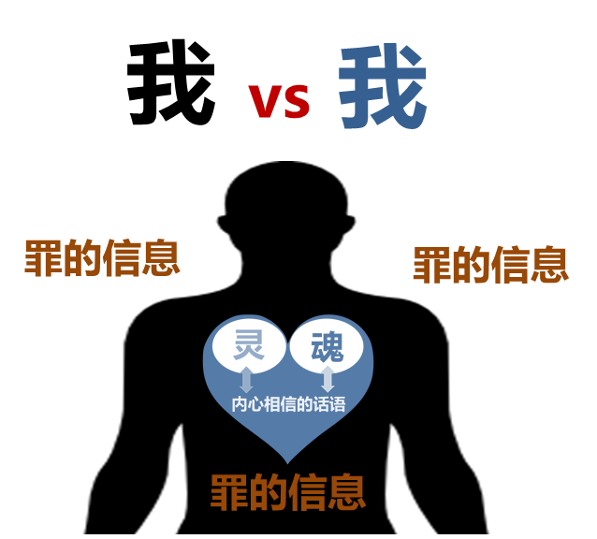

罗马书第8章 Romans 8
⁹ 如果神的灵住在你们心里，你们就不属肉体，乃属圣灵了。人若没有基督的灵，就不是属基督的。¹⁰ 基督若在你们心里，身体就因罪而死，心灵却因义而活。¹¹ 然而，叫耶稣从死里复活者的灵若住在你们心里，那叫基督耶稣从死里复活的，也必藉着住在你们心里的圣灵，使你们必死的身体又活过来。
⁹ However, you are not in the flesh but in the Spirit, if indeed the Spirit of God dwells in you. But if anyone does not have the Spirit of Christ, he does not belong to Him. ¹⁰ If Christ is in you, though the body is dead because of sin, yet the spirit is alive because of righteousness. ¹¹ But if the Spirit of Him who raised Jesus from the dead dwells in you, He who raised Christ Jesus from the dead will also give life to your mortal bodies through His Spirit who dwells in you.
罗6:5 我们若在他死的形状上与他联合，也要在他复活的形状上与他联合

Slide 17
罗马书第8章 Romans 8
¹² 弟兄们，这样看来，我们并不是欠肉体的债去顺从肉体活着。
¹³ 你们若顺从肉体活着，必要死；若靠着圣灵治死身体的恶行，必要活着。
¹² So then, brethren, we are under obligation, not to the flesh, to live according to the flesh–
¹³ for if you are living according to the flesh, you must die; but if by the Spirit you are putting to death the deeds of the body, you will live.
罗6:5 我们若在他死的形状上与他联合，也要在他复活的形状上与他联合

