Slide 1
死里复活(5）
Resurrection from the dead
（罗马书5-8章）

Slide 2
基督给了所有人一个重新选择的机会
林后11:2 我为你们起的愤恨，原是神那样的愤恨。因为我曾把你们许配一个丈夫，要把你们如同贞洁的童女，献给基督。11:3 我只怕你们的心或偏于邪，失去那向基督所存纯一清洁的心，就象蛇用诡诈诱惑了夏娃一样 （NKJV: so your minds may be corrupted from the simplicity that is in Christ；NASB: your minds will be led astray from the simplicity and purity of devotion to Christ）。

Slide 3
堕落前的亚当 与 重生的基督徒
人的状态用魂来定义（首先的亚当被称为一个活的魂，a living soul）
没有犯罪，但也没有称义
灵没有罪，但未与神合一
魂不认识自己灵里有像神的生命，经历上可以选择
体没有经历罪的后果（死）
人的状态用灵来定义（末后的亚当被称为使人活的灵，a life-giving spirit）
在基督里已经称义
与基督成为一灵，与神合一
魂经历过亚当里的死，灵里有基督的生命，但因不完全认识基督的生命而经历上可以选择
体经历了亚当里的死，也可以经历基督部分的救恩（医治）

Slide 4
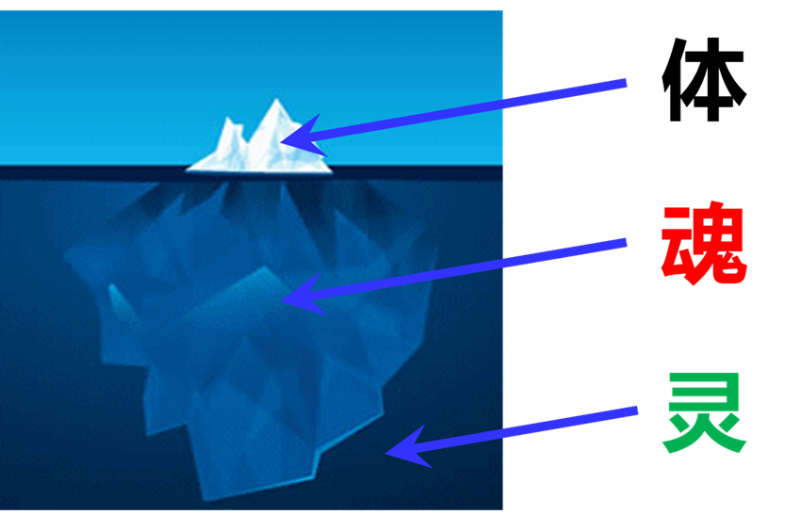
罗马书第六章 Romans 6
¹⁰ 他（基督）死是向罪死了，只有一次；他活是向神活着。¹¹ 这样，你们向罪也当看自己是死的；向神在基督耶稣里，却当看自己是活的。¹² 所以，不要容罪在你们必死的身上作王，使你们顺从身子的私慾。¹³ 也不要将你们的肢体献给罪作不义的器具；倒要象从死里复活的人，将自己献给神，并将肢体作义的器具献给神。¹⁴ 罪必不能作你们的主，因你们不在律法之下，乃在恩典之下。
¹⁰ For the death that He died, He died to sin once for all; but the life that He lives, He lives to God. ¹¹ Even so consider yourselves to be dead to sin, but alive to God in Christ Jesus. ¹² Therefore do not let sin reign in your mortal body so that you obey its lusts. ¹³ and do not go on presenting the members of your body to sin as instruments of unrighteousness; but present yourselves to God as those alive from the dead, and your members as instruments of righteousness to God. ¹⁴ For sin shall not be master over you, for you are not under law but under grace.
重生基督徒最大的难处？
灵
魂
体

Slide 5
罗马书第7章 Romans 7
¹ 弟兄们，我现在对明白律法的人说，你们岂不晓得律法管人是在活着的时候么？² 就如女人有了丈夫，丈夫还活着，就被律法约束；丈夫若死了，就脱离了丈夫的律法。³ 所以丈夫活着，她若归于别人，便叫淫妇；丈夫若死了，她就脱离了丈夫的律法，虽然归于别人，也不是淫妇。
¹ Or do you not know, brethren (for I am speaking to those who know the law), that the law has jurisdiction over a person as long as he lives? ² For the married woman is bound by law to her husband while he is living; but if her husband dies, she is released from the law concerning the husband. ³ So then, if while her husband is living she is joined to another man, she shall be called an adulteress; but if her husband dies, she is free from the law, so that she is not an adulteress though she is joined to another man.
先前的丈夫到底是谁？
可能性1：律法
罗7:6 但我们既然在捆我们的律法上死了，现今就脱离了律法，叫我们服事主，要按着心灵（心灵：或作圣灵）的新样，不按着仪文的旧样。
罗7:14 我们原晓得律法是属乎灵的，但我是属乎肉体的，是已经卖给罪了。
罗7:21 我觉得有个律，就是我愿意为善的时候，便有恶与我同在。。。7:24 我真是苦阿！谁能救我脱离这取死的身体呢？
罗8:11 然而，叫耶稣从死里复活者的灵若住在你们心里，那叫基督耶稣从死里复活的，也必藉着住在你们心里的圣灵，使你们必死的身体又活过来。

Slide 6
罗马书第7章 Romans 7
¹ 弟兄们，我现在对明白律法的人说，你们岂不晓得律法管人是在活着的时候么？² 就如女人有了丈夫，丈夫还活着，就被律法约束；丈夫若死了，就脱离了丈夫的律法。³ 所以丈夫活着，她若归于别人，便叫淫妇；丈夫若死了，她就脱离了丈夫的律法，虽然归于别人，也不是淫妇。
¹ Or do you not know, brethren (for I am speaking to those who know the law), that the law has jurisdiction over a person as long as he lives? ² For the married woman is bound by law to her husband while he is living; but if her husband dies, she is released from the law concerning the husband. ³ So then, if while her husband is living she is joined to another man, she shall be called an adulteress; but if her husband dies, she is free from the law, so that she is not an adulteress though she is joined to another man.
先前的丈夫到底是谁？
可能性2：旧灵或罪
罗6:11 这样，你们向罪也当看自己是死的；向神在基督耶稣里，却当看自己是活的。6:12 所以，不要容罪在你们必死的身上作王，使你们顺从身子的私慾。
罗7:14 我们原晓得律法是属乎灵的，但我是属乎肉体的，是已经卖给罪了。
罗7:21 我觉得有个律，就是我愿意为善的时候，便有恶与我同在。。。7:24 我真是苦阿！谁能救我脱离这取死的身体呢？
罗8:11 然而，叫耶稣从死里复活者的灵若住在你们心里，那叫基督耶稣从死里复活的，也必藉着住在你们心里的圣灵，使你们必死的身体又活过来。

Slide 7
罗马书第7章 Romans 7
¹ 弟兄们，我现在对明白律法的人说，你们岂不晓得律法管人是在活着的时候么？² 就如女人有了丈夫，丈夫还活着，就被律法约束；丈夫若死了，就脱离了丈夫的律法。³ 所以丈夫活着，她若归于别人，便叫淫妇；丈夫若死了，她就脱离了丈夫的律法，虽然归于别人，也不是淫妇。
¹ Or do you not know, brethren (for I am speaking to those who know the law), that the law has jurisdiction over a person as long as he lives? ² For the married woman is bound by law to her husband while he is living; but if her husband dies, she is released from the law concerning the husband. ³ So then, if while her husband is living she is joined to another man, she shall be called an adulteress; but if her husband dies, she is free from the law, so that she is not an adulteress though she is joined to another man.
先前的丈夫到底是谁？
可能性3：肉体
加5:24 凡属基督耶稣的人，是已经把肉体连肉体的邪情私慾同钉在十字架上了。5:25 我们若是靠圣灵得生，就当靠圣灵行事。
罗7:14 我们原晓得律法是属乎灵的，但我是属乎肉体的，是已经卖给罪了。
罗7:21 我觉得有个律，就是我愿意为善的时候，便有恶与我同在。。。7:24 我真是苦阿！谁能救我脱离这取死的身体呢？
罗8:11 然而，叫耶稣从死里复活者的灵若住在你们心里，那叫基督耶稣从死里复活的，也必藉着住在你们心里的圣灵，使你们必死的身体又活过来。

Slide 8
肉体到底是什么？
加5:19 情慾(flesh)的事都是显而易见的，就如姦淫、污秽、邪蕩、5:20 拜偶象、邪术、仇恨、争竞、忌恨、恼怒、结党、纷争、异端、5:21 嫉妒（有古卷在此有：凶杀二字）、醉酒、荒宴等类。我从前告诉你们，现在又告诉你们，行这样事的人必不能承受神的国。
圣经里肉体的概念
旧约时代是指堕落的亚当里生出来的天然人，重生以后（新约时代）指旧人留下来未被圣灵更新的魂与体，与重生的灵相对。
“生命”与神断绝，“活” 在死里。习惯用身体及从世界接受来的思想定义自我。特点是为自己、靠自己、荣耀自己。
虽然靠灵而生却不以为此，生活的目的是用魂与体范畴(属人、属世界)的东西试图填满内心的缺乏(lust)。
在里面沒有良善，沒有信心，也无法明白神圣灵的事，思想及行为都與神的原则相反。
是建立在撒但谎言上的“生命”状态

Slide 9
罗马书第7章 Romans 7
¹ 弟兄们，我现在对明白律法的人说，你们岂不晓得律法管人是在活着的时候么？² 就如女人有了丈夫，丈夫还活着，就被律法约束；丈夫若死了，就脱离了丈夫的律法。³ 所以丈夫活着，她若归于别人，便叫淫妇；丈夫若死了，她就脱离了丈夫的律法，虽然归于别人，也不是淫妇。
¹ Or do you not know, brethren (for I am speaking to those who know the law), that the law has jurisdiction over a person as long as he lives? ² For the married woman is bound by law to her husband while he is living; but if her husband dies, she is released from the law concerning the husband. ³ So then, if while her husband is living she is joined to another man, she shall be called an adulteress; but if her husband dies, she is free from the law, so that she is not an adulteress though she is joined to another man.
先前的丈夫到底是谁？
最大的可能
身体

Slide 10
罗马书第7章 Romans 7
¹ 弟兄们，我现在对明白律法的人说，你们岂不晓得律法管人是在活着的时候么？² 就如女人有了丈夫，丈夫还活着，就被律法约束；丈夫若死了，就脱离了丈夫的律法。³ 所以丈夫活着，她若归于别人，便叫淫妇；丈夫若死了，她就脱离了丈夫的律法，虽然归于别人，也不是淫妇。
¹ Or do you not know, brethren (for I am speaking to those who know the law), that the law has jurisdiction over a person as long as he lives? ² For the married woman is bound by law to her husband while he is living; but if her husband dies, she is released from the law concerning the husband. ³ So then, if while her husband is living she is joined to another man, she shall be called an adulteress; but if her husband dies, she is free from the law, so that she is not an adulteress though she is joined to another man.
先前的丈夫到底是谁？
最大的可能
身体

Slide 11
罗马书第7章 Romans 7
⁴ 我的弟兄们，这样说来，你们藉着基督的身体，在律法上也是死了，叫你们归于别人，就是归于那从死里复活的，叫我们结果子给神。⁵ 因为我们属肉体的时候，那因律法而生的恶慾就在我们肢体中发动，以致结成死亡的果子。⁶ 但我们既然在捆我们的律法上死了，现今就脱离了律法，叫我们服事主，要按着心灵（心灵：或作圣灵）的新样，不按着仪文的旧样。
⁴ Therefore, my brethren, you also were made to die to the Law through the body of Christ, so that you might be joined to another, to Him who was raised from the dead, in order that we might bear fruit for God. ⁵ For while we were in the flesh, the sinful passions, which were aroused by the Law, were at work in the members of our body to bear fruit for death. ⁶ But now we have been released from the Law, having died to that by which we were bound, so that we serve in newness of the Spirit and not in oldness of the letter.
我到底是谁？

Slide 12
属灵
的人
/as

Slide 13
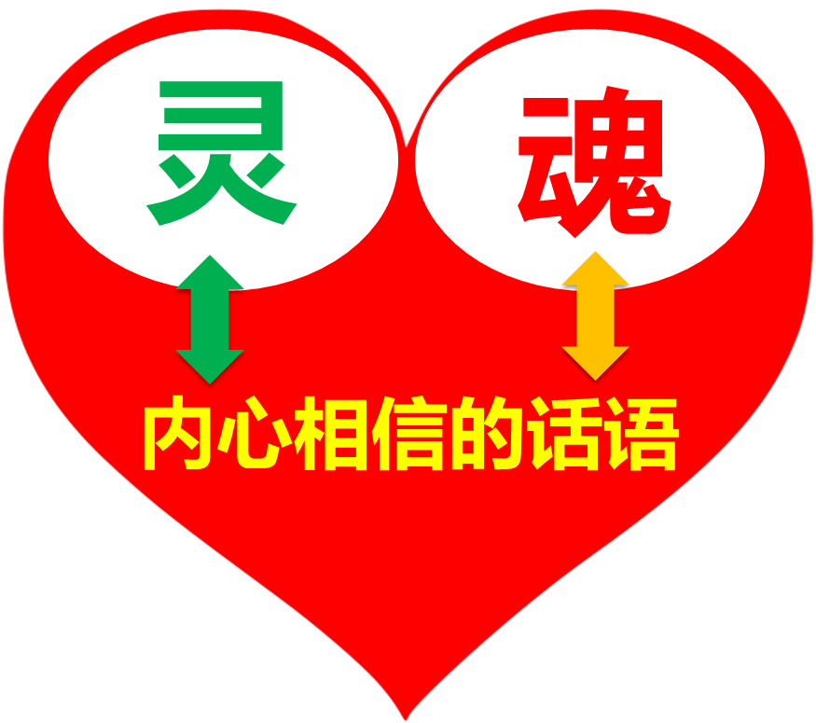
基督
我

Slide 14
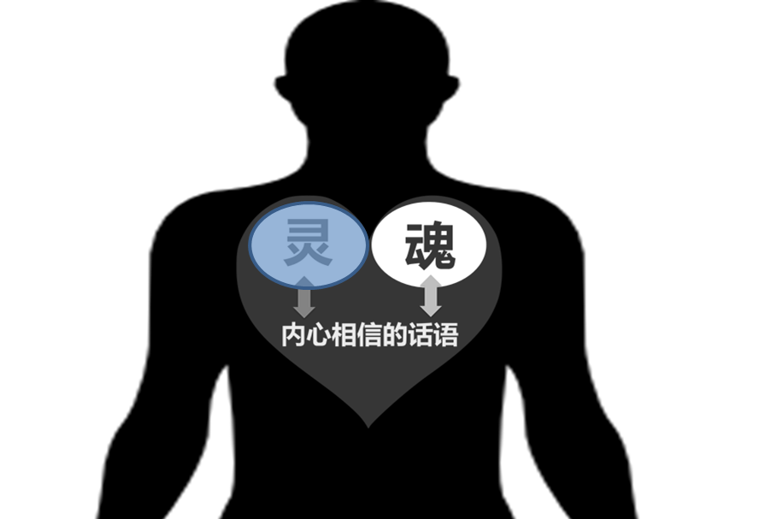
基督
我
林后5:21 神使那无罪（无罪：原文是不知罪）的，替我们成为罪，好叫我们在他里面成为神的义。
赛53:5 哪知他为我们的过犯受害，为我们的罪孽压伤。

Slide 15
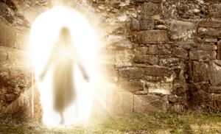
基督
我
罗6:5 我们若在他死的形状上与他联合，也要在他复活的形状上与他联合
林后5:21 神使那无罪（无罪：原文是不知罪）的，替我们成为罪，好叫我们在他里面成为神的义。
赛53:5 哪知他为我们的过犯受害，为我们的罪孽压伤。

Slide 16
罗马书第7章 Romans 7
⁴ 我的弟兄们，这样说来，你们藉着基督的身体，在律法上也是死了，叫你们归于别人，就是归于那从死里复活的，叫我们结果子给神。⁵ 因为我们属肉体的时候，那因律法而生的恶慾就在我们肢体中发动，以致结成死亡的果子。⁶ 但我们既然在捆我们的律法上死了，现今就脱离了律法，叫我们服事主，要按着心灵（心灵：或作圣灵）的新样，不按着仪文的旧样。
⁴ Therefore, my brethren, you also were made to die to the Law through the body of Christ, so that you might be joined to another, to Him who was raised from the dead, in order that we might bear fruit for God. ⁵ For while we were in the flesh, the sinful passions, which were aroused by the Law, were at work in the members of our body to bear fruit for death. ⁶ But now we have been released from the Law, having died to that by which we were bound, so that we serve in newness of the Spirit and not in oldness of the letter.
重生基督徒最大的难处？

