Slide 1

死里复活(4）
Resurrection from the dead
（罗马书5-8章）

Slide 2
灵魂体的概念
帖前 5:23愿赐平安的神亲自使你们全然成圣！又愿你们的灵与魂与身子得蒙保守，在我主耶稣基督降临的时候，完全无可指摘！
2 The 5:23 Now may the God of peace Himself sanctify you entirely; and may your spirit and soul and body be preserved complete, without blame at the coming of our Lord Jesus Christ.

Slide 3
灵魂体的概念
来 4:12 神的道是活泼的，是有功效的，比一切两刃的剑更快，甚至魂与灵，骨节与骨髓，都能刺入、剖开，连心中的思念和主意都能辨明。Heb 4:12 For the word of God is living and active and sharper than any two-edged sword, and piercing as far as the division of soul and spirit, of both joints and marrow, and able to judge the thoughts and intentions of the heart.

Slide 4
灵界
灵
魂
体
物质界

Slide 5
罗11:16 所献的新麵若是圣洁，全团也就圣洁了；树根若是圣洁，树枝也就圣洁了。11:17 若有几根枝子被折下来，你这野橄榄得接在其中，一同得着橄榄根的肥汁，11:18 你就不可向旧枝子夸口；若是夸口，当知道不是你托着根，乃是根托着你。
林前6:17 但与主联合的，便是与主成为一灵。But he that is joined unto the Lord is one spirit.

Slide 6
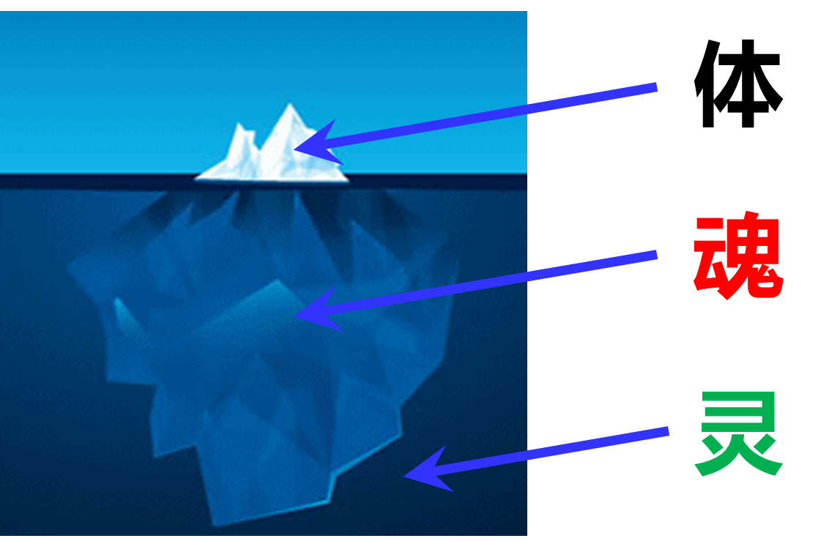
罗11:16 所献的新麵若是圣洁，全团也就圣洁了；树根若是圣洁，树枝也就圣洁了。11:17 若有几根枝子被折下来，你这野橄榄得接在其中，一同得着橄榄根的肥汁，11:18 你就不可向旧枝子夸口；若是夸口，当知道不是你托着根，乃是根托着你。
林前6:17 但与主联合的，便是与主成为一灵。But he that is joined unto the Lord is one spirit.

Slide 7

圣经里心的概念
灵
体
魂
体
魂
可 12:30 你要尽心（heart）、尽性 （soul）、尽意（mind）、尽力（might）爱主你的神。
箴 4:23 你要保守你心，胜过保守一切（或译：你要切切保守你心），因为一生的果效是由心发出。
内心相信的话语
内心相信的话语

Slide 8
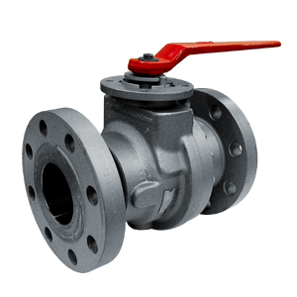

仇敌如何影响我们的人生
灵
魂
体
内心相信的话语

Slide 9
心意更新
灵
魂
体
内心相信的话语
内心相信
的话语

Slide 10
心意更新
灵
魂
体
内心相信
的话语
内心相信
的话语

Slide 11

罗马书第六章 Romans 6
¹ 这样，怎么说呢？我们可以仍在罪中、叫恩典显多么？ ² 断乎不可！我们在罪上死了的人岂可仍在罪中活着呢？³ 岂不知我们这受洗归入基督耶稣的人是受洗归入他的死么？⁴ 所以，我们藉着洗礼归入死，和他一同埋葬，原是叫我们一举一动有新生的样式，象基督藉着父的荣耀从死里复活一样。
¹ What shall we say then? Are we to continue in sin so that grace may increase? ² May it never be! How shall we who died to sin still live in it? ³ Or do you not know that all of us who have been baptized into Christ Jesus have been baptized into His death? ⁴ Therefore we have been buried with Him through baptism into death, so that as Christ was raised from the dead through the glory of the Father, so we too might walk in newness of life.
重生基督徒最大的难处？

Slide 12
罗马书第六章 Romans 6
⁵ 我们若在他死的形状上与他联合，也要在他复活的形状上与他联合；⁶ 因为知道我们的旧人和他同钉十字架，使罪身灭绝，叫我们不再作罪的奴仆；⁷ 因为已死的人是脱离了罪。⁸ 我们若是与基督同死，就信必与他同活。
⁵ For if we have become united with Him in the likeness of His death, certainly we shall also be in the likeness of His resurrection, ⁶ knowing this, that our old self was crucified with Him, in order that our body of sin might be done away with, so that we would no longer be slaves to sin; ⁷ for he who has died is freed from sin (YLT: for he who hath died hath been set free from the sin). ⁸ Now if we have died with Christ, we believe that we shall also live with Him,
重生基督徒最大的难处？
问题已经解决了！

Slide 13
罗马书第六章 Romans 6
⁹ 因为知道基督既从死里复活，就不再死，死也不再作他的主了。¹⁰ 他死是向罪死了，只有一次；他活是向神活着。¹¹ 这样，你们向罪也当看自己是死的；向神在基督耶稣里，却当看自己是活的。
⁹ knowing that Christ, having been raised from the dead, is never to die again; death no longer is master over Him. ¹⁰ For the death that He died, He died to sin once for all; but the life that He lives, He lives to God. ¹¹ Even so consider yourselves to be dead to sin, but alive to God in Christ Jesus.
重生基督徒最大的难处？
这才是真正意义上的认基督为主！

Slide 14
罗马书第六章 Romans 6
¹² 所以，不要容罪在你们必死的身上作王，使你们顺从身子的私慾。¹³ 也不要将你们的肢体献给罪作不义的器具；倒要象从死里复活的人，将自己献给神，并将肢体作义的器具献给神。
¹⁴ 罪必不能作你们的主，因你们不在律法之下，乃在恩典之下。
¹² Therefore do not let sin reign in your mortal body so that you obey its lusts, ¹³ and do not go on presenting the members of your body to sin as instruments of unrighteousness; but present yourselves to God as those alive from the dead, and your members as instruments of righteousness to God. ¹⁴ For sin shall not be master over you, for you are not under law but under grace.
重生基督徒最大的难处？
这个问题该怎么解决？

Slide 15
罗马书第六章 Romans 6
¹⁵ 这却怎么样呢？我们在恩典之下，不在律法之下，就可以犯罪么？断乎不可！¹⁶ 岂不晓得你们献上自己作奴仆，顺从谁，就作谁的奴仆么？或作罪的奴仆，以至于死；或作顺命的奴仆，以至成义。¹⁷ 感谢神！因为你们从前虽然作罪的奴仆，现今却从心里顺服了所传给你们道理的模范。
¹⁵ What then? Shall we sin because we are not under law but under grace? May it never be! ¹⁶ Do you not know that when you present yourselves to someone as slaves for obedience, you are slaves of the one whom you obey, either of sin resulting in death, or of obedience resulting in righteous-ness? ¹⁷ But thanks be to God that though you were slaves of sin, you became obedient from the heart to that form of teaching to which you were committed,
重生基督徒最大的难处？

Slide 16
罗马书第六章 Romans 6
¹⁸ 你们既从罪里得了释放，就作了义的奴仆。 ¹⁹ 我因你们肉体的软弱，就照人的常话对你们说。你们从前怎样将肢体献给不洁不法作奴仆，以至于不法；现今也要照样将肢体献给义作奴仆，以至于成圣。²⁰ 因为你们作罪之奴仆的时候，就不被义约束了。
¹⁸ and having been freed from sin, you became slaves of righteousness. ¹⁹ I am speaking in human terms because of the weakness of your flesh. For just as you presented your members as slaves to impurity and to lawlessness, resulting in further lawlessness, so now present your members as slaves to righteousness, resulting in sanctification. ²⁰ For when you were slaves of sin, you were free in regard to righteousness.
重生基督徒最大的难处？
这不是common sense吗？

Slide 17
罗马书第六章 Romans 6
²¹ 你们现今所看为羞耻的事，当日有甚么果子呢？那些事的结局就是死。
²² 但现今，你们既从罪里得了释放，作了神的奴仆，就有成圣的果子，那结局就是永生。
²³ 因为罪的工价乃是死；唯有神的恩赐，在我们的主基督耶稣里，乃是永生。
²¹ Therefore what benefit were you then deriving from the things of which you are now ashamed? For the outcome of those things is death.
²² But now having been freed from sin and enslaved to God, you derive your benefit, resulting in sanctification, and the outcome, eternal life.
²³ For the wages of sin is death, but the free gift of God is eternal life in Christ Jesus our Lord.
重生基督徒最大的难处？
这不是common sense吗？

