Slide 1
死里复活(2）
Resurrection from the dead
（罗马书5-8章）

Slide 2
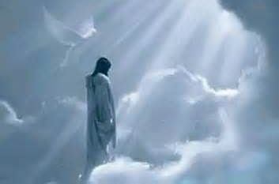
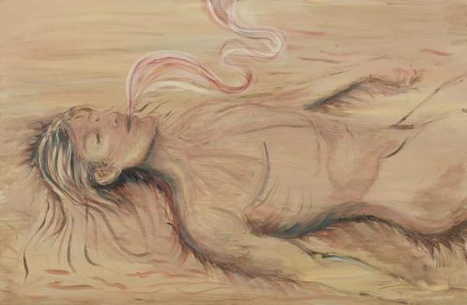
Paradigm Shift 范式转移
A fundamental change in approach or underlying assumptions
一个在方法或基本假设方面根本的变化

Slide 3
Paradigm Shift 范式转移
路24:44 耶稣对他们说：这就是我从前与你们同在之时所告诉你们的话说：摩西的律法、先知的书，和诗篇上所记的，凡指着我的话都必须应验。
西3:11 唯有基督是包括一切，又住在各人之内。but Christ is all and in all.

Slide 4
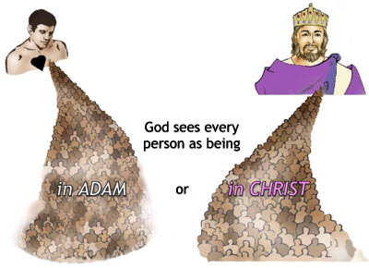
罗马书第五章 Romans 5
¹⁵ 只是过犯不如恩赐，若因一人的过犯，众人都死了，何况神的恩典，与那因耶稣基督一人恩典中的赏赐，岂不更加倍的临到众人么？¹⁶ 因一人犯罪就定罪，也不如恩赐，原来审判是由一人而定罪，恩赐乃是由许多过犯而称义。¹⁷ 若因一人的过犯，死就因这一人作了王，何况那些受洪恩又蒙所赐之义的，岂不更要因耶稣基督一人在生命中作王么？
¹⁸ 如此说来，因一次的过犯，众人都被定罪；照样，因一次的义行，众人也就被称义得生命了。¹⁹ 因一人的悖逆，众人成为罪人；照样，因一人的顺从，众人也成为义了。
神只看到
两个(种)人

Slide 5
罗马书第五章 Romans 5
¹⁵ 只是过犯不如恩赐，若因一人的过犯，众人都死了，何况神的恩典，与那因耶稣基督一人恩典中的赏赐，岂不更加倍的临到众人么？¹⁶ 因一人犯罪就定罪，也不如恩赐，原来审判是由一人而定罪，恩赐乃是由许多过犯而称义。¹⁷ 若因一人的过犯，死就因这一人作了王，何况那些受洪恩又蒙所赐之义的，岂不更要因耶稣基督一人在生命中作王么？
¹⁸ 如此说来，因一次的过犯，众人都被定罪；照样，因一次的义行，众人也就被称义得生命了。¹⁹ 因一人的悖逆，众人成为罪人；照样，因一人的顺从，众人也成为义了。
（天然）人是因为在亚当里才成为罪人的；（基督）人是因为在基督里才成为义人的
在亚当里没选择，在基督里也“没选择”，是否相信(接受)自己在基督里却是每个人的选择
人不能做什么改变自己的本质（本性），人所做的只是自己所相信的本质（本性）的表现

Slide 6
罗马书第五章 Romans 5
¹⁵ But the free gift is not like the transgression. For if by the transgression of the one the many died, much more did the grace of God and the gift by the grace of the one Man, Jesus Christ, abound to the many. ¹⁶ The gift is not like that which came through the one who sinned; for on the one hand the judgment arose from one transgression resulting in condemnation, but on the other hand the free gift arose from many transgressions resulting in justification. ¹⁷ For if by the transgression of the one, death reigned through the one, much more those who receive the abundance of grace and of the gift of righteousness will reign in life through the One, Jesus Christ. ¹⁸ So then as through one transgression there resulted condemnation to all men, even so through one act of righteousness there resulted justification of life to all men.
（天然）人是因为在亚当里才成为罪人的；（基督）人是因为在基督里才成为义人的
在亚当里没选择，在基督里也“没选择”，是否相信(接受)自己在基督里却是每个人的选择
人不能做什么改变自己的本质（本性），人所做的只是自己所相信的本质（本性）的表现

Slide 7
罗马书第五章 Romans 5
¹⁵ 只是过犯不如恩赐，若因一人的过犯，众人都死了，何况神的恩典，与那因耶稣基督一人恩典中的赏赐，岂不更加倍的临到众人么？¹⁶ 因一人犯罪就定罪，也不如恩赐，原来审判是由一人而定罪，恩赐乃是由许多过犯而称义。¹⁷ 若因一人的过犯，死就因这一人作了王，何况那些受洪恩又蒙所赐之义的，岂不更要因耶稣基督一人在生命中作王么？
¹⁸ 如此说来，因一次的过犯，众人都被定罪；照样，因一次的义行，众人也就被称义得生命了。¹⁹ 因一人的悖逆，众人成为罪人；照样，因一人的顺从，众人也成为义了。
创3:17 又对亚当说：你既听从妻子的话，吃了我所吩咐你不可吃的那树上的果子，地必为你的缘故受咒诅；你必终身劳苦纔能从地里得吃的。3:18 地必给你长出荆棘和蒺藜来；你也要吃田间的菜蔬。3:19 你必汗流满面纔得糊口，直到你归了土，因为你是从土而出的。你本是尘土，仍要归于尘土。

Slide 8
罗马书第五章 Romans 5
¹⁸ 如此说来，因一次的过犯，众人(all men) 都被定罪；照样，因一次的义行，众人(all men) 也就被称义得生命了。¹⁹ 因一人的悖逆，众人(the many) 成为罪人；照样，因一人的顺从，众人(the many) 也成为义了。
²⁰ 律法本是外添的，叫过犯显多；只是罪在那里显多，恩典就更显多了。²¹ 就如罪作王叫人死；照样，恩典也藉着义作王，叫人因我们的主耶稣基督得永生。
路2:10 那天使对他们说：不要惧怕！我报给你们大喜的信息，是关乎万民的；2:11 因今天在大卫的城里，为你们生了救主，就是主基督。2:12 你们要看见一个婴孩，包着布，卧在马槽里，那就是记号了。
福音（好消息）讲的是已经发生过的事情

Slide 9
罗马书第六章 Romans 6
¹ 这样，怎么说呢？我们可以仍在罪中、叫恩典显多么？ ² 断乎不可！我们在罪上死了的人岂可仍在罪中活着呢？³ 岂不知我们这受洗归入基督耶稣的人是受洗归入他的死么？⁴ 所以，我们藉着洗礼归入死，和他一同埋葬，原是叫我们一举一动有新生的样式，象基督藉着父的荣耀从死里复活一样。
¹ What shall we say then? Are we to continue in sin so that grace may increase? ² May it never be! How shall we who died to sin still live in it? ³ Or do you not know that all of us who have been baptized into Christ Jesus have been baptized into His death? ⁴ Therefore we have been buried with (sunthapto: bury together) Him through baptism into death, so that as Christ was raised from the dead through the glory of the Father, so we too might walk in newness of life.
西2:11 你们在他里面也受了不是人手所行的割礼，乃是基督使你们脱去肉体情慾的割礼。2:12 你们既受洗与他一同埋葬，也就在此与他一同复活，都因信那叫他从死里复活神的功用。
Col 2:11 and in Him you were also circumcised with a circumcision made without hands, in the removal of the body of the flesh by the circumcision of Christ; 2:12 having been buried with (sunthapto: bury together) Him in baptism, in which you were also raised up with (sunegeiro: raise together) Him through faith in the working of God, who raised Him from the dead.

Slide 10
罗马书第六章 Romans 6
¹ 这样，怎么说呢？我们可以仍在罪中、叫恩典显多么？ ² 断乎不可！我们在罪上死了的人岂可仍在罪中活着呢？³ 岂不知我们这受洗归入基督耶稣的人是受洗归入他的死么？⁴ 所以，我们藉着洗礼归入死，和他一同埋葬，原是叫我们一举一动有新生的样式，象基督藉着父的荣耀从死里复活一样。
¹ What shall we say then? Are we to continue in sin so that grace may increase? ² May it never be! How shall we who died to sin still live in it? ³ Or do you not know that all of us who have been baptized into Christ Jesus have been baptized into His death? ⁴ Therefore we have been buried with (sunthapto: bury together) Him through baptism into death, so that as Christ was raised from the dead through the glory of the Father, so we too might walk in newness of life.
彼前1:3 愿颂赞归与我们主耶稣基督的父神！他曾照自己的大怜悯，藉耶稣基督从死里复活，重生了我们，叫我们有活泼的盼望，1:4 可以得着不能朽坏、不能玷污、不能衰残、为你们存留在天上的基业。1Pet 1:3 Blessed be the God and Father of our Lord Jesus Christ, who according to His great mercy has caused us to be born again to a living hope through the resurrection of Jesus Christ from the dead,1:4 to obtain an inheritance which is imperishable and undefiled and will not fade away, reserved in heaven for you.

Slide 11
罗马书第六章 Romans 6
¹ 这样，怎么说呢？我们可以仍在罪中、叫恩典显多么？ ² 断乎不可！我们在罪上死了的人岂可仍在罪中活着呢？³ 岂不知我们这受洗归入基督耶稣的人是受洗归入他的死么？⁴ 所以，我们藉着洗礼归入死，和他一同埋葬，原是叫我们一举一动有新生的样式，象基督藉着父的荣耀从死里复活一样。
¹ What shall we say then? Are we to continue in sin so that grace may increase? ² May it never be! How shall we who died to sin still live in it? ³ Or do you not know that all of us who have been baptized into Christ Jesus have been baptized into His death? ⁴ Therefore we have been buried with (sunthapto: bury together) Him through baptism into death, so that as Christ was raised from the dead through the glory of the Father, so we too might walk in newness of life.
弗2:4 然而，神既有丰富的怜悯，因他爱我们的大爱，2:5 当我们死在过犯中的时候，便叫我们与基督一同活过来。你们得救是本乎恩。2:6 他又叫我们与基督耶稣一同复活，一同坐在天上，Eph 2:4 But God, being rich in mercy, because of His great love with which He loved us,2:5 even when we were dead in our transgressions, made us alive together with Christ (by grace you have been saved),2:6 and raised us up with Him, and seated us with Him in the heavenly places in Christ Jesus,

Slide 12
罗马书第六章 Romans 6
¹ 这样，怎么说呢？我们可以仍在罪中、叫恩典显多么？ ² 断乎不可！我们在罪上死了的人岂可仍在罪中活着呢？³ 岂不知我们这受洗归入基督耶稣的人是受洗归入他的死么？⁴ 所以，我们藉着洗礼归入死，和他一同埋葬，原是叫我们一举一动有新生的样式，象基督藉着父的荣耀从死里复活一样。
¹ What shall we say then? Are we to continue in sin so that grace may increase? ² May it never be! How shall we who died to sin still live in it? ³ Or do you not know that all of us who have been baptized into Christ Jesus have been baptized into His death? ⁴ Therefore we have been buried with (sunthapto: bury together) Him through baptism into death, so that as Christ was raised from the dead through the glory of the Father, so we too might walk in newness of life.
西3:3 因为你们已经死了，你们的生命与基督一同藏在神里面。3:4 基督是我们的生命，他显现的时候，你们也要与他一同显现在荣耀里。3:5 所以，要治死你们在地上的肢体，就如淫乱、污秽、邪情、恶慾，和贪婪。贪婪就与拜偶象一样。3:6 因这些事，神的忿怒必临到那悖逆（apeithes：1. unpersuadable, 2. (by direct extension) willfully and obstinately disobedient）之子。3:7 当你们在这些事中活着的时候，也曾这样行过。

Slide 13
罗马书第六章 Romans 6
¹ 这样，怎么说呢？我们可以仍在罪中、叫恩典显多么？ ² 断乎不可！我们在罪上死了的人岂可仍在罪中活着呢？³ 岂不知我们这受洗归入基督耶稣的人是受洗归入他的死么？⁴ 所以，我们藉着洗礼归入死，和他一同埋葬，原是叫我们一举一动有新生的样式，象基督藉着父的荣耀从死里复活一样。
¹ What shall we say then? Are we to continue in sin so that grace may increase? ² May it never be! How shall we who died to sin still live in it? ³ Or do you not know that all of us who have been baptized into Christ Jesus have been baptized into His death? ⁴ Therefore we have been buried with (sunthapto: bury together) Him through baptism into death, so that as Christ was raised from the dead through the glory of the Father, so we too might walk in newness of life.
加5:24 凡属基督耶稣的人，是已经把肉体连肉体的邪情私慾同钉在十字架上了。5:25 我们若是靠圣灵得生，就当靠圣灵行事。
Gal 5:24 Now those who belong to Christ Jesus have crucified the flesh with its passions and desires. 5:25 If we live by the Spirit, let us also walk by the Spirit.
我的肉体生命已经死吗？

Slide 14
罗马书第六章 Romans 6
⁵ 我们若在他死的形状上与他联合，也要在他复活的形状上与他联合；⁶ 因为知道我们的旧人和他同钉十字架，使罪身灭绝，叫我们不再作罪的奴仆；⁷ 因为已死的人是脱离了罪。⁸ 我们若是与基督同死，就信必与他同活。
⁵ For if we have become united with Him in the likeness of His death, certainly we shall also be in the likeness of His resurrection, ⁶ knowing this, that our old self was crucified with Him, in order that our body of sin might be done away with, so that we would no longer be slaves to sin; ⁷ for he who has died is freed from sin (YLT: for he who hath died hath been set free from the sin). ⁸ Now if we have died with Christ, we believe that we shall also live with Him,
加5:24 凡属基督耶稣的人，是已经把肉体连肉体的邪情私慾同钉在十字架上了。5:25 我们若是靠圣灵得生，就当靠圣灵行事。
Gal 5:24 Now those who belong to Christ Jesus have crucified the flesh with its passions and desires. 5:25 If we live by the Spirit, let us also walk by the Spirit.
我的肉体生命已经死吗？

Slide 15
罗马书第六章 Romans 6
⁹ 因为知道基督既从死里复活，就不再死，死也不再作他的主了。¹⁰ 他死是向罪死了，只有一次；他活是向神活着。¹¹ 这样，你们向罪也当看自己是死的；向神在基督耶稣里，却当看自己是活的。
⁹ knowing that Christ, having been raised from the dead, is never to die again; death no longer is master over Him. ¹⁰ For the death that He died, He died to sin once for all; but the life that He lives, He lives to God. ¹¹ Even so consider yourselves to be dead to sin, but alive to God in Christ Jesus.
加5:24 凡属基督耶稣的人，是已经把肉体连肉体的邪情私慾同钉在十字架上了。5:25 我们若是靠圣灵得生，就当靠圣灵行事。
Gal 5:24 Now those who belong to Christ Jesus have crucified the flesh with its passions and desires. 5:25 If we live by the Spirit, let us also walk by the Spirit.
我的肉体生命已经死吗？

Slide 16
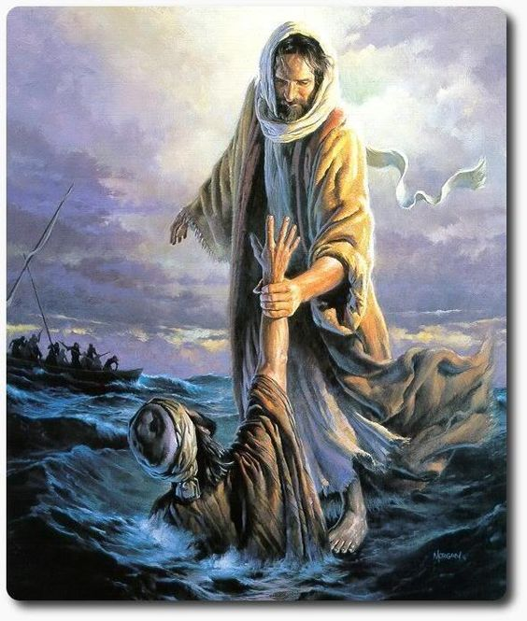
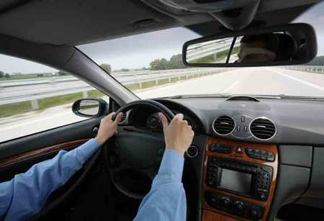
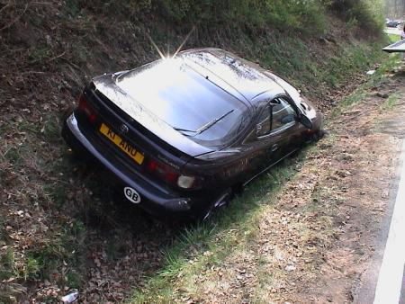
基督是一切
基督在我里面活着
属灵的万物
约14:6 耶稣说我就是道路、真理、生命；若不藉着我，没有人能到父那里去
属灵的人
无法主义
律法主义
因信称义
天然人/肉体

Slide 17
那不信主的人光景如何呢？
罗3:23 因为世人都犯了罪，亏缺了神的荣耀；3:24 如今却蒙神的恩典，因基督耶稣的救赎，就白白的称义。
罗5:18 如此说来，因一次的过犯，众人都被定罪；照样，因一次的义行，众人也就被称义得生命了。5:19 因一人的悖逆，众人成为罪人；照样，因一人的顺从，众人也成为义了。5:20 律法本是外添的，叫过犯显多；只是罪在那里显多，恩典就更显多了。
林后5:14 原来基督的爱激励我们；因我们想，一人既替众人 (all) 死，众人(all) 就都死了；5:15 并且他替众人死，是叫那些活着的人不再为自己活，乃为替他们死而复活的主活。5:16 所以，我们从今以后，不凭着外貌（原文是肉体；本节同）认人了。虽然凭着外貌认过基督，如今却不再这样认他了。5:17 若有人在基督里，他就是新造的人，旧事已过，都变成新的了。5:18 一切都是出于神；他藉着基督使我们与他和好，又将劝人与他和好的职分赐给我们。5:19 这就是神在基督里，叫世人与自己和好，不将他们的过犯归到他们身上，并且将这和好的道理託付了我们。
提前4:10 我们劳苦努力，正是为此，因我们的指望在乎永生的神；他是万人的救主，更是信徒的救主 （who is the Savior of all men, especially of believers ）。

