Slide 1

在基督里 (5):
进入安息
希伯来书 3:7-4:11
Hebrews 3:7-4:11
6/22/2014

Slide 2
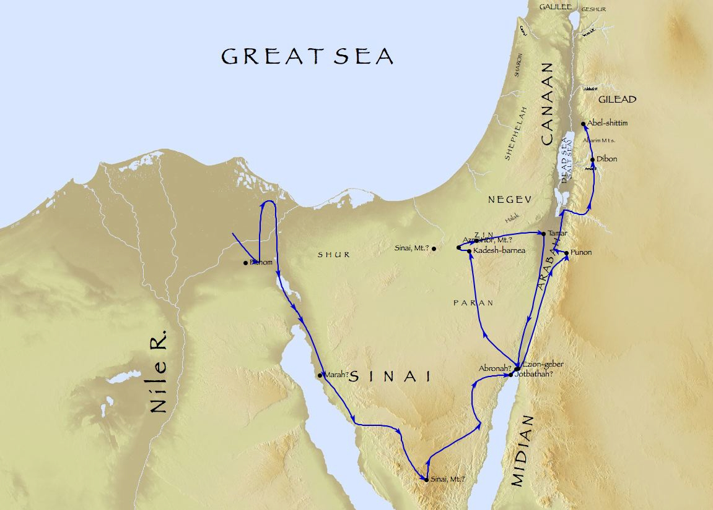
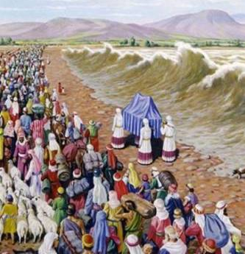
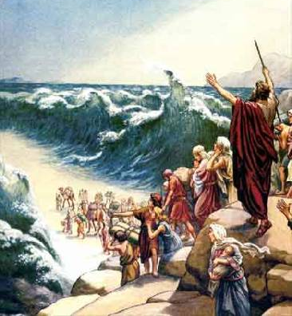
基督徒的经历
迦南
埃及
入迦南
出埃及
旷野
Notes:
1500BC exodus
Not only history, but also预表基督徒的经历

Slide 3
基督徒的经历
迦南
(安息)
埃及
入迦南
出埃及
旷野
Notes:
Today’s verse: Israelite enter Canaan to 说明 how to 进入安息

Slide 4
来3:7-11 ⁷圣灵有话说，你们今日若听他的话， ⁸就不可硬着心，像在旷野惹他发怒，试探他的时候一样。 ⁹在那里，你们的祖宗试我探我，并且观看我的作为，有四十年之久。 ¹⁰所以我厌烦那世代的人，说，他们心里常常迷糊，竟不晓得我的作为。 ¹¹我就在怒中起誓说，他们断不可进入我的安息。
Notes:
read

Slide 5
来3:12-14 ¹²弟兄们，你们要谨慎，免得你们中间，或有人存着不信的恶心，把永生神离弃了。 ¹³总要趁着还有今日，天天彼此相劝，免得你们中间，有人被罪迷惑，心里就刚硬了。 ¹⁴我们若将起初确实的信心，坚持到底，就在基督里有分了。

Slide 6
来3:15-19 ¹⁵经上说，你们今日若听他的话，就不可硬着心，像惹他发怒的日子一样。 ¹⁶那时听见他话惹他发怒的是谁呢。岂不是跟着摩西从埃及出来的众人麽。 ¹⁷神四十年之久，又厌烦谁呢。岂不是那些犯罪尸首倒在旷野的人麽。 ¹⁸又向谁起誓，不容他们进入他的安息呢。岂不是向那些不信从的人麽。 ¹⁹这样看来，他们不能进入安息，是因为不信的缘故了。

Slide 7
来4:1-3a ¹我们既蒙留下有进入他安息的应许，就当畏惧，免得我们中间，或有人似乎是赶不上了。 ²因为有福音传给我们，像传给他们一样。只是所听见的道与他们无益，因为他们没有信心与所听见的道调和。 ³但我们已经相信的人，得以进入那安息，正如神所说，我在怒中起誓说，他们断不可进入我的安息。…

Slide 8
来4:3b-7 ³ …其实造物之工，从创世以来已经成全了。 ⁴论到第七日，有一处说，到第七日神就歇了他一切的工。 ⁵又有一处说，他们断不可进入我的安息。 ⁶既有必进安息的人，那先前听见福音的，因为不信从，不得进去。 ⁷所以过了多年，就在大卫的书上，又限定一日，如以上所引的说，你们今日若听他的话，就不可硬着心。

Slide 9
来4:8-11 ⁸若是约书亚已叫他们享了安息，后来神就不再提别的日子了。 ⁹这样看来，必另有一安息日的安息，为神的子民存留。 ¹⁰因为那进入安息的，乃是歇了自己的工，正如神歇了他的工一样。 ¹¹所以我们务必竭力进入那安息，免得有人学那不信从的样子跌倒了。

Slide 10
来3:14 我们若将起初确实的信心，坚持到底，就在基督里有分了。
Heb. 3:14 (KJV) For we are made partakers of Christ, if we hold the beginning of our confidence stedfast unto the end;
Heb. 3:14 (NIV) We have come to share in Christ, if indeed we hold our original conviction firmly to the very end.
Notes:
进入安息 =进入基督已完成的工作 = 住在基督里
Key of 进入安息/住在基督里: 信心

Slide 11
Notes:
pray

Slide 12
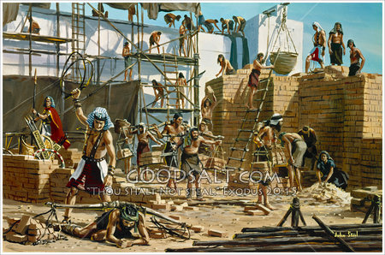
埃及为奴之家
Notes:
Slavery: Under Satan, bondage, labor

Slide 13
神的拯救
出3:7-8 ⁷耶和华说，我的百姓在埃及所受的困苦，我实在看见了，他们因受督工的辖制所发的哀声，我也听见了。我原知道他们的痛苦， ⁸我下来是要救他们脱离埃及人的手，领他们出了那地，...
Exodus 3:7-8 ⁷And the LORD said, I have surely seen the affliction of my people which are in Egypt, and have heard their cry by reason of their taskmasters; for I know their sorrows; ⁸And I am come down to deliver them out of the hand of the Egyptians, and to bring them up out of that land ...
Notes:
God first called Moses
Same today

Slide 14
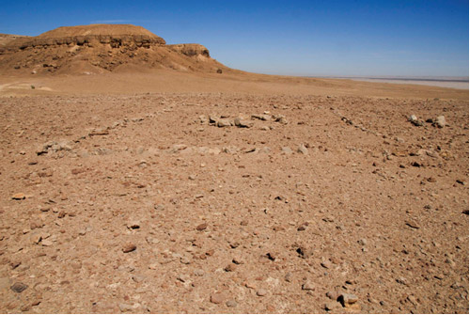
旷野
Notes:
People of God, free
Wilderness: 干旱疲乏无水之地
But overall bad circumstances, 缺乏
Know God’s presence and supply; Miracles/wonders sometimes
But cannot overcome, overall failure rather victory

Slide 15
神的旨意
出3:8 我下来是要救他们脱离埃及人的手，领他们出了那地，到美好宽阔，流奶与蜜之地，就是到迦南人，赫人，亚摩利人，比利洗人，希未人，耶布斯人之地。
Exodus 3:8 And I am come down to deliver them out of the hand of the Egyptians, and to bring them up out of that land unto a good land and a large, unto a land flowing with milk and honey; unto the place of the Canaanites, and the Hittites, and the Amorites, and the Perizzites, and the Hivites, and the Jebusites.
Notes:
出死入生
出黑暗入奇妙光明
Col 1:13 他救了我们脱离黑暗的权势、把我们迁到他爱子的国里．

Slide 16
对基督徒来说，
迦南地代表什么？

Slide 17
迦南地 = 安息
诗95:7-11 ⁷ ...惟愿你们今天听他的话。 ⁸你们不可硬着心，像当日在米利巴，就是在旷野的玛撒。... ¹¹所以我在怒中起誓，说，他们断不可进入我的安息。
Psalms 95:7 ⁷... To day if ye will hear his voice, ⁸ Harden not your heart, as in the provocation, and as in the day of temptation in the wilderness: ... ¹¹ Unto whom I sware in my wrath that they should not enter into my rest.
Notes:
To Christian: 迦南地 = 安息
(Psalms 95)

Slide 18
何谓安息？
来4:10 因为那进入安息的，乃是歇了自己的工，正如神歇了他的工一样。
Heb. 4:10 For he that is entered into his rest, he also hath ceased from his own works, as God did from his.
Notes:
歇了自己的工
正如神...

Slide 19
为何可以安息？
来4:3 …其实造物之工，从创世以来已经成全了。
来4:4 论到第七日，有一处说，到第七日神就歇了他一切的工。
Heb. 4:3 ... For we which have believed do enter into rest, as he said, As I have sworn in my wrath, if they shall enter into my rest: although the works were finished from the foundation of the world.
Heb. 4:4 For he spake in a certain place of the seventh day on this wise, And God did rest the seventh day from all his works.
Notes:
Because God’s work has finished

Slide 20
安息的意义
来4:10 因为那进入安息的，乃是歇了自己的工，正如神歇了他的工一样。
Heb. 4:10 For he that is entered into his rest, he also hath ceased from his own works, as God did from his.
进入安息
= 进入基督已完成的工作
= 住在基督里
Notes:
United with Christ, can share the fruit of His finished works
No longer need to struggle ourselves

Slide 21
进入安息的人生
是怎样的？

Slide 22
已经死了
西3:3 因为你们已经死了，你们的生命与基督一同藏在神里面。
Col. 3:3 For ye are dead, and your life is hid with Christ in God.
罗6:7 因为已死的人、是脱离了罪。
Romans 6:7 For he that is dead is freed from sin.
Notes:
Self:
Die with Christ

Slide 23
放胆无惧的来到神面前
弗3:12 我们因信耶稣，就在他里面放胆无惧，笃信不疑的来到神面前。
Eph. 3:12 In whom we have boldness and access with confidence by the faith of him.
约一2:28 小子们哪，你们要住在主里面。这样，他若显现，我们就可以坦然无惧。当他来的时候，在他面前也不至于惭愧。
1 John 2:28 And now, little children, abide in him; that, when he shall appear, we may have confidence, and not be ashamed before him at his coming.
Notes:
God:
God sees us thru Christ
No longer base on our performance

Slide 24
撒但在我们身上再没有权柄
约14:30 以后我不再和你们多说话，因为这世界的王将到。他在我里面是毫无所有。
John 14:30 Hereafter I will not talk much with you: for the prince of this world cometh, and hath nothing in me.
Notes:
Satan:
空中掌权者的首领, 掌死权
找不到任何可让牠指控的东西
1Jn 3:8 ... 神的儿子显现出来、为要除灭魔鬼的作为。

Slide 25
得了医治
彼前2:24 他被挂在木头上亲身担当了我们的罪、使我们既然在罪上死、就得以在义上活．因他受的鞭伤、你们便得了医治。
1 Peter 2:24 Who his own self bare our sins in his own body on the tree, that we, being dead to sins, should live unto righteousness: by whose stripes ye were healed.
Notes:
Bear our curse of sin

Slide 26
出人意外的平安
腓4:6 应当一无挂虑、只要凡事借着祷告、祈求、和感谢、将你们所要的告诉 神。
腓4:7 神所赐出人意外的平安、必在基督耶稣里、保守你们的心怀意念。
Phil. 4:6 Be careful for nothing; but in every thing by prayer and supplication with thanksgiving let your requests be made known unto God.
Phil. 4:7 And the peace of God, which passeth all understanding, shall keep your hearts and minds through Christ Jesus.

Slide 27
得胜有馀
罗8:35-37 谁能使我们与基督的爱隔绝呢。难道是患难麽，是困苦麽，是逼迫麽，是肌饿麽，是赤身露体麽，是危险麽，是刀剑麽。... 然而靠着爱我们的主，在这一切的事上，已经得胜有馀了。
Romans 8:35 Who shall separate us from the love of Christ? shall tribulation, or distress, or persecution, or famine, or nakedness, or peril, or sword? ... Nay, in all these things we are more than conquerors through him that loved us.

Slide 28
如何进入安息?
Notes:
Honest to self: Most people not yet.
Already yours but can’t enter

Slide 29
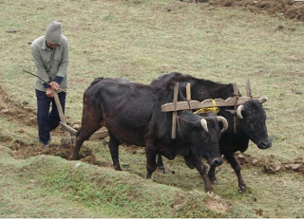
与基督联合 → 进入安息
太11:28-30 ²⁸凡劳苦担重担的人，可以到我这里来，我就使你们得安息。 ²⁹我心里柔和谦卑，你们当负我的轭，学我的样式，这样，你们心里就必得享安息。 ³⁰因为我的轭是容易的，我的担子是轻省的。
Matt. 11:28-30 ²⁸Come unto me, all ye that labour and are heavy laden, and I will give you rest. ²⁹Take my yoke upon you, and learn of me; for I am meek and lowly in heart: and ye shall find rest unto your souls. ³⁰For my yoke is easy, and my burden is light.
Notes:
到我这里来,负我的轭，学我的样式 – repent, Willing to give up living in Egypt
United/Identify with Christ → rest
柔和 towards God,谦卑 without self (Deny self)
but not enough

Slide 30
信 → 进入安息
来4:3 但我们已经相信的人，得以进入那安息，正如神所说，我在怒中起誓说，他们断不可进入我的安息。
Hebrews 4:3 For we which have believed do enter into rest, as he said, As I have sworn in my wrath, if they shall enter into my rest: although the works were finished from the foundation of the world.
Notes:
believe

Slide 31
不信 → 不能进入安息
来3:18 又向谁起誓，不容他们进入他的安息呢? 岂不是向那些不信从的人麽?
来3:19 这样看来，他们不能进入安息，是因为不信的缘故了。
Hebrews 3:18 And to whom sware he that they should not enter into his rest, but to them that believed not?
Hebrews 3:19 So we see that they could not enter in because of unbelief.
Notes:
unbelieve

Slide 32
不信 → 不能进入安息
来4:6 既有必进安息的人，那先前听见福音的，因为不信从，不得进去。
Hebrews 4:6 Seeing therefore it remaineth that some must enter therein, and they to whom it was first preached entered not in because of unbelief:
Notes:
Gospel (bases of faith):
not only leave Egypt, but also enter Canaan

Slide 33
不信 → 道与他们无益
来4:2 因为有福音传给我们，像传给他们一样。只是所听见的道与他们无益，因为他们没有信心与所听见的道调和。
Hebrews 4:2 For unto us was the gospel preached, as well as unto them: but the word preached did not profit them, not being mixed with faith in them that heard it.
Notes:
无益

Slide 34
不信 → 跌倒
来4:11 所以我们务必竭力进入那安息，免得有人学那不信从的样子跌倒了。
Hebrews 4:11 Let us labour therefore to enter into that rest, lest any man fall after the same example of unbelief.
Notes:
Cannot proceed in the road of faith to Canaan

Slide 35
不信 → 把永生神离弃
来3:12 弟兄们，你们要谨慎，免得你们中间，或有人存着不信的恶心，把永生神离弃了。
Hebrews 3:12 Take heed, brethren, lest there be in any of you an evil heart of unbelief, in departing from the living God.
来3:14 我们若将起初确实的信心，坚持到底，就在基督里有分了。
Hebrews 3:14 For we are made partakers of Christ, if we hold the beginning of our confidence stedfast unto the end;
Notes:
把永生神离弃了
在基督里有分

Slide 36
如何能信?

Slide 37
屬靈領域
屬靈的視力
感情
靈
Spirit
思想
意志
魂 Soul
體 Body
五官
物質領域
Notes:
Faith: Positive response to truth (from God)
Unbelieve: Positive response to other messages (from world or from Satan)
God’s word + Holy Spirit

Slide 38
不信的表现
来3:9-11 ⁹在那里，你们的祖宗试我探我，并且观看我的作为，有四十年之久。 ¹⁰所以我厌烦那世代的人，说，他们心里常常迷糊，竟不晓得我的作为。 ¹¹我就在怒中起誓说，他们断不可进入我的安息。
Hebrews 3:9-11 ⁹When your fathers tempted me, proved me, and saw my works forty years. ¹⁰Wherefore I was grieved with that generation, and said, They do alway err in their heart; and they have not known my ways. ¹¹So I sware in my wrath, They shall not enter into my rest.
Notes:
试我探我: experienced a lot!
迷糊: can’t see/accept spiritual truth

Slide 39
不可硬着心
来3:7-8 圣灵有话说，你们今日若听他的话，就不可硬着心，像在旷野惹他发怒，试探他的时候一样。
来3:15 经上说，你们今日若听他的话，就不可硬着心，像惹他发怒的日子一样。
来4:7 …你们今日若听他的话，就不可硬着心。
Hebrews 3:7-8, 3:15, 4:7 harden not your hearts
Notes:
God’s command is not “to believe”

Slide 40
心硬 → 不能信
约12:39-40 他们所以不能信，因为以赛亚又说，主叫他们瞎了眼，硬了心，免得他们眼睛看见，心里明白，回转过来，我就医治他们。
John 12:39-40 He hath blinded their eyes, and hardened their heart; that they should not see with their eyes, nor understand with their heart, and be converted, and I should heal them.
如何使刚硬的心软化？
Notes:
Not just believing a particular truth, but state of heart
How to avoid hardened heart?
Willingness to change, esteem God -- Our Choice
God’s Word
Prayer & Fasting
avoid sin – contradict to the truth

Slide 41
被罪迷惑 → 心硬
来3:13 总要趁着还有今日，天天彼此相劝，免得你们中间，有人被罪迷惑，心里就刚硬了。
Hebrews 3:13 But exhort one another daily, while it is called To day; lest any of you be hardened through the deceitfulness of sin.
Notes:
4. avoid sin – contradict to the truth
(Avoid anything contrary to God’s word)

Slide 42
持守起初的确信
来3:14 我们若将起初确实的信心，坚持到底，就在基督里有分了。
Heb. 3:14 (KJV) For we are made partakers of Christ, if we hold the beginning of our confidence stedfast unto the end;
Heb. 3:14 (NIV) We have come to share in Christ, if indeed we hold our original conviction firmly to the very end.
Notes:
持守信心

Slide 43
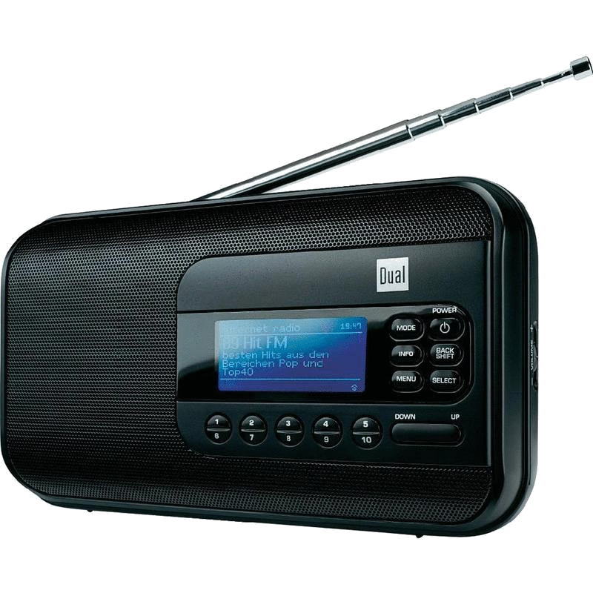
Notes:
Our mind resonance with God’s
Tuning by God’s word, daily devotion

Slide 44
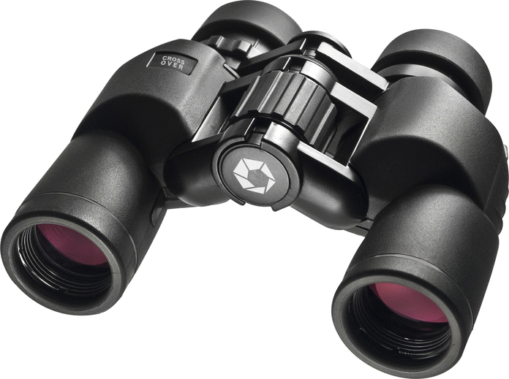
Notes:
Seek, focus

Slide 45
竭力进入安息
来4:11 所以我们务必竭力进入那安息，免得有人学那不信从的样子跌倒了。
Hebrews 4:11 Let us labour therefore to enter into that rest, lest any man fall after the same example of unbelief.

