Slide 1
在基督里 (3): 不犯罪
约翰一书 3:6
6/8/2014
Notes:
In Christ: most foundational concept in NT
Not sin

Slide 2
在基督里就不犯罪
约一3:6 凡住在他里面的、就不犯罪．凡犯罪的、是未曾看见他、也未曾认识他。
1 John 3:6 Whosoever abideth in him sinneth not: whosoever sinneth hath not seen him, neither known him.
Notes:
Read
What we need, But may not experience

Slide 3
Notes:
Pray

Slide 4
本乎恩、因着信
林前1:30 但你们得在基督耶稣里，是本乎神，......
1 Cor. 1:30 But of him are ye in Christ Jesus, ......
约一4:15 凡认耶稣为神儿子的，神就住在他里面，他也住在神里面。
1 John 4:15 Whosoever shall confess that Jesus is the Son of God, God dwelleth in him, and he in God.
Notes:
在基督里: 福音的根基
在基督里是本乎(神)恩、因着(人)信

Slide 5
在基督里成为新造
林後5:17 若有人在基督里，他就是新造的人。旧事已过，都变成新的了。
2 Cor. 5:17 Therefore if any man be in Christ, he is a new creature: old things are passed away; behold, all things are become new.
Notes:
Importance: new creature, no longer the same life

Slide 6
在基督里得神本性一切的丰盛
西2:9 因为神本性一切的丰盛都有形有体的居住在基督里面，
西2:10 你们在他里面也得了丰盛。他是各样执政掌权者的元首。
Colossians 2:9 For in him dwelleth all the fulness of the Godhead bodily.
Colossians 2:10 And ye are complete in him, which is the head of all principality and power:
Notes:
Christ is God.
All the fullness of the Godhead

Slide 7
在基督里得一切福气
弗1:3 愿颂赞归与我们主耶稣基督的父神，他在基督里，曾赐给我们天上各样属灵的福气。
Ephesians 1:3 Blessed be the God and Father of our Lord Jesus Christ, who hath blessed us with all spiritual blessings in heavenly places in Christ.
Notes:
all in Christ, none outside of Christ

Slide 8
在基督里得亲近神
弗2:13 你们从前远离神的人，如今却在基督耶稣里，靠着祂的血，已经得亲近了。
Ephesians 2:13 [NIV] But now in Christ Jesus you who once were far away have been brought near by the blood of Christ.
Notes:
should not focus on blessings
relationship with God
have God → have blessings

Slide 9
人类最根本的问题: 罪

Slide 10
都是罪人
罗3:23 因为世人都犯了罪，亏缺了神的荣耀
。
Romans 3:23 For all have sinned, and come short of the glory of God;
罗3:10 就如经上所记，没有义人，连一个也没有。
Romans 3:10 As it is written, There is none righteous, no, not one:

Slide 11
人的处境
弗2:1 你们死在过犯罪恶之中，...
Ephesians 2:1 And you ... were dead in trespasses and sins;
Notes:
were dead

Slide 12
与生命之源隔绝
赛59:2 但你们的罪孽使你们与神隔绝，你们的罪恶使他掩面不听你们。
Isaiah 59:2 But your iniquities have separated between you and your God, and your sins have hid his face from you, that he will not hear.
Notes:
From our perspective: afraid of God
From God’s perspective:掩面 is His mercy; righteousness -> judgement

Slide 13
Notes:
live in sin, will rot

Slide 14
好消息
提前1:15 基督耶稣降世，为要拯救罪人。......
太1:21 他将要生一个儿子。你要给他起名叫耶稣。因他要将自己的百姓从罪恶里救出来。
约一3:5 你们知道主曾显现，是要除掉人的罪。在他并没有罪。
Notes:
Not most basic goal of Gospel
(Should be restoring the original intent of creation, glorify God)
How?

Slide 15
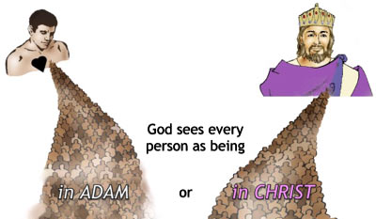
救赎的方法：在基督里
林前15:22 在亚当里众人都死了；
照样，在基督里众人也都要复活。
1 Corinthian 15:22 For as in Adam all die,
even so in Christ shall all be made alive.
Notes:
Representative, 种族
His experience becomes ours.

Slide 16
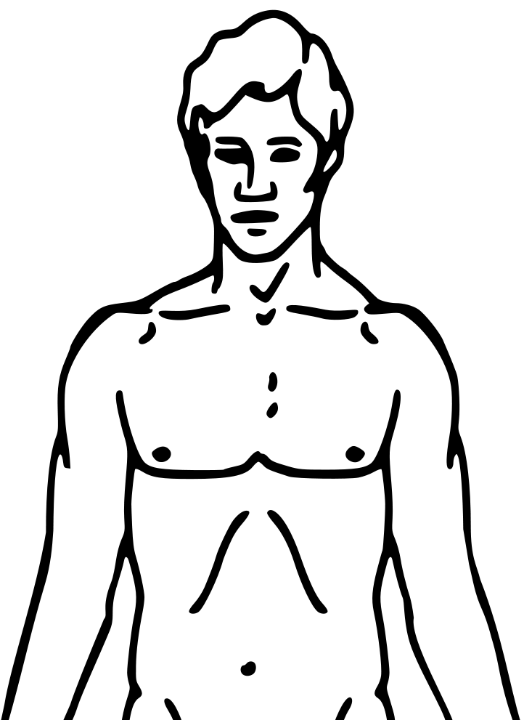
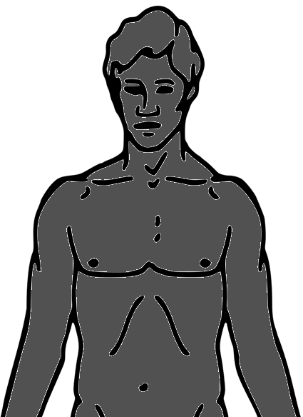
在亚当里是死的
来7:10 因为麦基洗德迎接亚伯拉罕的时候、利未已经在他先祖的身中。
Notes:
Adam our ancestor
Always in Adam (Lev 7:10)
Adam sins, we too
Adam dead, we too

Slide 17
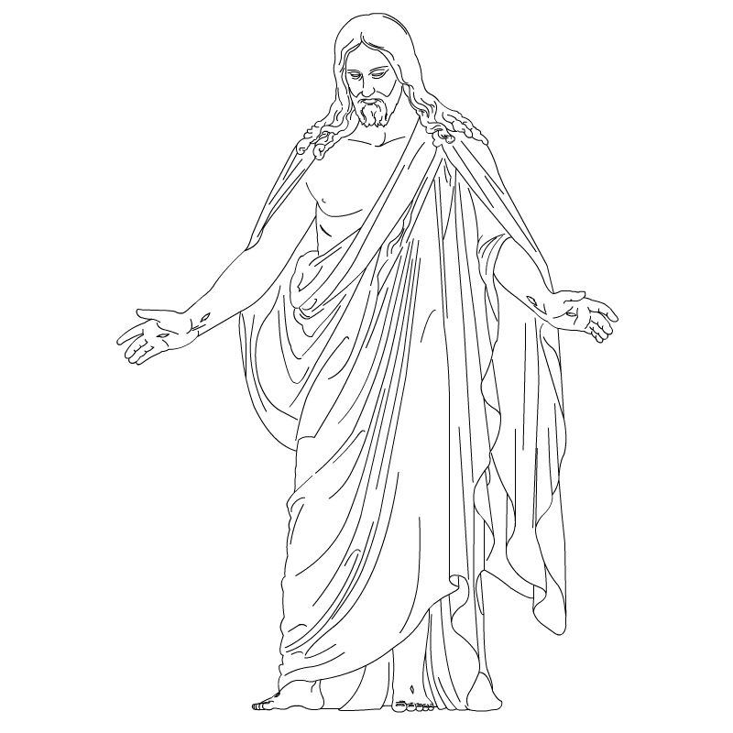
在基督里同死
林後5:21 神使那无罪的，替我们成为罪。好叫我们在他里面成为神的义。
Notes:
Same life
We in Him, He in Us.
JC lives thru us to accomplish his work.

Slide 18
在基督里同死
林後5:21 神使那无罪的，替我们成为罪。好叫我们在他里面成为神的义。
Notes:
Identify/united with us, become sin
Die: release us from the old/sinful life

Slide 19
在基督里同复活
彼前1:3 愿颂赞归与我们的主耶稣基督的父神，他曾照自己的大怜悯，藉耶稣基督从死里复活重生了我们，...
Notes:
Not life of Adam, but life of Jesus

Slide 20
在基督里得饶恕
弗4:32 并要以恩慈相待，存怜悯的心，彼此饶恕，正如神在基督里饶恕了你们一样。
Ephesians 4:32 And be ye kind one to another, tenderhearted, forgiving one another, even as God for Christ's sake hath forgiven you.
Notes:
God forgives Christ
Christ has paid the debt in full. (God’s righteousness satisfied)

Slide 21
在基督里不定罪
罗8:1 如今，那些在基督耶稣里的就不定罪了。
Romans 8:1 There is therefore now no condemnation to them which are in Christ Jesus, who walk not after the flesh, but after the Spirit.
Notes:
God not condemn Christ
Strong’s: an adverse sentence (the verdict)
Past: 被定罪生命
Now:基督生命

Slide 22
在基督里有基督的义
腓3:9 并且得以在他里面，不是有自己因律法而得的义，乃是有信基督的义，就是因信神而来的义。
Philippians 3:9 And be found in him, not having mine own righteousness, which is of the law, but that which is through the faith of Christ, the righteousness which is of God by faith.
Notes:
义: God’s standard
Christ is righteous
Christ’s credit to me

Slide 23
在基督里就不犯罪
约一3:6 凡住在他里面的、就不犯罪．凡犯罪的、是未曾看见他、也未曾认识他。
1 John 3:6 Whosoever abideth in him sinneth not: whosoever sinneth hath not seen him, neither known him.
Notes:
Christ is sinless

Slide 24
从神生的就不犯罪
约一3:9 凡从 神生的、就不犯罪、因 神的道〔原文作种〕存在他心里．他也不能犯罪、因为他是由 神生的。
约一5:18 我们知道凡从 神生的必不犯罪．从 神生的必保守自己、那恶者也就无法害他。

Slide 25
已脱离罪和死的律
罗8:1 如今，那些在基督耶稣里的就不定罪了。
罗8:2 因为赐生命圣灵的律，在基督耶稣里释放了我，使我脱离罪和死的律了。
Romans 8:1 There is therefore now no condemnation to them which are in Christ Jesus, who walk not after the flesh, but after the Spirit.
Romans 8:2 For the law of the Spirit of life in Christ Jesus hath made me free from the law of sin and death.
Notes:
Strong’s: an adverse sentence (the verdict)
Past: 被定罪生命
Now:基督生命

Slide 26
为什么这不是我的经历？
Notes:
不犯罪 hard to believe, because not what we experienced
But this exactly is the problem – do you have faith?

Slide 27
在基督里旧人已死
罗6:6 因为知道我们的旧人和他同定十字架，使罪身灭绝，叫我们不再作罪的奴仆。
罗6:7 因为已死的人，是脱离了罪。
Romans 6:6 Knowing this, that our old man is crucified with him, that the body of sin might be destroyed, that henceforth we should not serve sin.
Romans 6:7 For he that is dead is freed from sin.
Notes:
旧人: Adam’s life, old spirit
Have been dealed with, we are released from it.

Slide 28
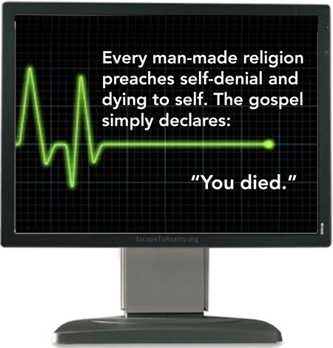

Slide 29
你是死还是活？
罗6:11 这样，你们向罪也当看自己是死的。向神在基督耶稣里却当看自己是活的。
Romans 6:11 Likewise reckon ye also yourselves to be dead indeed unto sin, but alive unto God through Jesus Christ our Lord.
Notes:
Question is do you see yourself as dead or alive?

Slide 30
罪不是我
罗7:20 若我去作所不愿意作的，就不是我作的，乃是住在我里头的罪作的。
Romans 7:20 Now if I do that I would not, it is no more I that do it, but sin that dwelleth in me.
Notes:
no need to please it

Slide 31
私欲生出罪来
各1:14 但各人被试探，乃是被自己的私欲牵引诱惑的。
各1:15 私欲既怀了胎，就生出罪来。罪既长成，就生出死来。
James 1:14 But every man is tempted, when he is drawn away of his own lust, and enticed.
James 1:15 Then when lust hath conceived, it bringeth forth sin: and sin, when it is finished, bringeth forth death.

Slide 32
里头的泉源
约4:13 耶稣回答说，凡喝这水的，还要再渴。
约4:14 人若喝我所赐的水就永远不渴。我所赐的水，要在他里头成为泉源，直涌到永生。
John 4:13 Jesus answered and said unto her, Whosoever drinketh of this water shall thirst again:
John 4:14 But whosoever drinketh of the water that I shall give him shall never thirst; but the water that I shall give him shall be in him a well of water springing up into everlasting life.
Notes:
Not only die

Slide 33
你看到哪一个？
Notes:
may see both sometimes
declare in faith dead in Adam and alive in Chirst

