Slide 1
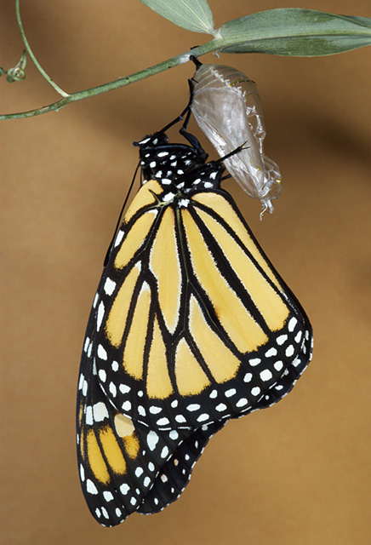
在基督里 (1):
成为新造
哥林多后書 5:17
5/25/2014
Notes:
Looks simple, yet profound
Commonly used: member of church family – miss out a lot!
>20 yrs, Never heard any sermon on it
Our church starts recently, ZY preaching; Want deeper
Today: New creature
Pray

Slide 2
成为新造
林後5:17 若有人在基督里，他就是新造的人。旧事已过，都变成新的了。
2 Cor. 5:17 Therefore if any man be in Christ, he is a new creature: old things are passed away; behold, all things are become new.
Notes:
Past: new beginning, another chance
new creature, no longer the same life
Key: In Christ

Slide 3
为什么要成为新造？
弗2:1 你们死在过犯罪恶之中，...
Ephesians 2:1 And you ... were dead in trespasses and sins;
Notes:
were dead

Slide 4
耶稣基督的福音
约10:10 ...我来了，是要叫羊（或作人）得生命，并且得的更丰盛。
John 10:10 ... I am come that they might have life, and that they might have it more abundantly.
Notes:
JC mission: have life

Slide 5
什么样的生命？
约1:12 凡接待他的、就是信他名的人、他就赐他们权柄、作 神的儿女。
约1:13 这等人不是从血气生的、不是从情欲生的、也不是从人意生的、乃是从 神生的。
John 1:12 But as many as received him, to them gave he power to become the sons of God, even to them that believe on his name:
John 1:13 Which were born, not of blood, nor of the will of the flesh, nor of the will of man, but of God.
Notes:
born of God
New creature,更丰盛
Key to be a Christian

Slide 6
基督如何使我们得生命？

Slide 7
与基督联合
罗6:3 岂不知我们这受洗归入基督耶稣的人、是受洗归入他的死么。
罗6:4 所以我们借着洗礼归入死、和他一同埋葬．原是叫我们一举一动有新生的样式、像基督借着父的荣耀、从死里复活一样。
Romans 6:3 Know ye not, that so many of us as were baptized into Jesus Christ were baptized into his death?
Romans 6:4 Therefore we are buried with him by baptism into death: that like as Christ was raised up from the dead by the glory of the Father, even so we also should walk in newness of life.
Notes:
Union with Christ
US: 信
Ｃｈｒｉｓｔ: baptize
道再一次成为肉身
新生的样式 not baby
4 pictures to help us to understand 归入基督 /在基督里

Slide 8
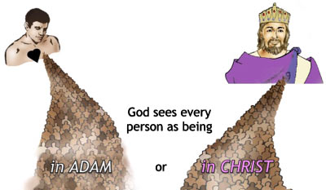
(1) 在亚当里 vs 在基督里
林前15:22 在亚当里众人都死了；照样，在基督里众人也都要复活。
1 Corinthian 15:22 For as in Adam all die, even so in Christ shall all be made alive.
Notes:
How JC’s death related to us
His experience becomes ours.
Representative
种族

Slide 9
(2) 在基督里:身子与肢体
罗12:4 正如我们一个身子上有好些肢体、肢体也不都是一样的用处。
罗12:5 我们这许多人、在基督里成为一身、互相联络作肢体、也是如此。
Romans 12:4 For as we have many members in one body, and all members have not the same office:
Romans 12:5 So we, being many, are one body in Christ, and every one members one of another.
Notes:
All Christian: 一身
One Christian: 肢体

Slide 10
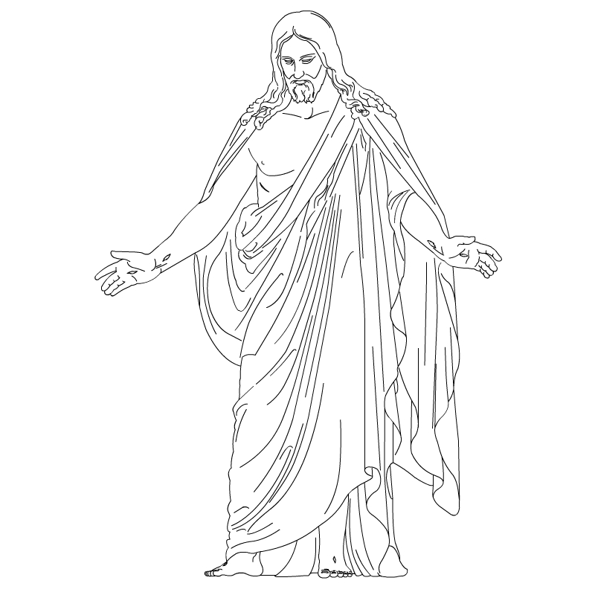

(2) 在基督里:身子与肢体
Notes:
Same life
We in Him, He in Us.
JC lives thru us to accomplish his work.

Slide 11


(3) 在基督里:丈夫与妻子
弗5:31 为这个缘故、人要离开父母、与妻子连合、二人成为一体。
Notes:
Love and submission
不再是两个人

Slide 12
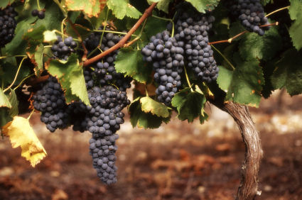
(4) 在基督里:葡萄树与枝子
约15:5 我是葡萄树、你们是枝子．常在我里面的、我也常在他里面、这人就多结果子．因为离了我、你们就不能作甚么。
John 15:5 I am the vine,
ye are the branches:
He that abideth in me,
and I in him, the same
bringeth forth much fruit:
for without me
ye can do nothing.
Notes:
Branch in vine, vine’s life in branch
Source of life, can’t live without

Slide 13
神在基督里
到底賜给我们什么？
Notes:
Life, but anything more concrete?

Slide 14
神本性一切的丰盛
西2:9 因为神本性一切的丰盛都有形有体的居住在基督里面，
西2:10 你们在他里面也得了丰盛。他是各样执政掌权者的元首。
Colossians 2:9 For in him dwelleth all the fulness of the Godhead bodily.
Colossians 2:10 And ye are complete in him, which is the head of all principality and power:
Notes:
Christ is God.

Slide 15
一切在基督里
弗1:3 愿颂赞归与我们主耶稣基督的父神，他在基督里，曾赐给我们天上各样属灵的福气。
Ephesians 1:3 Blessed be the God and Father of our Lord Jesus Christ, who hath blessed us with all spiritual blessings in heavenly places in Christ.
Notes:
all
in Christ, none outside of Christ
spiritual, but can experience with faith

Slide 16
口才、知识
林前1:4 我常为你们感谢我的神，因神在基督耶稣里所赐给你们的恩惠；
林前1:5 又因你们在他里面凡事富足，口才、知识都全备，
1 Corinthians 1:4 I thank my God always on your behalf, for the grace of God which is given you by Jesus Christ;
1 Corinthians 1:5 That in every thing ye are enriched by him, in all utterance, and in all knowledge;
Notes:
Can manifested in physical world

Slide 17
一切智慧知识
西2:3 所积蓄的一切智慧知识，都在他里面藏着。
Colossians 2:3 In whom are hid all the treasures of wisdom and knowledge.
Notes:
James 1:5 你们中间若有缺少智慧的、应当求那厚赐与众人、也不斥责人的 神、主就必赐给他。

Slide 18
在基督里夸胜
林後2:14 感谢神！常帅领我们在基督里夸胜，并藉着我们在各处显扬那因认识基督而有的香气。
2 Corinthians 2:14 Now thanks be unto God, which always causeth us to triumph in Christ, and maketh manifest the savour of his knowledge by us in every place.
Notes:
Christian life should be victorious.

Slide 19
本乎恩因着信的福音（4）
因著基督徒與基督聯合同為神的後嗣，神在基督里已經賜給他們一切恩典。Because Christians are joint-heirs with Christ, God has bestowed on them every spiritual blessing,

Slide 20
本乎恩因着信的福音（4）
（就是屬靈的福氣，包括公義、祝福、圣洁、属神的性情、天父无条件的接纳、医治、智慧、能力等等）。(i.e., grace, including righteousness from God, all blessings, holiness, godly nature, unconditional love and acceptance of God, healing, wisdom, power, etc.)

Slide 21
我生来是罪人,
神怎样看待我？
Notes:
Salvation: Save us from sin

Slide 22
饶恕
弗4:32 并要以恩慈相待，存怜悯的心，彼此饶恕，正如神在基督里饶恕了你们一样。
Ephesians 4:32 And be ye kind one to another, tenderhearted, forgiving one another, even as God for Christ's sake hath forgiven you.
Notes:
Defn: giving up my right to hurt you, for hurting me.
to wipe the slate clean, to pardon, to cancel a debt
Christ has paid the debt in full. (God’s righteousness satisfied)

Slide 23
不定罪
罗8:1 如今，那些在基督耶稣里的就不定罪了。
罗8:2 因为赐生命圣灵的律，在基督耶稣里释放了我，使我脱离罪和死的律了。
Romans 8:1 There is therefore now no condemnation to them which are in Christ Jesus, who walk not after the flesh, but after the Spirit.
Romans 8:2 For the law of the Spirit of life in Christ Jesus hath made me free from the law of sin and death.
Notes:
Strong’s: an adverse sentence (the verdict)
Dict: 谴责 , strong disapproval 强烈不满
Forgive: Your sins in the past
No condemnation: Your being

Slide 24
被称义
罗5:18 如此说来，因一次的过犯，众人都被定罪，照样，因一次的义行，众人也就被称义得生命了。
罗5:19 因一人的悖逆，众人成为罪人，照样，因一人的顺从，众人也成为义了。
Romans 5:18 Therefore as by the offence of one judgment came upon all men to condemnation; even so by the righteousness of one the free gift came upon all men unto justification of life.
Romans 5:19 For as by one man's disobedience many were made sinners, so by the obedience of one shall many be made righteous.
Notes:
称义, 成为义

Slide 25
成为神的义
林後5:21 神使那无罪的，替我们成为罪。好叫我们在他里面成为神的义。
2 Cor. 5:21 For he hath made him to be sin for us, who knew no sin; that we might be made the righteousness of God in him.
罗8:33 谁能控告神所拣选的人呢。有神称他们为义了。
Romans 8:33 Who shall lay any thing to the charge of God's elect? It is God that justifieth.
Notes:
神的义 (one interpretation: Christ himself)
People want to be 被肯定, 被接纳
Usually, from parents, spouses, friends.
Hurt if some said you 错, 不成, 无用
Know God is center of universal. Want God’s 肯定

Slide 26
我是罪人还是义人？
Notes:
In Christ:义人
Old man: dead
Key: how to see yourself
Need revelation

Slide 27
新造的人应如何活？
林後5:14 原来基督的爱激励我们。因我们想一人既替众人死，众人就都死了。
林後5:15 并且他替众人死，是叫那些活着的人，不再为自己活，乃为替他们死而复活的主活。
2 Cor. 5:14 For the love of Christ constraineth us; because we thus judge, that if one died for all, then were all dead:
2 Cor. 5:15 And that he died for all, that they which live should not henceforth live unto themselves, but unto him which died for them, and rose again.
Notes:
Knowing the meaning of In Christ....
old man die
Christ lives thru me

Slide 28
如何为主而活？
林後5:16 所以我们从今以后，不凭着外貌（原文作肉体本节同）认人了。虽然凭着外貌认过基督，如今不再这样认他了。
林後5:17 若有人在基督里，他就是新造的人。旧事已过，都变成新的了。
2 Cor. 5:16 Wherefore henceforth know we no man after the flesh: yea, though we have known Christ after the flesh, yet now henceforth know we him no more.
2 Cor. 5:17 Therefore if any man be in Christ, he is a new creature: old things are passed away; behold, all things are become new.
Notes:
No longer look at 肉体 (physical, outer part)
Look into spirit.

Slide 29
定睛于基督
罗6:11 这样、你们向罪也当看自己是死的．向 神在基督耶稣里、却当看自己是活的。
Romans 6:11 In the same way, count yourselves dead to sin but alive to God in Christ Jesus. (NIV)
Notes:
Dead in old creation
Alive in Christ

