Slide 1
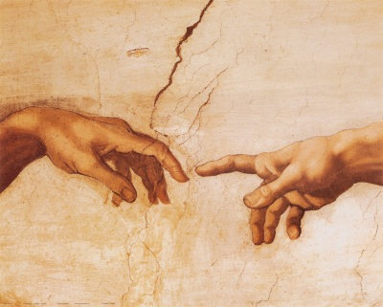
到神面前来
（6）

Slide 2
出埃及记 Exodus 33
¹⁸ 摩西说：求你显出你的荣耀给我看。¹⁹ 耶和华说：我要显我一切的恩慈，在你面前经过，宣告我的名。我要恩待谁就恩待谁；要怜悯谁就怜悯谁；²⁰ 又说：你不能看见我的面，因为人见我的面不能存活。
¹⁸ And he said, I beseech thee, shew me thy glory.
¹⁹ And he said, I will make all my goodness pass before thee, and I will proclaim the name of the LORD before thee; and will be gracious to whom I will be gracious, and will shew mercy on whom I will shew mercy. ²⁰ And he said, Thou canst not see my face: for there shall no man see me, and live.

Slide 3
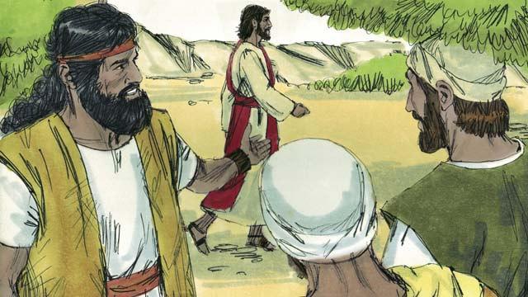

Slide 4
出埃及记 Exodus 33
²¹ 耶和华说：看哪，在我这里有地方，你要站在磐石上。²² 我的荣耀经过的时候，我必将你放在磐石穴中，用我的手遮掩你，等我过去，²³ 然后我要将我的手收回，你就得见我的背，却不得见我的面。
²¹ And the LORD said, Behold, there is a place by me, and thou shalt stand upon a rock: ²² And it shall come to pass, while my glory passeth by, that I will put thee in a clift of the rock, and will cover thee with my hand while I pass by: ²³ And I will take away mine hand, and thou shalt see my back parts: but my face shall not be seen.

Slide 5
路加福音 Luke 14
²⁶ 人到我这里来，若不爱我胜过爱（爱我胜过爱：原文是恨）自己的父母、妻子、儿女、弟兄、姊妹，和自己的性命，就不能作我的门徒。²⁷ 凡不背着自己十字架跟从我的，也不能作我的门徒。
²⁶ If any man come to me, and hate not his father, and mother, and wife, and children, and brethren, and sisters, yea, and his own life also, he cannot be my disciple. ²⁷ And whosoever doth not bear his cross, and come after me, cannot be my disciple.

Slide 6
路加福音 Luke 14
³³ 这样，你们无论甚么人，若不撇下一切所有的，就不能作我的门徒。
³³ So likewise, whosoever he be of you that forsaketh not all that he hath, he cannot be my disciple.

Slide 7
活着就是基督
腓 1:21 因我活着就是基督，我死了就有益处。
Phil 1:21 For to me to live is Christ, and to die is gain.

Slide 8
在基督里到神面前来
弗 2:11-13所以你们应当纪念：你们从前按肉体是外邦人，是称为没受割礼的；这名原是那些凭人手在肉身上称为受割礼之人所起的。 那时，你们与基督无关，在以色列国民以外，在所应许的诸约上是局外人，并且活在世上没有指望，没有神。 你们从前远离神的人，如今却在基督耶稣里，靠着他的血，已经得亲近了。
Eph 2:11-13Wherefore remember, that ye being in time past Gentiles in the flesh, who are called Uncircumcision by that which is called the Circumcision in the flesh made by hands; That at that time ye were without Christ, being aliens from the commonwealth of Israel, and strangers from the covenants of promise, having no hope, and without God in the world: But now in Christ Jesus ye who sometimes were far off are made nigh by the blood of Christ.

Slide 9
在基督里到神面前来
约 17:20-22 我不但为这些人祈求，也为那些因他们的话信我的人祈求， 使他们都合而为一。正如你父在我里面，我在你里面，使他们也在我们里面，叫世人可以信你差了我来。 你所赐给我的荣耀，我已赐给他们，使他们合而为一，象我们合而为一。
John 17:20-22Neither pray I for these alone, but for them also which shall believe on me through their word; That they all may be one; as thou, Father, art in me, and I in thee, that they also may be one in us: that the world may believe that thou hast sent me. And the glory which thou gavest me I have given them; that they may be one, even as we are one:

Slide 10
在灵和实际里到神面前来
约 4:21-24 耶稣说：妇人，你当信我。时候将到，你们拜父，也不在这山上，也不在耶路撒冷。 你们所拜的，你们不知道；我们所拜的，我们知道，因为救恩是从犹太人出来的。
John 4:21-24 Jesus saith unto her, Woman, believe me, the hour cometh, when ye shall neither in this mountain, nor yet at Jerusalem, worship the Father. Ye worship ye know not what: we know what we worship: for salvation is of the Jews.

Slide 11
在灵和实际里到神面前来
时候将到，如今就是了，那真正拜父的，要用心灵和诚实拜他，因为父要这样的人拜他。 神是个灵（或无个字），所以拜他的必须用心灵和诚实拜他。」
But the hour cometh, and now is, when the true worshippers shall worship the Father in spirit and in truth: for the Father seeketh such to worship him. God is a Spirit: and they that worship him must worship him in spirit and in truth.

Slide 12
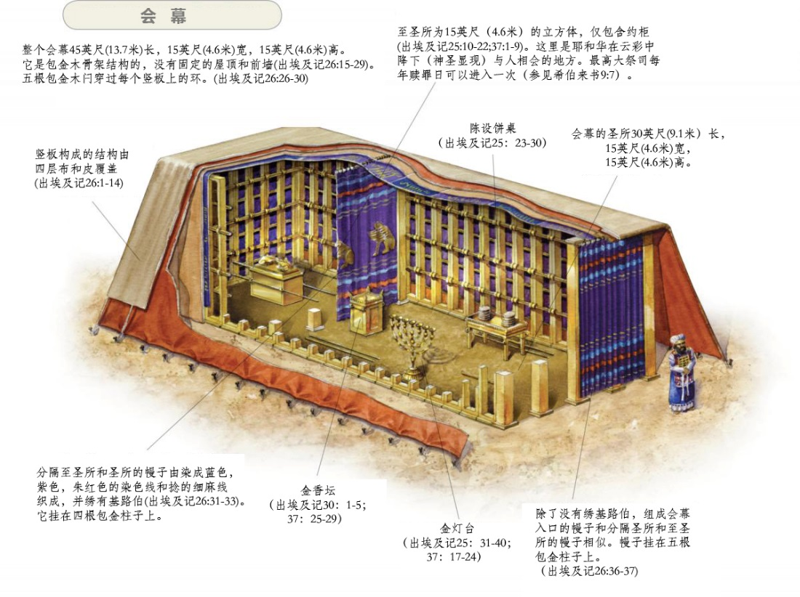
希伯来书 Hebrews 9
¹ 原来前约有礼拜的条例和属世界的圣幕。² 因为有预备的帐幕，头一层叫作圣所，里面有灯臺、桌子，和陈设饼。
¹ Then verily the first covenant had also ordinances of divine service, and a worldly sanctuary.
² For there was a tabernacle made; the first, wherein was the candlestick, and the table, and the shewbread; which is called the sanctuary.

Slide 13
希伯来书 Hebrews 9
³ 第二幔子后又有一层帐幕，叫作至圣所，
⁴ 有金香炉（或作：坛），有包金的约柜，柜里有盛吗哪的金罐和亚伦发过芽的杖，并两块约版；
³ And after the second veil, the tabernacle which is called the Holiest of all;
⁴ Which had the golden censer, and the ark of the covenant overlaid round about with gold, wherein was the golden pot that had manna, and Aaron's rod that budded, and the tables of the covenant;

Slide 14
希伯来书 Hebrews 9
⁵ 柜上面有荣耀基路伯的影罩着施恩（原文作：蔽罪）座。这几件我现在不能一一细说。
⁶ 这些物件既如此预备齐了，众祭司就常进头一层帐幕，行拜神的礼。
⁵ And over it the cherubims of glory shadowing the mercyseat; of which we cannot now speak particularly.
⁶ Now when these things were thus ordained, the priests went always into the first tabernacle, accomplishing the service of God.

Slide 15
希伯来书 Hebrews 9
⁷ 至于第二层帐幕，唯有大祭司一年一次独自进去，没有不带着血为自己和百姓的过错献上。⁸ 圣灵用此指明，头一层帐幕仍存的时候，进入至圣所的路还未显明。
⁷ But into the second went the high priest alone once every year, not without blood, which he offered for himself, and for the errors of the people:
⁸ The Holy Ghost this signifying, that the way into the holiest of all was not yet made manifest, while as the first tabernacle was yet standing:

Slide 16
希伯来书 Hebrews 9
⁹ 那头一层帐幕作现今的一个表样，所献的礼物和祭物，就着良心说，都不能叫礼拜的人得以完全。¹⁰ 这些事，连那饮食和诸般洗濯的规矩，都不过是属肉体的条例，命定到振兴的时候为止。
⁹ Which was a figure for the time then present, in which were offered both gifts and sacrifices, that could not make him that did the service perfect, as pertaining to the conscience; ¹⁰ Which stood only in meats and drinks, and divers washings, and carnal ordinances, imposed on them until the time of reformation.

Slide 17
希伯来书 Hebrews 9
¹¹ 但现在基督已经来到，作了将来美事的大祭司，经过那更大更全备的帐幕，不是人手所造、也不是属乎这世界的；¹² 并且不用山羊和牛犊的血，乃用自己的血，只一次进入圣所，成了永远赎罪的事。
¹¹ But Christ being come an high priest of good things to come, by a greater and more perfect tabernacle, not made with hands, that is to say, not of this building;
¹² Neither by the blood of goats and calves, but by his own blood he entered in once into the holy place, having obtained eternal redemption for us.

Slide 18
希伯来书 Hebrews 9
¹³ 若山羊和公牛的血，并母牛犊的灰，灑在不洁的人身上，尚且叫人成圣，身体洁净，¹⁴ 何况基督藉着永远的灵，将自己无瑕无疵献给神，他的血岂不更能洗净你们的心（原文是良心），除去你们的死行，使你们事奉那永生神么？
¹³ For if the blood of bulls and of goats, and the ashes of an heifer sprinkling the unclean, sanctifieth to the purifying of the flesh:
¹⁴ How much more shall the blood of Christ, who through the eternal Spirit offered himself without spot to God, purge your conscience from dead works to serve the living God?

Slide 19
希伯来书 Hebrews 10
¹ 律法既是将来美事的影儿，不是本物的真象，总不能藉着每年常献一样的祭物叫那近前来的人得以完全。² 若不然，献祭的事岂不早已止住了么？因为礼拜的人，良心既被洁净，就不再觉得有罪了。
¹ For the law having a shadow of good things to come, and not the very image of the things, can never with those sacrifices which they offered year by year continually make the comers thereunto perfect. ² For then would they not have ceased to be offered? because that the worshippers once purged should have had no more conscience of sins.

Slide 20
希伯来书 Hebrews 10
³ 但这些祭物是叫人每年想起罪来；
⁴ 因为公牛和山羊的血，断不能除罪。
⁵ 所以基督到世上来的时候，就说：神阿，祭物和礼物是你不愿意的；你曾给我预备了身体。
³ But in those sacrifices there is a remembrance again made of sins every year.
⁴ For it is not possible that the blood of bulls and of goats should take away sins.
⁵ Wherefore when he cometh into the world, he saith, Sacrifice and offering thou wouldest not, but a body hast thou prepared me:

Slide 21
希伯来书 Hebrews 10
⁶ 燔祭和赎罪祭是你不喜欢的。⁷ 那时我说：神阿，我来了，为要照你的旨意行；我的事在经卷上已经记载了。⁸ 以上说：祭物和礼物，燔祭和赎罪祭，是你不愿意的，也是你不喜欢的（这都是按着律法献的）；
⁶ In burnt offerings and sacrifices for sin thou hast had no pleasure.
⁷ Then said I, Lo, I come (in the volume of the book it is written of me,) to do thy will, O God.
⁸ Above when he said, Sacrifice and offering and burnt offerings and offering for sin thou wouldest not, neither hadst pleasure therein; which are offered by the law;

Slide 22
希伯来书 Hebrews 10
⁹ 后又说：我来了为要照你的旨意行；可见他是除去在先的，为要立定在后的。¹⁰ 我们凭这旨意，靠耶稣基督，只一次献上他的身体，就得以成圣。¹¹ 凡祭司天天站着事奉神，屡次献上一样的祭物，这祭物永不能除罪。
⁹ Then said he, Lo, I come to do thy will, O God. He taketh away the first, that he may establish the second. ¹⁰ By the which will we are sanctified through the offering of the body of Jesus Christ once for all. ¹¹ And every priest standeth daily ministering and offering oftentimes the same sacrifices, which can never take away sins:

Slide 23
希伯来书 Hebrews 10
¹² 但基督献了一次永远的赎罪祭，就在神的右边坐下了。
¹³ 从此，等候他仇敌成了他的脚凳。
¹⁴ 因为他一次献祭，便叫那得以成圣的人永远完全。
¹² But this man, after he had offered one sacrifice for sins for ever, sat down on the right hand of God;
¹³ From henceforth expecting till his enemies be made his footstool.
¹⁴ For by one offering he hath perfected for ever them that are sanctified.

Slide 24
希伯来书 Hebrews 10
¹⁵ 圣灵也对我们作见證；因为他既已说过：¹⁶ 主说：那些日子以后，我与他们所立的约乃是这样：我要将我的律法写在他们心上，又要放在他们的里面。¹⁷ 以后就说：我不再纪念他们的罪愆和他们的过犯。
¹⁵ Whereof the Holy Ghost also is a witness to us: for after that he had said before, ¹⁶ This is the covenant that I will make with them after those days, saith the Lord, I will put my laws into their hearts, and in their minds will I write them;
¹⁷ And their sins and iniquities will I remember no more.

Slide 25
希伯来书 Hebrews 10
¹⁸ 这些罪过既已赦免，就不用再为罪献祭了。
¹⁹ 弟兄们，我们既因耶稣的血得以坦然进入至圣所，
²⁰ 是藉着他给我们开了一条又新又活的路，从幔子经过，这幔子就是他的身体。
¹⁸ Now where remission of these is, there is no more offering for sin.
¹⁹ Having therefore, brethren, boldness to enter into the holiest by the blood of Jesus,
²⁰ By a new and living way, which he hath consecrated for us, through the veil, that is to say, his flesh;

Slide 26
希伯来书 Hebrews 10
²¹ 又有一位大祭司治理神的家！²² 并我们心中天良的亏欠已经灑去，身体用清水洗净了，就当存着诚心和充足的信心来到神面前；²³ 也要坚守我们所承认的指望，不至摇动，因为那应许我们的是信实的。
²¹ And having an high priest over the house of God;
²² Let us draw near with a true heart in full assurance of faith, having our hearts sprinkled from an evil conscience, and our bodies washed with pure water.
²³ Let us hold fast the profession of our faith without wavering; (for he is faithful that promised;)

