Slide 1
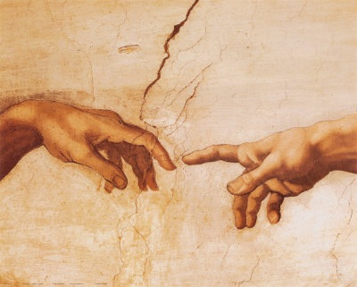
到神面前来
（5）

Slide 2
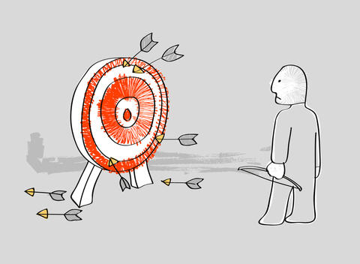
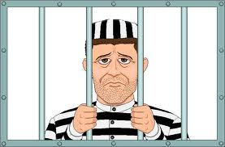
需要认识圣经中罪的观念不同寻常…
(Thayer’s) Sin（罪）= Hamartia
a. to be without a share in （无份）
b. to miss the mark （未中标）
c. to err, be mistaken （错误、失误）
d. to miss or wander from the path of uprightness and honour, to do or go wrong （从正道上迷失）
e. to wander from the law of God, violate God‘s law, sin（违背神的律法）

Slide 3
The Greatest Exchange
最伟大的交换
林后 5:21 神使那无罪（无罪：原文是不知罪）的，替我们成为罪，好叫我们在他里面成为神的义。
2 Cor 5:21 For he hath made him to be sin for us, who knew no sin; that we might be made the righteousness of God in him.

Slide 4
罗马书 Romans 4
⁴ 做工的得工价，不算恩典，乃是该得的；⁵ 唯有不做工的，只信称罪人为义的神，他的信就算为义。
⁴ Now to him that worketh is the reward not reckoned of grace, but of debt. ⁵ But to him that worketh not, but believeth on him that justifieth the ungodly, his faith is counted for righteousness.

Slide 5
罗马书 Romans 5
¹⁸ 如此说来，因一次的过犯，众人都被定罪；照样，因一次的义行，众人也就被称义得生命了。
¹⁹ 因一人的悖逆，众人成为罪人；照样，因一人的顺从，众人也成为义了。
¹⁸ Therefore as by the offence of one judgment came upon all men to condemnation; even so by the righteousness of one the free gift came upon all men unto justification of life.
¹⁹ For as by one man's disobedience many were made sinners, so by the obedience of one shall many be made righteous.

Slide 6
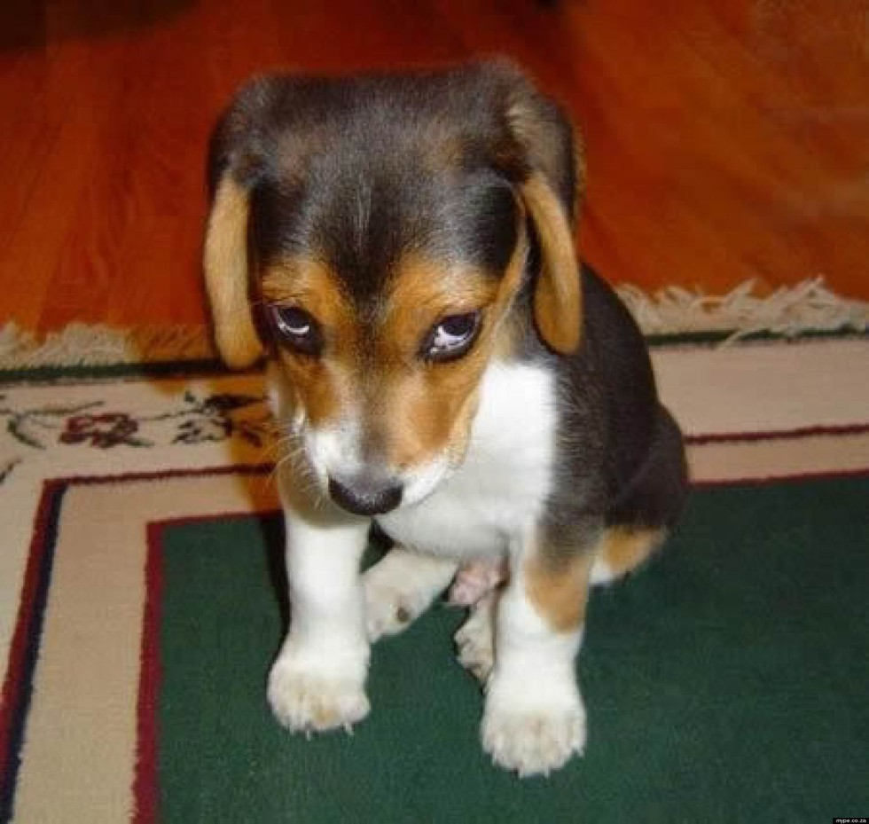
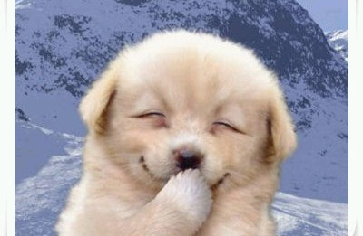
愧疚的良心
不再愧疚的良心
放心的良心

Slide 7
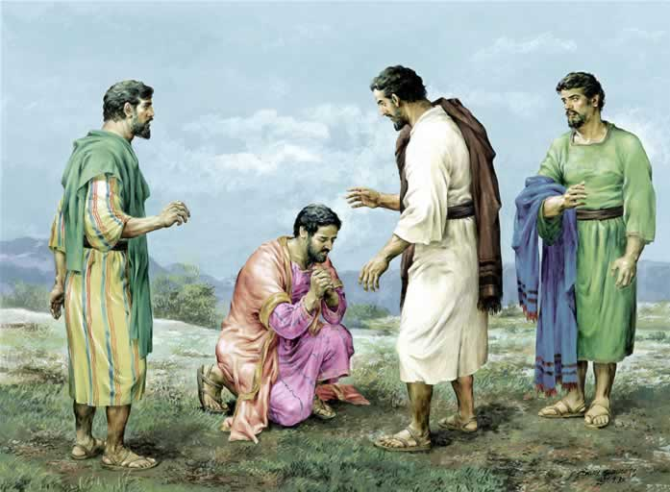
马可福音 Mark 10
¹⁷ 耶稣出来行路的时候，有一个人跑来，跪在他面前，问他说：良善的夫子，我当作甚么事纔可以承受永生？¹⁸ 耶稣对他说：你为甚么称我是良善的？除了神一位之外，再没有良善的。
¹⁷ And when he was gone forth into the way, there came one running, and kneeled to him, and asked him, Good Master, what shall I do that I may inherit eternal life? ¹⁸ And Jesus said unto him, Why callest thou me good? there is none good but one, that is, God.

Slide 8
马可福音 Mark 10
¹⁹ 诫命你是晓得的：不可杀人；不可姦淫；不可偷盗；不可作假见證；不可亏负人；当孝敬父母。²⁰ 他对耶稣说：夫子，这一切我从小都遵守了。
¹⁹ Thou knowest the commandments, Do not commit adultery, Do not kill, Do not steal, Do not bear false witness, Defraud not, Honour thy father and mother. ²⁰ And he answered and said unto him, Master, all these have I observed from my youth.

Slide 9
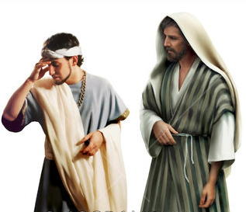
马可福音 Mark 10
²¹ 耶稣看着他，就爱他，对他说：你还缺少一件：去变卖你所有的，分给穷人，就必有财宝在天上；你还要来跟从我。²² 他听见这话，脸上就变了色，忧忧愁愁的走了，因为他的产业很多。
²¹ Then Jesus beholding him loved him, and said unto him, One thing thou lackest: go thy way, sell whatsoever thou hast, and give to the poor, and thou shalt have treasure in heaven: and come, take up the cross, and follow me. ²² And he was sad at that saying, and went away grieved: for he had great possessions.

Slide 10
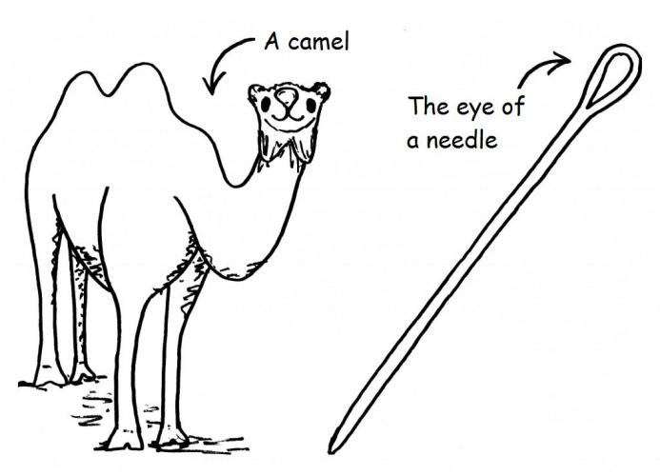
马可福音 Mark 10
²³ 耶稣周围一看，对门徒说：有钱财的人进神的国是何等的难哪！²⁴ 门徒希奇他的话。耶稣又对他们说：小子，倚靠钱财的人进神的国是何等的难哪！²⁵ 骆驼穿过针的眼，比财主进神的国还容易呢。
²³ And Jesus looked round about, and saith unto his disciples, How hardly shall they that have riches enter into the kingdom of God! ²⁴ And the disciples were astonished at his words. But Jesus answereth again, and saith unto them, Children, how hard is it for them that trust in riches to enter into the kingdom of God! ²⁵ It is easier for a camel to go through the eye of a needle, than for a rich man to enter into the kingdom of God.

Slide 11
马可福音 Mark 10
²⁶ 门徒就分外希奇，对他说：这样谁能得救呢？
²⁷ 耶稣看着他们，说：在人是不能，在神却不然，因为神凡事都能。
²⁶ And they were astonished out of measure, saying among themselves, Who then can be saved?
²⁷ And Jesus looking upon them saith, With men it is impossible, but not with God: for with God all things are possible.

Slide 12
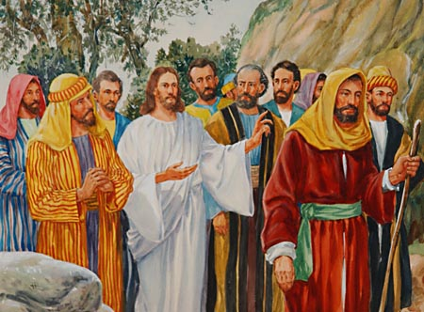
路加福音 Luke 14
²⁵ 有极多的人和耶稣同行。他转过来对他们说：
²⁵ And there went great multitudes with him: and he turned, and said unto them,

Slide 13
路加福音 Luke 14
²⁶ 人到我这里来，若不爱我胜过爱（爱我胜过爱：原文是恨）自己的父母、妻子、儿女、弟兄、姊妹，和自己的性命，就不能作我的门徒。²⁷ 凡不背着自己十字架跟从我的，也不能作我的门徒。
²⁶ If any man come to me, and hate not his father, and mother, and wife, and children, and brethren, and sisters, yea, and his own life also, he cannot be my disciple. ²⁷ And whosoever doth not bear his cross, and come after me, cannot be my disciple.

Slide 14
路加福音 Luke 14
²⁸ 你们那一个要盖一座楼，不先坐下算计花费，能盖成不能呢？²⁹ 恐怕安了地基，不能成功，看见的人都笑话他，说：
³⁰ 这个人开了工，却不能完工。
²⁸ For which of you, intending to build a tower, sitteth not down first, and counteth the cost, whether he have sufficient to finish it ? ²⁹ Lest haply, after he hath laid the foundation, and is not able to finish it, all that behold it begin to mock him, ³⁰ Saying, This man began to build, and was not able to finish.

Slide 15
路加福音 Luke 14
³¹ 或是一个王出去和别的王打仗，岂不先坐下酌量，能用一万兵去敌那领二万兵来攻打他的么？³² 若是不能，就趁敌人还远的时候，派使者去求和息的条款。
³¹ Or what king, going to make war against another king, sitteth not down first, and consulteth whether he be able with ten thousand to meet him that cometh against him with twenty thousand? ³² Or else, while the other is yet a great way off, he sendeth an ambassage, and desireth conditions of peace.

Slide 16
路加福音 Luke 14
³³ 这样，你们无论甚么人，若不撇下一切所有的，就不能作我的门徒。
³³ So likewise, whosoever he be of you that forsaketh not all that he hath, he cannot be my disciple.

Slide 17
怎么就叫撇下一切所有的？

Slide 18
马太福音 Matthews 10
³⁸ 不背着他的十字架跟从我的，也不配作我的门徒。³⁹ 得着生命的，将要失丧生命；为我失丧生命的，将要得着生命。 ⁴⁰ 人接待你们就是接待我；接待我就是接待那差我来的。
³⁸ And he that taketh not his cross, and followeth after me, is not worthy of me. ³⁹ He that findeth his life (psuche, i.e., soul) shall lose it: and he that loseth his life (psuche, i.e., soul) for my sake shall find it. ⁴⁰ He that receiveth you receiveth me, and he that receiveth me receiveth him that sent me.

Slide 19
我是谁？

Slide 20
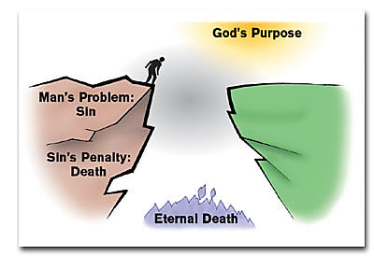
人的光景

Slide 21
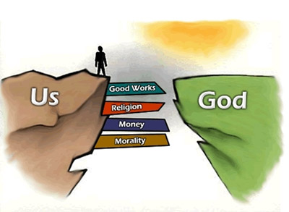
人的方法

Slide 22
创世记 Genesis 1
²⁶ 神说：我们要照着我们的形象、按着我们的样式造人，使他们管理海里的鱼、空中的鸟、地上的牲畜，和全地，并地上所爬的一切昆虫。²⁷ 神就照着自己的形象造人，乃是照着他的形象造男造女。
²⁶ And God said, Let us make man in our image, after our likeness: and let them have dominion over the fish of the sea, and over the fowl of the air, and over the cattle, and over all the earth, and over every creeping thing that creepeth upon the earth. ²⁷ So God created man in his own image, in the image of God created he him; male and female created he them.

Slide 23
创世记 Genesis 2
⁷ 耶和华 神用地上的尘土造人，将生气吹在他鼻孔里，他就成了有灵的活人，名叫亚当。
⁸ 耶和华 神在东方的伊甸立了一个园子，把所造的人安置在那里。
⁷ And the LORD God formed man of the dust of the ground, and breathed into his nostrils the breath of life; and man became a living soul.
⁸ And the LORD God planted a garden eastward in Eden; and there he put the man whom he had formed.

Slide 24
The Greatest Exchange
最伟大的交换
林后 5:21 神使那无罪（无罪：原文是不知罪）的，替我们成为罪，好叫我们在他里面成为神的义。
2 Cor 5:21 For he hath made him to be sin for us, who knew no sin; that we might be made the righteousness of God in him.

Slide 25
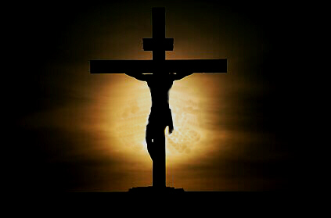
加 2:20 我已经与基督同钉十字架，现在活着的不再是我，乃是基督在我里面活着；并且我如今在肉身活着，是因信神的儿子而活；他是爱我，为我捨己。

Slide 26
马太福音 Matthews 10
³⁸ 不背着他的十字架跟从我的，也不配作我的门徒。³⁹ 得着生命的，将要失丧生命；为我失丧生命的，将要得着生命。 ⁴⁰ 人接待你们就是接待我；接待我就是接待那差我来的。
³⁸ And he that taketh not his cross, and followeth after me, is not worthy of me. ³⁹ He that findeth his life (psuche, i.e., soul) shall lose it: and he that loseth his life (psuche, i.e., soul) for my sake shall find it. ⁴⁰ He that receiveth you receiveth me, and he that receiveth me receiveth him that sent me.

Slide 27
加拉太书 Galatians 3
²⁷ 你们受洗归入基督的都是披戴基督了。
²⁸ 并不分犹太人、希腊人，自主的、为奴的，或男或女，因为你们在基督耶稣里都成为一了。
²⁷ For as many of you as have been baptized into Christ have put on Christ. ²⁸ There is neither Jew nor Greek, there is neither bond nor free, there is neither male nor female: for ye are all one in Christ Jesus.

Slide 28
活着就是基督
腓 1:21 因我活着就是基督，我死了就有益处。
Phil 1:21 For to me to live is Christ, and to die is gain.

