Slide 1
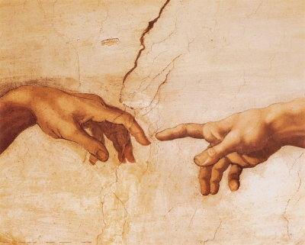
到神面前来
（4）

Slide 2
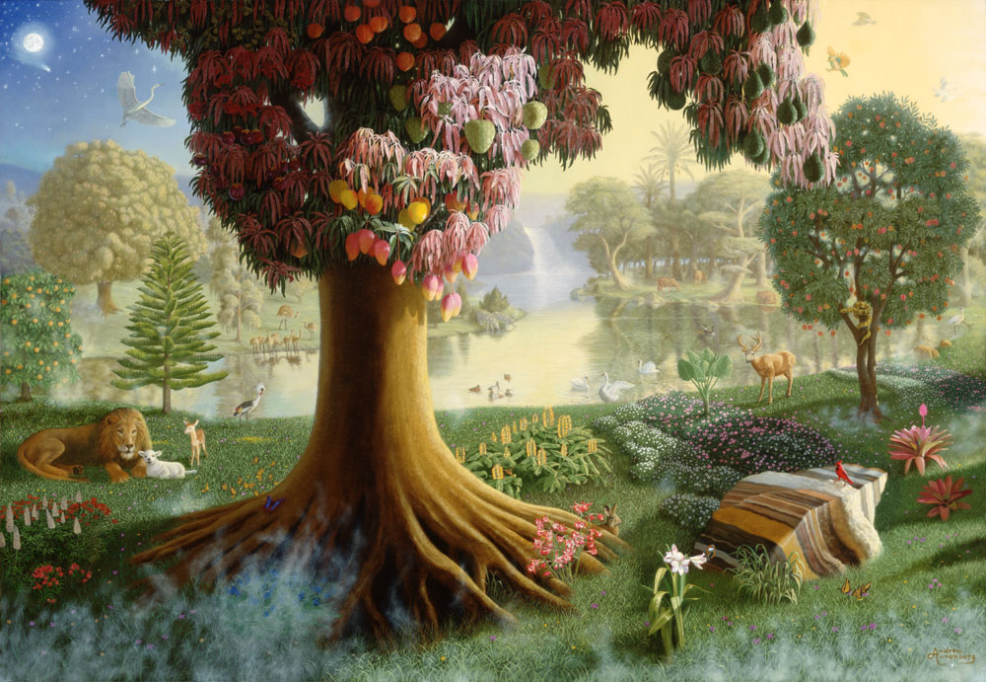
神的同在 ➔
满足的内心
无缺乏的环境

Slide 3
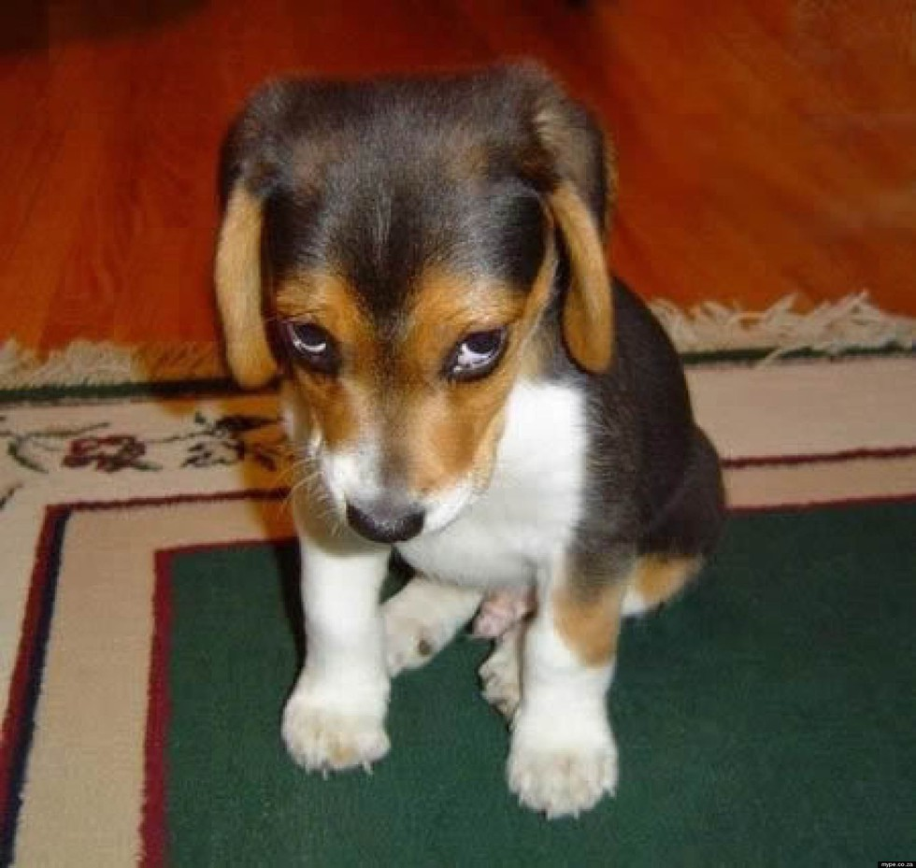
愧疚的良心

Slide 4
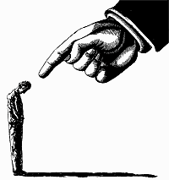
律法或良心的功用
为罪人设定界限
定罪人的罪
赋予罪能力胜过人

Slide 5
功用4: 预备人心接受恩典…
加 3:24 这样，律法是我们训蒙的师傅，引我们到基督那里，使我们因信称义。
Gal 3:24 Wherefore the law was our schoolmaster to bring us unto Christ, that we might be justified by faith.

Slide 6
什么样的人容易接受恩典的福音？

Slide 7
罗马书 Romans 3
¹⁹ 我们晓得律法上的话都是对律法以下之人说的，好塞住各人的口，叫普世的人都伏在神审判之下。
²⁰ 所以凡有血气的，没有一个因行律法能在神面前称义，因为律法本是叫人知罪。
¹⁹ Now we know that what things soever the law saith, it saith to them who are under the law: that every mouth may be stopped, and all the world may become guilty before God.
²⁰ Therefore by the deeds of the law there shall no flesh be justified in his sight: for by the law is the knowledge of sin.

Slide 8
罗马书 Romans 3
²¹ 但如今，神的义在律法以外已经显明出来，有律法和先知为證：
²² 就是神的义，因信耶稣基督加给一切相信的人，并没有分别。
²³ 因为世人都犯了罪，亏缺了神的荣耀；
²¹ But now the righteousness of God without the law is manifested, being witnessed by the law and the prophets;
²² Even the righteousness of God which is by faith of Jesus Christ unto all and upon all them that believe: for there is no difference:
²³ For all have sinned, and come short of the glory of God;

Slide 9
罗马书 Romans 3
²⁴ 如今却蒙神的恩典，因基督耶稣的救赎，就白白的称义。
²⁵ 神设立耶稣作挽回祭，是凭着耶稣的血，藉着人的信，要显明神的义；因为他用忍耐的心宽容人先时所犯的罪，
²⁴ Being justified freely by his grace through the redemption that is in Christ Jesus:
²⁵ Whom God hath set forth to be a propitiation through faith in his blood, to declare his righteousness for the remission of sins that are past, through the forbearance of God;

Slide 10
罗马书 Romans 3
²⁶ 好在今时显明他的义，使人知道他自己为义，也称信耶稣的人为义。²⁷ 既是这样，那里能夸口呢？没有可夸的了。用何法没有的呢？是用立功之法么？不是，乃用信主之法。²⁸ 所以我们看定了：人称义是因着信，不在乎遵行律法。
²⁶ To declare, I say, at this time his righteousness: that he might be just, and the justifier of him which believeth in Jesus. ²⁷ Where is boasting then? It is excluded. By what law? of works? Nay: but by the law of faith. ²⁸ Therefore we conclude that a man is justified by faith without the deeds of the law.

Slide 11
罗马书 Romans 4
⁴ 做工的得工价，不算恩典，乃是该得的；⁵ 唯有不做工的，只信称罪人为义的神，他的信就算为义。
⁴ Now to him that worketh is the reward not reckoned of grace, but of debt. ⁵ But to him that worketh not, but believeth on him that justifieth the ungodly, his faith is counted for righteousness.

Slide 12
愧疚的良心
不再愧疚的良心

Slide 13
什么样的人不容易接受恩典的福音？

Slide 14
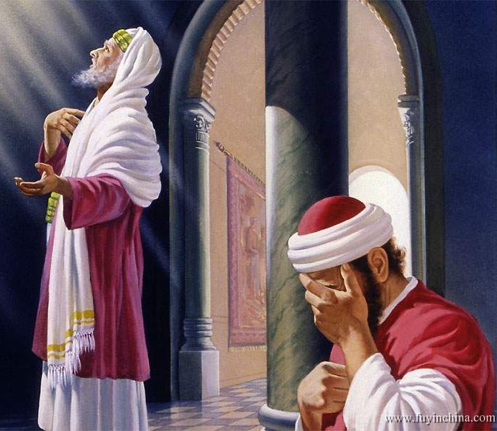
路加福音 Luke 18
⁹ 耶稣向那些仗着自己是义人，藐视别人的，设一个比喻，
¹⁰ 说：有两个人上殿里去祷告：一个是法利赛人，一个是税吏。
⁹ And he spake this parable unto certain which trusted in themselves that they were righteous, and despised others:
¹⁰ Two men went up into the temple to pray; the one a Pharisee, and the other a publican.

Slide 15
路加福音 Luke 18
¹¹ 法利赛人站着，自言自语的祷告说：神阿，我感谢你，我不象别人勒索、不义、姦淫，也不象这个税吏。¹² 我一个礼拜禁食两次，凡我所得的都捐上十分之一。
¹¹ The Pharisee stood and prayed thus with himself, God, I thank thee, that I am not as other men are, extortioners, unjust, adulterers, or even as this publican. ¹² I fast twice in the week, I give tithes of all that I possess.

Slide 16
路加福音 Luke 18
¹³ 那税吏远远的站着，连举目望天也不敢，只捶着胸说：神阿，开恩可怜我这个罪人！¹⁴ 我告诉你们，这人回家去比那人倒算为义了；因为，凡自高的，必降为卑；自卑的，必升为高。
¹³ And the publican, standing afar off, would not lift up so much as his eyes unto heaven, but smote upon his breast, saying, God be merciful to me a sinner. ¹⁴ I tell you, this man went down to his house justified rather than the other: for every one that exalteth himself shall be abased; and he that humbleth himself shall be exalted.

Slide 17
马太福音 Matthews 23
²³ 你们这假冒为善的文士和法利赛人有祸了！因为你们将薄荷、茴香、芹菜，献上十分之一，那律法上更重的事，就是公义、怜悯、信实，反倒不行了。这更重的是你们当行的；那也是不可不行的。
²³ Woe unto you, scribes and Pharisees, hypocrites! for ye pay tithe of mint and anise and cummin, and have omitted the weightier matters of the law, judgment, mercy, and faith: these ought ye to have done, and not to leave the other undone.

Slide 18
罗马书 Romans 2
²³ 你指着律法夸口，自己倒犯律法，玷辱神么？
²⁴ 神的名在外邦人中，因你们受了亵渎，正如经上所记的。
²³ Thou that makest thy boast of the law, through breaking the law dishonourest thou God?
²⁴ For the name of God is blasphemed among the Gentiles through you, as it is written.

Slide 19
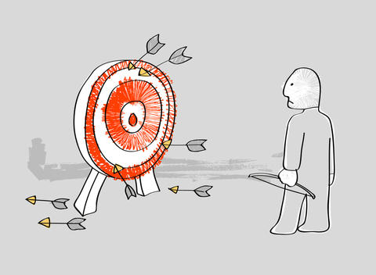
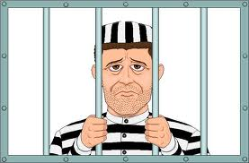
需要认识圣经中罪的观念不同寻常…
(Thayer’s) Sin（罪）= Hamartia
a. to be without a share in （无份）
b. to miss the mark （未中标）
c. to err, be mistaken （错误、失误）
d. to miss or wander from the path of uprightness and honour, to do or go wrong （从正道上迷失）
e. to wander from the law of God, violate God‘s law, sin（违背神的律法）

Slide 20
诗篇 Psalms 51
³ 因为，我知道我的过犯；我的罪常在我面前。⁴ 我向你犯罪，惟独得罪了你；在你眼前行了这恶，以致你责备我的时候显为公义，判断我的时候显为清正。⁵ 我是在罪孽里生的，在我母亲怀胎的时候就有了罪。
³ For I acknowledge my transgressions: and my sin is ever before me. ⁴ Against thee, thee only, have I sinned, and done this evil in thy sight: that thou mightest be justified when thou speakest, and be clear when thou judgest.
⁵ Behold, I was shapen in iniquity; and in sin did my mother conceive me.

Slide 21
罗马书 Romans 5
¹⁸ 如此说来，因一次的过犯，众人都被定罪；照样，因一次的义行，众人也就被称义得生命了。
¹⁹ 因一人的悖逆，众人成为罪人；照样，因一人的顺从，众人也成为义了。
¹⁸ Therefore as by the offence of one judgment came upon all men to condemnation; even so by the righteousness of one the free gift came upon all men unto justification of life.
¹⁹ For as by one man's disobedience many were made sinners, so by the obedience of one shall many be made righteous.

Slide 22
罗马书 Romans 5
¹⁸ 如此说来，因一次的过犯，众人都被定罪；照样，因一次的义行，众人也就被称义得生命了。
¹⁹ 因一人的悖逆，众人成为罪人；照样，因一人的顺从，众人也成为义了。
¹⁸ Therefore as by the offence of one judgment came upon all men to condemnation; even so by the righteousness of one the free gift came upon all men unto justification of life.
¹⁹ For as by one man's disobedience many were made sinners, so by the obedience of one shall many be made righteous.

Slide 23
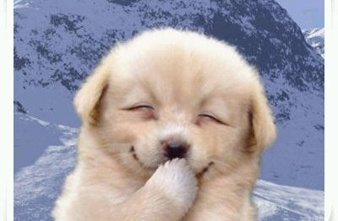
放心的良心

Slide 24
出埃及记 Exodus 33
²¹ 耶和华说：看哪，在我这里有地方，你要站在磐石上。²² 我的荣耀经过的时候，我必将你放在磐石穴中，用我的手遮掩你，等我过去，²³ 然后我要将我的手收回，你就得见我的背，却不得见我的面。
²¹ And the LORD said, Behold, there is a place by me, and thou shalt stand upon a rock: ²² And it shall come to pass, while my glory passeth by, that I will put thee in a clift of the rock, and will cover thee with my hand while I pass by: ²³ And I will take away mine hand, and thou shalt see my back parts: but my face shall not be seen.

