Slide 1
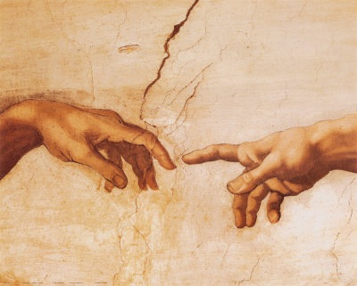
到神面前来
（3）

Slide 2
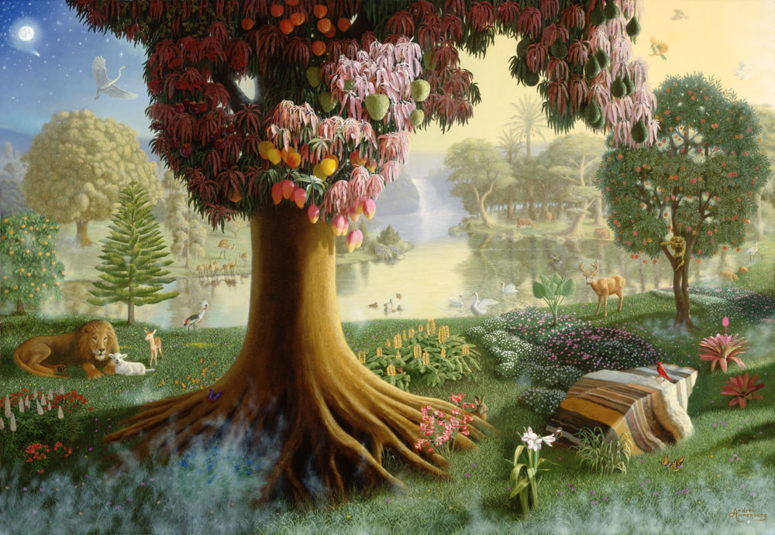
神的同在 ➔
满足的内心
无缺乏的环境

Slide 3
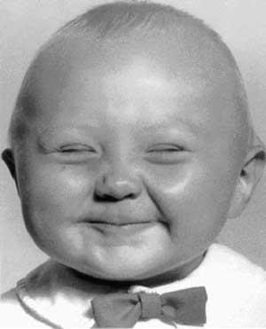
内心的重要性
???

Slide 4
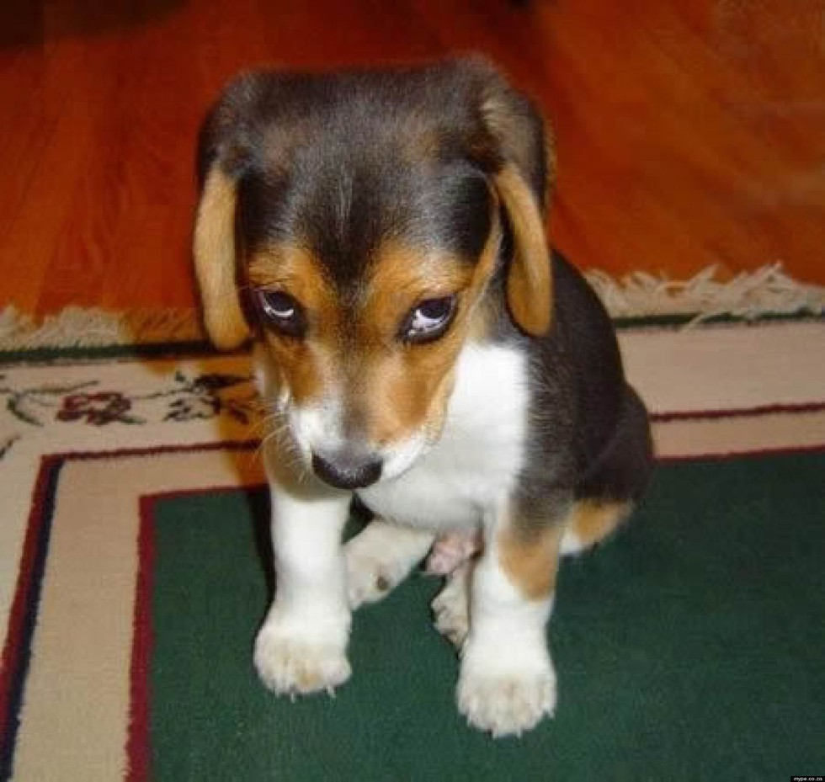
愧疚的良心

Slide 5
创世纪 Genesis 3
⁷ 他们二人的眼睛就明亮了，纔知道自己是赤身露体，便拿无花果树的叶子为自己编作裙子。
⁸ 天起了凉风，耶和华 神在园中行走。那人和他妻子听见 神的声音，就藏在园里的树木中，躲避耶和华 神的面。
⁷ And the eyes of them both were opened, and they knew that they were naked; and they sewed fig leaves together, and made themselves aprons.
⁸ And they heard the voice of the LORD God walking in the garden in the cool of the day: and Adam and his wife hid themselves from the presence of the LORD God amongst the trees of the garden.

Slide 6
创世纪 Genesis 4
¹⁵ 耶和华对他说：凡杀该隐的，必遭报七倍。耶和华就给该隐立一个记号，免得人遇见他就杀他。
¹⁶ 于是该隐离开耶和华的面，去住在伊甸东边挪得之地。
¹⁵ And the LORD said unto him, Therefore whosoever slayeth Cain, vengeance shall be taken on him sevenfold. And the LORD set a mark upon Cain, lest any finding him should kill him.
¹⁶ And Cain went out from the presence of the LORD, and dwelt in the land of Nod, on the east of Eden.

Slide 7
出埃及记 Exodus 20
¹⁸ 众百姓见雷轰、闪电、角声、山上冒烟，就都发颤，远远的站立，
¹⁹ 对摩西说：求你和我们说话，我们必听；不要 神和我们说话，恐怕我们死亡。
¹⁸ And all the people saw the thunderings, and the lightnings, and the noise of the trumpet, and the mountain smoking: and when the people saw it, they removed, and stood afar off.
¹⁹ And they said unto Moses, Speak thou with us, and we will hear: but let not God speak with us, lest we die.

Slide 8
诗篇 Psalms 51
³ 因为，我知道我的过犯；我的罪常在我面前。⁴ 我向你犯罪，惟独得罪了你；在你眼前行了这恶，以致你责备我的时候显为公义，判断我的时候显为清正。⁵ 我是在罪孽里生的，在我母亲怀胎的时候就有了罪。
³ For I acknowledge my transgressions: and my sin is ever before me. ⁴ Against thee, thee only, have I sinned, and done this evil in thy sight: that thou mightest be justified when thou speakest, and be clear when thou judgest.
⁵ Behold, I was shapen in iniquity; and in sin did my mother conceive me.

Slide 9
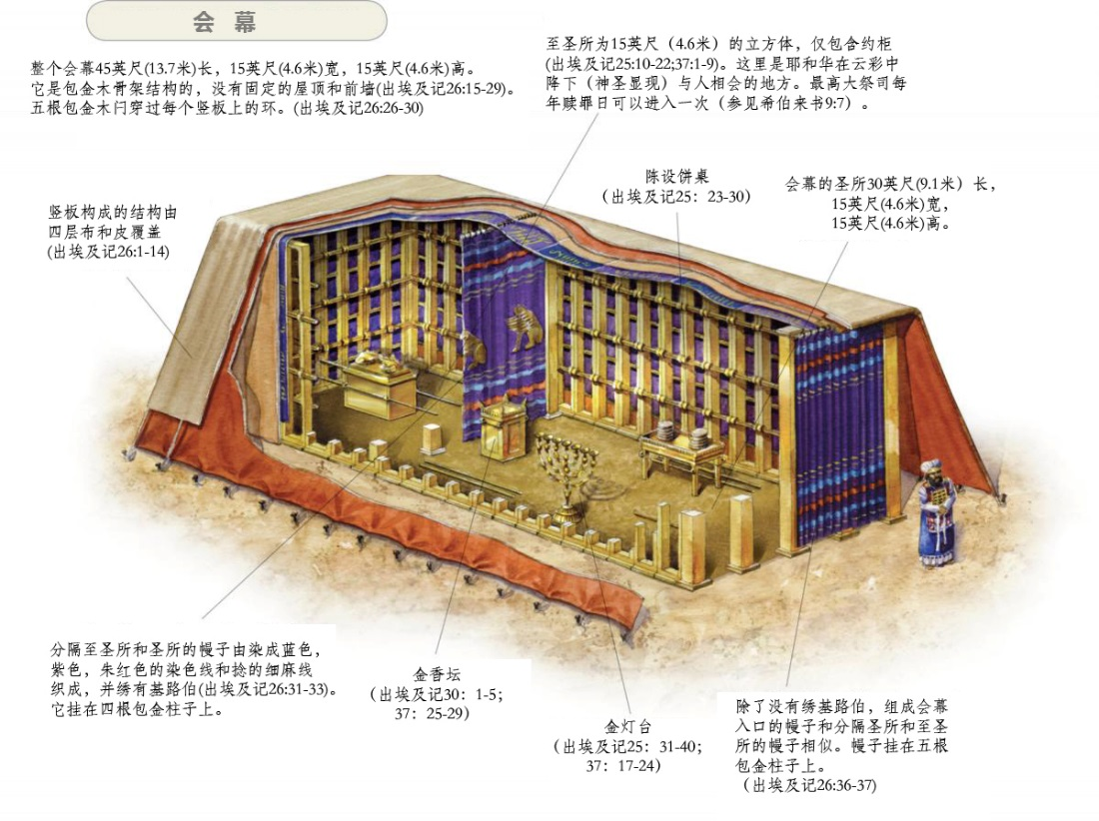

Slide 10
希伯来书 Hebrews 9
⁶ 这些物件既如此预备齐了，众祭司就常进头一层帐幕，行拜神的礼。
⁷ 至于第二层帐幕，唯有大祭司一年一次独自进去，没有不带着血为自己和百姓的过错献上。
⁶ Now when these things were thus ordained, the priests went always into the first tabernacle, accomplishing the service of God.
⁷ But into the second went the high priest alone once every year, not without blood, which he offered for himself, and for the errors of the people:

Slide 11
希伯来书 Hebrews 9
⁸ 圣灵用此指明，头一层帐幕仍存的时候，进入至圣所的路还未显明。
⁹ 那头一层帐幕作现今的一个表样，所献的礼物和祭物，就着良心说，都不能叫礼拜的人得以完全。
⁸ The Holy Ghost this signifying, that the way into the holiest of all was not yet made manifest, while as the first tabernacle was yet standing:
⁹ Which was a figure for the time then present, in which were offered both gifts and sacrifices, that could not make him that did the service perfect, as pertaining to the conscience;

Slide 12
为什么罪人不可以“到神面前”？

Slide 13
以斯拉记 Ezra 9
¹⁵ 耶和华以色列的 神啊，因你是公义的，我们这剩下的人纔得逃脱，正如今日的光景。看哪，我们在你面前有罪恶，因此无人在你面前站立得住。
¹⁵ O LORD God of Israel, thou art righteous: for we remain yet escaped, as it is this day: behold, we are before thee in our trespasses: for we cannot stand before thee because of this.

Slide 14
约翰一书 1 John 3
² 亲爱的弟兄阿，我们现在是神的儿女，将来如何，还未显明；但我们知道，主若显现，我们必要象他、因为必得见他的真体。³ 凡向他有这指望的，就洁净自己，象他洁净一样。
² Beloved, now are we the sons of God, and it doth not yet appear what we shall be: but we know that, when he shall appear, we shall be like him; for we shall see him as he is. ³ And every man that hath this hope in him purifieth himself, even as he is pure.

Slide 15
希伯来书 Hebrews 12
²⁶ 当时他的声音震动了地，但如今他应许说：再一次我不单要震动地，还要震动天。²⁷ 这再一次的话，是指明被震动的，就是受造之物都要挪去，使那不被震动的常存。²⁸ 所以我们既得了不能震动的国，就当感恩，照神所喜悦的，用虔诚、敬畏的心事奉神。²⁹ 因为我们的神乃是烈火。
²⁶ Whose voice then shook the earth: but now he hath promised, saying, Yet once more I shake not the earth only, but also heaven. ²⁷ And this word, Yet once more, signifieth the removing of those things that are shaken, as of things that are made, that those things which cannot be shaken may remain. ²⁸ Wherefore we receiving a kingdom which cannot be moved, let us have grace, whereby we may serve God acceptably with reverence and godly fear: ²⁹ For our God is a consuming fire.

Slide 16
罪恶感
从何而来？

Slide 17
罗马书 Romans 3
¹⁹ 我们晓得律法上的话都是对律法以下之人说的，好塞住各人的口，叫普世的人都伏在神审判之下。
²⁰ 所以凡有血气的，没有一个因行律法能在神面前称义，因为律法本是叫人知罪。
¹⁹ Now we know that what things soever the law saith, it saith to them who are under the law: that every mouth may be stopped, and all the world may become guilty before God.
²⁰ Therefore by the deeds of the law there shall no flesh be justified in his sight: for by the law is the knowledge of sin.

Slide 18
罗马书 Romans 2
¹³ （原来在神面前，不是听律法的为义，乃是行律法的称义。¹⁴ 没有律法的外邦人若顺着本性行律法上的事，他们虽然没有律法，自己就是自己的律法。
¹⁵ 这是显出律法的功用刻在他们心里，他们是非之心同作见證，并且他们的思念互相较量，或以为是，或以为非。）
¹³ (For not the hearers of the law are just before God, but the doers of the law shall be justified.¹⁴ For when the Gentiles, which have not the law, do by nature the things contained in the law, these, having not the law, are a law unto themselves: ¹⁵ Which shew the work of the law written in their hearts, their conscience also bearing witness, and their thoughts the mean while accusing or else excusing one another;)

Slide 19
律法或良心
的功用

Slide 20
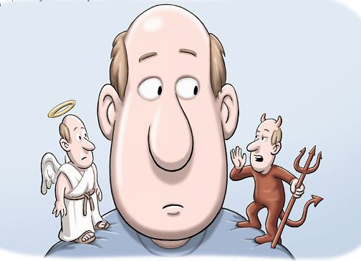
良心

Slide 21
功用1: 为罪人设定界限
加 3:23 但这因信得救的理还未来以先，我们被看守在律法之下，直圈到那将来的真道显明出来。
Gal 3:23 But before faith came, we were kept under the law, shut up unto the faith which should afterwards be revealed.

Slide 22
功用2: 定罪人的罪
罗 2:12 凡没有律法犯了罪的，也必不按律法灭亡；凡在律法以下犯了罪的，也必按律法受审判。
Romans 2:12 For as many as have sinned without law shall also perish without law: and as many as have sinned in the law shall be judged by the law;

Slide 23
功用2: 定罪人的罪
加 3:10 凡以行律法为本的，都是被咒诅的；因为经上记着：凡不常照律法书上所记一切之事去行的，就被咒诅。
Gal 3:10 For as many as are of the works of the law are under the curse: for it is written, Cursed is every one that continueth not in all things which are written in the book of the law to do them.

Slide 24
功用3: 赋予罪能力胜过人
林前 15:55-56 死阿！你得胜的权势在那里？死阿！你的毒钩在那里？ 死的毒钩就是罪，罪的权势就是律法。
1 Corinthians 15:55-56 O death, where is thy sting? O grave, where is thy victory? The sting of death is sin; and the strength of sin is the law.

Slide 25
罗马书 Romans 7
⁵ 因为我们属肉体的时候，那因律法而生的恶慾就在我们肢体中发动，以致结成死亡的果子。
⁶ 但我们既然在捆我们的律法上死了，现今就脱离了律法，叫我们服事主，要按着心灵（心灵：或作圣灵）的新样，不按着仪文的旧样。
⁵ For when we were in the flesh, the motions of sins, which were by the law, did work in our members to bring forth fruit unto death.¹
⁶ But now we are delivered from the law, that being dead wherein we were held; that we should serve in newness of spirit, and not in the oldness of the letter.

Slide 26
罗马书 Romans 7
⁷ 这样，我们可说甚么呢？律法是罪么？断乎不是！只是非因律法，我就不知何为罪。非律法说不可起贪心，我就不知何为贪心。
⁸ 然而罪趁着机会，就藉着诫命叫诸般的贪心在我里头发动；因为没有律法，罪是死的。
⁷ What shall we say then? Is the law sin? God forbid. Nay, I had not known sin, but by the law: for I had not known lust, except the law had said, Thou shalt not covet.³
⁸ But sin, taking occasion by the commandment, wrought in me all manner of concupiscence. For without the law sin was dead.

Slide 27
罗马书 Romans 7
⁹ 我以前没有律法是活着的；但是诫命来到，罪又活了，我就死了。¹⁰ 那本来叫人活的诫命，反倒叫我死；¹¹ 因为罪趁着机会，就藉着诫命引诱我，并且杀了我。¹² 这样看来，律法是圣洁的，诫命也是圣洁、公义、良善的。
⁹ For I was alive without the law once: but when the commandment came, sin revived, and I died.
¹⁰ And the commandment, which was ordained to life, I found to be unto death. ¹¹ For sin, taking occasion by the commandment, deceived me, and by it slew me. ¹² Wherefore the law is holy, and the commandment holy, and just, and good.

Slide 28
罗马书 Romans 7
¹³ 既然如此，那良善的是叫我死么？断乎不是！叫我死的乃是罪。但罪藉着那良善的叫我死，就显出真是罪，叫罪因着诫命更显出是恶极了。
¹⁴ 我们原晓得律法是属乎灵的，但我是属乎肉体的，是已经卖给罪了。
¹³ Was then that which is good made death unto me? God forbid. But sin, that it might appear sin, working death in me by that which is good; that sin by the commandment might become exceeding sinful.
¹⁴ For we know that the law is spiritual: but I am carnal, sold under sin.

Slide 29
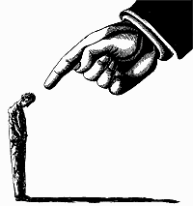
愧疚的良心

Slide 30
功用4: 预备人心接受恩典…
加 3:24 这样，律法是我们训蒙的师傅，引我们到基督那里，使我们因信称义。
Gal 3:24 Wherefore the law was our schoolmaster to bring us unto Christ, that we might be justified by faith.

Slide 31
出埃及记 Exodus 33
¹⁸ 摩西说：求你显出你的荣耀给我看。¹⁹ 耶和华说：我要显我一切的恩慈，在你面前经过，宣告我的名。我要恩待谁就恩待谁；要怜悯谁就怜悯谁；²⁰ 又说：你不能看见我的面，因为人见我的面不能存活。
¹⁸ And he said, I beseech thee, shew me thy glory.
¹⁹ And he said, I will make all my goodness pass before thee, and I will proclaim the name of the LORD before thee; and will be gracious to whom I will be gracious, and will shew mercy on whom I will shew mercy. ²⁰ And he said, Thou canst not see my face: for there shall no man see me, and live.

Slide 32
出埃及记 Exodus 33
²¹ 耶和华说：看哪，在我这里有地方，你要站在磐石上。²² 我的荣耀经过的时候，我必将你放在磐石穴中，用我的手遮掩你，等我过去，²³ 然后我要将我的手收回，你就得见我的背，却不得见我的面。
²¹ And the LORD said, Behold, there is a place by me, and thou shalt stand upon a rock: ²² And it shall come to pass, while my glory passeth by, that I will put thee in a clift of the rock, and will cover thee with my hand while I pass by: ²³ And I will take away mine hand, and thou shalt see my back parts: but my face shall not be seen.

