Slide 1
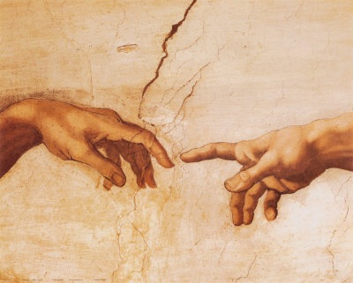
到神面前来
（2）

Slide 2
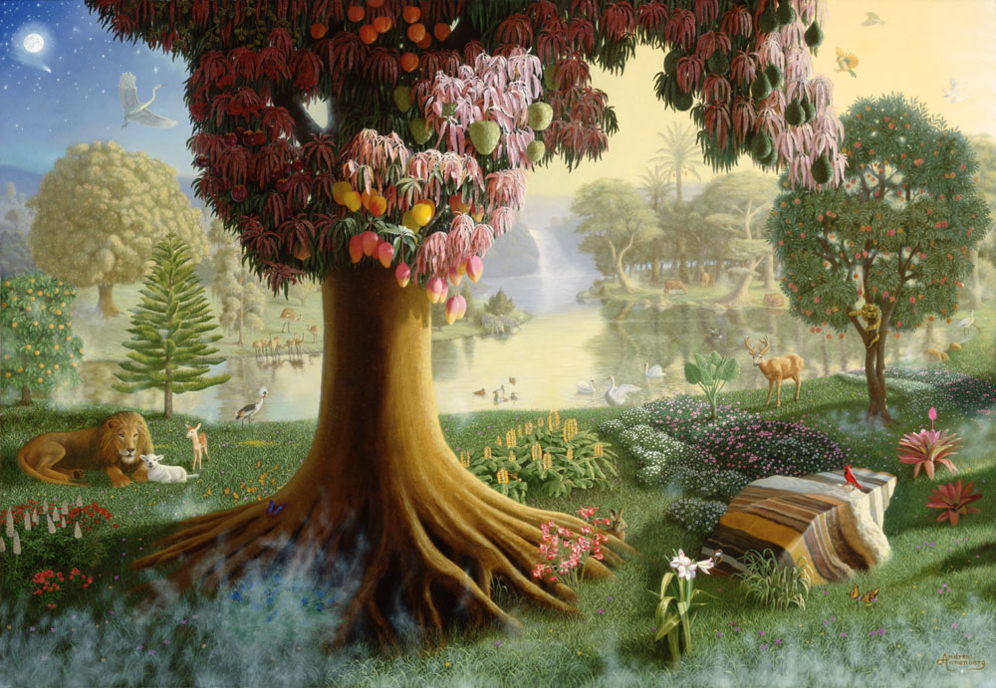
神的同在 ➔
满足的内心
无缺乏的环境

Slide 3
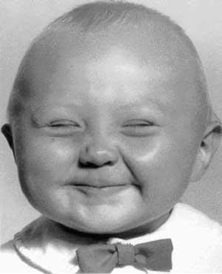
内心的重要性
???

Slide 4
愧疚的良心

Slide 5
这位神是
什么样的神？

Slide 6
神是自有永有的
出 3:13-14 摩西对 神说：我到以色列人那里，对他们说：你们祖宗的 神打发我到你们这里来。他们若问我说：他叫甚么名字？我要对他们说甚么呢？ 神对摩西说：我是自有永有的 （I AM THAT I AM）；又说：你要对以色列人这样说：那自有的（ I AM ）打发我到你们这里来。

Slide 7
神就是爱
约一 4:16 神爱我们的心，我们也知道也信。神就是爱；住在爱里面的，就是住在神里面，神也住在他里面。
And we have known and believed the love that God hath to us. God is love; and he that dwelleth in love dwelleth in God, and God in him.

Slide 8
使徒行传 Acts 17
²⁴ 创造宇宙和其中万物的神，既是天地的主，就不住人手所造的殿，
²⁵ 也不用人手服事，好象缺少甚么；自己倒将生命、气息、万物，赐给万人。
²⁴ God that made the world and all things therein, seeing that he is Lord of heaven and earth, dwelleth not in temples made with hands; ²⁵ Neither is worshipped with men's hands, as though he needed any thing, seeing he giveth to all life, and breath, and all things;

Slide 9
雅各书 James 1
¹⁶ 我亲爱的弟兄们，不要看错了。
¹⁷ 各样美善的恩赐和各样全备的赏赐都是从上头来的，从众光之父那里降下来的；在他并没有改变，也没有转动的影儿。
¹⁶ Do not err, my beloved brethren.
¹⁷ Every good gift and every perfect gift is from above, and cometh down from the Father of lights, with whom is no variableness, neither shadow of turning.

Slide 10
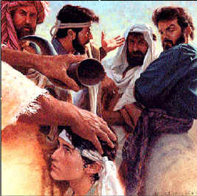
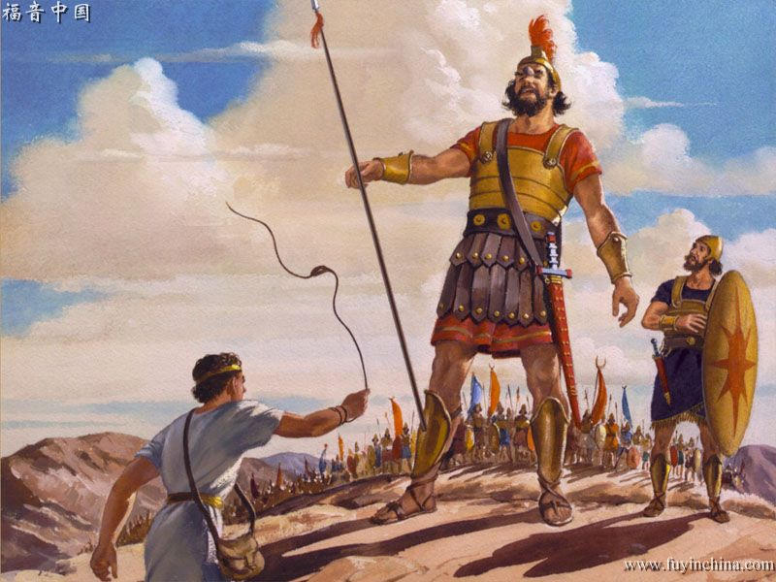
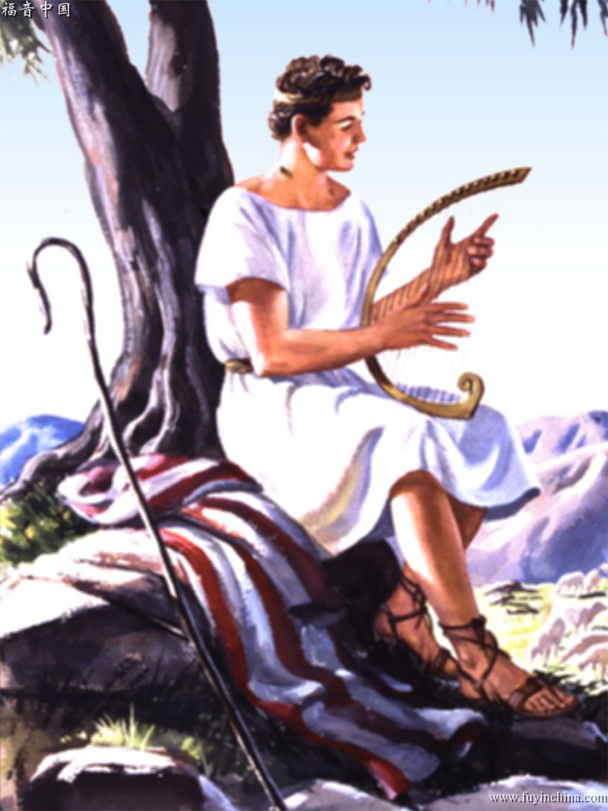
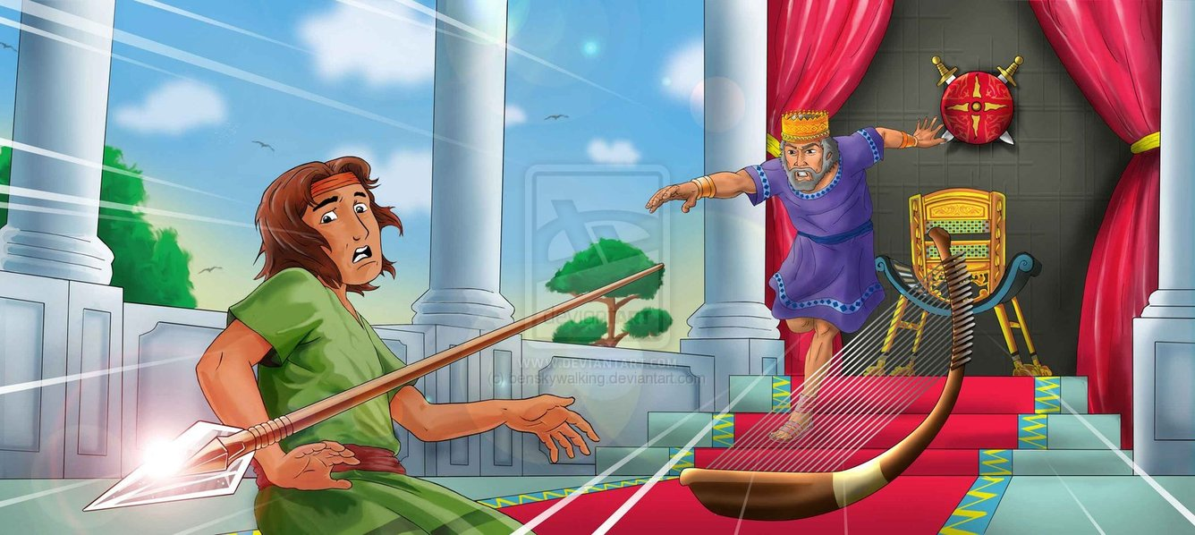

Slide 11
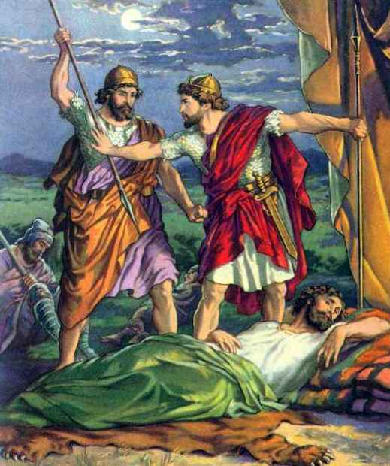
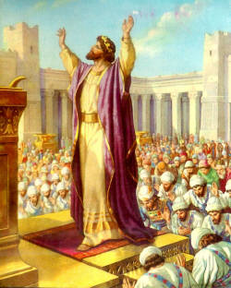
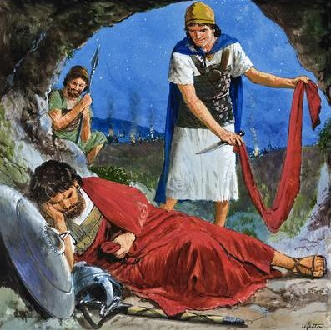
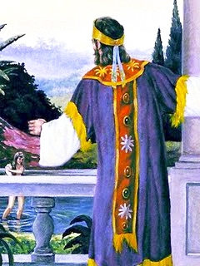
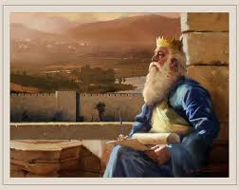

Slide 12
诗篇 Psalms 16
¹ （大卫的金诗） 神啊，求你保佑我，因为我投靠你。² 我的心哪，你曾对耶和华说：你是我的主；我的好处不在你以外。³ 论到世上的圣民，他们又美又善，是我最喜悦的。
¹ Michtam of David. Preserve me, O God: for in thee do I put my trust. ² O my soul, thou hast said unto the LORD, Thou art my Lord: my goodness extendeth not to thee; ³ But to the saints that are in the earth, and to the excellent, in whom is all my delight.

Slide 13
诗篇 Psalms 16
⁴ 以别 神代替耶和华的，他们的愁苦必加增；他们所浇奠的血我不献上；我嘴唇也不题别 神的名号。⁵ 耶和华是我的产业，是我杯中的分；我所得的，你为我持守。⁶ 用绳量给我的地界，坐落在佳美之处；我的产业实在美好。
⁴ Their sorrows shall be multiplied that hasten after another god: their drink offerings of blood will I not offer, nor take up their names into my lips. ⁵ The LORD is the portion of mine inheritance and of my cup: thou maintainest my lot. ⁶ The lines are fallen unto me in pleasant places; yea, I have a goodly heritage.

Slide 14
诗篇 Psalms 16
⁷ 我必称颂那指教我的耶和华；我的心肠在夜间也警戒我。⁸ 我将耶和华常摆在我面前，因他在我右边，我便不至摇动。⁹ 因此，我的心欢喜，我的灵（原文是荣耀）快乐；我的肉身也要安然居住。
⁷ I will bless the LORD, who hath given me counsel: my reins also instruct me in the night seasons. ⁸ I have set the LORD always before me: because he is at my right hand, I shall not be moved. ⁹ Therefore my heart is glad, and my glory rejoiceth: my flesh also shall rest in hope.

Slide 15
诗篇 Psalms 16
¹⁰ 因为你必不将我的灵魂撇在阴间，也不叫你的圣者见朽坏。¹¹ 你必将生命的道路指示我。在你面前有满足的喜乐；在你右手中有永远的福乐。
¹⁰ For thou wilt not leave my soul in hell; neither wilt thou suffer thine Holy One to see corruption. ¹¹ Thou wilt shew me the path of life: in thy presence is fulness of joy; at thy right hand there are pleasures for evermore.

Slide 16
诗篇 Psalms 23
¹ （大卫的诗。）耶和华是我的牧者，我必不至缺乏。
² 他使我躺卧在青草地上，领我在可安歇的水边。
¹ A Psalm of David. The LORD is my shepherd; I shall not want.
² He maketh me to lie down in green pastures: he leadeth me beside the still waters.

Slide 17
诗篇 Psalms 23
³ 他使我的灵魂甦醒，为自己的名引导我走义路。⁴ 我虽然行过死荫的幽谷，也不怕遭害，因为你与我同在；你的杖，你的竿，都安慰我。
³ He restoreth my soul: he leadeth me in the paths of righteousness for his name's sake. ⁴ Yea, though I walk through the valley of the shadow of death, I will fear no evil: for thou art with me; thy rod and thy staff they comfort me.

Slide 18
诗篇 Psalms 23
⁵ 在我敌人面前，你为我摆设筵席；你用油膏了我的头，使我的福杯满溢。
⁶ 我一生一世必有恩惠慈爱随着我；我且要住在耶和华的殿中，直到永远。
⁵ Thou preparest a table before me in the presence of mine enemies: thou anointest my head with oil; my cup runneth over. ⁶ Surely goodness and mercy shall follow me all the days of my life: and I will dwell in the house of the LORD for ever.

Slide 19
诗篇 Psalms 37
¹ （大卫的诗。）不要为作恶的心怀不平，也不要向那行不义的生出嫉妒。² 因为他们如草快被割下，又如青菜快要枯乾。³ 你当倚靠耶和华而行善，住在地上，以他的信实为粮；
¹ A Psalm of David. Fret not thyself because of evildoers, neither be thou envious against the workers of iniquity. ² For they shall soon be cut down like the grass, and wither as the green herb. ³ Trust in the LORD, and do good; so shalt thou dwell in the land, and verily thou shalt be fed.

Slide 20
诗篇 Psalms 37
⁴ 又要以耶和华为乐，他就将你心里所求的赐给你。⁵ 当将你的事交託耶和华，并倚靠他，他就必成全。⁶ 他要使你的公义如光发出，使你的公平明如正午。
⁴ Delight thyself also in the LORD; and he shall give thee the desires of thine heart. ⁵ Commit thy way unto the LORD; trust also in him; and he shall bring it to pass. ⁶ And he shall bring forth thy righteousness as the light, and thy judgment as the noonday.

Slide 21
诗篇 Psalms 37
⁷ 你当默然倚靠耶和华，耐性等候他；不要因那道路通达的和那恶谋成就的心怀不平。
⁸ 当止住怒气，离弃忿怒；不要心怀不平，以致作恶。⁹ 因为作恶的必被剪除；唯有等候耶和华的必承受地土。
⁷ Rest in the LORD, and wait patiently for him: fret not thyself because of him who prospereth in his way, because of the man who bringeth wicked devices to pass. ⁸ Cease from anger, and forsake wrath: fret not thyself in any wise to do evil. ⁹ For evildoers shall be cut off: but those that wait upon the LORD, they shall inherit the earth.

Slide 22
诗篇 Psalms 51
¹ （大卫与拔示巴同室以后，先知拿单来见他；他作这诗，交与伶长。） 神啊，求你按你的慈爱怜恤我！按你丰盛的慈悲涂抹我的过犯！² 求你将我的罪孽洗除净尽，并洁除我的罪！
¹ To the chief Musician, A Psalm of David, when Nathan the prophet came unto him, after he had gone in to Bathsheba. Have mercy upon me, O God, according to thy lovingkindness: according unto the multitude of thy tender mercies blot out my transgressions. ² Wash me throughly from mine iniquity, and cleanse me from my sin.

Slide 23
诗篇 Psalms 51
³ 因为，我知道我的过犯；我的罪常在我面前。⁴ 我向你犯罪，惟独得罪了你；在你眼前行了这恶，以致你责备我的时候显为公义，判断我的时候显为清正。⁵ 我是在罪孽里生的，在我母亲怀胎的时候就有了罪。
³ For I acknowledge my transgressions: and my sin is ever before me. ⁴ Against thee, thee only, have I sinned, and done this evil in thy sight: that thou mightest be justified when thou speakest, and be clear when thou judgest.
⁵ Behold, I was shapen in iniquity; and in sin did my mother conceive me.

Slide 24
诗篇 Psalms 51
⁶ 你所喜爱的是内里诚实；你在我隐密处，必使我得智慧。⁷ 求你用牛膝草洁净我，我就乾净；求你洗涤我，我就比雪更白。⁸ 求你使我得听欢喜快乐的声音，使你所压伤的骨头可以踊跃。
⁶ Behold, thou desirest truth in the inward parts: and in the hidden part thou shalt make me to know wisdom. ⁷ Purge me with hyssop, and I shall be clean: wash me, and I shall be whiter than snow. ⁸ Make me to hear joy and gladness; that the bones which thou hast broken may rejoice.

Slide 25
诗篇 Psalms 51
⁹ 求你掩面不看我的罪，涂抹我一切的罪孽。
¹⁰ 神啊，求你为我造清洁的心，使我里面重新有正直（或译：坚定）的灵。
¹¹ 不要丢弃我，使我离开你的面；不要从我收回你的圣灵。
⁹ Hide thy face from my sins, and blot out all mine iniquities. ¹⁰ Create in me a clean heart, O God; and renew a right spirit within me. ¹¹ Cast me not away from thy presence; and take not thy holy spirit from me.

Slide 26
诗篇 Psalms 51
¹² 求你使我仍得救恩之乐，赐我乐意的灵扶持我，¹³ 我就把你的道指教有过犯的人，罪人必归顺你。¹⁴ 神啊，你是拯救我的 神；求你救我脱离流人血的罪！我的舌头就高声歌唱你的公义。
¹² Restore unto me the joy of thy salvation; and uphold me with thy free spirit. ¹³ Then will I teach transgressors thy ways; and sinners shall be converted unto thee. ¹⁴ Deliver me from bloodguiltiness, O God, thou God of my salvation: and my tongue shall sing aloud of thy righteousness.

