Slide 1
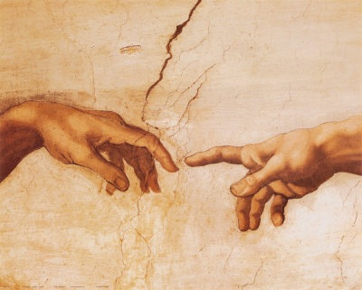
到神面前来
（1）

Slide 2
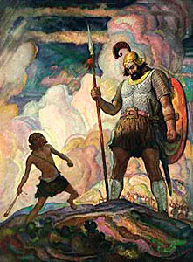
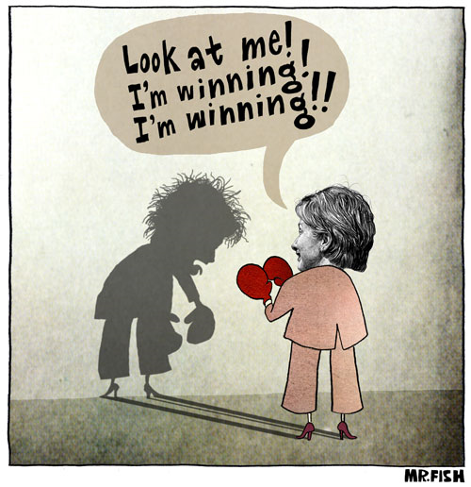
人（我）的問題？

Slide 3
更深的问题
是什么？

Slide 4
以弗所书 Ephesians 4
¹⁷ 所以我说，且在主里确实的说，你们行事不要再象外邦人存虚妄的心行事。¹⁸ 他们心地昏昧，与神所赐的生命隔绝了，都因自己无知，心里刚硬；¹⁹ 良心既然丧尽，就放纵私慾，贪行种种的污秽。
¹⁷ This I say therefore, and testify in the Lord, that ye henceforth walk not as other Gentiles walk, in the vanity of their mind, ¹⁸ Having the understanding darkened, being alienated from the life of God through the ignorance that is in them, because of the blindness of their heart: ¹⁹ Who being past feeling have given themselves over unto lasciviousness, to work all uncleanness with greediness.

Slide 5
内心的重要性
???

Slide 6
以弗所书 Ephesians 4
¹⁷ 所以我说，且在主里确实的说，你们行事不要再象外邦人存虚妄的心行事。¹⁸ 他们心地昏昧，与神所赐的生命隔绝了，都因自己无知，心里刚硬；¹⁹ 良心既然丧尽，就放纵私慾，贪行种种的污秽。
¹⁷ This I say therefore, and testify in the Lord, that ye henceforth walk not as other Gentiles walk, in the vanity of their mind (nous), ¹⁸ Having the understanding (dianoia) darkened, being alienated from the life of God through the ignorance that is in them, because of the blindness of their heart: ¹⁹ Who being past feeling have given themselves over unto lasciviousness, to work all uncleanness with greediness.

Slide 7
罗马书 Romans 1
²⁰ 自从造天地以来，神的永能和神性是明明可知的，虽是眼不能见，但藉着所造之物就可以晓得，叫人无可推诿。²¹ 因为，他们虽然知道神，却不当作神荣耀他，也不感谢他。他们的思念变为虚妄，无知的心就昏暗了。
²⁰ For the invisible things of him from the creation of the world are clearly seen, being understood by the things that are made, even his eternal power and Godhead; so that they are without excuse: ²¹ Because that, when they knew God, they glorified him not as God, neither were thankful; but became vain in their imaginations (reasoning), and their foolish heart was darkened.

Slide 8
罗马书 Romans 1
²² 自称为聪明，反成了愚拙，
²³ 将不能朽坏之神的荣耀变为偶象，彷彿必朽坏的人和飞禽、走兽、昆虫的样式。
²² Professing themselves to be wise, they became fools,
²³ And changed the glory of the uncorruptible God into an image made like to corruptible man, and to birds, and fourfooted beasts, and creeping things.

Slide 9
罗马书 Romans 1
²⁴ 所以，神任凭他们逞着心里的情慾行污秽的事，以致彼此玷辱自己的身体。²⁵ 他们将神的真实变为虚谎，去敬拜事奉受造之物，不敬奉那造物的主；主乃是可称颂的，直到永远。阿们！
²⁴ Wherefore God also gave them up to uncleanness through the lusts of their own hearts, to dishonour their own bodies between themselves: ²⁵ Who changed the truth of God into a lie, and worshipped and served the creature more than the Creator, who is blessed for ever. Amen.

Slide 10
私欲 （情欲）
= lust(s)
= a longing, especially for what is forbidden （Strong’s Dictionary)
= （对被禁止的东西的一个）渴求

Slide 11
私欲（lust）：
因相信（内心里看）
自己缺乏
而产生的渴求

Slide 12
我们是如何与神隔绝的？

Slide 13
圣经怎么说？

Slide 14
以赛亚书 Isaiah 59
¹ 耶和华的膀臂并非缩短，不能拯救，耳朵并非发沉，不能听见，² 但你们的罪孽使你们与 神隔绝；你们的罪恶使他掩面不听你们。³ 因你们的手被血沾染，你们的指头被罪孽沾污，你们的嘴唇说谎言，你们的舌头出恶语。
¹ Behold, the LORD'S hand is not shortened, that it cannot save; neither his ear heavy, that it cannot hear: ² But your iniquities have separated between you and your God, and your sins have hid his face from you, that he will not hear. ³ For your hands are defiled with blood, and your fingers with iniquity; your lips have spoken lies, your tongue hath muttered perverseness.

Slide 15
以赛亚书 Isaiah 59
⁴ 无一人按公义告状，无一人凭诚实辨白；都倚靠虚妄，说谎言。所怀的是毒害；所生的是罪孽。
⁵ 他们菢毒蛇蛋，结蜘蛛网；人吃这蛋必死。这蛋被踏，必出蝮蛇。
⁴ None calleth for justice, nor any pleadeth for truth: they trust in vanity, and speak lies; they conceive mischief, and bring forth iniquity.
⁵ They hatch cockatrice' eggs, and weave the spider's web: he that eateth of their eggs dieth, and that which is crushed breaketh out into a viper.

Slide 16
以赛亚书 Isaiah 59
⁶ 所结的网不能成为衣服；所做的也不能遮盖自己。他们的行为都是罪孽；手所做的都是强暴。
⁷ 他们的脚奔跑行恶；他们急速流无辜人的血；意念都是罪孽，所经过的路都荒凉毁灭。
⁶ Their webs shall not become garments, neither shall they cover themselves with their works: their works are works of iniquity, and the act of violence is in their hands.
⁷ Their feet run to evil, and they make haste to shed innocent blood: their thoughts are thoughts of iniquity; wasting and destruction are in their paths.

Slide 17
以赛亚书 Isaiah 59
⁸ 平安的路，他们不知道；所行的事没有公平。他们为自己修弯曲的路；凡行此路的都不知道平安。
⁹ 因此，公平离我们远，公义追不上我们。我们指望光亮，却是黑暗，指望光明，却行幽暗。
⁸ The way of peace they know not; and there is no judgment in their goings: they have made them crooked paths: whosoever goeth therein shall not know peace.
⁹ Therefore is judgment far from us, neither doth justice overtake us: we wait for light, but behold obscurity; for brightness, but we walk in darkness.

Slide 18
以赛亚书 Isaiah 59
¹⁰ 我们摸索墙壁，好象瞎子；我们摸索，如同无目之人。我们晌午绊脚，如在黄昏一样；我们在肥壮人中，象死人一般。
¹¹ 我们咆哮如熊，哀鸣如鸽；指望公平，却是没有；指望救恩，却远离我们。
¹⁰ We grope for the wall like the blind, and we grope as if we had no eyes: we stumble at noonday as in the night; we are in desolate places as dead men.
¹¹ We roar all like bears, and mourn sore like doves: we look for judgment, but there is none; for salvation, but it is far off from us.

Slide 19
以赛亚书 Isaiah 59
¹² 我们的过犯在你面前增多，罪恶作见證告我们；过犯与我们同在。至于我们的罪孽，我们都知道：
¹³ 就是悖逆、不认识耶和华，转去不跟从我们的 神，说欺压和叛逆的话，心怀谎言，随即说出。
¹² For our transgressions are multiplied before thee, and our sins testify against us: for our transgressions are with us; and as for our iniquities, we know them;
¹³ In transgressing and lying against the LORD, and departing away from our God, speaking oppression and revolt, conceiving and uttering from the heart words of falsehood.

Slide 20
再仔细读一读

Slide 21
以赛亚书 Isaiah 59
¹² 我们的过犯在你面前增多，罪恶作见證告我们；过犯与我们同在。至于我们的罪孽，我们都知道：
¹³ 就是悖逆、不认识耶和华，转去不跟从我们的 神，说欺压和叛逆的话，心怀谎言，随即说出。
¹² For our transgressions are multiplied before thee, and our sins testify against us: for our transgressions are with us; and as for our iniquities, we know them;
¹³ In transgressing and lying against the LORD, and departing away from our God, speaking oppression and revolt, conceiving and uttering from the heart words of falsehood.

Slide 22
人什么时候
离开神的？

Slide 23
创世纪 Genesis 2
¹⁵ 耶和华 神将那人安置在伊甸园，使他修理，看守。¹⁶ 耶和华 神吩咐他说：园中各样树上的果子，你可以随意吃，¹⁷ 只是分别善恶树上的果子，你不可吃，因为你吃的日子必定死！
¹⁵ And the LORD God took the man, and put him into the garden of Eden to dress it and to keep it.
¹⁶ And the LORD God commanded the man, saying, Of every tree of the garden thou mayest freely eat:
¹⁷ But of the tree of the knowledge of good and evil, thou shalt not eat of it: for in the day that thou eatest thereof thou shalt surely die.

Slide 24
创世纪 Genesis 3
⁴ 蛇对女人说：你们不一定死；
⁵ 因为 神知道，你们吃的日子眼睛就明亮了，你们便如神能知道善恶。
⁴ And the serpent said unto the woman, Ye shall not surely die:
⁵ For God doth know that in the day ye eat thereof, then your eyes shall be opened, and ye shall be as gods, knowing good and evil.

Slide 25
创世纪 Genesis 3
¹⁷ 又对亚当说：你既听从妻子的话，吃了我所吩咐你不可吃的那树上的果子，地必为你的缘故受咒诅；你必终身劳苦纔能从地里得吃的。
¹⁸ 地必给你长出荆棘和蒺藜来；你也要吃田间的菜蔬。
¹⁷ And unto Adam he said, Because thou hast hearkened unto the voice of thy wife, and hast eaten of the tree, of which I commanded thee, saying, Thou shalt not eat of it: cursed is the ground for thy sake; in sorrow shalt thou eat of it all the days of thy life;
¹⁸ Thorns also and thistles shall it bring forth to thee; and thou shalt eat the herb of the field;

Slide 26
创世纪 Genesis 3
¹⁹ 你必汗流满面纔得糊口，直到你归了土，因为你是从土而出的。你本是尘土，仍要归于尘土。
²⁰ 亚当给他妻子起名叫夏娃，因为他是众生之母。²¹ 耶和华 神为亚当和他妻子用皮子作衣服给他们穿。
¹⁹ In the sweat of thy face shalt thou eat bread, till thou return unto the ground; for out of it wast thou taken: for dust thou art, and unto dust shalt thou return.
²⁰ And Adam called his wife‘s name Eve; because she was the mother of all living.
²¹ Unto Adam also and to his wife did the LORD God make coats of skins, and clothed them.

Slide 27
创世纪 Genesis 3
²² 耶和华 神说：那人已经与我们相似，能知道善恶；现在恐怕他伸手又摘生命树的果子吃，就永远活着。
²³ 耶和华 神便打发他出伊甸园去，耕种他所自出之土。
²² And the LORD God said, Behold, the man is become as one of us, to know good and evil: and now, lest he put forth his hand, and take also of the tree of life, and eat, and live for ever:
²³ Therefore the LORD God sent him forth from the garden of Eden, to till the ground from whence he was taken.

Slide 28
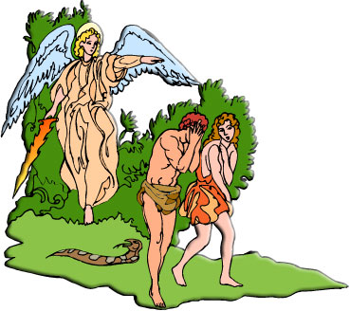
创世纪 Genesis 3
²⁴ 于是把他赶出去了；又在伊甸园的东边安设基路伯和四面转动发火焰的剑，要把守生命树的道路。
²⁴ So he drove out the man; and he placed at the east of the garden of Eden Cherubims, and a flaming sword which turned every way, to keep the way of the tree of life.

Slide 29
是不是神不能与罪人打交道？

Slide 30
创世纪 Genesis 4
¹ 有一日，那人和他妻子夏娃同房，夏娃就怀孕，生了该隐(就是得的意思)，便说：耶和华使我得了一个男子。
² 又生了该隐的兄弟亚伯。亚伯是牧羊的；该隐是种地的。
¹ And Adam knew Eve his wife; and she conceived, and bare Cain, and said, I have gotten a man from the LORD.
² And she again bare his brother Abel. And Abel was a keeper of sheep, but Cain was a tiller of the ground.

Slide 31
创世纪 Genesis 4
³ 有一日，该隐拿地里的出产为供物献给耶和华。⁴ 亚伯也将他羊群中头生的和羊的脂油献上。耶和华看中了亚伯和他的供物，⁵ 只是看不中该隐和他的供物。该隐就大大的发怒，变了脸色。
³ And in process of time it came to pass, that Cain brought of the fruit of the ground an offering unto the LORD. ⁴ And Abel, he also brought of the firstlings of his flock and of the fat thereof. And the LORD had respect unto Abel and to his offering: ⁵ But unto Cain and to his offering he had not respect. And Cain was very wroth, and his countenance fell.

Slide 32
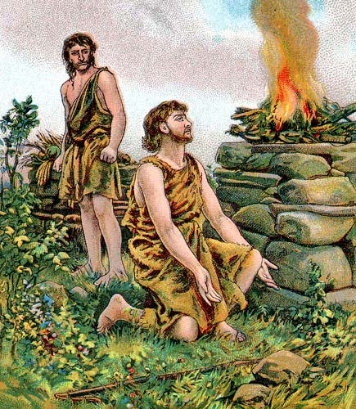
创世纪 Genesis 4
⁶ 耶和华对该隐说：你为甚么发怒呢？你为甚么变了脸色呢？⁷ 你若行得好，岂不蒙悦纳？你若行得不好，罪就伏在门前。它必恋慕你，你却要制伏它。
⁶ And the LORD said unto Cain, Why art thou wroth? and why is thy countenance fallen? ⁷ If thou doest well, shalt thou not be accepted? and if thou doest not well, sin lieth at the door. And unto thee shall be his desire, and thou shalt rule over him.

Slide 33
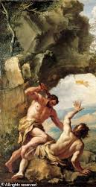
创世纪 Genesis 4
⁸ 该隐与他兄弟亚伯说话；二人正在田间。该隐起来打他兄弟亚伯，把他杀了。⁹ 耶和华对该隐说：你兄弟亚伯在那里？他说：我不知道！我岂是看守我兄弟的么？
⁸ And Cain talked with Abel his brother: and it came to pass, when they were in the field, that Cain rose up against Abel his brother, and slew him. ⁹ And the LORD said unto Cain, Where is Abel thy brother? And he said, I know not: Am I my brother's keeper?

Slide 34
创世纪 Genesis 4
¹⁰ 耶和华说：你作了甚么事呢？你兄弟的血有声音从地里向我哀告。¹¹ 地开了口，从你手里接受你兄弟的血。现在你必从这地受咒诅。¹² 你种地，地不再给你效力；你必流离飘蕩在地上。
¹⁰ And he said, What hast thou done? the voice of thy brother's blood crieth unto me from the ground. ¹¹ And now art thou cursed from the earth, which hath opened her mouth to receive thy brother's blood from thy hand; ¹² When thou tillest the ground, it shall not henceforth yield unto thee her strength; a fugitive and a vagabond shalt thou be in the earth.

Slide 35
创世纪 Genesis 4
¹³ 该隐对耶和华说：我的刑罚太重，过于我所能当的。
¹⁴ 你如今赶逐我离开这地，以致不见你面；我必流离飘蕩在地上，凡遇见我的必杀我。
¹³ And Cain said unto the LORD, My punishment is greater than I can bear.
¹⁴ Behold, thou hast driven me out this day from the face of the earth; and from thy face shall I be hid; and I shall be a fugitive and a vagabond in the earth; and it shall come to pass, that every one that findeth me shall slay me.

Slide 36
创世纪 Genesis 4
¹⁵ 耶和华对他说：凡杀该隐的，必遭报七倍。耶和华就给该隐立一个记号，免得人遇见他就杀他。
¹⁶ 于是该隐离开耶和华的面，去住在伊甸东边挪得之地。
¹⁵ And the LORD said unto him, Therefore whosoever slayeth Cain, vengeance shall be taken on him sevenfold. And the LORD set a mark upon Cain, lest any finding him should kill him.
¹⁶ And Cain went out from the presence of the LORD, and dwelt in the land of Nod, on the east of Eden.

Slide 37
这和我们今天有什么关系？

Slide 38
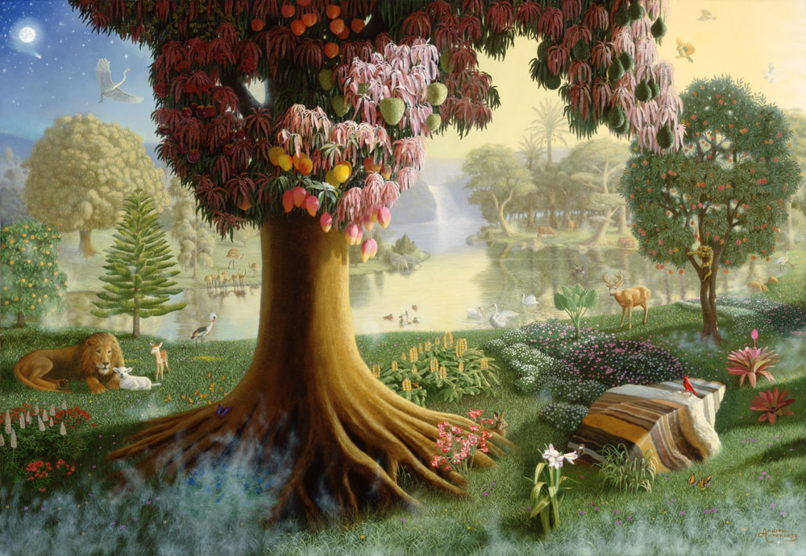
神的同在 ➔
满足的内心
无缺乏的环境

Slide 39
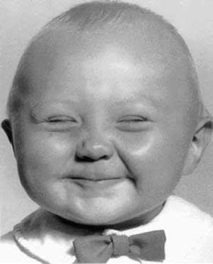
内心的重要性
???

Slide 40
诗篇 Psalms 24
³ 谁能登耶和华的山？谁能站在他的圣所？
⁴ 就是手洁心清、不向虚妄、起誓不怀诡诈的人。
⁵ 他必蒙耶和华赐福，又蒙救他的 神使他成义。
⁶ 这是寻求耶和华的族类，是寻求你面的雅各。
³ Who shall ascend into the hill of the LORD? or who shall stand in his holy place?
⁴ He that hath clean hands, and a pure heart; who hath not lifted up his soul unto vanity, nor sworn deceitfully. ⁵ He shall receive the blessing from the LORD, and righteousness from the God of his salvation. ⁶ This is the generation of them that seek him, that seek thy face, O Jacob.

Slide 41
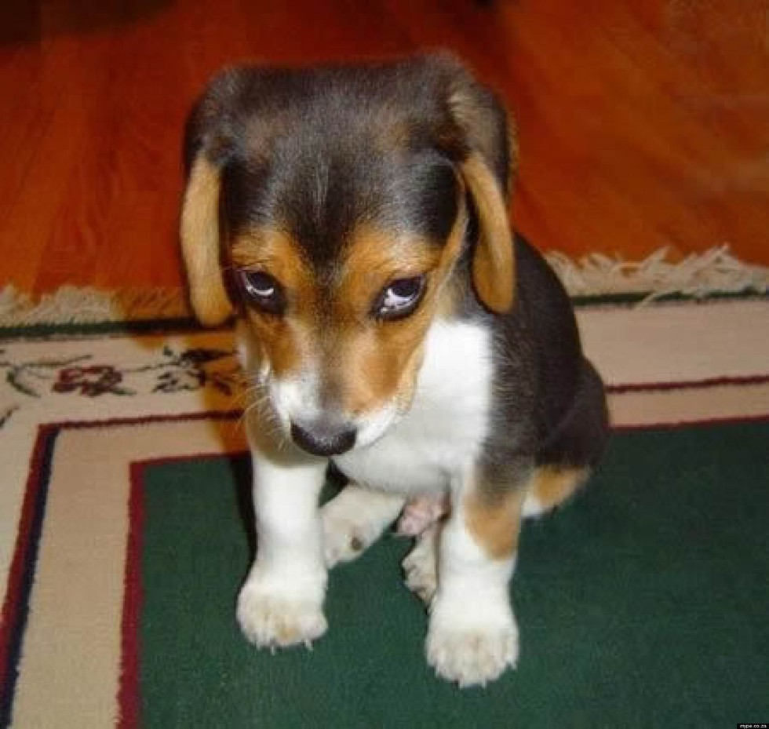
愧疚的良心

Slide 42
约翰一书 1 John 3
²¹ 亲爱的弟兄阿，我们的心若不责备我们，就可以向神坦然无惧了。
²² 并且我们一切所求的，就从他得着；因为我们遵守他的命令，行他所喜悦的事。
²¹ Beloved, if our heart condemn us not, then have we confidence toward God.
²² And whatsoever we ask, we receive of him, because we keep his commandments, and do those things that are pleasing in his sight.

