Slide 1
本乎恩因着信
的福音(5)

Slide 2
什么是恩典？

Slide 3
The Greatest Exchange
最伟大的交换
林后 8:9 你們知道我們主耶穌基督的恩典：他本來富足，卻為你們成了貧窮，叫你們因他的貧窮，可以成為富足。2Cor 8:9 For ye know the grace of our Lord Jesus Christ, that, though he was rich, yet for your sakes he became poor, that ye through his poverty might be rich.

Slide 4
本乎恩因着信的福音（1）
神對人類的救恩已經完全做成，借著基督在律法之下出生、成長、遵行律法的一切誡命，在十字架上的死，死裡復活，及升天成為大祭司代表信他的人坐在神的右邊。God has completed salvation for mankind through Christ's birth under the Law, growing up as a man, obeying everything required of the Law, dying on the cross, resurrection, ascension into heaven, and sitting on the right hand of God as the high priest on behalf of those who believe in Him.

Slide 5
本乎恩因着信的福音（1）
這個救恩的中心目的就是要人通過基督而有神的形象和樣式，活出神兒子的生命來榮耀祂。The central purpose of this salvation is for man to receive God’s image and likeness through Christ and, as a result, to live the life of the Son of God to glorify the Father.

Slide 6
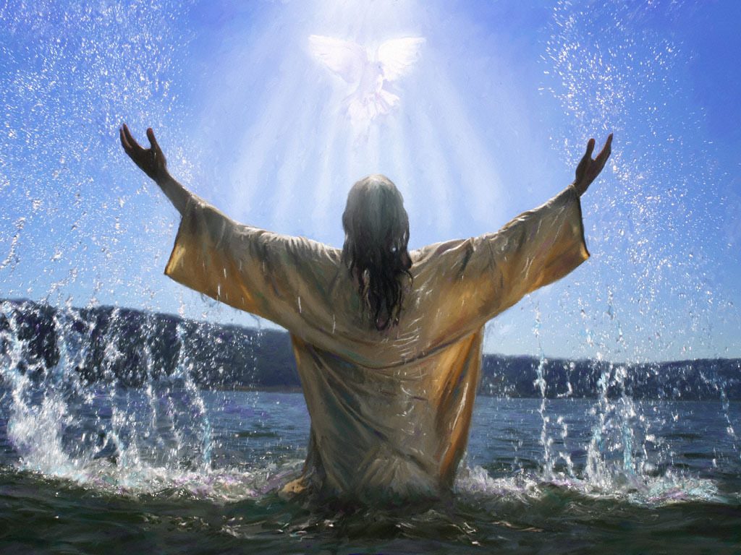
重生
= 我进入基督
= 基督进入我
= 我与基督同死同复活

Slide 7
本乎恩因着信的福音（2）
個人進入此救恩必須通過聖靈的光照啟示，也因著人願意完全放棄在亞當里墮落的、以自我為中心的生命，通過內心領受神的話語（福音）而重生。To receive such salvation, man has to be enlightened by the Holy Spirit; he/she also must be willing to forsake the fallen, self-centered adamic life. Spiritual regeneration or rebirth happens when a person (who is willing to forsake the adamic life) receives God’s Word (i.e., the Gospel) by heart (not just intellectually).

Slide 8
本乎恩因着信的福音（2）
真正重生的人必然不願犯罪，反而羡慕神的生命、話語。A born-again Christian does not desire (like) to live a sinful life but instead a life filled with God’s Word and Spirit.

Slide 9
本乎恩因着信的福音（3）
重生時内裏的生命（重生的靈）完全更新，與主合一，擁有復活的基督完全的生命、能力，When a Christian is born again, his/her inner life (i.e., the born-again spirit) is completely renewed. The born-again spirit is one with Christ and has the perfect life and power of the resurrected Christ.

Slide 10
本乎恩因着信的福音（4）
因著基督徒與基督聯合同為神的後嗣，神在基督里已經賜給他們一切恩典。Because Christians are joint-heirs with Christ, God has bestowed on them every spiritual blessing,

Slide 11
本乎恩因着信的福音（4）
（就是屬靈的福氣，包括公義、祝福、圣洁、属神的性情、天父无条件的接纳、医治、智慧、能力等等）。(i.e., grace, including righteousness from God, all blessings, holiness, godly nature, unconditional love and acceptance of God, healing, wisdom, power, etc.)

Slide 12
如何才能
经历恩典？

Slide 13
弗 2:8 你们得救是本乎恩，也因着信；这并不是出于自己，乃是神所赐的； Eph 2L8 For by grace are ye saved through faith; and that not of yourselves: it is the gift of God:

Slide 14
罗 3:27 既是这样，那里能夸口呢？没有可夸的了。用何法没有的呢？是用立功之法么？不是，乃用信主之法。 Rom 3:27 Where is boasting then? It is excluded. By what law? of works? Nay: but by the law of faith.

Slide 15
本乎恩因着信的福音（5）
真信心是從神及耶穌基督而來，通過人領受聖靈的啟示從內心（而不只是頭腦）接受、明白神的話而獲得。True faith comes from God and Jesus Christ and is received by the human heart (not by the head intellectually) when a person receives revelation of the Word of God by the Holy Spirit.

Slide 16
本乎恩因着信的福音（5）
真信心不是人意志力的產物，而是聖靈在人心超自然的工作。True faith is not a product of human will power but supernatural work of the Holy Spirit in the human heart.

Slide 17
本乎恩因着信的福音（5）
基督徒必須用神所賜的信心才能領受、經歷恩典。真信心必然在人的思想、言行、生活方面帶出神話語應許的果子，這些果子不是天然人可以做到的。Only by God-given faith can a Christian receive and experience God’s grace. True faith will produce fruit promised by God’s Word in a person’s thoughts, words, deeds, and external life. Such fruit cannot be produced by human effort.

Slide 18
本乎恩因着信的福音（5）
人要解決生活、行為上罪和死帶來的問題，不能憑藉天然人出於自我的努力，而需要尋求聖靈啟示神的話語、以至於內心屬世、屬肉體的思想、觀念、價值體系被神更新。The sin-and-death problems in a Christian’s life cannot be overcome by the works or efforts of natural man. Instead, such “bad fruit” is eradicated when a person receives the Holy Spirit-revealed Word of God to replace the worldly and carnal thoughts, attitudes, and value systems in the person’s heart.

Slide 19
神做事根据信心

Slide 20
本乎恩因着信的福音（5）
太 8:13 耶穌對百夫長說：你回去罷！照你的信心，給你成全了。那時，他的僕人就好了。Matt 8:13 And Jesus said unto the centurion, Go thy way; and as thou hast believed, so be it done unto thee. And his servant was healed in the selfsame hour.

Slide 21
本乎恩因着信的福音（5）
来 6:12並且不懈怠，總要效法那些憑信心和忍耐承受應許的人。Heb 6:12 That ye be not slothful, but followers of them who through faith and patience inherit the promises.

Slide 22
本乎恩因着信的福音（5）
来 4:1-3 我們既蒙留下，有進入他安息的應許，就當畏懼，免得我們（原文是你們）中間或有人似乎是趕不上了。 Heb 4:1-3 Let us therefore fear, lest, a promise being left us of entering into his rest, any of you should seem to come short of it.

Slide 23
本乎恩因着信的福音（5）
因為有福音傳給我們，像傳給他們一樣；只是所聽見的道與他們無益，因為他們沒有信心與所聽見的道調和。 For unto us was the gospel preached, as well as unto them: but the word preached did not profit them, not being mixed with faith in them that heard it.

Slide 24
本乎恩因着信的福音（5）
但我們已經相信的人得以進入那安息，正如神所說：我在怒中起誓說：他們斷不可進入我的安息！其實造物之工，從創世以來已經成全了。For we which have believed do enter into rest, as he said, As I have sworn in my wrath, if they shall enter into my rest: although the works were finished from the foundation of the world.

Slide 25
基督的信心

Slide 26
本乎恩因着信的福音（5）
来 12:2 仰望為我們信心創始成終的耶穌。他因那擺在前面的喜樂，就輕看羞辱，忍受了十字架的苦難，便坐在神寶座的右邊。Heb 12:2 Looking unto Jesus the author and finisher of our faith; who for the joy that was set before him endured the cross, despising the shame, and is set down at the right hand of the throne of God.

Slide 27
本乎恩因着信的福音（5）
弗 6:23 願平安、仁愛、信心、從父神和主耶穌基督歸與弟兄們！
Eph 6:23 Peace be to the brethren, and love with faith, from God the Father and the Lord Jesus Christ.

Slide 28
本乎恩因着信的福音（5）
彼后 1:1 作耶穌基督僕人和使徒的西門。彼得寫信給那因我們的神和（有古卷沒有和字）救主耶穌基督之義，與我們同得一樣寶貴信心的人。2Pet 1:1 Simon Peter, a servant and an apostle of Jesus Christ, to them that have obtained like precious faith with us through the righteousness of God and our Saviour Jesus Christ.

Slide 29
如何获得
基督的超然信心？

Slide 30
本乎恩因着信的福音（5）
羅10:17 可見信道是從聽道來的，聽道是從基督的話來的。Rom 10:17 So then faith cometh by hearing, and hearing by the word of God.

Slide 31
本乎恩因着信的福音（5）
羅10:8 他到底怎麼說呢？他說：這道離你不遠，正在你口裡，在你心裡。就是我們所傳信主的道。Rom 10:8 But what saith it? The word is nigh thee, even in thy mouth, and in thy heart: that is, the word of faith, which we preach.

Slide 32
本乎恩因着信的福音（5）
羅10:10 因為人心裡相信，就可以稱義；口裡承認，就可以得救。Rom 10:10 For with the heart man believeth unto righteousness; and with the mouth confession is made unto salvation.

Slide 33
本乎恩因着信的福音（5）
弗 1:17-19 求我們主耶穌基督的神，榮耀的父，將那賜人智慧和啟示的靈賞給你們，使你們真知道他， 並且照明你們心中的眼睛，Eph 1:17-19 That the God of our Lord Jesus Christ, the Father of glory, may give unto you the spirit of wisdom and revelation in the knowledge of him: The eyes of your understanding being enlightened;

Slide 34
本乎恩因着信的福音（5）
使你們知道他的恩召有何等指望，他在聖徒中得的基業有何等豐盛的榮耀； 並知道他向我們這信的人所顯的能力是何等浩大。that ye may know what is the hope of his calling, and what the riches of the glory of his inheritance in the saints, And what is the exceeding greatness of his power to us-ward who believe, according to the working of his mighty power.

Slide 35
本乎恩因着信的福音（5）
林前 2:13-14並且我們講說這些事，不是用人智慧所指教的言語，乃是用聖靈所指教的言語，將屬靈的話解釋屬靈的事。（或作：將屬靈的事講與屬靈的人） 1Cor 2:13-14 Which things also we speak, not in the words which man's wisdom teacheth, but which the Holy Ghost teacheth; comparing spiritual things with spiritual.

Slide 36
本乎恩因着信的福音（5）
然而，屬血氣的人不領會神聖靈的事，反倒以為愚拙，並且不能知道，因為這些事唯有屬靈的人纔能看透。But the natural man receiveth not the things of the Spirit of God: for they are foolishness unto him: neither can he know them, because they are spiritually discerned.

Slide 37
为什么相信了却没有得到？

Slide 38
本乎恩因着信的福音（5）
羅4:16-24 所以人得為後嗣是本乎信，因此就屬乎恩，叫應許定然歸給一切後裔；不但歸給那屬乎律法的，也歸給那效法亞伯拉罕之信的。 Rom 4:16-24 Therefore it is of faith, that it might be by grace; to the end the promise might be sure to all the seed; not to that only which is of the law, but to that also which is of the faith of Abraham; who is the father of us all,

Slide 39
本乎恩因着信的福音（5）
亞伯拉罕所信的，是那叫死人復活、使無變為有的神，他在主面前作我們世人的父。如經上所記：我已經立你作多國的父。 (As it is written, I have made thee a father of many nations,) before him whom he believed, even God, who quickeneth the dead, and calleth those things which be not as though they were.

Slide 40
本乎恩因着信的福音（5）
他在無可指望的時候，因信仍有指望，就得以作多國的父，正如先前所說，你的後裔將要如此。 Who against hope believed in hope, that he might become the father of many nations; according to that which was spoken, So shall thy seed be.

Slide 41
本乎恩因着信的福音（5）
他將近百歲的時候，雖然想到自己的身體如同已死，撒拉的生育已經斷絕，他的信心還是不軟弱； And being not weak in faith, he considered not his own body now dead, when he was about an hundred years old, neither yet the deadness of Sarah's womb:

Slide 42
本乎恩因着信的福音（5）
並且仰望神的應許，總沒有因不信心裡起疑惑，反倒因信心裡得堅固，將榮耀歸給神， He staggered not at the promise of God through unbelief; but was strong in faith, giving glory to God;

Slide 43
本乎恩因着信的福音（5）
且滿心相信神所應許的必能做成。 所以，這就算為他的義。 And being fully persuaded that, what he had promised, he was able also to perform. And therefore it was imputed to him for righteousness.

Slide 44
本乎恩因着信的福音（5）
算為他義的這句話不是單為他寫的， 也是為我們將來得算為義之人寫的，就是我們這信神使我們的主耶穌從死裡復活的人。Now it was not written for his sake alone, that it was imputed to him; But for us also, to whom it shall be imputed, if we believe on him that raised up Jesus our Lord from the dead;

Slide 45
本乎恩因着信的福音（5）
雅 1:5-8 你們中間若有缺少智慧的，應當求那厚賜與眾人、也不斥責人的神，主就必賜給他。 Jas 1:5-8 If any of you lack wisdom, let him ask of God, that giveth to all men liberally, and upbraideth not; and it shall be given him.

Slide 46
本乎恩因着信的福音（5）
只要憑著信心求，一點不疑惑；因為那疑惑的人，就像海中的波浪，被風吹動翻騰。 這樣的人不要想從主那裡得甚麼。 心懷二意的人，在他一切所行的路上都沒有定見。But let him ask in faith, nothing wavering. For he that wavereth is like a wave of the sea driven with the wind and tossed. For let not that man think that he shall receive any thing of the Lord. A double minded man is unstable in all his ways.

Slide 47
还有什么问题？

Slide 48
本乎恩因着信的福音（5）
太 17:14-21耶稣和门徒到了众人那里，有一个人来见耶稣，跪下，说： 主阿，怜悯我的儿子。他害癫痫的病很苦，屡次跌在火里，屡次跌在水里。 我带他到你门徒那里，他们却不能医治他。

Slide 49
本乎恩因着信的福音（5）
耶稣说：嗳！这又不信又悖谬的世代阿，我在你们这里要到几时呢？我忍耐你们要到几时呢？把他带到我这里来罢！ 耶稣斥责那鬼，鬼就出来；从此孩子就痊愈了。门徒暗暗的到耶稣跟前，说：我们为甚么不能赶出那鬼呢？

Slide 50
本乎恩因着信的福音（5）
耶稣说：是因你们的信心小（Because of your unbelief）。我实在告诉你们，你们若有信心（faith），象一粒芥菜种，就是对这座山说：你从这边挪到那边。他也必挪去；并且你们没有一件不能做的事了。 至于这一类的鬼，若不祷告、禁食，他就不出来（或作：不能赶他出来）。

Slide 51
生命更新的秘诀

Slide 52
本乎恩因着信的福音（5）
约 15:5 我是葡萄樹，你們是枝子。常在我裡面的，我也常在他裡面，這人就多結果子；因為離了我，你們就不能做甚麼。 John 15:5 I am the vine, ye are the branches: He that abideth in me, and I in him, the same bringeth forth much fruit: for without me ye can do nothing.

Slide 53
本乎恩因着信的福音（5）
西 1:6 這福音傳到你們那裡，也傳到普天之下，並且結果，增長，如同在你們中間，自從你們聽見福音，真知道神恩惠的日子一樣。 Col 1:6 Which (i.e. the Gospel) is come unto you, as it is in all the world; and bringeth forth fruit, as it doth also in you, since the day ye heard of it, and knew the grace of God in truth:

Slide 54
本乎恩因着信的福音（5）
腓 1:11 並靠著耶穌基督結滿了仁義的果子，叫榮耀稱讚歸與神。 Phil 1:11 Being filled with the fruits of righteousness, which are by Jesus Christ, unto the glory and praise of God.

Slide 55
本乎恩因着信的福音（5）
来 4:9-11這樣看來，必另有一安息日的安息為神的子民存留。 因為那進入安息的，乃是歇了自己的工，正如神歇了他的工一樣。 所以，我們務必竭力進入那安息，免得有人學那不信從的樣子跌倒了。 Heb 4:9-11 There remaineth therefore a rest to the people of God. For he that is entered into his rest, he also hath ceased from his own works, as God did from his. Let us labour therefore to enter into that rest, lest any man fall after the same example of unbelief.

Slide 56
本乎恩因着信的福音（5）
箴 4:23你要保守你心，勝過保守一切（或譯：你要切切保守你心），因為一生的果效是由心發出。 Prov 4:23 Keep thy heart with all diligence; for out of it are the issues of life.

Slide 57
本乎恩因着信的福音（5）
路 6:45 善人從他心裡所存的善就發出善來；惡人從他心裡所存的惡就發出惡來；因為心裡所充滿的，口裡就說出來。 Luke 6:45 A good man out of the good treasure of his heart bringeth forth that which is good; and an evil man out of the evil treasure of his heart bringeth forth that which is evil: for of the abundance of the heart his mouth speaketh.

