Slide 1
本乎恩因着信
的福音(4)

Slide 2
神的工作

Slide 3
本乎恩因着信的福音（1）
神對人類的救恩已經完全做成，借著基督在律法之下出生、成長、遵行律法的一切誡命，在十字架上的死，死裡復活，及升天成為大祭司代表信他的人坐在神的右邊。God has completed salvation for mankind through Christ's birth under the Law, growing up as a man, obeying everything required of the Law, dying on the cross, resurrection, ascension into heaven, and sitting on the right hand of God as the high priest on behalf of those who believe in Him.

Slide 4
本乎恩因着信的福音（1）
這個救恩的中心目的就是要人通過基督而有神的形象和樣式，活出神兒子的生命來榮耀祂。The central purpose of this salvation is for man to receive God’s image and likeness through Christ and, as a result, to live the life of the Son of God to glorify the Father.

Slide 5
如何进入救恩？

Slide 6
The Greatest Exchange
最伟大的交换
林后 8:9 你們知道我們主耶穌基督的恩典：他本來富足，卻為你們成了貧窮，叫你們因他的貧窮，可以成為富足。2Cor 8:9 For ye know the grace of our Lord Jesus Christ, that, though he was rich, yet for your sakes he became poor, that ye through his poverty might be rich.

Slide 7
重生

Slide 8
本乎恩因着信的福音（2）
個人進入此救恩必須通過聖靈的光照啟示，也因著人願意完全放棄在亞當里墮落的、以自我為中心的生命，通過內心領受神的話語（福音）而重生。To receive such salvation, man has to be enlightened by the Holy Spirit; he/she also must be willing to forsake the fallen, self-centered adamic life. Spiritual regeneration or rebirth happens when a person (who is willing to forsake the adamic life) receives God’s Word (i.e., the Gospel) by heart (not just intellectually).

Slide 9
本乎恩因着信的福音（2）
真正重生的人必然不願犯罪，反而羡慕神的生命、話語。A born-again Christian does not desire (like) to live a sinful life but instead a life filled with God’s Word and Spirit.

Slide 10
本乎恩因着信的福音（3）
重生時内裏的生命（重生的靈）完全更新，與主合一，擁有復活的基督完全的生命、能力，When a Christian is born again, his/her inner life (i.e., the born-again spirit) is completely renewed. The born-again spirit is one with Christ and has the perfect life and power of the resurrected Christ.

Slide 11
人算什么？

Slide 12
本乎恩因着信的福音（4）
因著基督徒與基督聯合同為神的後嗣，神在基督里已經賜給他們一切恩典。Because Christians are joint-heirs with Christ, God has bestowed on them every spiritual blessing,

Slide 13
本乎恩因着信的福音（4）
（就是屬靈的福氣，包括公義、祝福、圣洁、属神的性情、天父无条件的接纳、医治、智慧、能力等等）。(i.e., grace, including righteousness from God, all blessings, holiness, godly nature, unconditional love and acceptance of God, healing, wisdom, power, etc.)

Slide 14
本乎恩因着信的福音（4）
加 4:6-7你們既為兒子，神就差他兒子的靈進入你們（原文作我們）的心，呼叫：阿爸！父！ 可見，從此以後，你不是奴僕，乃是兒子了；既是兒子，就靠著神為後嗣。Gal 4:6-7 And because ye are sons, God hath sent forth the Spirit of his Son into your hearts, crying, Abba, Father. Wherefore thou art no more a servant, but a son; and if a son, then an heir of God through Christ.

Slide 15
本乎恩因着信的福音（4）
弗 3:6這奧秘就是外邦人在基督耶穌裡，藉著福音，得以同為後嗣，同為一體，同蒙應許。Eph 3:6 That the Gentiles should be fellowheirs, and of the same body, and partakers of his promise in Christ by the gospel:

Slide 16
基督为信他的人（在他里面的人）从神承受了什么？

Slide 17
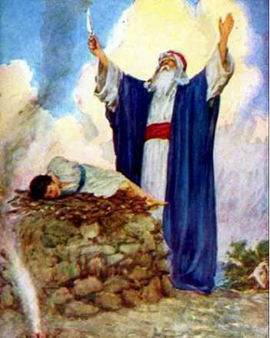
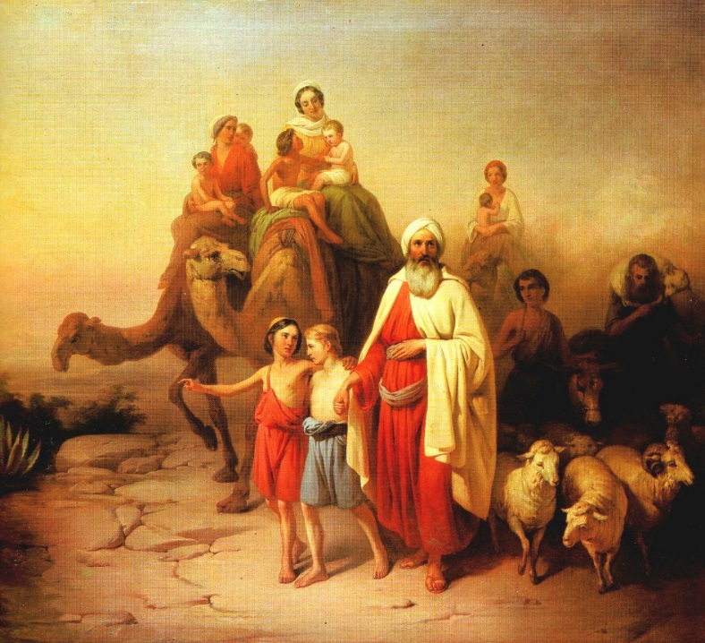
信心之父

Slide 18
创 12:1-3 耶和华对亚伯兰说：你要离开本地、本族、父家，往我所要指示你的地去。 我必叫你成为大国。我必赐福给你，叫你的名为大；你也要叫别人得福。 为你祝福的，我必赐福与他；那咒诅你的，我必咒诅他。地上的万族都要因你得福。 Gen 12:1-3 Now the LORD had said unto Abram, Get thee out of thy country, and from thy kindred, and from thy father's house, unto a land that I will shew thee: And I will make of thee a great nation, and I will bless thee, and make thy name great; and thou shalt be a blessing: And I will bless them that bless thee, and curse him that curseth thee: and in thee shall all families of the earth be blessed.

Slide 19
本乎恩因着信的福音（4）
加 3:7-8 所以，你們要知道：那以信為本的人，就是亞伯拉罕的子孫。 並且聖經既然預先看明，神要叫外邦人因信稱義，就早已傳福音給亞伯拉罕，說：萬國都必因你得福 Gal 3:7-8 Know ye therefore that they which are of faith, the same are the children of Abraham. And the scripture, foreseeing that God would justify the heathen through faith, preached before the gospel unto Abraham, saying, In thee shall all nations be blessed.

Slide 20
本乎恩因着信的福音（4）
加 3:9 可見那以信為本的人和有信心的亞伯拉罕一同得福。Gal 3:9 So then they which be of faith are blessed with faithful Abraham.

Slide 21
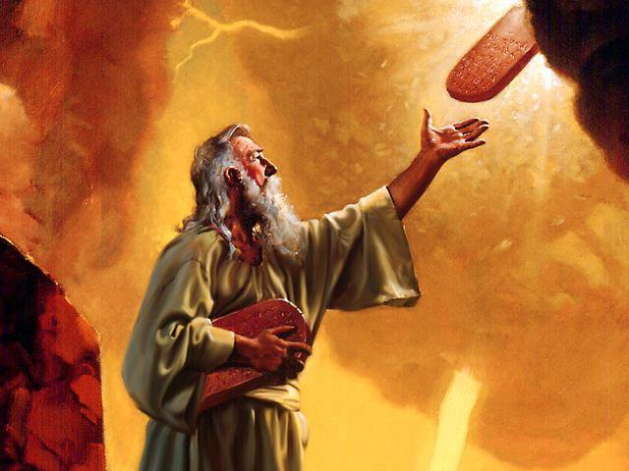

Slide 22
本乎恩因着信的福音（1）
太 5:17-18莫想我來要廢掉律法和先知。我來不是要廢掉，乃是要成全。 我實在告訴你們，就是到天地都廢去了，律法的一點一畫也不能廢去，都要成全。Think not that I am come to destroy the law, or the prophets: I am not come to destroy, but to fulfil. For verily I say unto you, Till heaven and earth pass, one jot or one tittle shall in no wise pass from the law, till all be fulfilled.

Slide 23
申命记28章
¹ 你若留意听从耶和华―你 神的话，谨守遵行他的一切诫命，就是我今日所吩咐你的，他必使你超乎天下万民之上。² 你若听从耶和华―你 神的话，这以下的福必追随你，临到你身上：³ 你在城里必蒙福，在田间也必蒙福。⁴ 你身所生的，地所产的，牲畜所下的，以及牛犊、羊羔，都必蒙福。

Slide 24
申命记28章
⁵ 你的筐子和你的抟麵盆都必蒙福。
⁶ 你出也蒙福，入也蒙福。
⁷ 仇敌起来攻击你，耶和华必使他们在你面前被你杀败；他们从一条路来攻击你，必从七条路逃跑。
⁸ 在你仓房里，并你手所办的一切事上，耶和华所命的福必临到你。耶和华―你 神也要在所给你的地上赐福与你。

Slide 25
申命记28章
⁹ 你若谨守耶和华―你 神的诫命，遵行他的道，他必照着向你所起的誓立你作为自己的圣民。
¹⁰ 天下万民见你归在耶和华的名下，就要惧怕你。
¹¹ 你在耶和华向你列祖起誓应许赐你的地上，他必使你身所生的，牲畜所下的，地所产的，都绰绰有余。

Slide 26
申命记28章
¹² 耶和华必为你开天上的府库，按时降雨在你的地上。在你手里所办的一切事上赐福与你。你必借给许多国民，却不至向他们借贷。
¹³ 你若听从耶和华―你 神的诫命，就是我今日所吩咐你的，谨守遵行，不偏左右，也不随从事奉别神，耶和华就必使你作首不作尾，但居上不居下。

Slide 27
不但如此…

Slide 28
本乎恩因着信的福音（4）
林后 1:20 神的应许，不论有多少，在基督都是是的。所以藉着他也都是实在（实在：原文是阿们）的，叫神因我们得荣耀。 2 Cor 1:20 For all the promises of God in him are yea, and in him Amen, unto the glory of God by us.

Slide 29
还有什么？

Slide 30
本乎恩因着信的福音（4）
弗 1:3-4願頌讚歸與我們主耶穌基督的父神！他在基督裡曾賜給我們天上各樣屬靈的福氣：就如神從創立世界以前，在基督裡揀選了我們，使我們在他面前成為聖潔，無有瑕疵。Eph 1:3-4 Blessed be the God and Father of our Lord Jesus Christ, who hath blessed us with all spiritual blessings in heavenly places in Christ: According as he hath chosen us in him before the foundation of the world, that we should be holy and without blame before him in love.

Slide 31
本乎恩因着信的福音（4）
彼后 1:3-4神的神能已將一切關乎生命和虔敬的事賜給我們，皆因我們認識那用自己榮耀和美德召我們的主。 因此，他已將又寶貴又極大的應許賜給我們，叫我們既脫離世上從情慾來的敗壞，就得與神的性情有分。2Pet 1:3-4 According as his divine power hath given unto us all things that pertain unto life and godliness, through the knowledge of him that hath called us to glory and virtue: Whereby are given unto us exceeding great and precious promises: that by these ye might be partakers of the divine nature, having escaped the corruption that is in the world through lust.

Slide 32
本乎恩因着信的福音（4）
林前 1:30但你們得在基督耶穌裡，是本乎神，神又使他成為我們的智慧、公義、聖潔、救贖。1Cor 1:30 But of him are ye in Christ Jesus, who of God is made unto us wisdom, and righteousness, and sanctification, and redemption:

Slide 33
本乎恩因着信的福音（4）
林后 6:2因為他說：在悅納的時候，我應允了你；在拯救的日子，我搭救了你。看哪！現在正是悅納的時候；現在正是拯救的日子。2Cor 6:2 (For he saith, I have heard thee in a time accepted, and in the day of salvation have I succoured thee: behold, now is the accepted time; behold, now is the day of salvation.)

Slide 34
本乎恩因着信的福音（4）
来 8:12-13我要寬恕他們的不義，不再紀念他們的罪愆。 既說新約。就以前約為舊了；但那漸舊漸衰的，就必快歸無有了。Heb 8:12-13 For I will be merciful to their unrighteousness, and their sins and their iniquities will I remember no more. In that he saith, A new covenant, he hath made the first old. Now that which decayeth and waxeth old is ready to vanish away.

Slide 35
本乎恩因着信的福音（4）
太 8:16-17到了晚上，有人帶著許多被鬼附的來到耶穌跟前，他只用一句話就把鬼都趕出去，並且治好了一切有病的人。 這是要應驗先知以賽亞的話，說：他代替我們的軟弱，擔當我們的疾病。Matt 8:16-17 When the even was come, they brought unto him many that were possessed with devils: and he cast out the spirits with his word, and healed all that were sick: That it might be fulfilled which was spoken by Esaias the prophet, saying, Himself took our infirmities, and bare our sicknesses.

Slide 36
耶和华拉法
出 15:26又說：你若留意聽耶和華─你 神的話，又行我眼中看為正的事，留心聽我的誡命，守我一切的律例，我就不將所加與埃及人的疾病加在你身上，因為我─耶和華是醫治你的。Exo 15:26 And said, If thou wilt diligently hearken to the voice of the LORD thy God, and wilt do that which is right in his sight, and wilt give ear to his commandments, and keep all his statutes, I will put none of these diseases upon thee, which I have brought upon the Egyptians: for I am the LORD that healeth thee.

Slide 37
本乎恩因着信的福音（4）
诗 103:2-3我的心哪，你要稱頌耶和華！不可忘記他的一切恩惠！ 他赦免你的一切罪孽，醫治你的一切疾病。Ps 103:2-3 Bless the LORD, O my soul, and forget not all his benefits: Who forgiveth all thine iniquities; who healeth all thy diseases.

Slide 38
本乎恩因着信的福音（4）
徒 10:38神怎樣以聖靈和能力膏拿撒勒人耶穌，這都是你們知道的。他周流四方，行善事，醫好凡被魔鬼壓制的人，因為神與他同在。Acts 10:38 How God anointed Jesus of Nazareth with the Holy Ghost and with power: who went about doing good, and healing all that were oppressed of the devil; for God was with him.

Slide 39
难怪先知、君王都羡慕！

Slide 40
本乎恩因着信的福音（4）
彼前 1:10-11論到這救恩，那預先說你們要得恩典的眾先知早已詳細的尋求考察， 就是考察在他們心裡基督的靈，預先證明基督受苦難，後來得榮耀，是指著甚麼時候，並怎樣的時候。1Pet 1:10-11 Of which salvation the prophets have enquired and searched diligently, who prophesied of the grace that should come unto you: Searching what, or what manner of time the Spirit of Christ which was in them did signify, when it testified beforehand the sufferings of Christ, and the glory that should follow.

Slide 41
本乎恩因着信的福音（4）
路 10:24 我告诉你们，从前有许多先知和君王要看你们所看的，却没有看见，要听你们所听的，却没有听见。 Luke 10:24 For I tell you, that many prophets and kings have desired to see those things which ye see, and have not seen them; and to hear those things which ye hear, and have not heard them.

Slide 42
本乎恩因着信的福音（4）
约 1:16-17從他豐滿的恩典裡，我們都領受了，而且恩上加恩。 律法本是藉著摩西傳的；恩典和真理都是由耶穌基督來的。John 1:16-17 And of his fulness have all we received, and grace for grace. For the law was given by Moses, but grace and truth came by Jesus Christ.

Slide 43
最后，神为什么不用担心
人会投机？

Slide 44
本乎恩因着信的福音（4）
因著基督徒與基督聯合同為神的後嗣，神在基督里已經賜給他們一切恩典。Because Christians are joint-heirs with Christ, God has bestowed on them every spiritual blessing,

Slide 45
重生

Slide 46
本乎恩因着信的福音（4）
羅8:32神既不愛惜自己的兒子，為我們眾人捨了，豈不也把萬物和他一同白白的賜給我們麼？Rom 8:32 He that spared not his own Son, but delivered him up for us all, how shall he not with him also freely give us all things?

