Slide 1
本乎恩因着信
的福音(2)

Slide 3
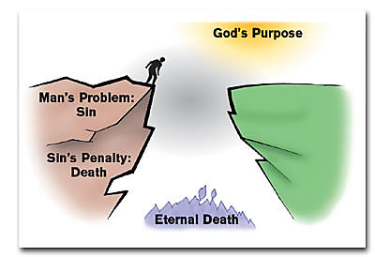
人的光景

Slide 4
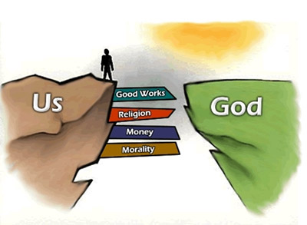
人的方法
雅 1:16-17 我亲爱的弟兄们，不要看错了。 各样美善的恩赐和各样全备的赏赐都是从上头来的，从众光之父那里降下来的；在他并没有改变，也没有转动的影儿。

Slide 5
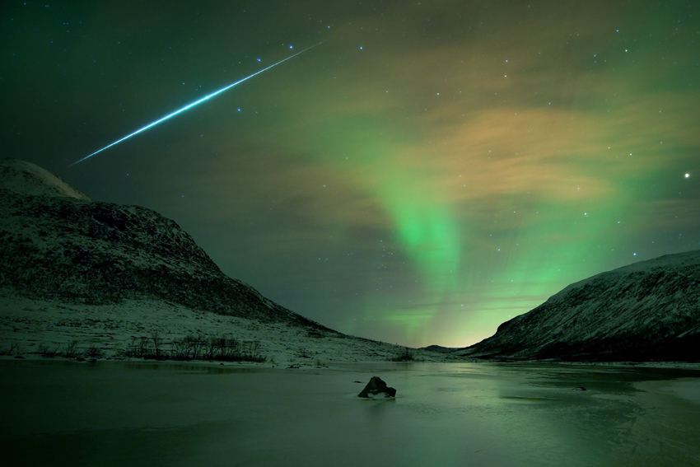
诗 8:3-4 我观看你指头所造的天，并你所陈设的月亮星宿，便说：人算甚么，你竟顾念他？世人算甚么，你竟眷顾他？

Slide 6
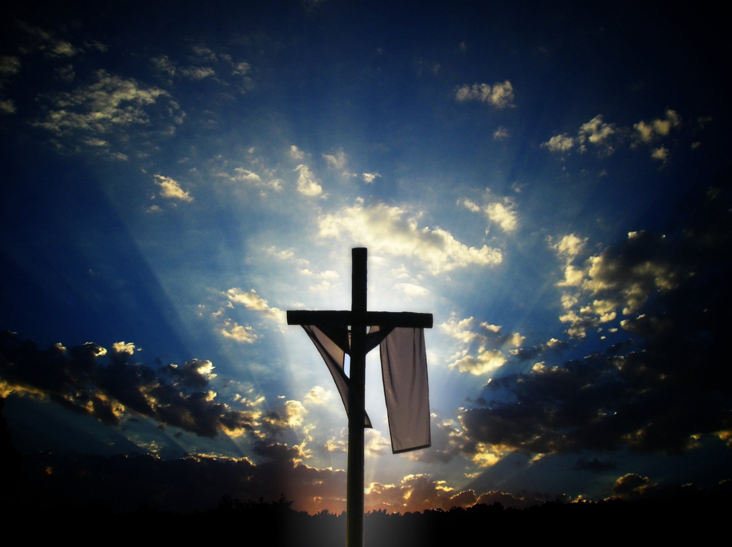
Vicarious: performed or suffered by one person as a substitute for another or to the benefit or advantage of another

Slide 7
本乎恩因着信的福音（1）
神對人類的救恩已經完全做成，借著基督在律法之下出生、成長、遵行律法的一切誡命，在十字架上的死，死裡復活，及升天成為大祭司代表信他的人坐在神的右邊。God has completed salvation for mankind through Christ's birth under the Law, growing up as a man, obeying everything required of the Law, dying on the cross, resurrection, ascension into heaven, and sitting on the right hand of God as the high priest on behalf of those who believe in Him.

Slide 8
本乎恩因着信的福音（1）
這個救恩的中心目的就是要人通過基督而有神的形象和樣式，活出神兒子的生命來榮耀祂。The central purpose of this salvation is for man to receive God’s image and likeness through Christ and, as a result, to live the life of the Son of God to glorify the Father.

Slide 9
如何进入救恩？

Slide 10
本乎恩因着信的福音（2）
個人進入此救恩必須通過聖靈的光照啟示，也因著人願意完全放棄在亞當里墮落的、以自我為中心的生命，通過內心領受神的話語（福音）而重生。To receive such salvation, man has to be enlightened by the Holy Spirit; he/she also must be willing to forsake the fallen, self-centered adamic life. Spiritual regeneration or rebirth happens when a person (who is willing to forsake the adamic life) receives God’s Word (i.e., the Gospel) by heart (not just intellectually).

Slide 11
本乎恩因着信的福音（2）
真正重生的人必然不願犯罪，反而羡慕神的生命、話語。A born-again Christian does not desire (like) to live a sinful life but instead a life filled with God’s Word and Spirit.

Slide 12
神的工作

Slide 13
本乎恩因着信的福音（2）
林前 12:3 所以我告訴你們，被神的靈感動的，沒有說耶穌是可咒詛的；若不是被聖靈感動的，也沒有能說耶穌是主的。 1Cor 12:3 Wherefore I give you to understand, that no man speaking by the Spirit of God calleth Jesus accursed: and that no man can say that Jesus is the Lord, but by the Holy Ghost.

Slide 14
本乎恩因着信的福音（2）
约 6:44 若不是差我来的父吸引人，就没有能到我这里来的；到我这里来的，在末日我要叫他复活。 John 6:44 No man can come to me, except the Father which hath sent me draw him: and I will raise him up at the last day.

Slide 15
本乎恩因着信的福音（2）
约 16:7 然而，我將真情告訴你們，我去是與你們有益的；我若不去，保惠師就不到你們這裡來；我若去，就差他來。 John 16:7 Nevertheless I tell you the truth; It is expedient for you that I go away: for if I go not away, the Comforter will not come unto you; but if I depart, I will send him unto you.

Slide 16
本乎恩因着信的福音（2）
约 16:8 他既來了，就要叫世人為罪、為義、為審判，自己責備自己。 John 16:8 And when he is come, he will reprove the world of sin, and of righteousness, and of judgment.

Slide 17
人要做什么？

Slide 18
本乎恩因着信的福音（2）
太 3:1-2那时，有施洗的约翰出来，在犹太的旷野传道，说： 天国近了，你们应当悔改！ Matt 3:1-2 In those days came John the Baptist, preaching in the wilderness of Judaea, And saying, Repent ye: for the kingdom of heaven is at hand.

Slide 19
本乎恩因着信的福音（2）
太 3:3 这人就是先知以赛亚所说的。他说：在旷野有人声喊着说：预备主的道，修直他的路！ Matt 3:3 For this is he that was spoken of by the prophet Esaias, saying, The voice of one crying in the wilderness, Prepare ye the way of the Lord, make his paths straight.

Slide 20
本乎恩因着信的福音（2）
太 4:17從那時候，耶穌就傳起道來，說：天國近了，你們應當悔改！ Matt 4:17 From that time Jesus began to preach, and to say, Repent: for the kingdom of heaven is at hand.

Slide 21
为什么一定
要悔改？

Slide 22
本乎恩因着信的福音（2）
罗 3:19 我們曉得律法上的話都是對律法以下之人說的，好塞住各人的口，叫普世的人都伏在神審判之下。 Rom 3:19 Now we know that what things soever the law saith, it saith to them who are under the law: that every mouth may be stopped, and all the world may become guilty before God.

Slide 23
本乎恩因着信的福音（2）
罗 3:20 所以凡有血氣的，沒有一個因行律法能在神面前稱義，因為律法本是叫人知罪。 Rom 3:20 Therefore by the deeds of the law there shall no flesh be justified in his sight: for by the law is the knowledge of sin.

Slide 24
本乎恩因着信的福音（2）
罗 3:21-22但如今，神的義在律法以外已經顯明出來，有律法和先知為證： 就是神的義，因信耶穌基督加給一切相信的人，並沒有分別。 Rom 3:21-22 But now the righteousness of God without the law is manifested, being witnessed by the law and the prophets; Even the righteousness of God which is by faith of Jesus Christ unto all and upon all them that believe: for there is no difference.

Slide 25
本乎恩因着信的福音（2）
路 9:23-24 耶穌又對眾人說：若有人要跟從我，就當捨己，天天背起他的十字架來跟從我。 因為，凡要救自己生命（生命：或作靈魂；下同）的，必喪掉生命；凡為我喪掉生命的，必救了生命。 Luke 9:23-24 And he said to them all, If any man will come after me, let him deny himself, and take up his cross daily, and follow me. For whosoever will save his life shall lose it: but whosoever will lose his life for my sake, the same shall save it.

Slide 26
本乎恩因着信的福音（2）
約 5:24 我實實在在的告訴你們，那聽我話、又信差我來者的，就有永生；不至於定罪，是已經出死入生了。 John 5:24-25 Verily, verily, I say unto you, He that heareth my word, and believeth on him that sent me, hath everlasting life, and shall not come into condemnation; but is passed from death unto life.

Slide 27
本乎恩因着信的福音（2）
約 5:25 我實實在在的告訴你們，時候將到，現在就是了，死人要聽見神兒子的聲音，聽見的人就要活了。 John 5:25 Verily, verily, I say unto you, The hour is coming, and now is, when the dead shall hear the voice of the Son of God: and they that hear shall live.

Slide 28
本乎恩因着信的福音（2）
彼前 1:23 你们蒙了重生，不是由于能坏的种子，乃是由于不能坏的种子，是藉着神活泼常存的道。 1Pet 1:23 Being born again, not of corruptible seed, but of incorruptible, by the word of God, which liveth and abideth for ever.

Slide 29
本乎恩因着信的福音（2）
羅10:9-10 你若口裡認耶穌為主，心裡信神叫他從死裡復活，就必得救。 因為人心裡相信，就可以稱義；口裡承認，就可以得救。 Rom 10:9-10 That if thou shalt confess with thy mouth the Lord Jesus, and shalt believe in thine heart that God hath raised him from the dead, thou shalt be saved. For with the heart man believeth unto righteousness; and with the mouth confession is made unto salvation.

Slide 30
本乎恩因着信的福音（2）
羅 10:17 可見信道是從聽道來的，聽道是從基督的話來的。 Rom 10:17 So then faith cometh by hearing, and hearing by the word of God.

Slide 31
重生的重要性

Slide 32
本乎恩因着信的福音（2）
約 1:12-13凡接待他的，就是信他名的人，他就赐他们权柄，作神的儿女。这等人不是从血气生的，不是从情慾生的，也不是从人意生的，乃是从神生的。 John 1:12-13 But as many as received him, to them gave he power to become the sons of God, even to them that believe on his name: Which were born, not of blood, nor of the will of the flesh, nor of the will of man, but of God.

Slide 33
本乎恩因着信的福音（2）
约一 5:18 我們知道凡從神生的，必不犯罪，從神生的，必保守自己，那惡者也就無法害他。 1John 5:18 We know that whosoever is born of God sinneth not; but he that is begotten of God keepeth himself, and that wicked one toucheth him not.

Slide 34
本乎恩因着信的福音（2）
约 10:27 我的羊聽我的聲音，我也認識他們，他們也跟著我。 John 10:27 My sheep hear my voice, and I know them, and they follow me:

