Slide 1
本乎恩因着信
的福音(1)

Slide 2
弗 2:8 你们得救是本乎恩，也因着信；这并不是出于自己，乃是神所赐的； For by grace are ye saved through faith; and that not of yourselves: it is the gift of God:

Slide 3
人算什么？

Slide 4
人算什么？
创 1:26神說：我們要照著我們的形像、按著我們的樣式造人。And God said, Let us make man in our image, after our likeness.

Slide 5
本乎恩因着信的福音（1）
神對人類的救恩已經完全做成，借著基督在律法之下出生、成長、遵行律法的一切誡命，在十字架上的死，死裡復活，及升天成為大祭司代表信他的人坐在神的右邊。God has completed salvation for mankind through Christ's birth under the Law, growing up as a man, obeying everything required of the Law, dying on the cross, resurrection, ascension into heaven, and sitting on the right hand of God as the high priest on behalf of those who believe in Him.

Slide 6
本乎恩因着信的福音（1）
這個救恩的中心目的就是要人通過基督而有神的形象和樣式，活出神兒子的生命來榮耀祂。The central purpose of this salvation is for man to receive God’s image and likeness through Christ and, as a result, to live the life of the Son of God to glorify the Father.

Slide 7
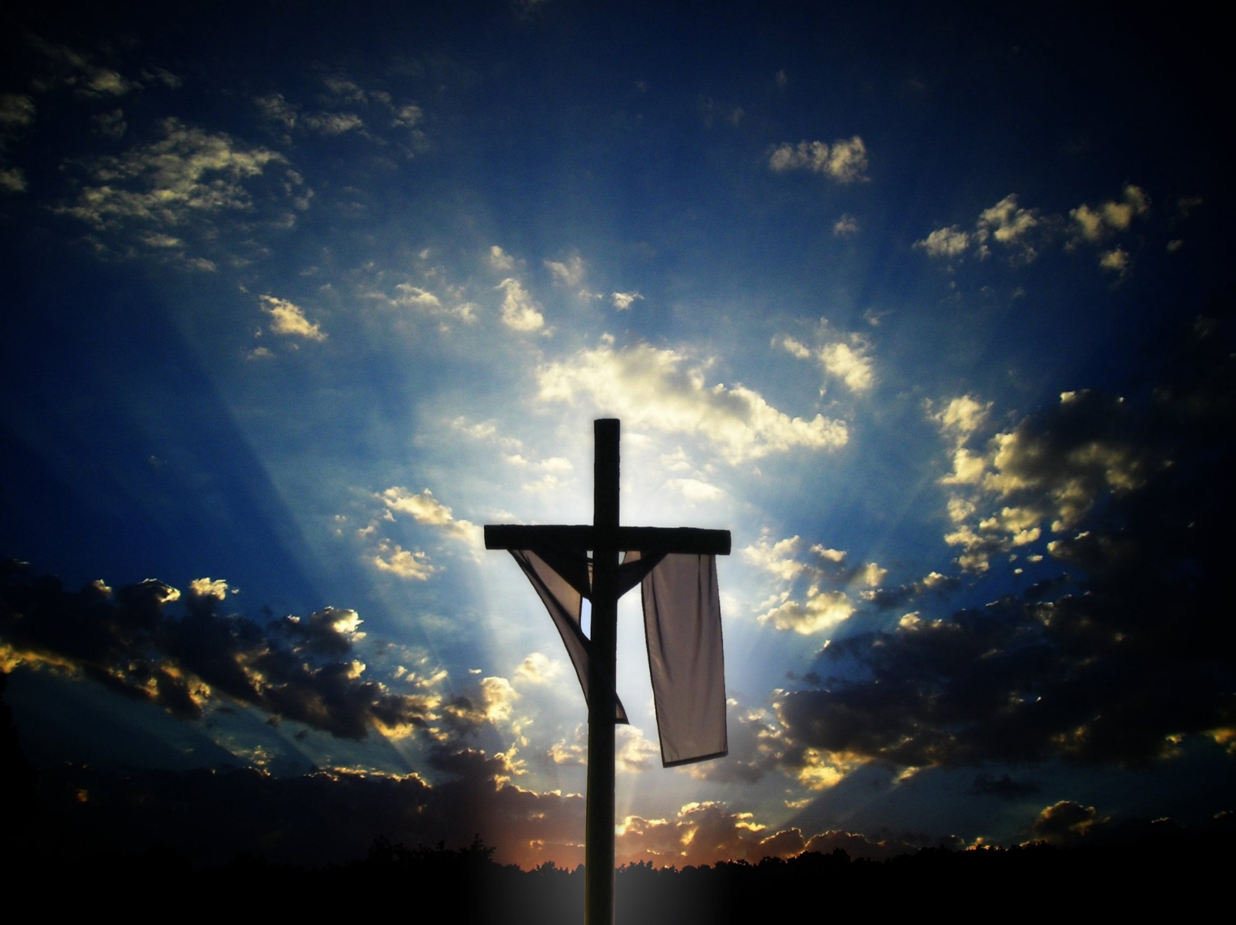
Vicarious: performed or suffered by one person as a substitute for another or to the benefit or advantage of another

Slide 8
本乎恩因着信的福音（1）
神對人類的救恩已經完全做成，借著基督在律法之下出生、成長、遵行律法的一切誡命，在十字架上的死，死裡復活，及升天成為大祭司代表信他的人坐在神的右邊。God has completed salvation for mankind through Christ's birth under the Law, growing up as a man, obeying everything required of the Law, dying on the cross, resurrection, ascension into heaven, and sitting on the right hand of God as the high priest on behalf of those who believe in Him.

Slide 9
本乎恩因着信的福音（1）
這個救恩的中心目的就是要人通過基督而有神的形象和樣式，活出神兒子的生命來榮耀祂。The central purpose of this salvation is for man to receive God’s image and likeness through Christ and, as a result, to live the life of the Son of God to glorify the Father.

Slide 10
本乎恩因着信的福音（1）
羅5:18-19如此說來，因一次的過犯，眾人都被定罪；照樣，因一次的義行，眾人也就被稱義得生命了。 因一人的悖逆，眾人成為罪人；照樣，因一人的順從，眾人也成為義了。Therefore as by the offence of one judgment came upon all men to condemnation; even so by the righteousness of one the free gift came upon all men unto justification of life. For as by one man's disobedience many were made sinners, so by the obedience of one shall many be made righteous.

Slide 11
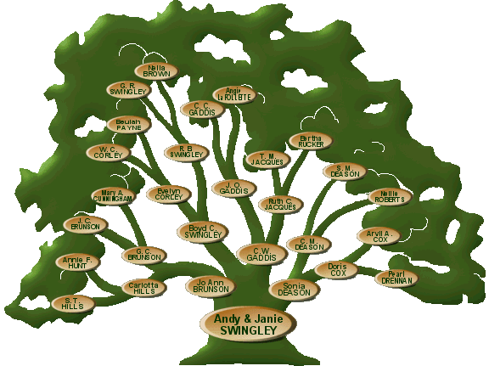

Slide 15
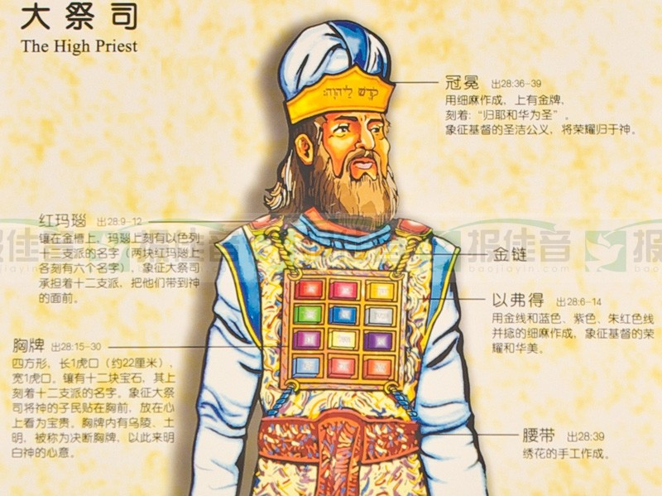

Slide 16
本乎恩因着信的福音（1）
来 5:1凡從人間挑選的大祭司，是奉派替人辦理屬神的事，為要獻上禮物和贖罪祭（或作：要為罪獻上禮物和祭物）。For every high priest taken from among men is ordained for men in things pertaining to God, that he may offer both gifts and sacrifices for sins:

Slide 17
本乎恩因着信的福音（1）
加 4:4及至時候滿足，神就差遣他的兒子，為女子所生，且生在律法以下。But when the fulness of the time was come, God sent forth his Son, made of a woman, made under the law.

Slide 18
本乎恩因着信的福音（1）
太 5:17-18莫想我來要廢掉律法和先知。我來不是要廢掉，乃是要成全。 我實在告訴你們，就是到天地都廢去了，律法的一點一畫也不能廢去，都要成全。Think not that I am come to destroy the law, or the prophets: I am not come to destroy, but to fulfil. For verily I say unto you, Till heaven and earth pass, one jot or one tittle shall in no wise pass from the law, till all be fulfilled.

Slide 19
本乎恩因着信的福音（1）
约 19:28-30這事以後，耶穌知道各樣的事已經成了，為要使經上的話應驗，就說：我渴了。 有一個器皿盛滿了醋，放在那裡；他們就拿海絨蘸滿了醋，綁在牛膝草上，送到他口。 耶穌嘗（原文作受）了那醋，就說：成了！便低下頭，將靈魂交付神了。After this, Jesus knowing that all things were now accomplished, that the scripture might be fulfilled, saith, I thirst. Now there was set a vessel full of vinegar: and they filled a spunge with vinegar, and put it upon hyssop, and put it to his mouth. When Jesus therefore had received the vinegar, he said, It is finished: and he bowed his head, and gave up the ghost.

Slide 20
本乎恩因着信的福音（1）
羅4:25耶穌被交給人，是為我們的過犯；復活，是為叫我們稱義（或作：耶穌是為我們的過犯交付了，是為我們稱義復活了）。Who (i.e., Jesus Christ) was delivered for our offences, and was raised again for our justification.

Slide 21
本乎恩因着信的福音（1）
来 9:24因為基督並不是進了人手所造的聖所（這不過是真聖所的影像），乃是進了天堂，如今為我們顯在神面前。For Christ is not entered into the holy places made with hands, which are the figures of the true; but into heaven itself, now to appear in the presence of God for us

Slide 23
本乎恩因着信的福音（1）
弗 2:5-6當我們死在過犯中的時候，便叫我們與基督一同活過來。你們得救是本乎恩。 他又叫我們與基督耶穌一同復活，一同坐在天上。Even when we were dead in sins, hath quickened us together with Christ, (by grace ye are saved;) And hath raised us up together, and made us sit together in heavenly places in Christ Jesus:

Slide 24
本乎恩因着信的福音（1）
来 10:12-14但基督獻了一次永遠的贖罪祭，就在神的右邊坐下了。 從此，等候他仇敵成了他的腳凳。 因為他一次獻祭，便叫那得以成聖的人永遠完全。But this man, after he had offered one sacrifice for sins for ever, sat down on the right hand of God; From henceforth expecting till his enemies be made his footstool. For by one offering he hath perfected for ever them that are sanctified.

Slide 25
本乎恩因着信的福音（1）
来 2:10-11原來那為萬物所屬為萬物所本的，要領許多的兒子進榮耀裡去，使救他們的元帥，因受苦難得以完全，本是合宜的。 因那使人成聖的和那些得以成聖的，都是出於一。所以，他稱他們為弟兄也不以為恥。For it became him, for whom are all things, and by whom are all things, in bringing many sons unto glory, to make the captain of their salvation perfect through sufferings. For both he that sanctifieth and they who are sanctified are all of one: for which cause he is not ashamed to call them brethren.

Slide 26
本乎恩因着信的福音（1）
加 5:24-25凡屬基督耶穌的人，是已經把肉體連肉體的邪情私慾同釘在十字架上了。 我們若是靠聖靈得生，就當靠聖靈行事。And they that are Christ's have crucified the flesh with the affections and lusts. If we live in the Spirit, let us also walk in the Spirit.

Slide 27
本乎恩因着信的福音（1）
创 1:26神說：我們要照著我們的形像、按著我們的樣式造人。And God said, Let us make man in our image, after our likeness.

Slide 28
本乎恩因着信的福音（1）
弗 1:10 要照所安排的，在日期滿足的時候，使天上、地上、一切所有的都在基督裡面同歸於一。That in the dispensation of the fulness of times he might gather together in one all things in Christ, both which are in heaven, and which are on earth; even in him.

