Slide 1
从西门到彼得
（5）

Slide 2
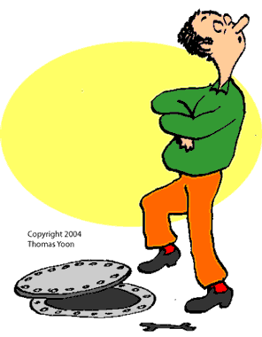
箴 16:18 骄傲在败坏以先；狂心在跌倒之前。
箴 18:12 败坏之先，人心骄傲；尊荣以前，必有谦卑。
骄傲

Slide 3
狂心在跌倒之前
路 22:1-3 除酵节，又名逾越节，近了。 祭司长和文士想法子怎么纔能杀害耶稣，是因他们惧怕百姓。 这时，撒但入了那称为加略人犹大的心；他本是十二门徒里的一个。
Luke 22:1-3 Now the feast of unleavened bread drew nigh, which is called the Passover. And the chief priests and scribes sought how they might kill him; for they feared the people. Then entered Satan into Judas surnamed Iscariot, being of the number of the twelve.

Slide 4
狂心在跌倒之前
路 22:4-6 他去和祭司长并守殿官商量，怎么可以把耶稣交给他们。 他们欢喜，就约定给他银子。 他应允了，就找机会，要趁众人不在跟前的时候把耶稣交给他们。
Luke 22:4-6 And he went his way, and communed with the chief priests and captains, how he might betray him unto them. And they were glad, and covenanted to give him money. And he promised, and sought opportunity to betray him unto them in the absence of the multitude.

Slide 5
狂心在跌倒之前
路 22:7-9 除酵节，须宰逾越羊羔的那一天到了。 耶稣打发彼得、约翰，说：你们去为我们预备逾越节的筵席，好叫我们吃。 他们问他说：要我们在那里预备？
Luke 22:7-9 Then came the day of unleavened bread, when the passover must be killed. And he sent Peter and John, saying, Go and prepare us the passover, that we may eat. And they said unto him, Where wilt thou that we prepare?

Slide 6
狂心在跌倒之前
路 22:10-12 耶稣说：你们进了城，必有人拿着一瓶水迎面而来，你们就跟着他，到他所进的房子里去， 对那家的主人说：夫子说：客房在那里？我与门徒好在那里吃逾越节的筵席。 他必指给你们摆设整齐的一间大楼，你们就在那里预备。Luke 22:10-12 And he said unto them, Behold, when ye are entered into the city, there shall a man meet you, bearing a pitcher of water; follow him into the house where he entereth in. And ye shall say unto the goodman of the house, The Master saith unto thee, Where is the guestchamber, where I shall eat the passover with my disciples? And he shall shew you a large upper room furnished: there make ready.

Slide 7
狂心在跌倒之前
路 22:13-15 他们去了，所遇见的正如耶稣所说的；他们就预备了逾越节的筵席。 时候到了，耶稣坐席，使徒也和他同坐。 耶稣对他们说：我很愿意在受害以先和你们吃这逾越节的筵席。
Luke 22:13-15 And they went, and found as he had said unto them: and they made ready the passover. And when the hour was come, he sat down, and the twelve apostles with him. And he said unto them, With desire I have desired to eat this passover with you before I suffer:

Slide 8
狂心在跌倒之前
路 22:16-18 我告诉你们，我不再吃这筵席，直到成就在神的国里。 耶稣接过杯来，祝谢了，说：你们拿这个，大家分着喝。 我告诉你们，从今以后，我不再喝这葡萄汁，直等神的国来到。
Luke 22:16-18 For I say unto you, I will not any more eat thereof, until it be fulfilled in the kingdom of God. And he took the cup, and gave thanks, and said, Take this, and divide it among yourselves: For I say unto you, I will not drink of the fruit of the vine, until the kingdom of God shall come.

Slide 9
狂心在跌倒之前
路 22:19-20 又拿起饼来，祝谢了，就擘开，递给他们，说：这是我的身体，为你们捨的，你们也应当如此行，为的是纪念我。 饭后也照样拿起杯来，说：这杯是用我血所立的新约，是为你们流出来的。
Luke 22:19-20 And he took bread, and gave thanks, and brake it, and gave unto them, saying, This is my body which is given for you: this do in remembrance of me. Likewise also the cup after supper, saying, This cup is the new testament in my blood, which is shed for you.

Slide 10
狂心在跌倒之前
路 22:21-23 看哪！那卖我之人的手与我一同在桌子上。 人子固然要照所预定的去世，但卖人子的人有祸了！ 他们就彼此对问，是那一个要做这事。
Luke 22:21-23 But, behold, the hand of him that betrayeth me is with me on the table. And truly the Son of man goeth, as it was determined: but woe unto that man by whom he is betrayed! And they began to enquire among themselves, which of them it was that should do this thing.

Slide 11
狂心在跌倒之前
路 22:24-26 门徒起了争论，他们中间那一个可算为大。 耶稣说：外邦人有君王为主治理他们，那掌权管他们的称为恩主。 但你们不可这样；你们里头为大的，倒要象年幼的；为首领的，倒要象服事人的。
Luke 22:24-26 And there was also a strife among them, which of them should be accounted the greatest. And he said unto them, The kings of the Gentiles exercise lordship over them; and they that exercise authority upon them are called benefactors. But ye shall not be so: but he that is greatest among you, let him be as the younger; and he that is chief, as he that doth serve.

Slide 12
狂心在跌倒之前
路 22:29-30 我将国赐给你们，正如我父赐给我一样， 叫你们在我国里，坐在我的席上吃喝，并且坐在宝座上，审判以色列十二个支派。
Luke 22:29-30 And I appoint unto you a kingdom, as my Father hath appointed unto me; That ye may eat and drink at my table in my kingdom, and sit on thrones judging the twelve tribes of Israel.

Slide 13
狂心在跌倒之前
路 22:31-33 主又说：西门！西门！撒但想要得着你们，好筛你们象筛麦子一样； 但我已经为你祈求，叫你不至于失了信心，你回头以后，要坚固你的弟兄。 彼得说：主阿，我就是同你下监，同你受死，也是甘心！
Luke 22:31-33 And the Lord said, Simon, Simon, behold, Satan hath desired to have you, that he may sift you as wheat: But I have prayed for thee, that thy faith fail not: and when thou art converted, strengthen thy brethren. And he said unto him, Lord, I am ready to go with thee, both into prison, and to death.

Slide 14
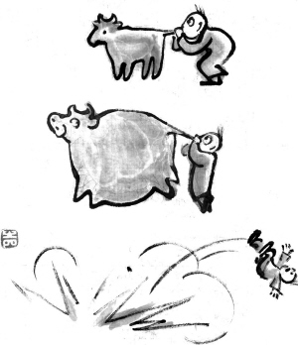
狂心在跌倒之前
太 26:33 彼得说：众人虽然为你的缘故跌倒，我却永不跌倒。 Matt 26:33 Peter answered and said unto him, Though all men shall be offended because of thee, yet will I never be offended.

Slide 15
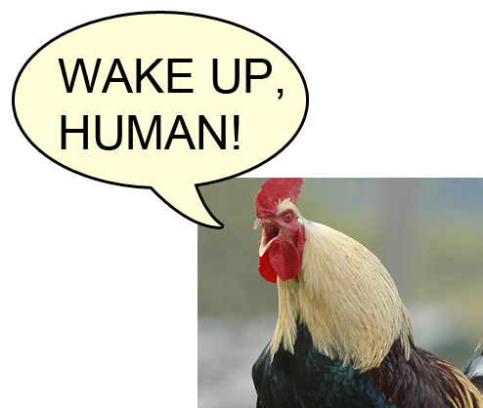
狂心在跌倒之前
路 22:34 耶稣说：彼得，我告诉你，今日鸡还没有叫，你要叁次说不认得我。
Luke 22:34 And he said, I tell thee, Peter, the cock shall not crow this day, before that thou shalt thrice deny that thou knowest me.

Slide 16
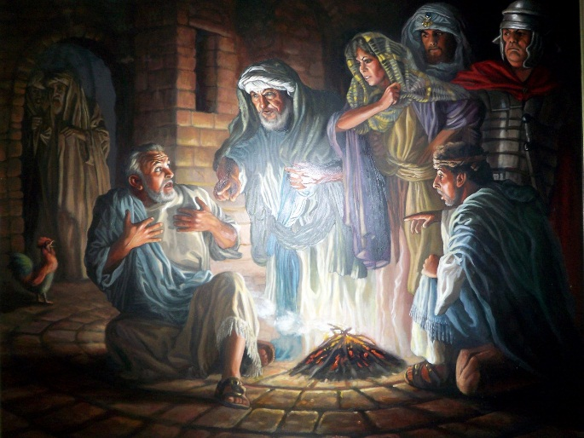

Slide 17
狂心在跌倒之前
路 22:54-56 他们拿住耶稣，把他带到大祭司的宅里。彼得远远的跟着。 他们在院子里生了火，一同坐着；彼得也坐在他们中间。 有一个使女看见彼得坐在火光里，就定睛看他，说：这个人素来也是同那人一夥的。 Luke 22:54-56 Then took they him, and led him, and brought him into the high priest's house. And Peter followed afar off. And when they had kindled a fire in the midst of the hall, and were set down together, Peter sat down among them. But a certain maid beheld him as he sat by the fire, and earnestly looked upon him, and said, This man was also with him.

Slide 18
狂心在跌倒之前
路 22:57-58 彼得却不承认，说：女子，我不认得他。 过了不多的时候，又有一个人看见他，说：你也是他们一党的。彼得说：你这个人！我不是。 Luke 22:31-33 And the Lord said, Simon, Simon, behold, Satan hath desired to have you, that he may sift you as wheat: But I have prayed for thee, that thy faith fail not: and when thou art converted, strengthen thy brethren. And he said unto him, Lord, I am ready to go with thee, both into prison, and to death.

Slide 19
狂心在跌倒之前
路 22:59-60 约过了一小时，又有一个人极力的说：他实在是同那人一夥的，因为他也是加利利人。 彼得说：你这个人！我不晓得你说的是甚么！正说话之间，鸡就叫了。
Luke 22:59-60 And about the space of one hour after another confidently affirmed, saying, Of a truth this fellow also was with him: for he is a Galilaean. And Peter said, Man, I know not what thou sayest. And immediately, while he yet spake, the cock crew.

Slide 20
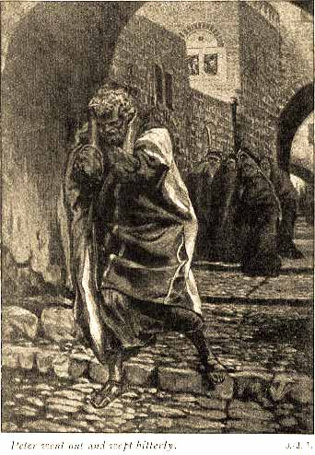
狂心在跌倒之前
路 22:61-62 主转过身来看彼得。彼得便想起主对他所说的话：今日鸡叫以先，你要叁次不认我。 他就出去痛哭。Luke 22:61-62 And the Lord turned, and looked upon Peter. And Peter remembered the word of the Lord, how he had said unto him, Before the cock crow, thou shalt deny me thrice. And Peter went out, and wept bitterly.

Slide 21
彼得不是胆小鬼
约 18:3-5 犹大领了一队兵，和祭司长并法利赛人的差役，拿着灯笼、火把、兵器，就来到园里。 耶稣知道将要临到自己的一切事，就出来对他们说：你们找谁？ 他们回答说：找拿撒勒人耶稣。耶稣说：我就是。卖他的犹大也同他们站在那里。 John 18:3-5 Judas then, having received a band of men and officers from the chief priests and Pharisees, cometh thither with lanterns and torches and weapons. Jesus therefore, knowing all things that should come upon him, went forth, and said unto them, Whom seek ye? They answered him, Jesus of Nazareth. Jesus saith unto them, I am he. And Judas also, which betrayed him, stood with them.

Slide 22
彼得不是胆小鬼
约 18:6-8 耶稣一说我就是，他们就退后倒在地上。 他又问他们说：你们找谁？他们说：找拿撒勒人耶稣。 耶稣说：我已经告诉你们，我就是。你们若找我，就让这些人去罢。
John 18:6-8 As soon then as he had said unto them, I am he, they went backward, and fell to the ground. Then asked he them again, Whom seek ye? And they said, Jesus of Nazareth. Jesus answered, I have told you that I am he: if therefore ye seek me, let these go their way:

Slide 23
彼得不是胆小鬼
约 18:9-11 这要应验耶稣从前的话，说：你所赐给我的人，我没有失落一个。 西门彼得带着一把刀，就拔出来，将大祭司的仆人砍了一刀，削掉他的右耳；那仆人名叫马勒古。 耶稣就对彼得说：收刀入鞘罢，我父所给我的那杯，我岂可不喝呢？ John 18:9-11 That the saying might be fulfilled, which he spake, Of them which thou gavest me have I lost none. Then Simon Peter having a sword drew it, and smote the high priest's servant, and cut off his right ear. The servant's name was Malchus. Then said Jesus unto Peter, Put up thy sword into the sheath: the cup which my Father hath given me, shall I not drink it?

Slide 24
彼得不是不爱主
约 21:1-3 这些事以后，耶稣在提比哩亚海边又向门徒显现。他怎样显现记在下面： 有西门彼得和称为低土马的多马，并加利利的迦拿人拿但业，还有西庇太的两个儿子，又有两个门徒，都在一处。 西门彼得对他们说：我打鱼去。他们说：我们也和你同去。他们就出去，上了船；那一夜并没有打着甚么。 John 21:1-3 After these things Jesus shewed himself again to the disciples at the sea of Tiberias; and on this wise shewed he himself. There were together Simon Peter, and Thomas called Didymus, and Nathanael of Cana in Galilee, and the sons of Zebedee, and two other of his disciples. Simon Peter saith unto them, I go a fishing. They say unto him, We also go with thee. They went forth, and entered into a ship immediately; and that night they caught nothing.

Slide 25
彼得不是不爱主
约 21:4-6 天将亮的时候，耶稣站在岸上，门徒却不知道是耶稣。 耶稣就对他们说：小子！你们有吃的没有？他们回答说：没有。 耶稣说：你们把网撒在船的右边，就必得着。他们便撒下网去，竟拉不上来了，因为鱼甚多。 John 21:4-6 But when the morning was now come, Jesus stood on the shore: but the disciples knew not that it was Jesus. Then Jesus saith unto them, Children, have ye any meat? They answered him, No. And he said unto them, Cast the net on the right side of the ship, and ye shall find. They cast therefore, and now they were not able to draw it for the multitude of fishes.

Slide 26
彼得不是不爱主
约 21:7-9 耶稣所爱的那门徒对彼得说：是主！那时西门彼得赤着身子，一听见是主，就束上一件外衣，跳在海里。 其余的门徒离岸不远，约有二百肘（古代以肘为尺，一肘约有今时尺半），就在小船上把那网鱼拉过来。 他们上了岸，就看见那里有炭火，上面有鱼，又有饼。 John 21:7-9 Therefore that disciple whom Jesus loved saith unto Peter, It is the Lord. Now when Simon Peter heard that it was the Lord, he girt his fisher's coat unto him, (for he was naked,) and did cast himself into the sea. And the other disciples came in a little ship; (for they were not far from land, but as it were two hundred cubits,) dragging the net with fishes. As soon then as they were come to land, they saw a fire of coals there, and fish laid thereon, and bread.

Slide 27
彼得不是不爱主
约 21:10-11 耶稣对他们说：把刚纔打的鱼拿几条来。 西门彼得就去（或作：上船），把网拉到岸上。那网满了大鱼，共一百五十叁条；鱼虽这样多，网却没有破。
John 21:9-11 As soon then as they were come to land, they saw a fire of coals there, and fish laid thereon, and bread. Jesus saith unto them, Bring of the fish which ye have now caught. Simon Peter went up, and drew the net to land full of great fishes, an hundred and fifty and three: and for all there were so many, yet was not the net broken.

Slide 28
彼得不是不爱主
约 21:12-14 耶稣说：你们来吃早饭。门徒中没有一个敢问他：你是谁？因为知道是主。 耶稣就来拿饼和鱼给他们。 耶稣从死里复活以后，向门徒显现，这是第叁次。
John 21:12-14 Jesus saith unto them, Come and dine. And none of the disciples durst ask him, Who art thou? knowing that it was the Lord. Jesus then cometh, and taketh bread, and giveth them, and fish likewise. This is now the third time that Jesus shewed himself to his disciples, after that he was risen from the dead.

Slide 29
彼得不是不爱主
约 21:15-16 他们吃完了早饭，耶稣对西门彼得说：约翰（在太16：17称约拿）的儿子西门，你爱我比这些更深么？彼得说：主阿，是的，你知道我爱你。耶稣对他说：你餵养我的小羊。 耶稣第二次又对他说：约翰的儿子西门，你爱我么？彼得说：主阿，是的，你知道我爱你。耶稣说：你牧养我的羊。 John 21:15-16 So when they had dined, Jesus saith to Simon Peter, Simon, son of Jonas, lovest thou me more than these? He saith unto him, Yea, Lord; thou knowest that I love thee. He saith unto him, Feed my lambs. He saith to him again the second time, Simon, son of Jonas, lovest thou me? He saith unto him, Yea, Lord; thou knowest that I love thee. He saith unto him, Feed my sheep.

Slide 30
西门需要在基督里成为彼得
约 21:17-18 第叁次对他说：约翰的儿子西门，你爱我么？彼得因为耶稣第叁次对他说你爱我么，就忧愁，对耶稣说：主阿，你是无所不知的；你知道我爱你。耶稣说：你餵养我的羊。 我实实在在的告诉你，你年少的时候，自己束上带子，随意往来；但年老的时候，你要伸出手来，别人要把你束上，带你到不愿意去的地方。 John 21:17-18 He saith unto him the third time, Simon, son of Jonas, lovest thou me? Peter was grieved because he said unto him the third time, Lovest thou me? And he said unto him, Lord, thou knowest all things; thou knowest that I love thee. Jesus saith unto him, Feed my sheep. Verily, verily, I say unto thee, When thou wast young, thou girdedst thyself, and walkedst whither thou wouldest: but when thou shalt be old, thou shalt stretch forth thy hands, and another shall gird thee, and carry thee whither thou wouldest not.

Slide 31
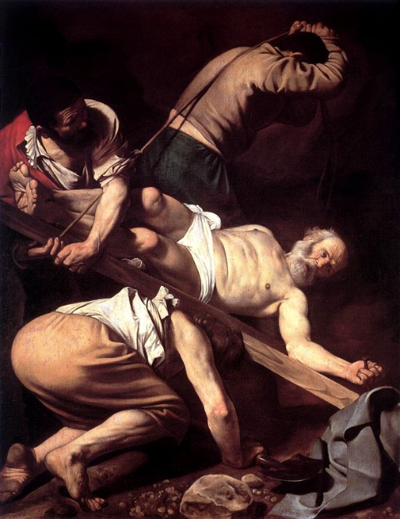
西门需要在基督里成为彼得
约 21:19 耶稣说这话是指着彼得要怎样死，荣耀神。说了这话，就对他说：你跟从我罢！
John 21:19 This spake he, signifying by what death he should glorify God. And when he had spoken this, he saith unto him, Follow me.

