Slide 1
从西门到彼得
（4）

Slide 2
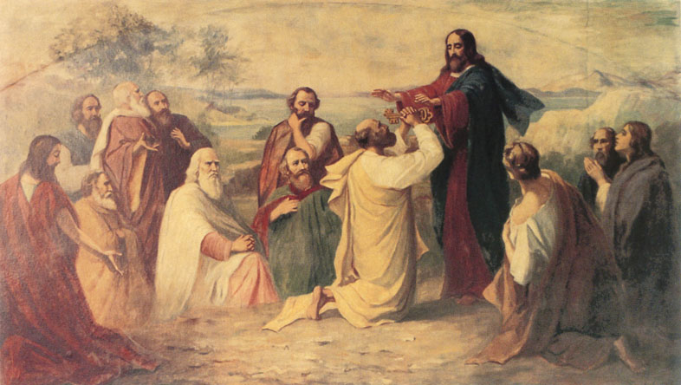
得着基督的启示

Slide 3
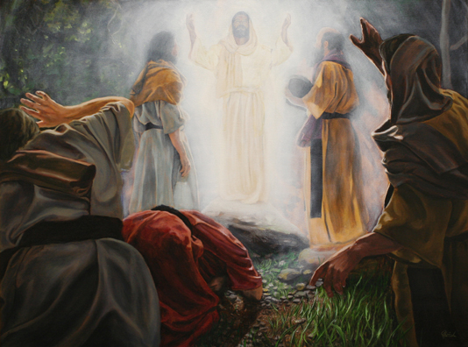
亲睹主的荣耀

Slide 4
亲睹主的荣耀
太 17:1-2 过了六天，耶稣带着彼得、雅各，和雅各的兄弟约翰，暗暗的上了高山， 就在他们面前变了形象，脸面明亮如日头，衣裳洁白如光。
Matt 17:1-2 And after six days Jesus taketh Peter, James, and John his brother, and bringeth them up into an high mountain apart, And was transfigured before them: and his face did shine as the sun, and his raiment was white as the light.

Slide 5
亲睹主的荣耀
太 17:3-4 忽然，有摩西、以利亚向他们显现，同耶稣说话。 彼得对耶稣说：主阿，我们在这里真好！你若愿意，我就在这里搭叁座棚，一座为你，一座为摩西，一座为以利亚。
Matt 17:3-4 And, behold, there appeared unto them Moses and Elias talking with him. Then answered Peter, and said unto Jesus, Lord, it is good for us to be here: if thou wilt, let us make here three tabernacles; one for thee, and one for Moses, and one for Elias.

Slide 6
亲睹主的荣耀
太 17:5-6 说话之间，忽然有一朵光明的云彩遮盖他们，且有声音从云彩里出来，说：这是我的爱子，我所喜悦的。你们要听他！ 门徒听见，就俯伏在地，极其害怕。
Matt 17:5-6 While he yet spake, behold, a bright cloud overshadowed them: and behold a voice out of the cloud, which said, This is my beloved Son, in whom I am well pleased; hear ye him. And when the disciples heard it, they fell on their face, and were sore afraid.

Slide 7
亲睹主的荣耀
太 17:7-9 耶稣进前来，摸他们，说：起来，不要害怕！ 他们举目不见一人，只见耶稣在那里。 下山的时候，耶稣吩咐他们说：人子还没有从死里复活，你们不要将所看见的告诉人。
Matt 17:7-9 And Jesus came and touched them, and said, Arise, and be not afraid. And when they had lifted up their eyes, they saw no man, save Jesus only. And as they came down from the mountain, Jesus charged them, saying, Tell the vision to no man, until the Son of man be risen again from the dead.

Slide 8
主的荣耀和我们有什么关系？

Slide 9
主的荣耀和我们有什么关系？
来 2:10-11 原来那为万物所属为万物所本的，要领许多的儿子进荣耀里去，使救他们的元帅，因受苦难得以完全，本是合宜的。 因那使人成圣的和那些得以成圣的，都是出于一。所以，他称他们为弟兄也不以为耻， Heb 2:10-11 For it became him, for whom are all things, and by whom are all things, in bringing many sons unto glory, to make the captain of their salvation perfect through sufferings. For both he that sanctifieth and they who are sanctified are all of one: for which cause he is not ashamed to call them brethren,

Slide 10
主的荣耀和我们有什么关系？
约 12:24-25 我实实在在的告诉你们，一粒麦子不落在地里死了，仍旧是一粒，若是死了，就结出许多子粒来。 爱惜自己生命的，就失丧生命；在这世上恨恶自己生命的，就要保守生命到永生。
John 12:24-25Verily, verily, I say unto you, Except a corn of wheat fall into the ground and die, it abideth alone: but if it die, it bringeth forth much fruit. He that loveth his life shall lose it; and he that hateth his life in this world shall keep it unto life eternal.

Slide 11
主的荣耀和我们有什么关系？
约 17:20-22 我不但为这些人祈求，也为那些因他们的话信我的人祈求， 使他们都合而为一。正如你父在我里面，我在你里面，使他们也在我们里面，叫世人可以信你差了我来。 你所赐给我的荣耀，我已赐给他们，使他们合而为一，象我们合而为一。 John 17:20-22 Neither pray I for these alone, but for them also which shall believe on me through their word; That they all may be one; as thou, Father, art in me, and I in thee, that they also may be one in us: that the world may believe that thou hast sent me. And the glory which thou gavest me I have given them; that they may be one, even as we are one:

Slide 12
主的荣耀和我们有什么关系？
西 2:9-10 因为神本性一切的丰盛都有形有体的居住在基督里面， 你们在他里面也得了丰盛。Col 2:9-10 For in him dwelleth all the fulness of the Godhead bodily. And ye are complete (pleroo: completely filled, completely full, perfect) in him.

Slide 13
主的荣耀和我们有什么关系？
约一 4:17 这样，爱在我们里面得以完全，我们就可以在审判的日子坦然无惧。因为他如何，我们在这世上也如何。
1 John 4:17 Herein is our love made perfect, that we may have boldness in the day of judgment: because as he is, so are we in this world.

Slide 14
如何活出主的荣耀？

Slide 15
如何活出主的荣耀？
林后 3:1-2 我们岂是又举荐自己么？岂象别人用人的荐信给你们或用你们的荐信给人么？ 你们就是我们的荐信，写在我们的心里，被众人所知道所念诵的。 2 Cor 3:1-2 Do we begin again to commend ourselves? or need we, as some others, epistles of commendation to you, or letters of commendation from you? Ye are our epistle written in our hearts, known and read of all men:

Slide 16
如何活出主的荣耀？
林后 3:3-4 你们明显是基督的信，藉着我们修成的。不是用墨写的，乃是用永生神的灵写的；不是写在石版上，乃是写在心版上。 我们因基督，所以在神面前纔有这样的信心。 2 Cor 3:3-4 Forasmuch as ye are manifestly declared to be the epistle of Christ ministered by us, written not with ink, but with the Spirit of the living God; not in tables of stone, but in fleshy tables of the heart. And such trust have we through Christ to God-ward:

Slide 17
如何活出主的荣耀？
林后 3:5-6 并不是我们凭自己能承担甚么事；我们所能承担的，乃是出于神。 他叫我们能承当这新约的执事，不是凭着字句，乃是凭着精意；因为那字句是叫人死，精意（或作：圣灵）是叫人活。
2 Cor 3:5-6 Not that we are sufficient of ourselves to think any thing as of ourselves; but our sufficiency is of God; Who also hath made us able ministers of the new testament; not of the letter, but of the spirit: for the letter killeth, but the spirit giveth life.

Slide 18
如何活出主的荣耀？
林后 3:7-8 那用字刻在石头上属死的职事尚且有荣光，甚至以色列人因摩西面上的荣光，不能定睛看他的脸；这荣光原是渐渐退去的， 何况那属灵的职事岂不更有荣光么？ 2 Cor 3:7-8 But if the ministration of death, written and engraven in stones, was glorious, so that the children of Israel could not stedfastly behold the face of Moses for the glory of his countenance; which glory was to be done away: How shall not the ministration of the spirit be rather glorious?

Slide 19
如何活出主的荣耀？
林后 3:9-11 若是定罪的职事有荣光，那称义的职事荣光就越发大了。 那从前有荣光的，因这极大的荣光就算不得有荣光了； 若那废掉的有荣光，这长存的就更有荣光了。 2 Cor 3:9-11 For if the ministration of condemnation be glory, much more doth the ministration of righteousness exceed in glory. For even that which was made glorious had no glory in this respect, by reason of the glory that excelleth. For if that which is done away was glorious, much more that which remaineth is glorious.

Slide 20
如何活出主的荣耀？
林后 3:12-13 我们既有这样的盼望，就大胆讲说， 不象摩西将帕子蒙在脸上，叫以色列人不能定睛看到那将废者的结局。
2 Cor 3:12-13 Seeing then that we have such hope, we use great plainness of speech: And not as Moses, which put a vail over his face, that the children of Israel could not stedfastly look to the end of that which is abolished:

Slide 21
如何活出主的荣耀？
林后 3:14-16 但他们的心地刚硬，直到今日诵读旧约的时候，这帕子还没有揭去。这帕子在基督里已经废去了。 然而直到今日，每逢诵读摩西书的时候，帕子还在他们心上。 但他们的心几时归向主，帕子就几时除去了。
2 Cor 3:14-16 But their minds were blinded: for until this day remaineth the same vail untaken away in the reading of the old testament; which vail is done away in Christ. But even unto this day, when Moses is read, the vail is upon their heart. Nevertheless when it shall turn to the Lord, the vail shall be taken away.

Slide 22
如何活出主的荣耀？
林后 3:17-18 主就是那灵；主的灵在那里，那里就得以自由。 我们众人既然敞着脸得以看见主的荣光，好象从镜子里返照，就变成主的形状，荣上加荣，如同从主的灵变成的。
2 Cor 3:17-18 Now the Lord is that Spirit: and where the Spirit of the Lord is, there is liberty. But we all, with open face beholding as in a glass the glory of the Lord, are changed into the same image from glory to glory, even as by the Spirit of the Lord.

Slide 23
如何活出主的荣耀？
雅 1:19-21 我亲爱的弟兄们，这是你们所知道的，但你们各人要快快的听，慢慢的说，慢慢的动怒， 因为人的怒气并不成就神的义。 所以，你们要脱去一切的污秽和盈余的邪恶，存温柔的心领受那所栽种的道，就是能救你们灵魂的道。 James 1:19-21 Wherefore, my beloved brethren, let every man be swift to hear, slow to speak, slow to wrath: For the wrath of man worketh not the righteousness of God. Wherefore lay apart all filthiness and superfluity of naughtiness, and receive with meekness the engrafted word, which is able to save your souls.

Slide 24
如何活出主的荣耀？
雅 1:22-24 只是你们要行道，不要单单听道，自己欺哄自己。 因为听道而不行道的，就象人对着镜子看自己本来的面目， 看见，走后，随即忘了他的相貌如何。
James 1:22-24 But be ye doers of the word, and not hearers only, deceiving your own selves. For if any be a hearer of the word, and not a doer, he is like unto a man beholding his natural face in a glass: For he beholdeth himself, and goeth his way, and straightway forgetteth what manner of man he was.

Slide 25
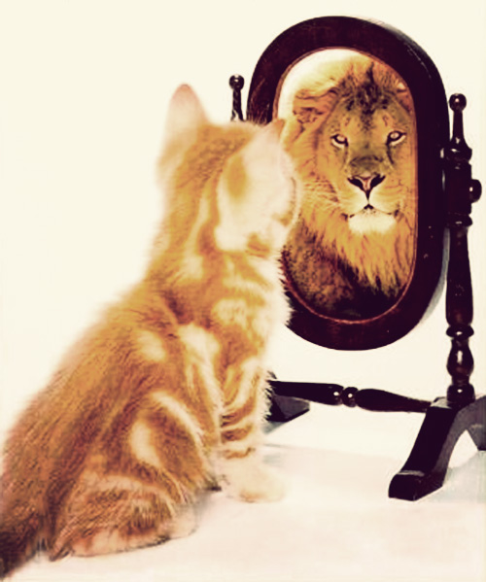
如何活出主的荣耀？
雅 1:25 唯有详细察看那全备、使人自由之律法的，并且时常如此，这人既不是听了就忘，乃是实在行出来，就在他所行的事上必然得福。
James 1:25 But whoso looketh into the perfect law of liberty, and continueth therein, he being not a forgetful hearer, but a doer of the work, this man shall be blessed in his deed.

