Slide 1
从西门到彼得
（3）

Slide 2

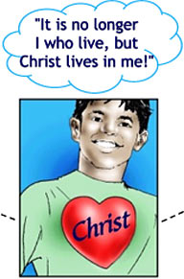
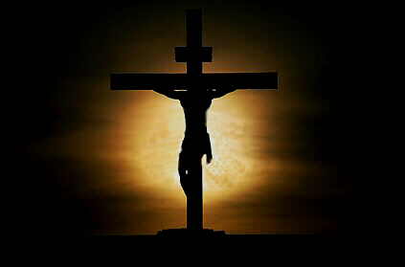

加 2:20 我已经与基督同钉十字架，现在活着的不再是我，乃是基督在我里面活着；并且我如今在肉身活着，是因信神的儿子而活；他是爱我，为我捨己。

Slide 3
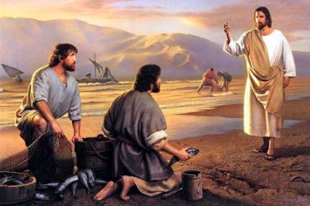
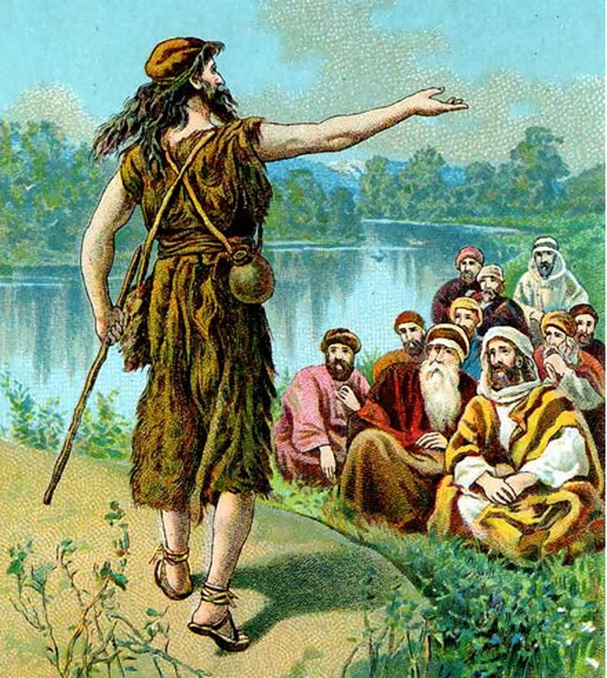
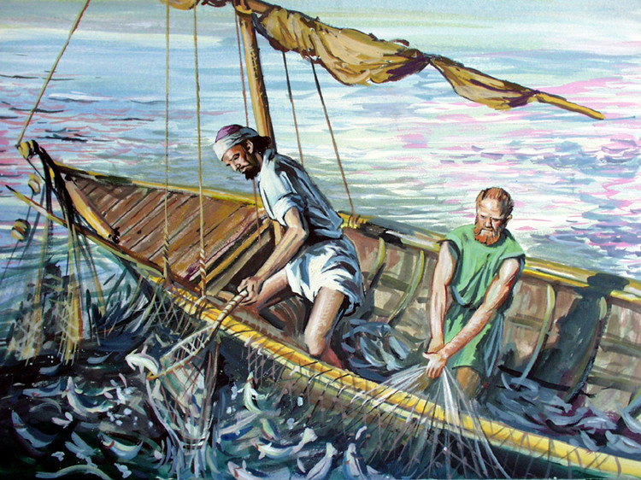

Slide 4
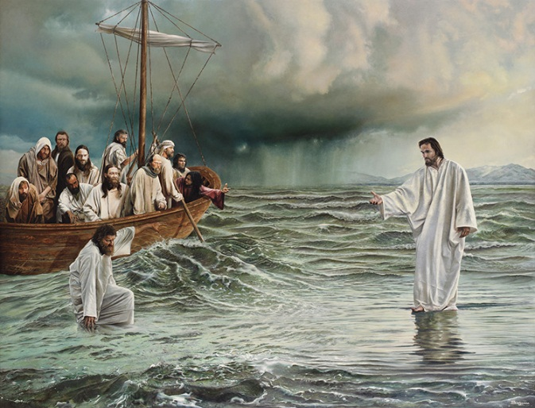
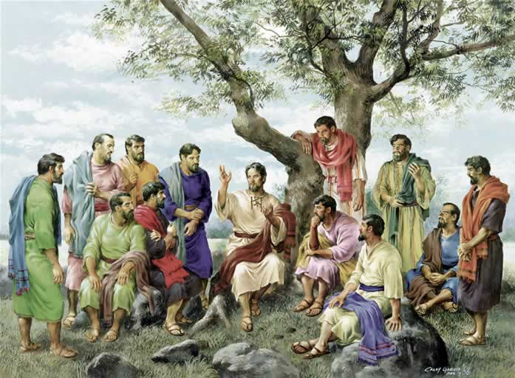
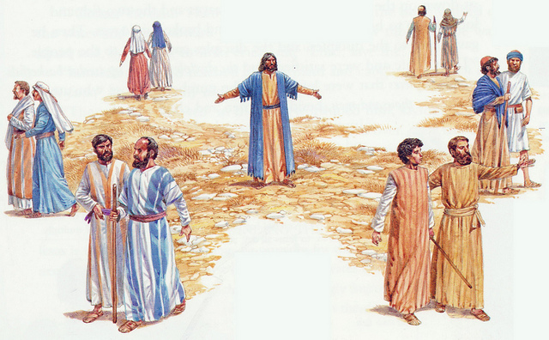

Slide 5
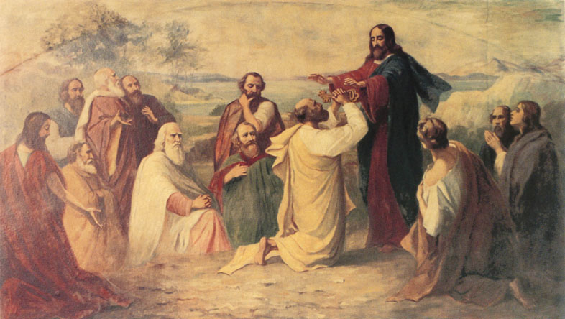
得着基督的启示

Slide 6
得着基督的启示
太 16:13-14 耶稣到了该撒利亚腓立比的境内，就问门徒说：人说我（有古卷没有我字）人子是谁？ 他们说：有人说是施洗的约翰；有人说是以利亚；又有人说是耶利米或是先知里的一位。
Matt 16:13-14 When Jesus came into the coasts of Caesarea Philippi, he asked his disciples, saying, Whom do men say that I the Son of man am? And they said, Some say that thou art John the Baptist: some, Elias; and others, Jeremias, or one of the prophets.

Slide 7
得着基督的启示
太 16:15-16 耶稣说：你们说我是谁？ 西门彼得回答说：你是基督，是永生神的儿子。
Matt 16:15-16 He saith unto them, But whom say ye that I am? And Simon Peter answered and said, Thou art the Christ, the Son of the living God.

Slide 8
得着基督的启示
太 16:17-18 耶稣对他说：西门巴约拿，你是有福的！因为这不是属血肉的指示你的，乃是我在天上的父指示的。 我还告诉你，你是彼得，我要把我的教会建造在这磐石上；阴间的权柄（权柄：原文是门），不能胜过他。
Matt 16:17-18 And Jesus answered and said unto him, Blessed art thou, Simon Barjona: for flesh and blood hath not revealed it unto thee, but my Father which is in heaven. And I say also unto thee, That thou art Peter (Petros: a piece of rock), and upon this rock (petra: a mass of rock) I will build my church; and the gates of hell shall not prevail against it.

Slide 9
得着基督的启示
太 16:17-18 耶稣对他说：西门巴约拿，你是有福的！因为这不是属血肉的指示你的，乃是我在天上的父指示的。 我还告诉你，你是彼得，我要把我的教会建造在这磐石上；阴间的权柄（权柄：原文是门），不能胜过他。
Matt 16:17-18 And Jesus answered and said unto him, Blessed art thou, Simon Barjona: for flesh and blood hath not revealed it unto thee, but my Father which is in heaven. And I say also unto thee, That thou art Peter (Petros: a piece of rock), and upon this rock (petra: a mass of rock) I will build my church; and the gates of hell shall not prevail against it.

Slide 10
得着基督的启示
太 16:17-18 耶稣对他说：西门巴约拿，你是有福的！因为这不是属血肉的指示你的，乃是我在天上的父指示的。 我还告诉你，你是彼得，我要把我的教会建造在这磐石上；阴间的权柄（权柄：原文是门），不能胜过他。
Matt 16:17-18 And Jesus answered and said unto him, Blessed art thou, Simon Barjona: for flesh and blood hath not revealed it unto thee, but my Father which is in heaven. And I say also unto thee, That thou art Peter (Petros: a piece of rock), and upon this rock (petra: a mass of rock) I will build my church; and the gates of hell shall not prevail against it.

Slide 11
多年以后的认知
彼前 2:4 主乃活石，固然是被人所弃的，却是被神所拣选、所宝贵的。
1 Peter 2:4 To whom coming, as unto a living stone, disallowed indeed of men, but chosen of God, and precious,

Slide 12
多年以后的认知
彼前 2:5-6 你们来到主面前，也就象活石，被建造成为灵宫，作圣洁的祭司，藉着耶稣基督奉献神所悦纳的灵祭。 因为经上说：看哪，我把所拣选、所宝贵的房角石安放在锡安；信靠他的人必不至于羞愧。1 Peter 2:5-6 Ye also, as lively stones, are built up a spiritual house, an holy priesthood, to offer up spiritual sacrifices, acceptable to God by Jesus Christ. Wherefore also it is contained in the scripture, Behold, I lay in Sion a chief corner stone, elect, precious: and he that believeth on him shall not be confounded.

Slide 13
加 2:20 我已经与基督同钉十字架，现在活着的不再是我，乃是基督在我里面活着；并且我如今在肉身活着，是因信神的儿子而活；他是爱我，为我捨己。

Slide 14
多年以后的认知
彼前 2:7-8 所以，他在你们信的人就为宝贵，在那不信的人有话说：匠人所弃的石头已作了房角的头块石头。 又说：作了绊脚的石头，跌人的磐石。他们既不顺从，就在道理上绊跌（或译：他们绊跌都因不顺从道理）；他们这样绊跌也是预定的。1 Peter 2:7-8 Unto you therefore which believe he is precious: but unto them which be disobedient, the stone which the builders disallowed, the same is made the head of the corner, And a stone of stumbling, and a rock of offence, even to them which stumble at the word, being disobedient: whereunto also they were appointed.

Slide 16
成为基督的代表（肢体）
太 16:19-20 我要把天国的钥匙给你，凡你在地上所捆绑的，在天上也要捆绑；凡你在地上所释放的，在天上也要释放。 当下，耶稣嘱咐门徒，不可对人说他是基督。
Matt 16:19-20 And I will give unto thee the keys of the kingdom of heaven: and whatsoever thou shalt bind on earth shall be bound in heaven: and whatsoever thou shalt loose on earth shall be loosed in heaven. Then charged he his disciples that they should tell no man that he was Jesus the Christ.

Slide 17
成为基督的代表（肢体）
约 20:19-20 那日（就是七日的第一日）晚上，门徒所在的地方，因怕犹太人，门都关了。耶稣来，站在当中，对他们说：愿你们平安！ 说了这话，就把手和肋旁指给他们看。门徒看见主，就喜乐了。
John 20:19-20 Then the same day at evening, being the first day of the week, when the doors were shut where the disciples were assembled for fear of the Jews, came Jesus and stood in the midst, and saith unto them, Peace be unto you. And when he had so said, he shewed unto them his hands and his side. Then were the disciples glad, when they saw the Lord.

Slide 18
成为基督的代表（肢体）
约 20:21-23 耶稣又对他们说：愿你们平安！父怎样差遣了我，我也照样差遣你们。 说了这话，就向他们吹一口气，说：你们受圣灵！ 你们赦免谁的罪，谁的罪就赦免了；你们留下谁的罪，谁的罪就留下了。 John 20:21-23 Then said Jesus to them again, Peace be unto you: as my Father hath sent me, even so send I you. And when he had said this, he breathed on them, and saith unto them, Receive ye the Holy Ghost: Whose soever sins ye remit, they are remitted unto them; and whose soever sins ye retain, they are retained.

Slide 19
赦罪还是定罪？？？
约 5:22 父不审判甚么人，乃将审判的事全交与子，
John 5:22 For the Father judgeth no man, but hath committed all judgment unto the Son:
约 5:30 我凭着自己不能做甚么，我怎么听见就怎么审判。我的审判也是公平的；因为我不求自己的意思，只求那差我来者的意思。John 5:30 I can of mine own self do nothing: as I hear, I judge: and my judgment is just; because I seek not mine own will, but the will of the Father which hath sent me.

Slide 20
赦罪还是定罪？？？
林后 5:18-19 一切都是出于神；他藉着基督使我们与他和好，又将劝人与他和好的职分赐给我们。 这就是神在基督里，叫世人与自己和好，不将他们的过犯归到他们身上，并且将这和好的道理託付了我们。
2Cor 5:18-19 And all things are of God, who hath reconciled us to himself by Jesus Christ, and hath given to us the ministry of reconciliation; To wit, that God was in Christ, reconciling the world unto himself, not imputing their trespasses unto them; and hath committed unto us the word of reconciliation.

Slide 21
赦罪还是定罪？？？
罗 3:23-24 因为世人都犯了罪，亏缺了神的荣耀； 如今却蒙神的恩典，因基督耶稣的救赎，就白白的称义。
Rom 3:23-24 For all have sinned, and come short of the glory of God; Being justified freely by his grace through the redemption that is in Christ Jesus:

Slide 22
赦罪还是定罪？？？
罗 5:18-19 如此说来，因一次的过犯，众人都被定罪；照样，因一次的义行，众人也就被称义得生命了。 因一人的悖逆，众人成为罪人；照样，因一人的顺从，众人也成为义了。
Rom 5:18-19 Therefore as by the offence of one judgment came upon all men to condemnation; even so by the righteousness of one the free gift came upon all men unto justification of life. For as by one man's disobedience many were made sinners, so by the obedience of one shall many be made righteous.

Slide 23
赦罪还是定罪？？？
林后 3:9-10 若是定罪的职事有荣光，那称义的职事荣光就越发大了。 那从前有荣光的，因这极大的荣光就算不得有荣光了；
2 Cor 3:9-10 For if the ministration of condemnation be glory, much more doth the ministration of righteousness exceed in glory. For even that which was made glorious had no glory in this respect, by reason of the glory that excelleth.

Slide 24
赦罪还是定罪？？？
罗 10:12-13 犹太人和希腊人并没有分别，因为众人同有一位主；他也厚待一切求告他的人。 因为凡求告主名的，就必得救。
Rom 10:12-13 For there is no difference between the Jew and the Greek: for the same Lord over all is rich unto all that call upon him. For whosoever shall call upon the name of the Lord shall be saved.

Slide 25
赦罪还是定罪？？？
罗 10:14-15 然而，人未曾信他，怎能求他呢？未曾听见他，怎能信他呢？没有传道的，怎能听见呢？ 若没有奉差遣，怎能传道呢？如经上所记：报福音、传喜信的人，他们的脚踪何等佳美。Rom 10:14-15 How then shall they call on him in whom they have not believed? and how shall they believe in him of whom they have not heard? and how shall they hear without a preacher? And how shall they preach, except they be sent? as it is written, How beautiful are the feet of them that preach the gospel of peace, and bring glad tidings of good things!

Slide 26
赦罪还是定罪？？？
约 12:47-48 若有人听见我的话不遵守，我不审判他。我来本不是要审判世界，乃是要拯救世界。 弃绝我、不领受我话的人，有审判他的---就是我所讲的道在末日要审判他。
John 12:47-48And if any man hear my words, and believe not, I judge him not: for I came not to judge the world, but to save the world. He that rejecteth me, and receiveth not my words, hath one that judgeth him: the word that I have spoken, the same shall judge him in the last day.

Slide 27
得着基督的启示之后…

Slide 28
得着基督的启示之后…
太 16:21-22 从此，耶稣纔指示门徒，他必须上耶路撒冷去，受长老、祭司长、文士许多的苦，并且被杀，第叁日复活。 彼得就拉着他，劝他说：主阿，万不可如此！这事必不临到你身上。 Matt 16:21-22 From that time forth began Jesus to shew unto his disciples, how that he must go unto Jerusalem, and suffer many things of the elders and chief priests and scribes, and be killed, and be raised again the third day. Then Peter took him, and began to rebuke him, saying, Be it far from thee, Lord: this shall not be unto thee.

Slide 29
得着基督的启示之后…
太 16:23-24 耶稣转过来，对彼得说：撒但，退我后边去罢！你是绊我脚的；因为你不体贴神的意思，只体贴人的意思。 于是耶稣对门徒说：若有人要跟从我，就当捨己，背起他的十字架来跟从我。
Matt 16:23-24 But he turned, and said unto Peter, Get thee behind me, Satan: thou art an offence unto me: for thou savourest not the things that be of God, but those that be of men. Then said Jesus unto his disciples, If any man will come after me, let him deny himself, and take up his cross, and follow me.

Slide 30
得着基督的启示之后…
太 16:25-26 因为，凡要救自己生命（生命：或作灵魂；下同）的，必丧掉生命；凡为我丧掉生命的，必得着生命。 人若赚得全世界，赔上自己的生命，有甚么益处呢？人还能拿甚么换生命呢？
Matt 16:25-26 For whosoever will save his life shall lose it: and whosoever will lose his life for my sake shall find it. For what is a man profited, if he shall gain the whole world, and lose his own soul? or what shall a man give in exchange for his soul?

Slide 31
加 2:20 我已经与基督同钉十字架，现在活着的不再是我，乃是基督在我里面活着；并且我如今在肉身活着，是因信神的儿子而活；他是爱我，为我捨己。

