Slide 1
从西门到彼得
（2）

Slide 2
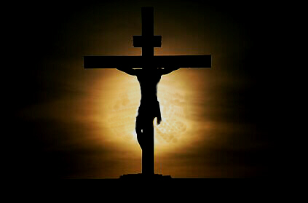
加 2:20 我已经与基督同钉十字架，现在活着的不再是我，乃是基督在我里面活着；并且我如今在肉身活着，是因信神的儿子而活；他是爱我，为我捨己。

Slide 3
The Greatest Exchange
最伟大的交换
林后 5:21 神使那无罪（无罪：原文是不知罪）的，替我们成为罪，好叫我们在他里面成为神的义。
2 Cor 5:21 For he hath made him to be sin for us, who knew no sin; that we might be made the righteousness of God in him.

Slide 4
The Greatest Exchange
最伟大的交换
林后 8:9 你们知道我们主耶稣基督的恩典：他本来富足，却为你们成了贫穷，叫你们因他的贫穷，可以成为富足。
2 Cor 8:9 For ye know the grace of our Lord Jesus Christ, that, though he was rich, yet for your sakes he became poor, that ye through his poverty might be rich.

Slide 5
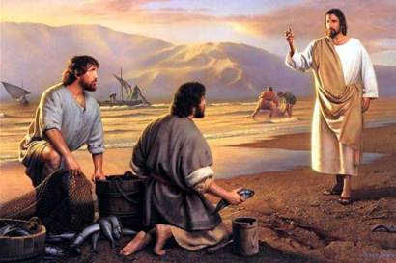
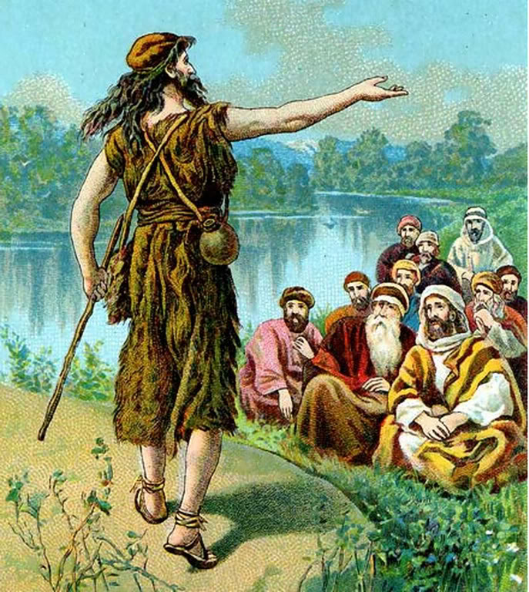
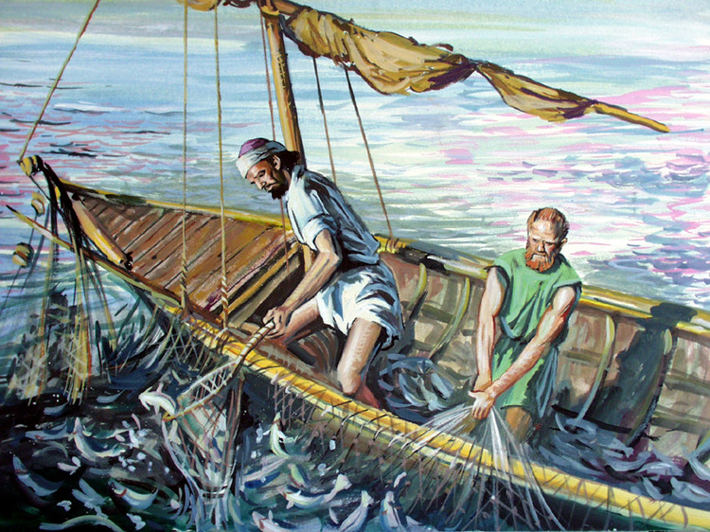

Slide 6
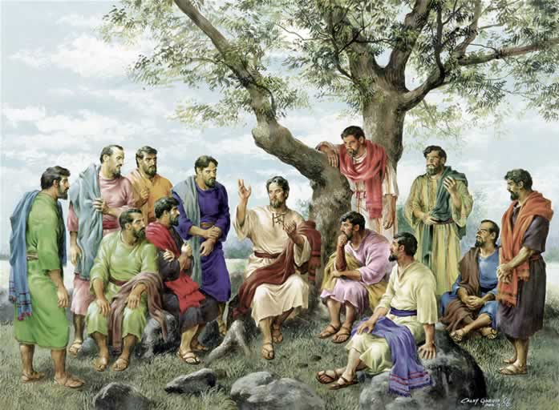
被召为使徒

Slide 7
被召为使徒
可 3:13-15 耶稣上了山，随自己的意思叫人来；他们便来到他那里。 他就设立十二个人，要他们常和自己同在，也要差他们去传道， 并给他们权柄赶鬼。 Mark 3:13-15 And he goeth up into a mountain, and calleth unto him whom he would: and they came unto him. And he ordained twelve, that they should be with him, and that he might send them forth to preach, And to have power to heal sicknesses, and to cast out devils:

Slide 8
被召为使徒
可 3:16-17 这十二个人有西门―耶稣又给他起名叫彼得， 还有西庇太的儿子雅各和雅各的兄弟约翰，又给这两个人起名叫半尼其，就是雷子的意思， Mark 3:16-17 And Simon he surnamed Peter; And James the son of Zebedee, and John the brother of James; and he surnamed them Boanerges, which is, The sons of thunder:

Slide 9
被召为使徒
可 3:18-19 又有安得烈、腓力、巴多罗买、马太、多马、亚勒腓的儿子雅各、和达太，并奋锐党的西门； 还有卖耶稣的加略人犹大。
Mark 3:18-19 And Andrew, and Philip, and Bartholomew, and Matthew, and Thomas, and James the son of Alphaeus, and Thaddaeus, and Simon the Canaanite, And Judas Iscariot, which also betrayed him: and they went into an house.

Slide 10
被召为使徒
路 6:12-13 那时，耶稣出去，上山祷告，整夜祷告神； 到了天亮，叫他的门徒来，就从他们中间挑选十二个人，称他们为使徒。
Luke 6:12-13 And it came to pass in those days, that he went out into a mountain to pray, and continued all night in prayer to God. And when it was day, he called unto him his disciples: and of them he chose twelve, whom also he named apostles;

Slide 11
被召为使徒
路 6:6-7 又有一个安息日，耶稣进了会堂教训人，在那里有一个人右手枯乾了。 文士和法利赛人窥探耶稣，在安息日治病不治病，要得把柄去告他。
Luke 6:6-7 And it came to pass also on another sabbath, that he entered into the synagogue and taught: and there was a man whose right hand was withered. And the scribes and Pharisees watched him, whether he would heal on the sabbath day; that they might find an accusation against him.

Slide 12
被召为使徒
路 6:8-9耶稣却知道他们的意念，就对那枯乾一隻手的人说：起来！站在当中。那人就起来，站着。 耶稣对他们说：我问你们，在安息日行善行恶，救命害命，那样是可以的呢？ Luke 6:8-9 But he knew their thoughts, and said to the man which had the withered hand, Rise up, and stand forth in the midst. And he arose and stood forth. Then said Jesus unto them, I will ask you one thing; Is it lawful on the sabbath days to do good, or to do evil? to save life, or to destroy it?

Slide 13
被召为使徒
路 6:10-11 他就周围看着他们众人，对那人说：伸出手来！他把手一伸，手就复了原。 他们就满心大怒，彼此商议怎样处治耶稣。
Luke 6:10-11 And looking round about upon them all, he said unto the man, Stretch forth thy hand. And he did so: and his hand was restored whole as the other. And they were filled with madness; and communed one with another what they might do to Jesus.

Slide 14
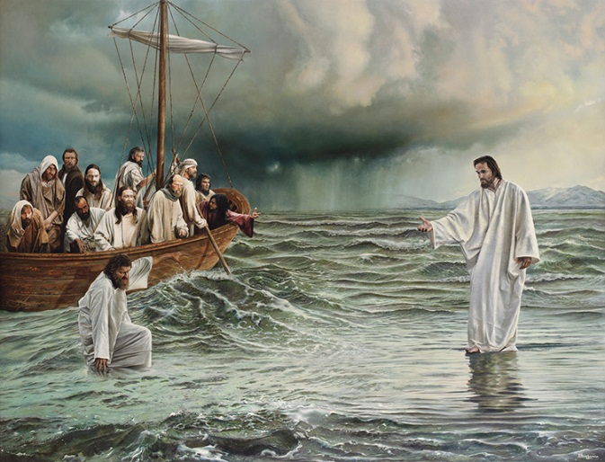
经历神迹

Slide 15
经历神迹
太 14:20-22 他们都吃，并且吃饱了；把剩下的零碎收拾起来，装满了十二个篮子。 吃的人，除了妇女孩子，约有五千。 耶稣随即催门徒上船，先渡到那边去，等他叫众人散开。 Matt 14:20-22 And they did all eat, and were filled: and they took up of the fragments that remained twelve baskets full. And they that had eaten were about five thousand men, beside women and children. And straightway Jesus constrained his disciples to get into a ship, and to go before him unto the other side, while he sent the multitudes away.

Slide 16
经历神迹
太 14:23-25 散了众人以后，他就独自上山去祷告。到了晚上，只有他一人在那里。 那时船在海中，因风不顺，被浪摇撼。 夜里四更天，耶稣在海面上走，往门徒那里去。 Matt 14:23-25 And when he had sent the multitudes away, he went up into a mountain apart to pray: and when the evening was come, he was there alone. But the ship was now in the midst of the sea, tossed with waves: for the wind was contrary. And in the fourth watch of the night Jesus went unto them, walking on the sea.

Slide 17
经历神迹
太 14:26-28 门徒看见他在海面上走，就惊慌了，说：是个鬼怪！便害怕，喊叫起来。 耶稣连忙对他们说：你们放心！是我，不要怕！ 彼得说：主，如果是你，请叫我从水面上走到你那里去。 Matt 14:26-28 And when the disciples saw him walking on the sea, they were troubled, saying, It is a spirit; and they cried out for fear. But straightway Jesus spake unto them, saying, Be of good cheer; it is I; be not afraid. And Peter answered him and said, Lord, if it be thou, bid me come unto thee on the water.

Slide 18
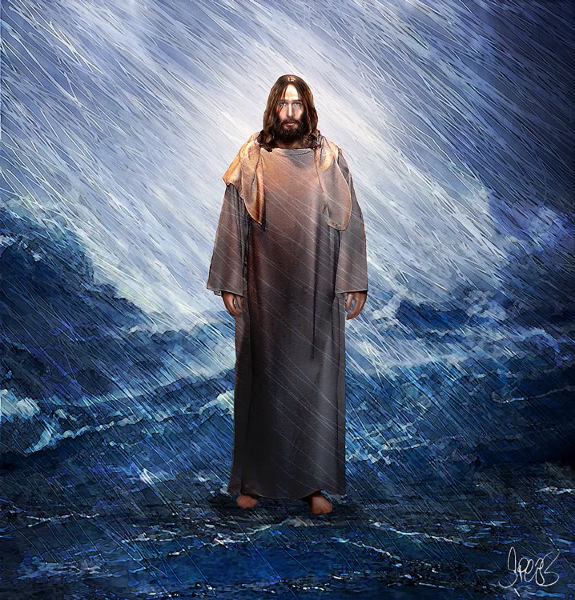
经历神迹
太 14:29 耶稣说：你来罢。彼得就从船上下去，在水面上走，要到耶稣那里去； Matt 14:29 And he said, Come. And when Peter was come down out of the ship, he walked on the water, to go to Jesus.

Slide 19
经历神迹
太 14:30 只因见风甚大，就害怕，将要沉下去，便喊着说：主阿，救我！
Matt 14:30 But when he saw the wind boisterous, he was afraid; and beginning to sink, he cried, saying, Lord, save me.

Slide 20
经历神迹
太 14:31 耶稣赶紧伸手拉住他，说：你这小信的人哪，为甚么疑惑呢？
Matt 14:31 And immediately Jesus stretched forth his hand, and caught him, and said unto him, O thou of little faith, wherefore didst thou doubt?

Slide 21
经历神迹
太 14:32-33 他们上了船，风就住了。 在船上的人都拜他，说：你真是神的儿子了。
Matt 14:32-33 And when they were come into the ship, the wind ceased. Then they that were in the ship came and worshipped him, saying, Of a truth thou art the Son of God.

Slide 22
加 2:20 我已经与基督同钉十字架，现在活着的不再是我，乃是基督在我里面活着；并且我如今在肉身活着，是因信神的儿子而活；他是爱我，为我捨己。

Slide 23
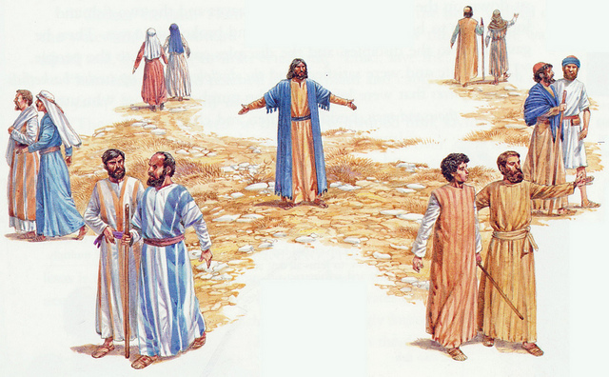
被差传道

Slide 24
被差传道
太 10:1-2 耶稣叫了十二个门徒来，给他们权柄，能赶逐污鬼，并医治各样的病症。 这十二使徒的名：头一个叫西门、又称彼得，还有他兄弟安得烈，西庇太的儿子雅各和雅各的兄弟约翰， Matt 10:1-2 And when he had called unto him his twelve disciples, he gave them power against unclean spirits, to cast them out, and to heal all manner of sickness and all manner of disease. Now the names of the twelve apostles are these; The first, Simon, who is called Peter, and Andrew his brother; James the son of Zebedee, and John his brother;

Slide 25
被差传道
太 10:3-4 腓力和巴多罗买，多马和税吏马太，亚勒腓的儿子雅各，和达太， 奋锐党的西门，还有卖耶稣的加略人犹大。
Matt 10:3-4 Philip, and Bartholomew; Thomas, and Matthew the publican; James the son of Alphaeus, and Lebbaeus, whose surname was Thaddaeus; Simon the Canaanite, and Judas Iscariot, who also betrayed him.

Slide 26
被差传道
太 10:5-6 耶稣差这十二个人去，吩咐他们说：外邦人的路，你们不要走；撒玛利亚人的城，你们不要进； 宁可往以色列家迷失的羊那里去。
Matt 10:5-6 These twelve Jesus sent forth, and commanded them, saying, Go not into the way of the Gentiles, and into any city of the Samaritans enter ye not: But go rather to the lost sheep of the house of Israel.

Slide 27
被差传道
太 10:7-8 随走随传，说天国近了！ 医治病人，叫死人复活，叫长大痲疯的洁净，把鬼赶出去。你们白白的得来，也要白白的捨去。
Matt 10:7-8 And as ye go, preach, saying, The kingdom of heaven is at hand. Heal the sick, cleanse the lepers, raise the dead, cast out devils: freely ye have received, freely give.

Slide 28
被差传道
太 10:9-10 腰袋里不要带金银铜钱。 行路不要带口袋；不要带两件褂子，也不要带鞋和柺杖。因为工人得饮食是应当的。
Matt 10:9-10 Provide neither gold, nor silver, nor brass in your purses, Nor scrip for your journey, neither two coats, neither shoes, nor yet staves: for the workman is worthy of his meat.

Slide 29
被差传道
太 10:11-12 你们无论进那一城，那一村，要打听那里谁是好人，就住在他家，直住到走的时候。 进他家里去，要请他的安。
Matt 10:11-12 And into whatsoever city or town ye shall enter, enquire who in it is worthy; and there abide till ye go thence. And when ye come into an house, salute it.

Slide 30
被差传道
太 10:13-14 那家若配得平安，你们所求的平安就必临到那家；若不配得，你们所求的平安仍归你们。 凡不接待你们、不听你们话的人，你们离开那家，或是那城的时候，就把脚上的尘土跺下去。
Matt 10:13-14 And if the house be worthy, let your peace come upon it: but if it be not worthy, let your peace return to you. And whosoever shall not receive you, nor hear your words, when ye depart out of that house or city, shake off the dust of your feet.

