Slide 1

住在基督里
（47）

Slide 2

住在基督里的生活
弗5:15 你们要谨慎行事，不要象愚昧人，当象智慧人。5:16 要爱惜（赎回）光阴，因为现今的世代邪恶。5:17 不要作糊涂人，要明白主的旨意如何。 5:18 不要醉酒，酒能使人放蕩；乃要被圣灵充满。5:19 当用诗章、颂词、灵歌、彼此对说，口唱心和的赞美主。5:20 凡事要奉我们主耶稣基督的名常常感谢父神。
时间掌握在谁的手里？
可4:21 耶稣又对他们说：人拿灯来，岂是要放在斗底下，床底下，不放在灯臺上么？ 4:22 因为掩藏的事，没有不显出来的；隐瞒的事，没有不露出来的。 4:23 有耳可听的，就应当听！ 4:24 又说：你们所听的要留心。你们用甚么量器量给人，也必用甚么量器量给你们，并且要多给你们。 4:25 因为有的，还要给他；没有的，连他所有的也要夺去。 4:26 又说：神的国如同人把种撒在地上。 4:27 黑夜睡觉，白日起来，这种就发芽渐长，那人却不晓得如何这样。 4:28 地生五榖是出于自然的：先发苗，后长穗，再后穗上结成饱满的子粒； 4:29 榖既熟了，就用镰刀去割，因为收成的时候到了。
Eph 5:15 See then that you walk circumspectly, not as fools but as wise, 5:16 redeeming the time, because the days are evil. 5:17 Therefore do not be unwise, but understand what the will of the Lord is. 5:18 And do not be drunk with wine, in which is dissipation; but be filled with the Spirit, 5:19 speaking to one another in psalms and hymns and spiritual songs, singing and making melody in your heart to the Lord, 5:20 giving thanks always for all things to God the Father in the name of our Lord Jesus Christ,

Slide 3
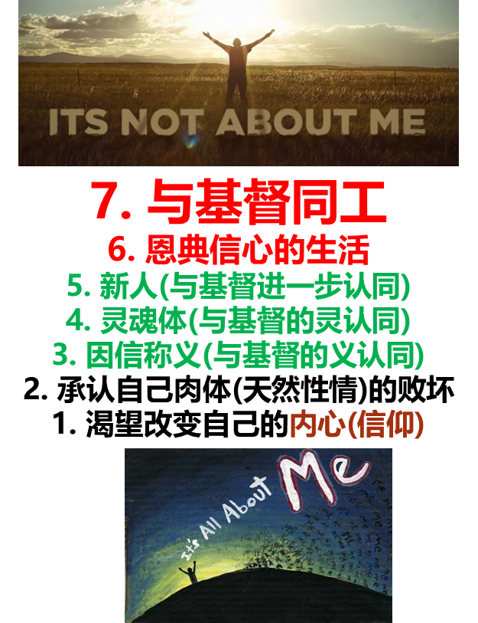
住在基督里的生活
弗5:15 你们要谨慎行事，不要象愚昧人，当象智慧人。5:16 要爱惜（赎回）光阴，因为现今的世代邪恶。5:17 不要作糊涂人，要明白主的旨意如何。 5:18 不要醉酒，酒能使人放蕩；乃要被圣灵充满。5:19 当用诗章、颂词、灵歌、彼此对说，口唱心和的赞美主。5:20 凡事要奉我们主耶稣基督的名常常感谢父神。
时间掌握在谁的手里？
罗12:2 不要效法这个世界，只要心意(nous) 更新而变化，叫你们察验何为神的善良、纯全、可喜悦的旨意
Eph 5:15 See then that you walk circumspectly, not as fools but as wise, 5:16 redeeming the time, because the days are evil. 5:17 Therefore do not be unwise, but understand what the will of the Lord is. 5:18 And do not be drunk with wine, in which is dissipation; but be filled with the Spirit, 5:19 speaking to one another in psalms and hymns and spiritual songs, singing and making melody in your heart to the Lord, 5:20 giving thanks always for all things to God the Father in the name of our Lord Jesus Christ,
nous：内心相信/接受的思想，特别是所相信的基本原则及价值体系。通过接受从外界而来的信息而建立，是人衡量、理解事物的依据。

Slide 4
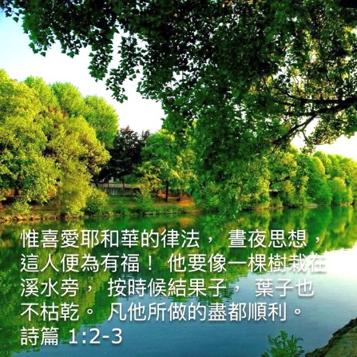
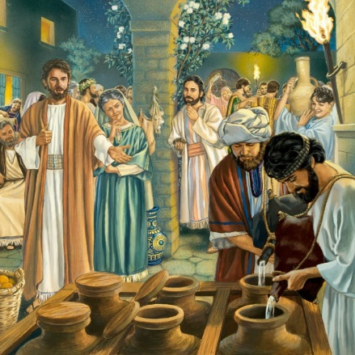
住在基督里的生活
弗5:15 你们要谨慎行事，不要象愚昧人，当象智慧人。5:16 要爱惜（赎回）光阴，因为现今的世代邪恶。5:17 不要作糊涂人，要明白主的旨意如何。5:18 不要醉酒，酒能使人放蕩；乃要被圣灵充满。5:19 当用诗章、颂词、灵歌、彼此对说，口唱心和的赞美主。5:20 凡事要奉我们主耶稣基督的名常常感谢父神。5:21 又当存敬畏基督的心，彼此顺服。
如何被圣灵充满？
罗12:2 不要效法这个世界，只要心意(nous) 更新而变化，叫你们察验何为神的善良、纯全、可喜悦的旨意
Eph 5:15 See then that you walk circumspectly, not as fools but as wise, 5:16 redeeming the time, because the days are evil. 5:17 Therefore do not be unwise, but understand what the will of the Lord is. 5:18 And do not be drunk with wine, in which is dissipation; but be filled with the Spirit, 5:19 speaking to one another in psalms and hymns and spiritual songs, singing and making melody in your heart to the Lord, 5:20 giving thanks always for all things to God the Father in the name of our Lord Jesus Christ, 5:21 submitting to one another in the fear of God.
nous：内心相信/接受的思想，特别是所相信的基本原则及价值体系。通过接受从外界而来的信息而建立，是人衡量、理解事物的依据。

Slide 5
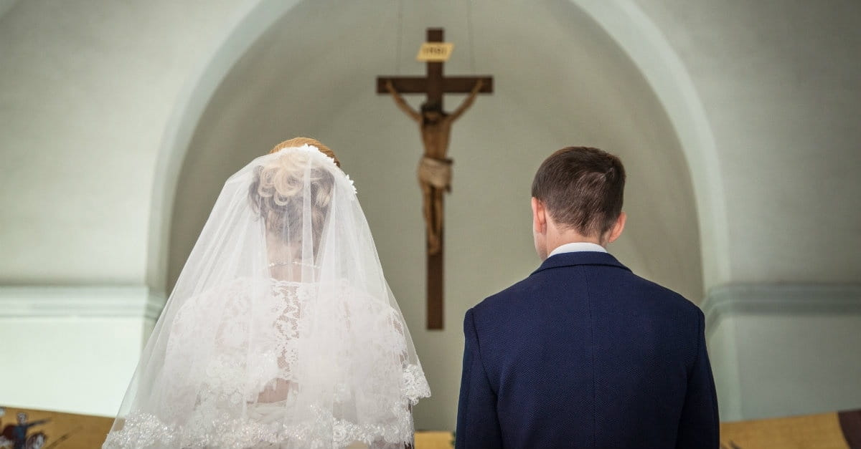
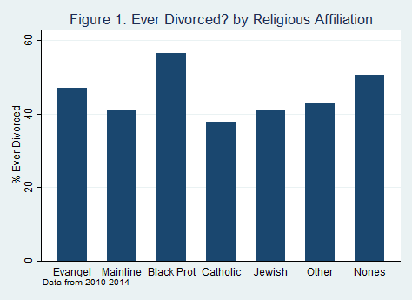
住在基督里的生活
弗5:22 你们作妻子的，当顺服自己的丈夫，如同顺服主。 5:23 因为丈夫是妻子的头，如同基督是教会的头；他又是教会全体的救主。 5:24 教会怎样顺服基督，妻子也要怎样凡事顺服丈夫。 5:25 你们作丈夫的，要爱你们的妻子，正如基督爱教会，为教会捨己。 5:26 要用水藉着道 (rhema) 把教会洗净，成为圣洁， 5:27 可以献给自己，作个荣耀的教会，毫无玷污、皱纹等类的病，乃是圣洁没有瑕疵的。
Eph 5:22 Wives, submit to your own husbands, as to the Lord. 5:23 For the husband is head of the wife, as also Christ is head of the church; and He is the Savior of the body. 5:24 Therefore, just as the church is subject to Christ, so let the wives be to their own husbands in everything. 5:25 Husbands, love your wives, just as Christ also loved the church and gave Himself for her, 5:26 that He might sanctify and cleanse her with the washing of water by the word, 5:27 that He might present her to Himself a glorious church, not having spot or wrinkle or any such thing, but that she should be holy and without blemish.
https://ifstudies.org/blog/what-god-has-joined-together-religion-and-the-risk-of-divorce

Slide 6


住在基督里的生活
弗5:22 你们作妻子的，当顺服自己的丈夫，如同顺服主。 5:23 因为丈夫是妻子的头，如同基督是教会的头；他又是教会全体的救主。 5:24 教会怎样顺服基督，妻子也要怎样凡事顺服丈夫。 5:25 你们作丈夫的，要爱你们的妻子，正如基督爱教会，为教会捨己。 5:26 要用水藉着道 (rhema) 把教会洗净，成为圣洁， 5:27 可以献给自己，作个荣耀的教会，毫无玷污、皱纹等类的病，乃是圣洁没有瑕疵的。
通常关于顺服的教导
顺服这个字的定义是：顺从计划；符合其样式；遵守其规则；坚守其标准；服从其目的。基督徒生活中的“底线”就是顺服。
顺服就是按照神的时间和方式做事情。
需要像耶稣一样了解圣经（马太福音4章1-10节），有听命的决心，并愿意承担任何后果的意念，这就是顺服。
Eph 5:22 Wives, submit to your own husbands, as to the Lord. 5:23 For the husband is head of the wife, as also Christ is head of the church; and He is the Savior of the body. 5:24 Therefore, just as the church is subject to Christ, so let the wives be to their own husbands in everything. 5:25 Husbands, love your wives, just as Christ also loved the church and gave Himself for her, 5:26 that He might sanctify and cleanse her with the washing of water by the word, 5:27 that He might present her to Himself a glorious church, not having spot or wrinkle or any such thing, but that she should be holy and without blemish.

Slide 7
住在基督里的生活
弗5:22 你们作妻子的，当顺服自己的丈夫，如同顺服主。 5:23 因为丈夫是妻子的头，如同基督是教会的头；他又是教会全体的救主。 5:24 教会怎样顺服基督，妻子也要怎样凡事顺服丈夫。 5:25 你们作丈夫的，要爱你们的妻子，正如基督爱教会，为教会捨己。 5:26 要用水藉着道 (rhema) 把教会洗净，成为圣洁， 5:27 可以献给自己，作个荣耀的教会，毫无玷污、皱纹等类的病，乃是圣洁没有瑕疵的。
顺服究竟是什么？
林前15:23 但各人是按着自己的次序复活：初熟的果子是基督；以后，在他来的时候，是那些属基督的。 15:24 再后，末期到了，那时基督既将一切执政的、掌权的、有能的、都毁灭了，就把国交与父神。 15:25 因为基督必要作王，等神把一切仇敌都放在他的脚下。 15:26 儘末了所毁灭的仇敌，就是死。 15:27 因为经上说：神叫万物都服在他的脚下。既说万物都服了他，明显那叫万物服他的，不在其内了。 15:28 万物既服了他，那时子也要自己服那叫万物服他的，叫神在万物之上，为万物之主。
Eph 5:22 Wives, submit to your own husbands, as to the Lord. 5:23 For the husband is head of the wife, as also Christ is head of the church; and He is the Savior of the body. 5:24 Therefore, just as the church is subject to Christ, so let the wives be to their own husbands in everything. 5:25 Husbands, love your wives, just as Christ also loved the church and gave Himself for her, 5:26 that He might sanctify and cleanse her with the washing of water by the word, 5:27 that He might present her to Himself a glorious church, not having spot or wrinkle or any such thing, but that she should be holy and without blemish.

Slide 8

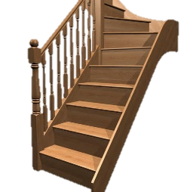
住在基督里的生活
弗5:22 你们作妻子的，当顺服自己的丈夫，如同顺服主。 5:23 因为丈夫是妻子的头，如同基督是教会的头；他又是教会全体的救主。 5:24 教会怎样顺服基督，妻子也要怎样凡事顺服丈夫。 5:25 你们作丈夫的，要爱你们的妻子，正如基督爱教会，为教会捨己。 5:26 要用水藉着道 (rhema) 把教会洗净，成为圣洁， 5:27 可以献给自己，作个荣耀的教会，毫无玷污、皱纹等类的病，乃是圣洁没有瑕疵的。
顺服究竟是什么？
顺服 （submit）：Hupotasso
（内心）让自己处于低于对方的位置
1. to arrange under, to subordinate
2. to subject, put in subjection
3. to subject one's self, obey
4. to submit to one's control
5. to yield to one's admonition or advice
6. to obey, be subject
Eph 5:22 Wives, submit to your own husbands, as to the Lord. 5:23 For the husband is head of the wife, as also Christ is head of the church; and He is the Savior of the body. 5:24 Therefore, just as the church is subject to Christ, so let the wives be to their own husbands in everything. 5:25 Husbands, love your wives, just as Christ also loved the church and gave Himself for her, 5:26 that He might sanctify and cleanse her with the washing of water by the word, 5:27 that He might present her to Himself a glorious church, not having spot or wrinkle or any such thing, but that she should be holy and without blemish.

Slide 9

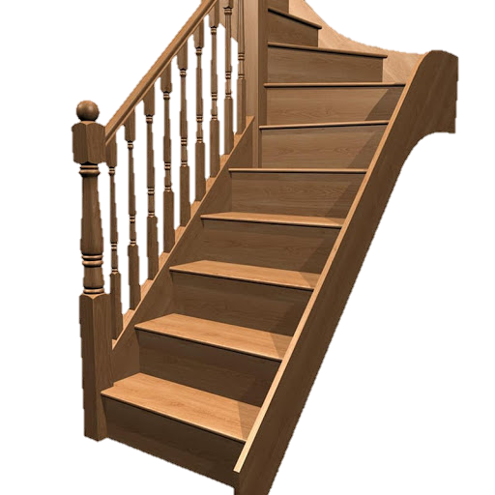

住在基督里的生活
弗5:22 你们作妻子的，当顺服自己的丈夫，如同顺服主。 5:23 因为丈夫是妻子的头，如同基督是教会的头；他又是教会全体的救主。 5:24 教会怎样顺服基督，妻子也要怎样凡事顺服丈夫。 5:25 你们作丈夫的，要爱你们的妻子，正如基督爱教会，为教会捨己。 5:26 要用水藉着道 (rhema) 把教会洗净，成为圣洁， 5:27 可以献给自己，作个荣耀的教会，毫无玷污、皱纹等类的病，乃是圣洁没有瑕疵的。
弗5:21 又当存敬畏基督的心，彼此顺服。
行政职位
身价
社会地位
个人价值
认知能力
Eph 5:22 Wives, submit to your own husbands, as to the Lord. 5:23 For the husband is head of the wife, as also Christ is head of the church; and He is the Savior of the body. 5:24 Therefore, just as the church is subject to Christ, so let the wives be to their own husbands in everything. 5:25 Husbands, love your wives, just as Christ also loved the church and gave Himself for her, 5:26 that He might sanctify and cleanse her with the washing of water by the word, 5:27 that He might present her to Himself a glorious church, not having spot or wrinkle or any such thing, but that she should be holy and without blemish.

Slide 10




住在基督里的生活
弗5:22 你们作妻子的，当顺服自己的丈夫，如同顺服主。 5:23 因为丈夫是妻子的头，如同基督是教会的头；他又是教会全体的救主。 5:24 教会怎样顺服基督，妻子也要怎样凡事顺服丈夫。 5:25 你们作丈夫的，要爱你们的妻子，正如基督爱教会，为教会捨己。 5:26 要用水藉着道 (rhema) 把教会洗净，成为圣洁， 5:27 可以献给自己，作个荣耀的教会，毫无玷污、皱纹等类的病，乃是圣洁没有瑕疵的。
为什么我们很难做到谦卑？
创3:4 蛇对女人说：你们不一定死；3:5 因为 神知道，你们吃的日子眼睛就明亮了，你们便如神能知道善恶。
肉体
解决方法1
（学业、成就）
自我
依靠
Eph 5:22 Wives, submit to your own husbands, as to the Lord. 5:23 For the husband is head of the wife, as also Christ is head of the church; and He is the Savior of the body. 5:24 Therefore, just as the church is subject to Christ, so let the wives be to their own husbands in everything. 5:25 Husbands, love your wives, just as Christ also loved the church and gave Himself for her, 5:26 that He might sanctify and cleanse her with the washing of water by the word, 5:27 that He might present her to Himself a glorious church, not having spot or wrinkle or any such thing, but that she should be holy and without blemish.
解决方法2
（钱财）
解决方法3
（男女关系）
希望别人也不好
缺乏2
缺乏1
缺乏3
撒但的谎言：
你没有，你不行

Slide 11
住在基督里的生活
弗5:22 你们作妻子的，当顺服自己的丈夫，如同顺服主。 5:23 因为丈夫是妻子的头，如同基督是教会的头；他又是教会全体的救主。 5:24 教会怎样顺服基督，妻子也要怎样凡事顺服丈夫。 5:25 你们作丈夫的，要爱你们的妻子，正如基督爱教会，为教会捨己。 5:26 要用水藉着道 (rhema) 把教会洗净，成为圣洁， 5:27 可以献给自己，作个荣耀的教会，毫无玷污、皱纹等类的病，乃是圣洁没有瑕疵的。
为什么我们很难做到谦卑？
弗5:14 所以主说：你这睡着的人当醒过来，从死里复活！基督就要光照你了。
肉体
解决方法1
（学业、成就）
自我
依靠
Eph 5:22 Wives, submit to your own husbands, as to the Lord. 5:23 For the husband is head of the wife, as also Christ is head of the church; and He is the Savior of the body. 5:24 Therefore, just as the church is subject to Christ, so let the wives be to their own husbands in everything. 5:25 Husbands, love your wives, just as Christ also loved the church and gave Himself for her, 5:26 that He might sanctify and cleanse her with the washing of water by the word, 5:27 that He might present her to Himself a glorious church, not having spot or wrinkle or any such thing, but that she should be holy and without blemish.
解决方法2
（钱财）
解决方法3
（男女关系）
希望别人也不好
缺乏2
缺乏1
缺乏3
撒但的谎言：
你没有，你不行

Slide 12
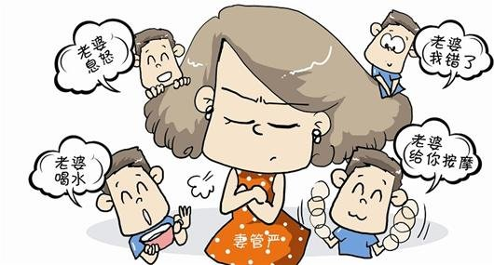
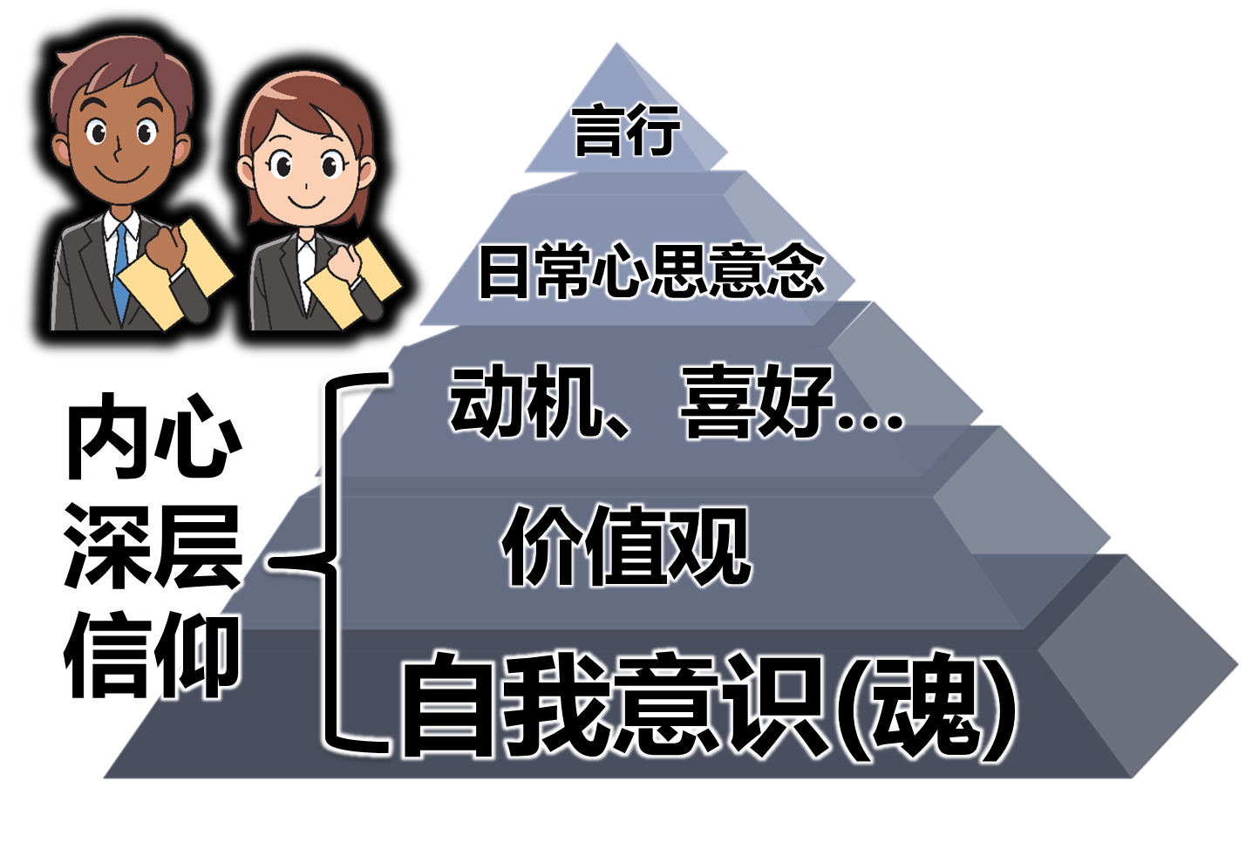

住在基督里的生活
弗5:22 你们作妻子的，当顺服自己的丈夫，如同顺服主。 5:23 因为丈夫是妻子的头，如同基督是教会的头；他又是教会全体的救主。 5:24 教会怎样顺服基督，妻子也要怎样凡事顺服丈夫。 5:25 你们作丈夫的，要爱你们的妻子，正如基督爱教会，为教会捨己。 5:26 要用水藉着道 (rhema) 把教会洗净，成为圣洁， 5:27 可以献给自己，作个荣耀的教会，毫无玷污、皱纹等类的病，乃是圣洁没有瑕疵的。
在基督里的顺服
Eph 5:22 Wives, submit to your own husbands, as to the Lord. 5:23 For the husband is head of the wife, as also Christ is head of the church; and He is the Savior of the body. 5:24 Therefore, just as the church is subject to Christ, so let the wives be to their own husbands in everything. 5:25 Husbands, love your wives, just as Christ also loved the church and gave Himself for her, 5:26 that He might sanctify and cleanse her with the washing of water by the word, 5:27 that He might present her to Himself a glorious church, not having spot or wrinkle or any such thing, but that she should be holy and without blemish.
偶像
特别指天然人用来解决内心空虚和定罪感的人、事、物

Slide 13
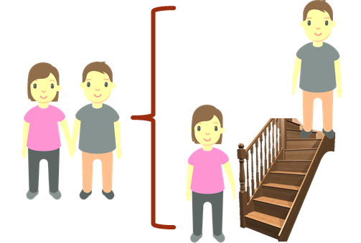
住在基督里的生活
弗5:22 你们作妻子的，当顺服自己的丈夫，如同顺服主。 5:23 因为丈夫是妻子的头，如同基督是教会的头；他又是教会全体的救主。 5:24 教会怎样顺服基督，妻子也要怎样凡事顺服丈夫。 5:25 你们作丈夫的，要爱你们的妻子，正如基督爱教会，为教会捨己。 5:26 要用水藉着道 (rhema) 把教会洗净，成为圣洁， 5:27 可以献给自己，作个荣耀的教会，毫无玷污、皱纹等类的病，乃是圣洁没有瑕疵的。
在基督里的顺服
罗8:6 体贴肉体的，就是死；体贴圣灵的，乃是生命、平安。 8:7 原来体贴肉体的，就是与神为仇；因为不服神的律法，也是不能服，
林前14:31 因为你们都可以一个一个的作先知讲道，叫众人学道理，叫众人得劝勉。 14:32 先知的灵原是顺服先知的；
路10:17 那七十个人欢欢喜喜的回来，说：主阿！因你的名，就是鬼也服了我们。 10:18 耶稣对他们说：我曾看见撒但从天上坠落，象闪电一样。 10:19 我已经给你们权柄可以践踏蛇和蝎子，又胜过仇敌一切的能力，断没有甚么能害你们。 10:20 然而，不要因鬼服了你们就欢喜，要因你们的名记录在天上欢喜。
Eph 5:22 Wives, submit to your own husbands, as to the Lord. 5:23 For the husband is head of the wife, as also Christ is head of the church; and He is the Savior of the body. 5:24 Therefore, just as the church is subject to Christ, so let the wives be to their own husbands in everything. 5:25 Husbands, love your wives, just as Christ also loved the church and gave Himself for her, 5:26 that He might sanctify and cleanse her with the washing of water by the word, 5:27 that He might present her to Himself a glorious church, not having spot or wrinkle or any such thing, but that she should be holy and without blemish.

Slide 14
住在基督里的生活
弗5:22 你们作妻子的，当顺服自己的丈夫，如同顺服主。 5:23 因为丈夫是妻子的头，如同基督是教会的头；他又是教会全体的救主。 5:24 教会怎样顺服基督，妻子也要怎样凡事顺服丈夫。 5:25 你们作丈夫的，要爱你们的妻子，正如基督爱教会，为教会捨己。 5:26 要用水藉着道 (rhema) 把教会洗净，成为圣洁， 5:27 可以献给自己，作个荣耀的教会，毫无玷污、皱纹等类的病，乃是圣洁没有瑕疵的。
在基督里的顺服
约5:19 耶稣对他们说：我实实在在的告诉你们，子凭着自己不能做甚么，唯有看见父所做的，子纔能做；父所做的事，子也照样做。 5:20 父爱子，将自己所做的一切事指给他看，还要将比这更大的事指给他看，叫你们希奇。 5:21 父怎样叫死人起来，使他们活着，子也照样随自己的意思使人活着。 5:22 父不审判甚么人，乃将审判的事全交与子， 5:23 叫人都尊敬子如同尊敬父一样。不尊敬子的，就是不尊敬差子来的父。
路2:51 他就同他们下去，回到拿撒勒，并且顺从他们。他母亲把这一切的事都存在心里。
Eph 5:22 Wives, submit to your own husbands, as to the Lord. 5:23 For the husband is head of the wife, as also Christ is head of the church; and He is the Savior of the body. 5:24 Therefore, just as the church is subject to Christ, so let the wives be to their own husbands in everything. 5:25 Husbands, love your wives, just as Christ also loved the church and gave Himself for her, 5:26 that He might sanctify and cleanse her with the washing of water by the word, 5:27 that He might present her to Himself a glorious church, not having spot or wrinkle or any such thing, but that she should be holy and without blemish.

Slide 15

住在基督里的生活
弗5:22 你们作妻子的，当顺服自己的丈夫，如同顺服主。 5:23 因为丈夫是妻子的头，如同基督是教会的头；他又是教会全体的救主。 5:24 教会怎样顺服基督，妻子也要怎样凡事顺服丈夫。 5:25 你们作丈夫的，要爱你们的妻子，正如基督爱教会，为教会捨己。 5:26 要用水藉着道 (rhema) 把教会洗净，成为圣洁， 5:27 可以献给自己，作个荣耀的教会，毫无玷污、皱纹等类的病，乃是圣洁没有瑕疵的。
在基督里的顺服
彼前3:7 你们作丈夫的，也要按情理（原文是知识）和妻子同住；因他比你软弱（比你软弱：原文作是软弱的器皿），与你一同承受生命之恩的，所以要敬重他。这样，便叫你们的祷告没有阻碍。
彼前3:1 你们作妻子的要顺服自己的丈夫；这样，若有不信从道理的丈夫，他们虽然不听道，也可以因妻子的品行被感化过来； 3:2 这正是因看见你们有贞洁的品行和敬畏的心。 3:3 你们不要以外面的辫头髮，戴金饰，穿美衣为妆饰， 3:4 只要以里面存着长久温柔、安静的心为妆饰；这在神面前是极宝贵的。 3:5 因为古时仰赖神的圣洁妇人正是以此为妆饰，顺服自己的丈夫，
Eph 5:22 Wives, submit to your own husbands, as to the Lord. 5:23 For the husband is head of the wife, as also Christ is head of the church; and He is the Savior of the body. 5:24 Therefore, just as the church is subject to Christ, so let the wives be to their own husbands in everything. 5:25 Husbands, love your wives, just as Christ also loved the church and gave Himself for her, 5:26 that He might sanctify and cleanse her with the washing of water by the word, 5:27 that He might present her to Himself a glorious church, not having spot or wrinkle or any such thing, but that she should be holy and without blemish.

Slide 16
住在基督里的生活
弗5:22 你们作妻子的，当顺服自己的丈夫，如同顺服主。 5:23 因为丈夫是妻子的头，如同基督是教会的头；他又是教会全体的救主。 5:24 教会怎样顺服基督，妻子也要怎样凡事顺服丈夫。5:25 你们作丈夫的，要爱你们的妻子，正如基督爱教会，为教会捨己。 5:26 要用水藉着道 (rhema) 把教会洗净，成为圣洁， 5:27 可以献给自己，作个荣耀的教会，毫无玷污、皱纹等类的病，乃是圣洁没有瑕疵的。
在基督里的爱
彼前3:7 你们作丈夫的，也要按情理（原文是知识）和妻子同住；因他比你软弱（比你软弱：原文作是软弱的器皿），与你一同承受生命之恩的，所以要敬重他。这样，便叫你们的祷告没有阻碍。
Eph 5:22 Wives, submit to your own husbands, as to the Lord. 5:23 For the husband is head of the wife, as also Christ is head of the church; and He is the Savior of the body. 5:24 Therefore, just as the church is subject to Christ, so let the wives be to their own husbands in everything. 5:25 Husbands, love your wives, just as Christ also loved the church and gave Himself for her, 5:26 that He might sanctify and cleanse her with the washing of water by the word, 5:27 that He might present her to Himself a glorious church, not having spot or wrinkle or any such thing, but that she should be holy and without blemish.

Slide 17
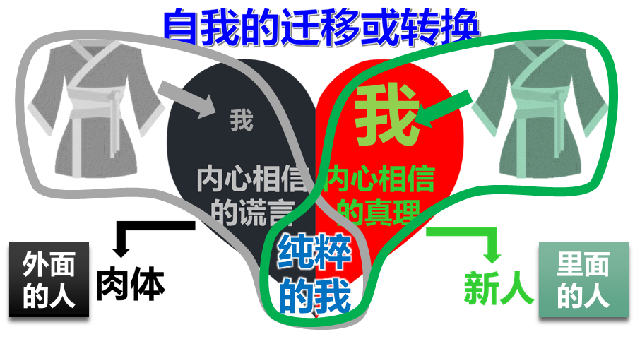
住在基督里的生活
弗5:22 你们作妻子的，当顺服自己的丈夫，如同顺服主。 5:23 因为丈夫是妻子的头，如同基督是教会的头；他又是教会全体的救主。 5:24 教会怎样顺服基督，妻子也要怎样凡事顺服丈夫。5:25 你们作丈夫的，要爱你们的妻子，正如基督爱教会，为教会捨己。 5:26 要用水藉着道 (rhema) 把教会洗净，成为圣洁， 5:27 可以献给自己，作个荣耀的教会，毫无玷污、皱纹等类的病，乃是圣洁没有瑕疵的。
在基督里的爱
彼前3:7 你们作丈夫的，也要按情理（原文是知识）和妻子同住；因他比你软弱（比你软弱：原文作是软弱的器皿），与你一同承受生命之恩的，所以要敬重他。这样，便叫你们的祷告没有阻碍。
Eph 5:22 Wives, submit to your own husbands, as to the Lord. 5:23 For the husband is head of the wife, as also Christ is head of the church; and He is the Savior of the body. 5:24 Therefore, just as the church is subject to Christ, so let the wives be to their own husbands in everything. 5:25 Husbands, love your wives, just as Christ also loved the church and gave Himself for her, 5:26 that He might sanctify and cleanse her with the washing of water by the word, 5:27 that He might present her to Himself a glorious church, not having spot or wrinkle or any such thing, but that she should be holy and without blemish.

Slide 18
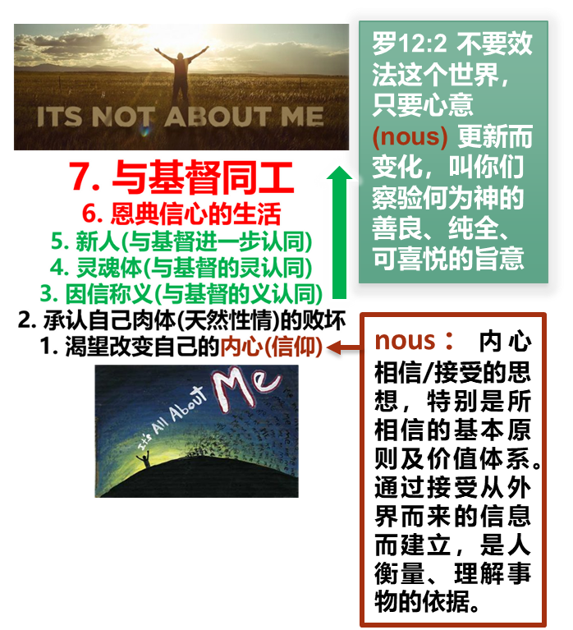

住在基督里的生活
在基督里的爱
弗5:28 丈夫也当照样爱妻子，如同爱自己的身子；爱妻子便是爱自己了。 5:29 从来没有人恨恶自己的身子，总是保养顾惜，正象基督待教会一样， 5:30 因我们是他身上的肢体（有古卷在此有：就是他的骨他的肉）。 5:31 为这个缘故，人要离开父母，与妻子连合，二人成为一体。 5:32 这是极大的奥秘，但我是指着基督和教会说的。 5:33 然而，你们各人都当爱妻子，如同爱自己一样。妻子也当敬重他的丈夫。
在基督里的爱
加2:20 我已经与基督同钉十字架，现在活着的不再是我，乃是基督在我里面活着；并且我如今在肉身活着，是因信神的儿子而活；他是爱我，为我捨己。
Eph 5:28 So husbands ought to love their own wives as their own bodies; he who loves his wife loves himself. 5:29 For no one ever hated his own flesh, but nourishes and cherishes it, just as the Lord does the church. 5:30 For we are members of His body, of His flesh and of His bones. 5:31 “For this reason a man shall leave his father and mother and be joined to his wife, and the two shall become one flesh.” 5:32 This is a great mystery, but I speak concerning Christ and the church. 5:33 Nevertheless let each one of you in particular so love his own wife as himself, and let the wife see that she respects her husband.
罗5:7 为义人死，是少有的；为仁人死、或者有敢做的。 5:8 唯有基督在我们还作罪人的时候为我们死，神的爱就在此向我们显明了。

Slide 19
住在基督里的生活
弗5:28 丈夫也当照样爱妻子，如同爱自己的身子；爱妻子便是爱自己了。 5:29 从来没有人恨恶自己的身子，总是保养顾惜，正象基督待教会一样， 5:30 因我们是他身上的肢体（有古卷在此有：就是他的骨他的肉）。 5:31 为这个缘故，人要离开父母，与妻子连合，二人成为一体。 5:32 这是极大的奥秘，但我是指着基督和教会说的。 5:33 然而，你们各人都当爱妻子，如同爱自己一样。妻子也当敬重他的丈夫。
在基督里的爱
我爱你因为：
你 让我 对自己可以感觉良好
你 让我 对自己的生命有新的认识
我 在你 面前不需要伪装
你 帮助我 对负面事物可以有不同的看法
你 总有时间和我 谈心里话
你 理解我
你 选择了我
你 让我 觉得自己很特别
（我）
（你）
（我）
（你）
（你）
（我）
（我）
（你）
Eph 5:28 So husbands ought to love their own wives as their own bodies; he who loves his wife loves himself. 5:29 For no one ever hated his own flesh, but nourishes and cherishes it, just as the Lord does the church. 5:30 For we are members of His body, of His flesh and of His bones. 5:31 “For this reason a man shall leave his father and mother and be joined to his wife, and the two shall become one flesh.” 5:32 This is a great mystery, but I speak concerning Christ and the church. 5:33 Nevertheless let each one of you in particular so love his own wife as himself, and let the wife see that she respects her husband.
（我）
（你）
（我）
（你）
（我）
（你）
（我）
（你）

