Slide 1

住在基督里
（43）

Slide 2
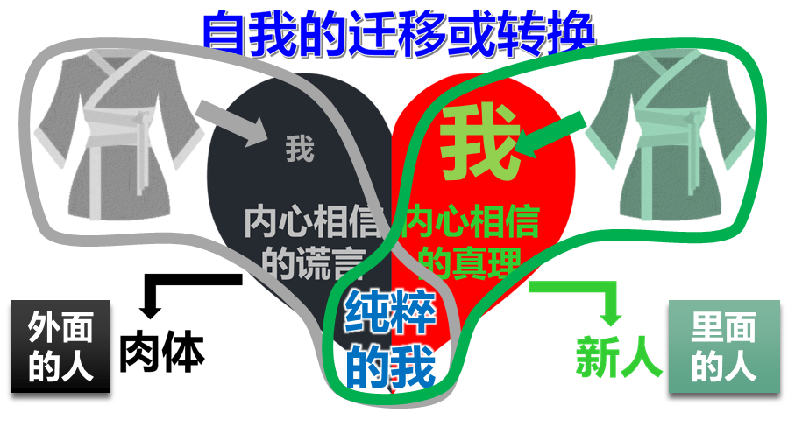
住在基督里的生活
弗4:1 我为主被囚的劝你们：既然蒙召，行事为人就当与蒙召的恩相称。4:2 凡事谦虚、温柔、忍耐，用爱心互相宽容，4:3 用和平彼此联络，竭力保守圣灵所赐合而为一的心。4:4 身体只有一个，圣灵只有一个，正如你们蒙召同有一个指望。4:5 一主，一信，一洗，4:6 一神，就是众人的父，超乎众人之上，贯乎众人之中，也住在众人之内。
Eph 4:1 I, therefore, the prisoner of the Lord, beseech you to walk worthy of the calling with which you were called, 4:2 with all lowliness (humility) and gentleness, with longsuffering, bearing with one another in love, 4:3 endeavoring to keep the unity of the Spirit in the bond of peace. 4:4 There is one body and one Spirit, just as you were called in one hope of your calling; 4:5 one Lord, one faith, one baptism; 4:6 one God and Father of all, who is above all, and through all, and in you all.
关键是需要有属灵的眼光
弗1:15 因此，我既听见你们信从主耶稣，亲爱众圣徒，1:16 就为你们不住的感谢神。祷告的时候，常题到你们，1:17 求我们主耶稣基督的神，荣耀的父，将那赐人智慧和启示的灵赏给你们，使你们真知道他，1:18 并且照明你们心中的眼睛，使你们知道他的恩召有何等指望，他在圣徒中得的基业有何等丰盛的荣耀；1:19 并知道他向我们这信的人所显的能力是何等浩大，1:20 就是照他在基督身上所运行的大能大力（which He worked in Christ）。。。

Slide 3

住在基督里的生活
弗4:1 我为主被囚的劝你们：既然蒙召，行事为人就当与蒙召的恩相称。4:2 凡事谦虚、温柔、忍耐，用爱心互相宽容，4:3 用和平彼此联络，竭力保守圣灵所赐合而为一的心。4:4 身体只有一个，圣灵只有一个，正如你们蒙召同有一个指望。4:5 一主，一信，一洗，4:6 一神，就是众人的父，超乎众人之上，贯乎众人之中，也住在众人之内。
Eph 4:1 I, therefore, the prisoner of the Lord, beseech you to walk worthy of the calling with which you were called, 4:2 with all lowliness (humility) and gentleness, with longsuffering, bearing with one another in love, 4:3 endeavoring to keep the unity of the Spirit in the bond of peace. 4:4 There is one body and one Spirit, just as you were called in one hope of your calling; 4:5 one Lord, one faith, one baptism; 4:6 one God and Father of all, who is above all, and through all, and in you all.
关键是需要有属灵的眼光
从内心信仰产生的对事物及其发展的衡量、理解和推断
约17:22 你所赐给我的荣耀，我已赐给他们，使他们合而为一，象我们合而为一。

Slide 4




住在基督里的生活
弗4:17 所以我说，且在主里确实的说，你们行事不要再象外邦人存虚妄的心 (nous) 行事。4:18 他们心地(dianoia) 昏昧，与神所赐的生命隔绝了，都因自己无知，心里刚硬；4:19 良心既然丧尽，就放纵私慾，贪行种种的污秽。4:20 你们学了基督，却不是这样。4:21 如果你们听过他的道，领了他的教，学了他的真理，4:22 就要脱去你们从前行为上的旧人，这旧人是因私慾的迷惑渐渐变坏的；
属地的眼光从哪里来的？
创3:4 蛇对女人说：你们不一定死；3:5 因为 神知道，你们吃的日子眼睛就明亮了，你们便如神能知道善恶。
肉体
解决方法1
（学业、成就）
自我
依靠
Eph 4:17 This I say, therefore, and testify in the Lord, that you should no longer walk as the rest of the Gentiles walk, in the futility of their mind, 4:18 having their understanding darkened, being alienated from the life of God, because of the ignorance that is in them, because of the blindness (or hardness) of their heart; 4:19 who, being past feeling, have given themselves over to lewdness, to work all uncleanness with greediness. 4:20 But you have not so learned Christ, 4:21 if indeed you have heard Him and have been taught by Him, as the truth is in Jesus: 4:22 that you put off, concerning your former conduct, the old man which grows corrupt according to the deceitful lusts,
解决方法2
（钱财）
解决方法3
（男女关系）
希望别人也不好
缺乏2
缺乏1
缺乏3
撒但的谎言：
你没有，你不行

Slide 5

住在基督里的生活
弗4:17 所以我说，且在主里确实的说，你们行事不要再象外邦人存虚妄的心 (nous) 行事。4:18 他们心地(dianoia) 昏昧，与神所赐的生命隔绝了，都因自己无知，心里刚硬；4:19 良心既然丧尽，就放纵私慾，贪行种种的污秽。4:20 你们学了基督，却不是这样。4:21 如果你们听过他的道，领了他的教，学了他的真理，4:22 就要脱去你们从前行为上的旧人，这旧人是因私慾的迷惑渐渐变坏的；
Eph 4:17 This I say, therefore, and testify in the Lord, that you should no longer walk as the rest of the Gentiles walk, in the futility of their mind, 4:18 having their understanding darkened, being alienated from the life of God, because of the ignorance that is in them, because of the blindness (or hardness) of their heart; 4:19 who, being past feeling, have given themselves over to lewdness, to work all uncleanness with greediness. 4:20 But you have not so learned Christ, 4:21 if indeed you have heard Him and have been taught by Him, as the truth is in Jesus: 4:22 that you put off, concerning your former conduct, the old man which grows corrupt according to the deceitful lusts,

Slide 6


住在基督里的生活
弗4:23 又要将你们的心志 (nous) 改换一新，4:24 并且穿上新人；这新人是照着神的形象造的，有真理的仁义和圣洁。4:25 所以你们要弃绝谎言，各人与邻舍说实话，因为我们是互相为肢体。4:26 生气(orgizo)却不要犯罪；不可含怒到日落，4:27 也不可给魔鬼留地步。4:28 从前偷窃的，不要再偷；总要劳力，亲手做正经事，就可有余分给那缺少的人。
心意更新的关键？
人生有值得的追求
减少不必要的痛苦
心意更新变的轻省
获得有永久价值的产业
价值观的更新
Eph 4:23 and be renewed in the spirit of your mind, 4:24 and that you put on the new man which was created according to God, in true righteousness and holiness. 4:25 Therefore, putting away lying, “Let each one of you speak truth with his neighbor,” for we are members of one another. 4:26 “Be angry, and do not sin”: do not let the sun go down on your wrath, 4:27 nor give place to the devil.4:28 Let him who stole steal no longer, but rather let him labor, working with his hands what is good, that he may have something to give him who has need.
罗12:2 不要效法这个世界，只要心意(nous) 更新而变化（do not be conformed to this world, but be transformed by the renewing of your mind），叫你们察验何为神的善良、纯全、可喜悦的旨意。

Slide 7
住在基督里的生活
弗4:23 又要将你们的心志 (nous) 改换一新，4:24 并且穿上新人；这新人是照着神的形象造的，有真理的仁义和圣洁。4:25 所以你们要弃绝谎言，各人与邻舍说实话，因为我们是互相为肢体。4:26 生气(orgizo)却不要犯罪；不可含怒到日落，4:27 也不可给魔鬼留地步。4:28 从前偷窃的，不要再偷；总要劳力，亲手做正经事，就可有余分给那缺少的人。
西3:9 不要彼此说谎；因你们已经脱去旧人和旧人的行为， 3:10 穿上了新人。这新人在知识上渐渐更新，正如造他主的形象。 3:11 在此并不分希腊人、犹太人，受割礼的、未受割礼的，化外人，西古提人，为奴的、自主的，唯有基督是包括一切，又住在各人之内。
Eph 4:23 and be renewed in the spirit of your mind, 4:24 and that you put on the new man which was created according to God, in true righteousness and holiness. 4:25 Therefore, putting away lying, “Let each one of you speak truth with his neighbor,” for we are members of one another. 4:26 “Be angry, and do not sin”: do not let the sun go down on your wrath, 4:27 nor give place to the devil.4:28 Let him who stole steal no longer, but rather let him labor, working with his hands what is good, that he may have something to give him who has need.
罗12:2 不要效法这个世界，只要心意(nous) 更新而变化（do not be conformed to this world, but be transformed by the renewing of your mind），叫你们察验何为神的善良、纯全、可喜悦的旨意。

Slide 8
住在基督里的生活
弗4:23 又要将你们的心志 (nous) 改换一新，4:24 并且穿上新人；这新人是照着神的形象造的，有真理的仁义和圣洁。4:25 所以你们要弃绝谎言，各人与邻舍说实话，因为我们是互相为肢体。4:26 生气(orgizo)却不要犯罪；不可含怒到日落，4:27 也不可给魔鬼留地步。4:28 从前偷窃的，不要再偷；总要劳力，亲手做正经事，就可有余分给那缺少的人。
雅4:7 故此，你们要顺服神。务要抵挡魔鬼，魔鬼就必离开你们逃跑了。
雅4:7 Therefore submit to God. Resist the devil and he will flee from you.
Eph 4:23 and be renewed in the spirit of your mind, 4:24 and that you put on the new man which was created according to God, in true righteousness and holiness. 4:25 Therefore, putting away lying, “Let each one of you speak truth with his neighbor,” for we are members of one another. 4:26 “Be angry, and do not sin”: do not let the sun go down on your wrath, 4:27 nor give place to the devil.4:28 Let him who stole steal no longer, but rather let him labor, working with his hands what is good, that he may have something to give him who has need.
罗12:2 不要效法这个世界，只要心意(nous) 更新而变化（do not be conformed to this world, but be transformed by the renewing of your mind），叫你们察验何为神的善良、纯全、可喜悦的旨意。

Slide 9
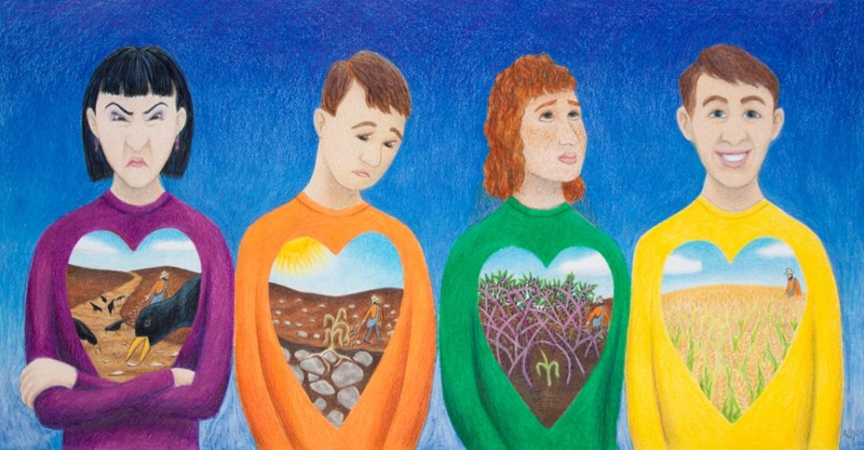
住在基督里的生活
弗4:23 又要将你们的心志 (nous) 改换一新，4:24 并且穿上新人；这新人是照着神的形象造的，有真理的仁义和圣洁。4:25 所以你们要弃绝谎言，各人与邻舍说实话，因为我们是互相为肢体。4:26 生气(orgizo)却不要犯罪；不可含怒到日落，4:27 也不可给魔鬼留地步。4:28 从前偷窃的，不要再偷；总要劳力，亲手做正经事，就可有余分给那缺少的人。
如何“被心意更新”？
可4:13 又对他们说：你们不明白这比喻么？这样怎能明白一切的比喻呢？ 4:14 撒种之人所撒的就是道。 4:15 那撒在路旁的，就是人听了道，撒但立刻来，把撒在他心里的道夺了去。 4:16 那撒在石头地上的，就是人听了道，立刻欢喜领受， 4:17 但他心里没有根，不过是暂时的，及至为道遭了患难，或是受了逼迫，立刻就跌倒了。 4:18 还有那撒在荆棘里的，就是人听了道， 4:19 后来有世上的思虑、钱财的迷惑，和别样的私慾进来，把道挤住了，就不能结实。 4:20 那撒在好地上的，就是人听道，又领受，并且结实，有叁十倍的，有六十倍的，有一百倍的。
Eph 4:23 and be renewed in the spirit of your mind, 4:24 and that you put on the new man which was created according to God, in true righteousness and holiness. 4:25 Therefore, putting away lying, “Let each one of you speak truth with his neighbor,” for we are members of one another. 4:26 “Be angry, and do not sin”: do not let the sun go down on your wrath, 4:27 nor give place to the devil.4:28 Let him who stole steal no longer, but rather let him labor, working with his hands what is good, that he may have something to give him who has need.
罗12:2 不要效法这个世界，只要心意(nous) 更新而变化（do not be conformed to this world, but be transformed by the renewing of your mind），叫你们察验何为神的善良、纯全、可喜悦的旨意。

Slide 10
住在基督里的生活
弗4:23 又要将你们的心志 (nous) 改换一新，4:24 并且穿上新人；这新人是照着神的形象造的，有真理的仁义和圣洁。4:25 所以你们要弃绝谎言，各人与邻舍说实话，因为我们是互相为肢体。4:26 生气(orgizo)却不要犯罪；不可含怒到日落，4:27 也不可给魔鬼留地步。4:28 从前偷窃的，不要再偷；总要劳力，亲手做正经事，就可有余分给那缺少的人。
如何“被心意更新”？
可4:21 耶稣又对他们说：人拿灯来，岂是要放在斗底下，床底下，不放在灯臺上么？ 4:22 因为掩藏的事，没有不显出来的；隐瞒的事，没有不露出来的。 4:23 有耳可听的，就应当听！ 4:24 又说：你们所听的要留心。你们用甚么量器量给人，也必用甚么量器量给你们，并且要多给你们。 4:25 因为有的，还要给他；没有的，连他所有的也要夺去。 4:26 又说：神的国如同人把种撒在地上。 4:27 黑夜睡觉，白日起来，这种就发芽渐长，那人却不晓得如何这样。 4:28 地生五榖是出于自然的：先发苗，后长穗，再后穗上结成饱满的子粒； 4:29 榖既熟了，就用镰刀去割，因为收成的时候到了。
Eph 4:23 and be renewed in the spirit of your mind, 4:24 and that you put on the new man which was created according to God, in true righteousness and holiness. 4:25 Therefore, putting away lying, “Let each one of you speak truth with his neighbor,” for we are members of one another. 4:26 “Be angry, and do not sin”: do not let the sun go down on your wrath, 4:27 nor give place to the devil.4:28 Let him who stole steal no longer, but rather let him labor, working with his hands what is good, that he may have something to give him who has need.
罗12:2 不要效法这个世界，只要心意(nous) 更新而变化（do not be conformed to this world, but be transformed by the renewing of your mind），叫你们察验何为神的善良、纯全、可喜悦的旨意。

Slide 11
住在基督里的生活
弗4:29 污秽的言语一句不可出口，只要随事说造就人的好话，叫听见的人得益处。4:30 不要叫神的圣灵担忧；你们原是受了他的印记，等候得赎的日子来到。4:31 一切苦毒、恼恨、忿怒 (orge)、嚷闹、毁谤，并一切的恶毒（或作：阴毒），都当从你们中间除掉；4:32 并要以恩慈相待，存怜悯的心，彼此饶恕，正如神在基督里饶恕了你们一样。
如何“被心意更新”？
可4:21 耶稣又对他们说：人拿灯来，岂是要放在斗底下，床底下，不放在灯臺上么？ 4:22 因为掩藏的事，没有不显出来的；隐瞒的事，没有不露出来的。 4:23 有耳可听的，就应当听！ 4:24 又说：你们所听的要留心。你们用甚么量器量给人，也必用甚么量器量给你们，并且要多给你们。 4:25 因为有的，还要给他；没有的，连他所有的也要夺去。 4:26 又说：神的国如同人把种撒在地上。 4:27 黑夜睡觉，白日起来，这种就发芽渐长，那人却不晓得如何这样。 4:28 地生五榖是出于自然的：先发苗，后长穗，再后穗上结成饱满的子粒； 4:29 榖既熟了，就用镰刀去割，因为收成的时候到了。
Eph 4:29 Let no corrupt word proceed out of your mouth, but what is good for necessary edification, that it may impart grace to the hearers. 4:30 And do not grieve the Holy Spirit of God, by whom you were sealed for the day of redemption. 4:31 Let all bitterness, wrath, anger, clamor, and evil speaking be put away from you, with all malice. 4:32 And be kind to one another, tenderhearted, forgiving one another, even as God in Christ forgave you.
罗12:2 不要效法这个世界，只要心意(nous) 更新而变化（do not be conformed to this world, but be transformed by the renewing of your mind），叫你们察验何为神的善良、纯全、可喜悦的旨意。

Slide 12
住在基督里的生活
弗4:29 污秽的言语一句不可出口，只要随事说造就人的好话，叫听见的人得益处。4:30 不要叫神的圣灵担忧；你们原是受了他的印记，等候得赎的日子来到。4:31 一切苦毒、恼恨、忿怒 (orge)、嚷闹、毁谤，并一切的恶毒（或作：阴毒），都当从你们中间除掉；4:32 并要以恩慈相待，存怜悯的心，彼此饶恕，正如神在基督里饶恕了你们一样。
如何“被心意更新”？
路6:44 凡树木看果子，就可以认出他来。人不是从荆棘上摘无花果，也不是从蒺蔾里摘葡萄。 6:45 善人从他心里所存的善就发出善来；恶人从他心里所存的恶就发出恶来；因为心里所充满的，口里就说出来。
Eph 4:29 Let no corrupt word proceed out of your mouth, but what is good for necessary edification, that it may impart grace to the hearers. 4:30 And do not grieve the Holy Spirit of God, by whom you were sealed for the day of redemption. 4:31 Let all bitterness, wrath, anger, clamor, and evil speaking be put away from you, with all malice. 4:32 And be kind to one another, tenderhearted, forgiving one another, even as God in Christ forgave you.
罗12:2 不要效法这个世界，只要心意(nous) 更新而变化（do not be conformed to this world, but be transformed by the renewing of your mind），叫你们察验何为神的善良、纯全、可喜悦的旨意。

Slide 13
住在基督里的生活
弗4:29 污秽的言语一句不可出口，只要随事说造就人的好话，叫听见的人得益处。4:30 不要叫神的圣灵担忧；你们原是受了他的印记，等候得赎的日子来到。4:31 一切苦毒、恼恨、忿怒 (orge)、嚷闹、毁谤，并一切的恶毒（或作：阴毒），都当从你们中间除掉；4:32 并要以恩慈相待，存怜悯的心，彼此饶恕，正如神在基督里饶恕了你们一样。
如何“被心意更新”？
路6:44 凡树木看果子，就可以认出他来。人不是从荆棘上摘无花果，也不是从蒺蔾里摘葡萄。 6:45 善人从他心里所存的善就发出善来；恶人从他心里所存的恶就发出恶来；因为心里所充满的，口里就说出来。
Eph 4:29 Let no corrupt word proceed out of your mouth, but what is good for necessary edification, that it may impart grace to the hearers. 4:30 And do not grieve the Holy Spirit of God, by whom you were sealed for the day of redemption. 4:31 Let all bitterness, wrath, anger, clamor, and evil speaking be put away from you, with all malice. 4:32 And be kind to one another, tenderhearted, forgiving one another, even as God in Christ forgave you.
罗12:2 不要效法这个世界，只要心意(nous) 更新而变化（do not be conformed to this world, but be transformed by the renewing of your mind），叫你们察验何为神的善良、纯全、可喜悦的旨意。

Slide 14
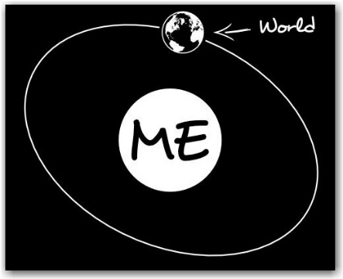
住在基督里的生活
弗4:29 污秽的言语一句不可出口，只要随事说造就人的好话，叫听见的人得益处。4:30 不要叫神的圣灵担忧；你们原是受了他的印记，等候得赎的日子来到。4:31 一切苦毒、恼恨、忿怒 (orge)、嚷闹、毁谤，并一切的恶毒（或作：阴毒），都当从你们中间除掉；4:32 并要以恩慈相待，存怜悯的心，彼此饶恕，正如神在基督里饶恕了你们一样。
如何“被心意更新”？
路6:44 凡树木看果子，就可以认出他来。人不是从荆棘上摘无花果，也不是从蒺蔾里摘葡萄。 6:45 善人从他心里所存的善就发出善来；恶人从他心里所存的恶就发出恶来；因为心里所充满的，口里就说出来。
Eph 4:29 Let no corrupt word proceed out of your mouth, but what is good for necessary edification, that it may impart grace to the hearers. 4:30 And do not grieve the Holy Spirit of God, by whom you were sealed for the day of redemption. 4:31 Let all bitterness, wrath, anger, clamor, and evil speaking be put away from you, with all malice. 4:32 And be kind to one another, tenderhearted, forgiving one another, even as God in Christ forgave you.
罗12:2 不要效法这个世界，只要心意(nous) 更新而变化（do not be conformed to this world, but be transformed by the renewing of your mind），叫你们察验何为神的善良、纯全、可喜悦的旨意。

