Slide 1

住在基督里
（42）

Slide 2

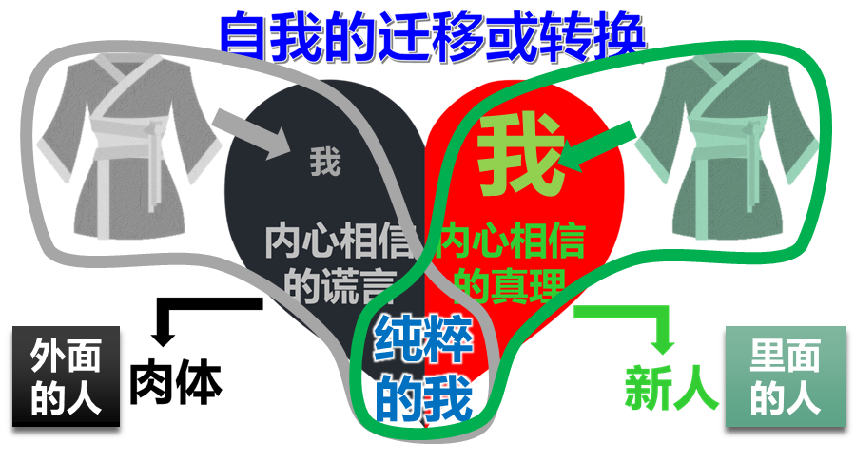
住在基督里的生活
弗4:1 我为主被囚的劝你们：既然蒙召，行事为人就当与蒙召的恩相称。4:2 凡事谦虚、温柔、忍耐，用爱心互相宽容，4:3 用和平彼此联络，竭力保守圣灵所赐合而为一的心。4:4 身体只有一个，圣灵只有一个，正如你们蒙召同有一个指望。4:5 一主，一信，一洗，4:6 一神，就是众人的父，超乎众人之上，贯乎众人之中，也住在众人之内。
Eph 4:1 I, therefore, the prisoner of the Lord, beseech you to walk worthy of the calling with which you were called,4:2 with all lowliness (humility) and gentleness, with longsuffering, bearing with one another in love,4:3 endeavoring to keep the unity of the Spirit in the bond of peace.4:4 There is one body and one Spirit, just as you were called in one hope of your calling;4:5 one Lord, one faith, one baptism;4:6 one God and Father of all, who is above all, and through all, and in you all.
关键是需要有属灵的眼光
在某一时刻，对某领域趋势准确预测的能力---百度百科

Slide 3
住在基督里的生活
弗4:1 我为主被囚的劝你们：既然蒙召，行事为人就当与蒙召的恩相称。4:2 凡事谦虚、温柔、忍耐，用爱心互相宽容，4:3 用和平彼此联络，竭力保守圣灵所赐合而为一的心。4:4 身体只有一个，圣灵只有一个，正如你们蒙召同有一个指望。4:5 一主，一信，一洗，4:6 一神，就是众人的父，超乎众人之上，贯乎众人之中，也住在众人之内。
Eph 4:1 I, therefore, the prisoner of the Lord, beseech you to walk worthy of the calling with which you were called,4:2 with all lowliness (humility) and gentleness, with longsuffering, bearing with one another in love,4:3 endeavoring to keep the unity of the Spirit in the bond of peace.4:4 There is one body and one Spirit, just as you were called in one hope of your calling;4:5 one Lord, one faith, one baptism;4:6 one God and Father of all, who is above all, and through all, and in you all.
关键是需要有属灵的眼光
从内心信仰产生的对事物及其发展的衡量、理解和推断
约17:22 你所赐给我的荣耀，我已赐给他们，使他们合而为一，象我们合而为一。

Slide 4
住在基督里的生活
弗4:1 我为主被囚的劝你们：既然蒙召，行事为人就当与蒙召的恩相称。4:2 凡事谦虚、温柔、忍耐，用爱心互相宽容，4:3 用和平彼此联络，竭力保守圣灵所赐合而为一的心。4:4 身体只有一个，圣灵只有一个，正如你们蒙召同有一个指望。4:5 一主，一信，一洗，4:6 一神，就是众人的父，超乎众人之上，贯乎众人之中，也住在众人之内。
Eph 4:1 I, therefore, the prisoner of the Lord, beseech you to walk worthy of the calling with which you were called,4:2 with all lowliness (humility) and gentleness, with longsuffering, bearing with one another in love,4:3 endeavoring to keep the unity of the Spirit in the bond of peace.4:4 There is one body and one Spirit, just as you were called in one hope of your calling;4:5 one Lord, one faith, one baptism;4:6 one God and Father of all, who is above all, and through all, and in you all.
关键是需要有属灵的眼光
弗1:15 因此，我既听见你们信从主耶稣，亲爱众圣徒，1:16 就为你们不住的感谢神。祷告的时候，常题到你们，1:17 求我们主耶稣基督的神，荣耀的父，将那赐人智慧和启示的灵赏给你们，使你们真知道他，1:18 并且照明你们心中的眼睛，使你们知道他的恩召有何等指望，他在圣徒中得的基业有何等丰盛的荣耀；1:19 并知道他向我们这信的人所显的能力是何等浩大，1:20 就是照他在基督身上所运行的大能大力（which He worked in Christ）。。。

Slide 5
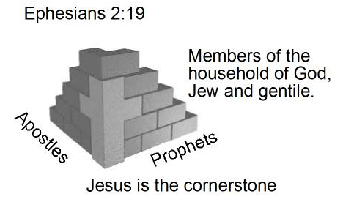
住在基督里的生活
弗4:7 我们各人蒙恩，都是照基督所量给各人的恩赐。4:8 所以经上说：他升上高天的时候，掳掠了仇敌，将各样的恩赐赏给人。4:9 （既说升上，岂不是先降在地下么？4:10 那降下的，就是远升诸天之上要充满万有的。）4:11 他所赐的，有使徒，有先知，有传福音的，有牧师和教师，4:12 为要成全圣徒，各尽其职，建立基督的身体，
你人生到底在追求什么？
Eph 4:7 But to each one of us grace was given according to the measure of Christ’s gift.4:8 Therefore He says: “When He ascended on high, He led captivity captive, And gave gifts to men.” 4:9 (Now this, “He ascended”–what does it mean but that He also first descended into the lower parts of the earth?4:10 He who descended is also the One who ascended far above all the heavens, that He might fill all things.)4:11 And He Himself gave some to be apostles, some prophets, some evangelists, and some pastors and teachers,4:12 for the equipping of the saints for the work of
ministry, for the edifying of the body of Christ,
弗2:19 这样，你们不再作外人和客旅，是与圣徒同国，是神家里的人了；2:20 并且被建造在使徒和先知的根基上，有基督耶稣自己为房角石，2:21 各（或作：全）房靠他联络得合式，渐渐成为主的圣殿。2:22 你们也靠他同被建造，成为神藉着圣灵居住的所在。

Slide 6
住在基督里的生活
弗4:13 直等到我们众人在真道上同归于一，认识神的儿子，得以长大成人，满有基督长成的身量，4:14 使我们不再作小孩子，中了人的诡计和欺骗的法术，被一切异教之风摇动，飘来飘去，就随从各样的异端；4:15 惟用爱心说诚实话，凡事长进，连于元首基督，4:16 全身都靠他联络得合式，百节各按各职，照着各体的功用彼此相助，便叫身体渐渐增长，在爱中建立自己。
你人生到底在追求什么？
Eph 4:13 Till we all come in the unity of the faith, and of the knowledge of the Son of God, unto a perfect man, unto the measure of the stature of the fullness of Christ: 4:14 That we henceforth be no more children, tossed back and forth, and carried about with every wind of doctrine, by the sleight of men, and cunning craftiness, whereby they lie in wait to deceive;4:15 But speaking the truth in love, may grow up into him in all things, which is the head, even Christ:4:16 From whom the whole body fitly joined together and compacted by that which every joint supplies, according to the effectual working in the measure of
every part, makes increase of the body unto the
edifying of itself in love.
弗2:19 这样，你们不再作外人和客旅，是与圣徒同国，是神家里的人了；2:20 并且被建造在使徒和先知的根基上，有基督耶稣自己为房角石，2:21 各（或作：全）房靠他联络得合式，渐渐成为主的圣殿。2:22 你们也靠他同被建造，成为神藉着圣灵居住的所在。

Slide 7

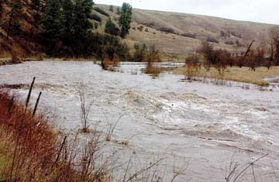
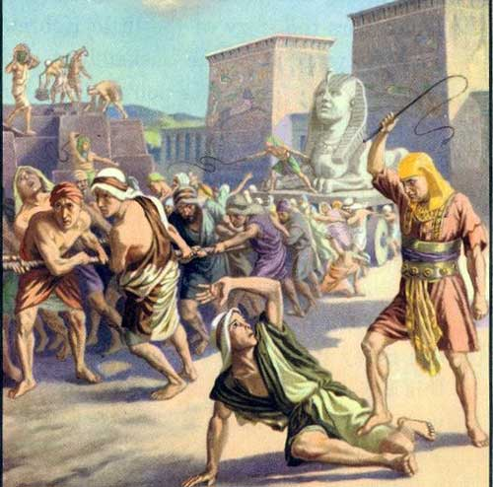


基督徒的人生经历
埃及
旷野
迦南
（在世界）
红
海
约
旦
河
（在基督里）
（未信主）
（属肉体）
（属灵）

Slide 8




住在基督里的生活
弗4:17 所以我说，且在主里确实的说，你们行事不要再象外邦人存虚妄的心 (nous) 行事。4:18 他们心地(dianoia) 昏昧，与神所赐的生命隔绝了，都因自己无知，心里刚硬；4:19 良心既然丧尽，就放纵私慾，贪行种种的污秽。4:20 你们学了基督，却不是这样。4:21 如果你们听过他的道，领了他的教，学了他的真理，4:22 就要脱去你们从前行为上的旧人，这旧人是因私慾的迷惑渐渐变坏的；
基督人应该有的属灵眼光
创3:4 蛇对女人说：你们不一定死；3:5 因为 神知道，你们吃的日子眼睛就明亮了，你们便如神能知道善恶。
肉体
解决方法1
（学业、成就）
自我
依靠
Eph 4:17 This I say, therefore, and testify in the Lord, that you should no longer walk as the rest of the Gentiles walk, in the futility of their mind,4:18 having their understanding darkened, being alienated from the life of God, because of the ignorance that is in them, because of the blindness (or hardness) of their heart;4:19 who, being past feeling, have given themselves over to lewdness, to work all uncleanness with greediness.4:20 But you have not so learned Christ,4:21 if indeed you have heard Him and have been taught by Him, as the truth is in Jesus:4:22 that you put off, concerning your former conduct, the old man which grows corrupt according to the deceitful lusts,
解决方法2
（钱财）
解决方法3
（男女关系）
希望别人也不好
缺乏2
缺乏1
缺乏3
撒但的谎言：
你没有，你不行

Slide 9
住在基督里的生活
弗4:23 又要将你们的心志 (nous) 改换一新，4:24 并且穿上新人；这新人是照着神的形象造的，有真理的仁义和圣洁。4:25 所以你们要弃绝谎言，各人与邻舍说实话，因为我们是互相为肢体。4:26 生气却不要犯罪；不可含怒到日落，4:27 也不可给魔鬼留地步。4:28 从前偷窃的，不要再偷；总要劳力，亲手做正经事，就可有余分给那缺少的人。
心意更新的关键？
太6:19 不要为自己积攒财宝在地上；地上有虫子咬，能锈坏，也有贼挖窟窿来偷。6:20 只要积攒财宝在天上；天上没有虫子咬，不能锈坏，也没有贼挖窟窿来偷。6:21 因为你的财宝在那里，你的心也在那里。6:22 眼睛就是身上的灯。你的眼睛若瞭亮，全身就光明；6:23 你的眼睛若昏花，全身就黑暗。你里头的光若黑暗了，那黑暗是何等大呢！6:24 一个人不能事奉两个主；不是恶这个，爱那个，就是重这个，轻那个。你们不能又事奉神，又事奉玛门（玛门：财利的意思）。
Eph 4:23 and be renewed in the spirit of your mind,4:24 and that you put on the new man which was created according to God, in true righteousness and holiness.4:25 Therefore, putting away lying, “Let each one of you speak truth with his neighbor,” for we are members of one another.4:26 “Be angry, and do not sin”: do not let the sun go down on your wrath,4:27 nor give place to the devil.4:28 Let him who stole steal no longer, but rather let him labor, working with his hands what is good, that he may have something to give him who has need.
罗12:2 不要效法这个世界，只要心意(nous) 更新而变化（do not be conformed to this world, but be transformed by the renewing of your mind），叫你们察验何为神的善良、纯全、可喜悦的旨意。

Slide 10



住在基督里的生活
弗4:23 又要将你们的心志 (nous) 改换一新，4:24 并且穿上新人；这新人是照着神的形象造的，有真理的仁义和圣洁。4:25 所以你们要弃绝谎言，各人与邻舍说实话，因为我们是互相为肢体。4:26 生气却不要犯罪；不可含怒到日落，4:27 也不可给魔鬼留地步。4:28 从前偷窃的，不要再偷；总要劳力，亲手做正经事，就可有余分给那缺少的人。
心意更新的关键？
人生有值得的追求
减少不必要的痛苦
心意更新变的轻省
获得有永久价值的产业
价值观的更新
Eph 4:23 and be renewed in the spirit of your mind,4:24 and that you put on the new man which was created according to God, in true righteousness and holiness.4:25 Therefore, putting away lying, “Let each one of you speak truth with his neighbor,” for we are members of one another.4:26 “Be angry, and do not sin”: do not let the sun go down on your wrath,4:27 nor give place to the devil.4:28 Let him who stole steal no longer, but rather let him labor, working with his hands what is good, that he may have something to give him who has need.
罗12:2 不要效法这个世界，只要心意(nous) 更新而变化（do not be conformed to this world, but be transformed by the renewing of your mind），叫你们察验何为神的善良、纯全、可喜悦的旨意。

Slide 11
住在基督里的生活
弗4:29 污秽的言语一句不可出口，只要随事说造就人的好话，叫听见的人得益处。4:30 不要叫神的圣灵担忧；你们原是受了他的印记，等候得赎的日子来到。4:31 一切苦毒、恼恨、忿怒、嚷闹、毁谤，并一切的恶毒（或作：阴毒），都当从你们中间除掉；4:32 并要以恩慈相待，存怜悯的心，彼此饶恕，正如神在基督里饶恕了你们一样。
心意更新的关键？
人生有值得的追求
减少不必要的痛苦
心意更新变的轻省
获得有永久价值的产业
价值观的更新
Eph 4:29 Let no corrupt word proceed out of your mouth, but what is good for necessary edification, that it may impart grace to the hearers.4:30 And do not grieve the Holy Spirit of God, by whom you were sealed for the day of redemption.4:31 Let all bitterness, wrath, anger, clamor, and evil speaking be put away from you, with all malice.4:32 And be kind to one another, tenderhearted, forgiving one another, even as God in Christ forgave you.
罗12:2 不要效法这个世界，只要心意(nous) 更新而变化（do not be conformed to this world, but be transformed by the renewing of your mind），叫你们察验何为神的善良、纯全、可喜悦的旨意。

