Slide 1

住在基督里
（41）

Slide 2
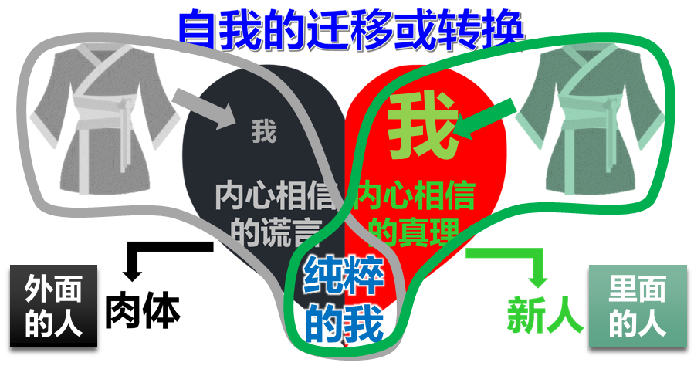
住在基督里的生活
弗4:1 我为主被囚的劝你们：既然蒙召，行事为人就当与蒙召的恩相称。4:2 凡事谦虚、温柔、忍耐，用爱心互相宽容，4:3 用和平彼此联络，竭力保守圣灵所赐合而为一的心。4:4 身体只有一个，圣灵只有一个，正如你们蒙召同有一个指望。4:5 一主，一信，一洗，4:6 一神，就是众人的父，超乎众人之上，贯乎众人之中，也住在众人之内。
Eph 4:1 I, therefore, the prisoner of the Lord, beseech you to walk worthy of the calling with which you were called,4:2 with all lowliness (humility) and gentleness, with longsuffering, bearing with one another in love,4:3 endeavoring to keep the unity of the Spirit in the bond of peace.4:4 There is one body and one Spirit, just as you were called in one hope of your calling;4:5 one Lord, one faith, one baptism;4:6 one God and Father of all, who is above all, and through all, and in you all.
我们所蒙的恩召是什么？
弗1:3 愿颂赞归与我们主耶稣基督的父神！他在基督里曾赐给我们天上各样属灵的福气：1:4 就如（according as）神从创立世界以前，在基督里拣选了我们，使我们在他面前成为圣洁，无有瑕疵；1:5 又因爱我们，就按着自己意旨所喜悦的，预定我们藉着耶稣基督得儿子的名分，1:6 使他荣耀的恩典得着称赞；这恩典是他在爱子里所赐给我们的。

Slide 3
住在基督里的生活
弗4:1 我为主被囚的劝你们：既然蒙召，行事为人就当与蒙召的恩相称。4:2 凡事谦虚、温柔、忍耐，用爱心互相宽容，4:3 用和平彼此联络，竭力保守圣灵所赐合而为一的心。4:4 身体只有一个，圣灵只有一个，正如你们蒙召同有一个指望。4:5 一主，一信，一洗，4:6 一神，就是众人的父，超乎众人之上，贯乎众人之中，也住在众人之内。
Eph 4:1 I, therefore, the prisoner of the Lord, beseech you to walk worthy of the calling with which you were called,4:2 with all lowliness (humility) and gentleness, with longsuffering, bearing with one another in love,4:3 endeavoring to keep the unity of the Spirit in the bond of peace.4:4 There is one body and one Spirit, just as you were called in one hope of your calling;4:5 one Lord, one faith, one baptism;4:6 one God and Father of all, who is above all, and through all, and in you all.
我们所蒙的恩召是什么？
弗1:15 因此，我既听见你们信从主耶稣，亲爱众圣徒，1:16 就为你们不住的感谢神。祷告的时候，常题到你们，1:17 求我们主耶稣基督的神，荣耀的父，将那赐人智慧和启示的灵赏给你们，使你们真知道他，1:18 并且照明你们心中的眼睛，使你们知道他的恩召有何等指望，他在圣徒中得的基业有何等丰盛的荣耀；1:19 并知道他向我们这信的人所显的能力是何等浩大，1:20 就是照他在基督身上所运行的大能大力（which He worked in Christ）。。。

Slide 4
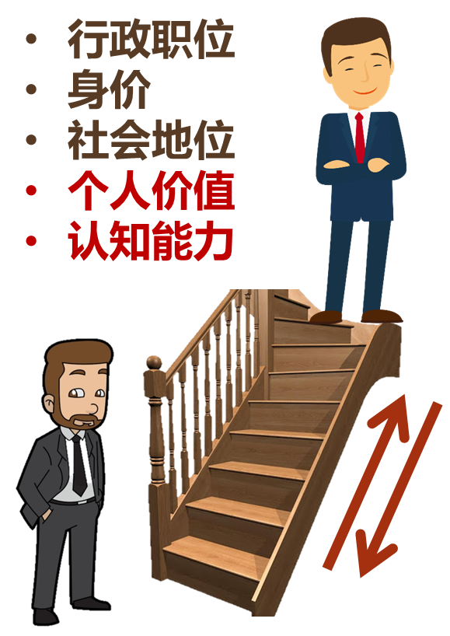
住在基督里的生活
弗4:1 我为主被囚的劝你们：既然蒙召，行事为人就当与蒙召的恩相称。4:2 凡事谦虚、温柔、忍耐，用爱心互相宽容，4:3 用和平彼此联络，竭力保守圣灵所赐合而为一的心。4:4 身体只有一个，圣灵只有一个，正如你们蒙召同有一个指望。4:5 一主，一信，一洗，4:6 一神，就是众人的父，超乎众人之上，贯乎众人之中，也住在众人之内。
Eph 4:1 I, therefore, the prisoner of the Lord, beseech you to walk worthy of the calling with which you were called,4:2 with all lowliness (humility) and gentleness, with longsuffering, bearing with one another in love,4:3 endeavoring to keep the unity of the Spirit in the bond of peace.4:4 There is one body and one Spirit, just as you were called in one hope of your calling;4:5 one Lord, one faith, one baptism;4:6 one God and Father of all, who is above all, and through all, and in you all.
生活如何与这一恩召相配？
谦卑、温柔、忍耐、爱
以和平的联结保持属灵的合一

Slide 5




住在基督里的生活
弗4:1 我为主被囚的劝你们：既然蒙召，行事为人就当与蒙召的恩相称。4:2 凡事谦虚、温柔、忍耐，用爱心互相宽容，4:3 用和平彼此联络，竭力保守圣灵所赐合而为一的心。4:4 身体只有一个，圣灵只有一个，正如你们蒙召同有一个指望。4:5 一主，一信，一洗，4:6 一神，就是众人的父，超乎众人之上，贯乎众人之中，也住在众人之内。
Eph 4:1 I, therefore, the prisoner of the Lord, beseech you to walk worthy of the calling with which you were called,4:2 with all lowliness (humility) and gentleness, with longsuffering, bearing with one another in love,4:3 endeavoring to keep the unity of the Spirit in the bond of peace.4:4 There is one body and one Spirit, just as you were called in one hope of your calling;4:5 one Lord, one faith, one baptism;4:6 one God and Father of all, who is above all, and through all, and in you all.
为什么我们很难做到谦卑？
创3:4 蛇对女人说：你们不一定死；3:5 因为 神知道，你们吃的日子眼睛就明亮了，你们便如神能知道善恶。
肉体
解决方法1
（学业、成就）
自我
依靠
解决方法2
（钱财）
解决方法3
（男女关系）
希望别人也不好
缺乏2
缺乏1
缺乏3
撒但的谎言：
你没有，你不行

Slide 6

住在基督里的生活
弗4:1 我为主被囚的劝你们：既然蒙召，行事为人就当与蒙召的恩相称。4:2 凡事谦虚、温柔、忍耐，用爱心互相宽容，4:3 用和平彼此联络，竭力保守圣灵所赐合而为一的心。4:4 身体只有一个，圣灵只有一个，正如你们蒙召同有一个指望。4:5 一主，一信，一洗，4:6 一神，就是众人的父，超乎众人之上，贯乎众人之中，也住在众人之内。
Eph 4:1 I, therefore, the prisoner of the Lord, beseech you to walk worthy of the calling with which you were called,4:2 with all lowliness (humility) and gentleness, with longsuffering, bearing with one another in love,4:3 endeavoring to keep the unity of the Spirit in the bond of peace.4:4 There is one body and one Spirit, just as you were called in one hope of your calling;4:5 one Lord, one faith, one baptism;4:6 one God and Father of all, who is above all, and through all, and in you all.
生活如何与这一恩召相配？
谦卑、温柔、忍耐、爱
以和平的联结保持属灵的合一
太11:28 凡劳苦担重担的人可以到我这里来，我就使你们得安息。11:29 我心里柔和谦卑，你们当负我的轭，学我的样式；这样，你们心里就必得享安息。11:30 因为我的轭是容易的，我的担子是轻省的。

Slide 7
住在基督里的生活
弗4:1 我为主被囚的劝你们：既然蒙召，行事为人就当与蒙召的恩相称。4:2 凡事谦虚、温柔、忍耐，用爱心互相宽容，4:3 用和平彼此联络，竭力保守圣灵所赐合而为一的心。4:4 身体只有一个，圣灵只有一个，正如你们蒙召同有一个指望。4:5 一主，一信，一洗，4:6 一神，就是众人的父，超乎众人之上，贯乎众人之中，也住在众人之内。
Eph 4:1 I, therefore, the prisoner of the Lord, beseech you to walk worthy of the calling with which you were called,4:2 with all lowliness (humility) and gentleness, with longsuffering, bearing with one another in love,4:3 endeavoring to keep the unity of the Spirit in the bond of peace.4:4 There is one body and one Spirit, just as you were called in one hope of your calling;4:5 one Lord, one faith, one baptism;4:6 one God and Father of all, who is above all, and through all, and in you all.
生活如何与这一恩召相配？
谦卑、温柔、忍耐、爱
以和平的联结保持属灵的合一
约13:3 耶稣知道父已将万有交在他手里，且知道自己是从神出来的，又要归到神那里去， 13:4 就离席站起来，脱了衣服，拿一条手巾束腰， 13:5 随后把水倒在盆里，就洗门徒的脚，并用自己所束的手巾擦乾。 13:6 挨到西门彼得，彼得对他说：主阿，你洗我的脚么？ 13:7 耶稣回答说：我所做的，你如今不知道，后来必明白。

Slide 8
住在基督里的生活
弗4:1 我为主被囚的劝你们：既然蒙召，行事为人就当与蒙召的恩相称。4:2 凡事谦虚、温柔、忍耐，用爱心互相宽容，4:3 用和平彼此联络，竭力保守圣灵所赐合而为一的心。4:4 身体只有一个，圣灵只有一个，正如你们蒙召同有一个指望。4:5 一主，一信，一洗，4:6 一神，就是众人的父，超乎众人之上，贯乎众人之中，也住在众人之内。
Eph 4:1 I, therefore, the prisoner of the Lord, beseech you to walk worthy of the calling with which you were called,4:2 with all lowliness (humility) and gentleness, with longsuffering, bearing with one another in love,4:3 endeavoring to keep the unity of the Spirit in the bond of peace.4:4 There is one body and one Spirit, just as you were called in one hope of your calling;4:5 one Lord, one faith, one baptism;4:6 one God and Father of all, who is above all, and through all, and in you all.
生活如何与这一恩召相配？
谦卑、温柔、忍耐、爱
以和平的联结保持属灵的合一
腓2:5 你们当以基督耶稣的心为心（Let this mind be in you which was also in Christ Jesus）： 2:6 他本有神的形象，不以自己与神同等为强夺的； 2:7 反倒虚己（set aside the privileges of deity），取了奴仆的形象，成为人的样式； 2:8 既有人的样子，就自己卑微，存心顺服，以至于死，且死在十字架上。

Slide 9
住在基督里的生活
弗4:1 我为主被囚的劝你们：既然蒙召，行事为人就当与蒙召的恩相称。4:2 凡事谦虚、温柔、忍耐，用爱心互相宽容，4:3 用和平彼此联络，竭力保守圣灵所赐合而为一的心。4:4 身体只有一个，圣灵只有一个，正如你们蒙召同有一个指望。4:5 一主，一信，一洗，4:6 一神，就是众人的父，超乎众人之上，贯乎众人之中，也住在众人之内。
Eph 4:1 I, therefore, the prisoner of the Lord, beseech you to walk worthy of the calling with which you were called,4:2 with all lowliness (humility) and gentleness, with longsuffering, bearing with one another in love,4:3 endeavoring to keep the unity of the Spirit in the bond of peace.4:4 There is one body and one Spirit, just as you were called in one hope of your calling;4:5 one Lord, one faith, one baptism;4:6 one God and Father of all, who is above all, and through all, and in you all.
生活如何与这一恩召相配？
谦卑、温柔、忍耐、爱
以和平的联结保持属灵的合一
腓4:11 我并不是因缺乏说这话；我无论在甚么景况都可以知足，这是我已经学会了。4:12 我知道怎样处卑贱，也知道怎样处丰富；或饱足，或饥饿；或有余，或缺乏，随事随在，我都得了秘诀。4:13 我靠着那加给我力量的，凡事都能做。

Slide 10
住在基督里的生活
弗4:1 我为主被囚的劝你们：既然蒙召，行事为人就当与蒙召的恩相称。4:2 凡事谦虚、温柔、忍耐，用爱心互相宽容，4:3 用和平彼此联络，竭力保守圣灵所赐合而为一的心。4:4 身体只有一个，圣灵只有一个，正如你们蒙召同有一个指望。4:5 一主，一信，一洗，4:6 一神，就是众人的父，超乎众人之上，贯乎众人之中，也住在众人之内。
Eph 4:1 I, therefore, the prisoner of the Lord, beseech you to walk worthy of the calling with which you were called,4:2 with all lowliness (humility) and gentleness, with longsuffering, bearing with one another in love,4:3 endeavoring to keep the unity of the Spirit in the bond of peace.4:4 There is one body and one Spirit, just as you were called in one hope of your calling;4:5 one Lord, one faith, one baptism;4:6 one God and Father of all, who is above all, and through all, and in you all.
生活如何与这一恩召相配？
谦卑、温柔、忍耐、爱
以和平的联结保持属灵的合一
林后10:4 我们争战的兵器本不是属血气的，乃是在神面前有能力，可以攻破坚固的营垒，10:5 将各样的计谋，各样拦阻人认识神的那些自高之事，一概攻破了，又将人所有的心意夺回，使他都顺服基督。10:6 并且我已经预备好了，等你们十分顺服的时候，要责罚那一切不顺服的人。

Slide 11
住在基督里的生活
弗4:1 我为主被囚的劝你们：既然蒙召，行事为人就当与蒙召的恩相称。4:2 凡事谦虚、温柔、忍耐，用爱心互相宽容，4:3 用和平彼此联络，竭力保守圣灵所赐合而为一的心。4:4 身体只有一个，圣灵只有一个，正如你们蒙召同有一个指望。4:5 一主，一信，一洗，4:6 一神，就是众人的父，超乎众人之上，贯乎众人之中，也住在众人之内。
Eph 4:1 I, therefore, the prisoner of the Lord, beseech you to walk worthy of the calling with which you were called,4:2 with all lowliness (humility) and gentleness, with longsuffering, bearing with one another in love,4:3 endeavoring to keep the unity of the Spirit in the bond of peace.4:4 There is one body and one Spirit, just as you were called in one hope of your calling;4:5 one Lord, one faith, one baptism;4:6 one God and Father of all, who is above all, and through all, and in you all.
关键是需要有属灵的眼光
谦卑、温柔、忍耐、爱
以和平的联结保持属灵的合一
林后10:4 我们争战的兵器本不是属血气的，乃是在神面前有能力，可以攻破坚固的营垒，10:5 将各样的计谋，各样拦阻人认识神的那些自高之事，一概攻破了，又将人所有的心意夺回，使他都顺服基督。10:6 并且我已经预备好了，等你们十分顺服的时候，要责罚那一切不顺服的人。

Slide 12
住在基督里的生活
弗4:1 我为主被囚的劝你们：既然蒙召，行事为人就当与蒙召的恩相称。4:2 凡事谦虚、温柔、忍耐，用爱心互相宽容，4:3 用和平彼此联络，竭力保守圣灵所赐合而为一的心。4:4 身体只有一个，圣灵只有一个，正如你们蒙召同有一个指望。4:5 一主，一信，一洗，4:6 一神，就是众人的父，超乎众人之上，贯乎众人之中，也住在众人之内。
Eph 4:1 I, therefore, the prisoner of the Lord, beseech you to walk worthy of the calling with which you were called,4:2 with all lowliness (humility) and gentleness, with longsuffering, bearing with one another in love,4:3 endeavoring to keep the unity of the Spirit in the bond of peace.4:4 There is one body and one Spirit, just as you were called in one hope of your calling;4:5 one Lord, one faith, one baptism;4:6 one God and Father of all, who is above all, and through all, and in you all.
关键是需要有属灵的眼光
约17:20 我不但为这些人祈求，也为那些因他们的话信我的人祈求，17:21 使他们都合而为一。正如你父在我里面，我在你里面，使他们也在我们里面，叫世人可以信你差了我来。17:22 你所赐给我的荣耀，我已赐给他们，使他们合而为一，象我们合而为一。17:23 我在他们里面，你在我里面，使他们完完全全的合而为一，叫世人知道你差了我来，也知道你爱他们如同爱我一样。17:24 父阿，我在那里，愿你所赐给我的人也同我在那里，叫他们看见你所赐给我的荣耀；因为创立世界以前，你已经爱我了。

Slide 13
住在基督里的生活
弗4:1 我为主被囚的劝你们：既然蒙召，行事为人就当与蒙召的恩相称。4:2 凡事谦虚、温柔、忍耐，用爱心互相宽容，4:3 用和平彼此联络，竭力保守圣灵所赐合而为一的心。4:4 身体只有一个，圣灵只有一个，正如你们蒙召同有一个指望。4:5 一主，一信，一洗，4:6 一神，就是众人的父，超乎众人之上，贯乎众人之中，也住在众人之内。
Eph 4:1 I, therefore, the prisoner of the Lord, beseech you to walk worthy of the calling with which you were called,4:2 with all lowliness (humility) and gentleness, with longsuffering, bearing with one another in love,4:3 endeavoring to keep the unity of the Spirit in the bond of peace.4:4 There is one body and one Spirit, just as you were called in one hope of your calling;4:5 one Lord, one faith, one baptism;4:6 one God and Father of all, who is above all, and through all, and in you all.
关键是需要有属灵的眼光
弗1:15 因此，我既听见你们信从主耶稣，亲爱众圣徒，1:16 就为你们不住的感谢神。祷告的时候，常题到你们，1:17 求我们主耶稣基督的神，荣耀的父，将那赐人智慧和启示的灵赏给你们，使你们真知道他，1:18 并且照明你们心中的眼睛，使你们知道他的恩召有何等指望，他在圣徒中得的基业有何等丰盛的荣耀；1:19 并知道他向我们这信的人所显的能力是何等浩大，1:20 就是照他在基督身上所运行的大能大力（which He worked in Christ）。。。

Slide 14
住在基督里的生活
弗4:1 我为主被囚的劝你们：既然蒙召，行事为人就当与蒙召的恩相称。4:2 凡事谦虚、温柔、忍耐，用爱心互相宽容，4:3 用和平彼此联络，竭力保守圣灵所赐合而为一的心。4:4 身体只有一个，圣灵只有一个，正如你们蒙召同有一个指望。4:5 一主，一信，一洗，4:6 一神，就是众人的父，超乎众人之上，贯乎众人之中，也住在众人之内。
Eph 4:1 I, therefore, the prisoner of the Lord, beseech you to walk worthy of the calling with which you were called,4:2 with all lowliness (humility) and gentleness, with longsuffering, bearing with one another in love,4:3 endeavoring to keep the unity of the Spirit in the bond of peace.4:4 There is one body and one Spirit, just as you were called in one hope of your calling;4:5 one Lord, one faith, one baptism;4:6 one God and Father of all, who is above all, and through all, and in you all.
关键是需要有属灵的眼光
创3:4 蛇对女人说：你们不一定死；3:5 因为 神知道，你们吃的日子眼睛就明亮了，你们便如神能知道善恶。
肉体
解决方法1
（学业、成就）
自我
依靠
解决方法2
（钱财）
解决方法3
（男女关系）
希望别人也不好
缺乏2
缺乏1
缺乏3
撒但的谎言：
你没有，你不行

Slide 15
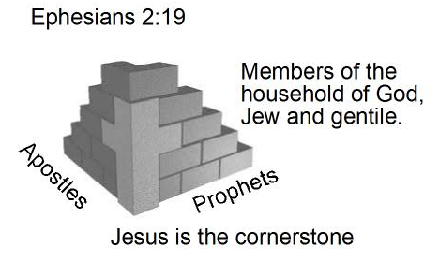
住在基督里的生活
弗4:7 我们各人蒙恩，都是照基督所量给各人的恩赐。4:8 所以经上说：他升上高天的时候，掳掠了仇敌，将各样的恩赐赏给人。4:9 （既说升上，岂不是先降在地下么？4:10 那降下的，就是远升诸天之上要充满万有的。）4:11 他所赐的，有使徒，有先知，有传福音的，有牧师和教师，4:12 为要成全圣徒，各尽其职，建立基督的身体，
你人生到底在追求什么？
Eph 4:7 But to each one of us grace was given according to the measure of Christ’s gift.4:8 Therefore He says: “When He ascended on high, He led captivity captive, And gave gifts to men.” 4:9 (Now this, “He ascended”–what does it mean but that He also first descended into the lower parts of the earth?4:10 He who descended is also the One who ascended far above all the heavens, that He might fill all things.)4:11 And He Himself gave some to be apostles, some prophets, some evangelists, and some pastors and teachers,4:12 for the equipping of the saints for the work of
ministry, for the edifying of the body of Christ,
弗2:19 这样，你们不再作外人和客旅，是与圣徒同国，是神家里的人了；2:20 并且被建造在使徒和先知的根基上，有基督耶稣自己为房角石，2:21 各（或作：全）房靠他联络得合式，渐渐成为主的圣殿。2:22 你们也靠他同被建造，成为神藉着圣灵居住的所在。

Slide 16
住在基督里的生活
弗4:13 直等到我们众人在真道上同归于一，认识神的儿子，得以长大成人，满有基督长成的身量，4:14 使我们不再作小孩子，中了人的诡计和欺骗的法术，被一切异教之风摇动，飘来飘去，就随从各样的异端；4:15 惟用爱心说诚实话，凡事长进，连于元首基督，4:16 全身都靠他联络得合式，百节各按各职，照着各体的功用彼此相助，便叫身体渐渐增长，在爱中建立自己。
你人生到底在追求什么？
Eph 4:13 Till we all come in the unity of the faith, and of the knowledge of the Son of God, unto a perfect man, unto the measure of the stature of the fullness of Christ: 4:14 That we henceforth be no more children, tossed back and forth, and carried about with every wind of doctrine, by the sleight of men, and cunning craftiness, whereby they lie in wait to deceive;4:15 But speaking the truth in love, may grow up into him in all things, which is the head, even Christ:4:16 From whom the whole body fitly joined together and compacted by that which every joint supplies, according to the effectual working in the measure of
every part, makes increase of the body unto the
edifying of itself in love.
弗2:19 这样，你们不再作外人和客旅，是与圣徒同国，是神家里的人了；2:20 并且被建造在使徒和先知的根基上，有基督耶稣自己为房角石，2:21 各（或作：全）房靠他联络得合式，渐渐成为主的圣殿。2:22 你们也靠他同被建造，成为神藉着圣灵居住的所在。

Slide 17
住在基督里的生活
弗4:13 直等到我们众人在真道上同归于一，认识神的儿子，得以长大成人，满有基督长成的身量，4:14 使我们不再作小孩子，中了人的诡计和欺骗的法术，被一切异教之风摇动，飘来飘去，就随从各样的异端；4:15 惟用爱心说诚实话，凡事长进，连于元首基督，4:16 全身都靠他联络得合式，百节各按各职，照着各体的功用彼此相助，便叫身体渐渐增长，在爱中建立自己。
得着属灵眼光最关键之处？
太6:19 不要为自己积攒财宝在地上；地上有虫子咬，能锈坏，也有贼挖窟窿来偷。6:20 只要积攒财宝在天上；天上没有虫子咬，不能锈坏，也没有贼挖窟窿来偷。6:21 因为你的财宝在那里，你的心也在那里。6:22 眼睛就是身上的灯。你的眼睛若瞭亮，全身就光明；6:23 你的眼睛若昏花，全身就黑暗。你里头的光若黑暗了，那黑暗是何等大呢！6:24 一个人不能事奉两个主；不是恶这个，爱那个，就是重这个，轻那个。你们不能又事奉神，又事奉玛门（玛门：财利的意思）。
Eph 4:13 Till we all come in the unity of the faith, and of the knowledge of the Son of God, unto a perfect man, unto the measure of the stature of the fullness of Christ: 4:14 That we henceforth be no more children, tossed back and forth, and carried about with every wind of doctrine, by the sleight of men, and cunning craftiness, whereby they lie in wait to deceive;4:15 But speaking the truth in love, may grow up into him in all things, which is the head, even Christ:4:16 From whom the whole body fitly joined together and compacted by that which every joint supplies, according to the effectual working in the measure of
every part, makes increase of the body unto the
edifying of itself in love.

