Slide 1
死里复活(6）
Resurrection from the dead
（罗马书5-8章）

Slide 2
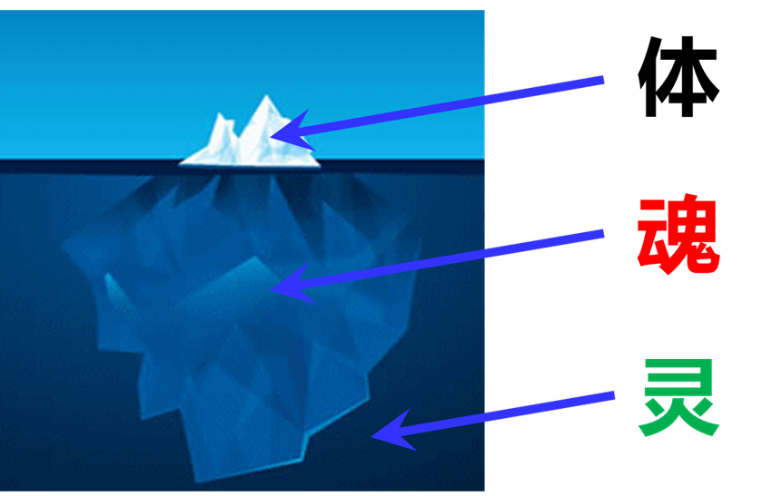
在亚当里的人 与 在基督里的人
在罪中（罗5：12-21；6：1-11）
在义里（罗5：12-21；6：17-18）
是死的（罗5：12-21；6：1-11，23）
是活的（罗5：12-21；6：4-5，23）
肢体是罪的器具（罗6：13，17）
肢体是义的器具（罗6：13，18）
在律法之下（罗6：14）
在恩典之下（罗6：14 ）
与旧丈夫联合（罗7：2-3）
与新丈夫联合（罗7：2-3）
是属肉体的（罗7：5）
是属灵的（罗7：4，6）
知道福音的基督徒生命中的难处到底如何解决？

Slide 3
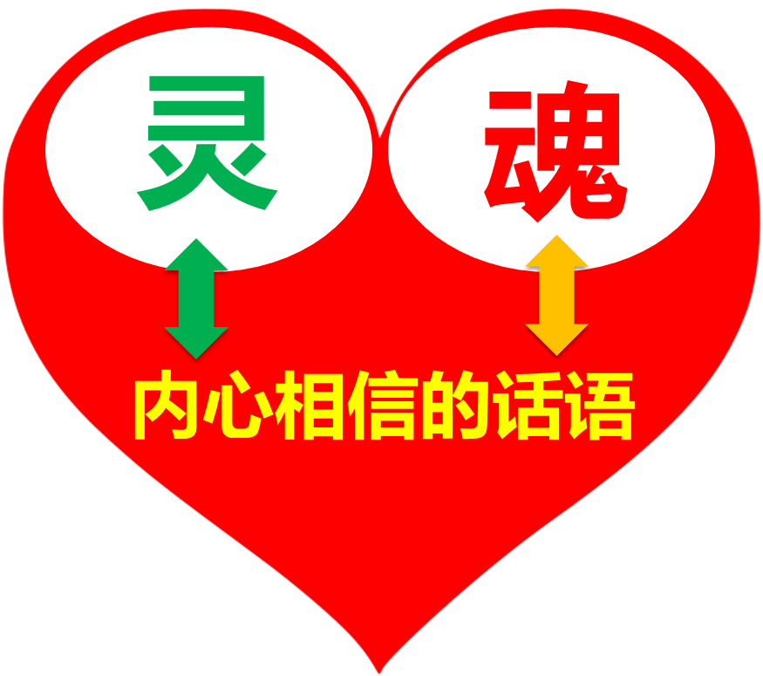
基督
我

Slide 4
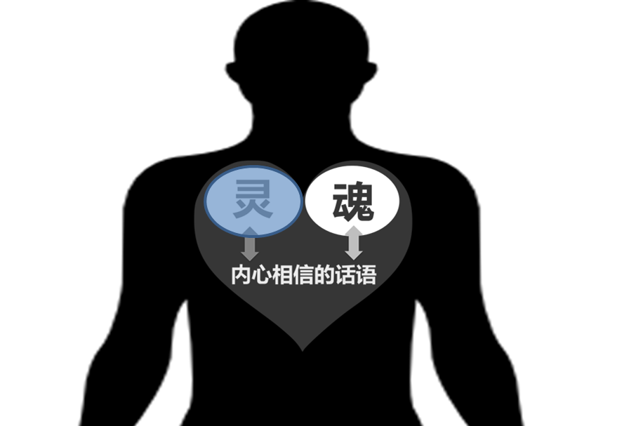
基督
我
林后5:21 神使那无罪（无罪：原文是不知罪）的，替我们成为罪，好叫我们在他里面成为神的义。
赛53:5 哪知他为我们的过犯受害，为我们的罪孽压伤。

Slide 5
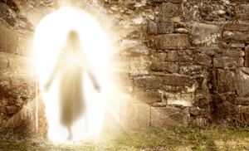
基督
我
罗6:5 我们若在他死的形状上与他联合，也要在他复活的形状上与他联合
林后5:21 神使那无罪（无罪：原文是不知罪）的，替我们成为罪，好叫我们在他里面成为神的义。
赛53:5 哪知他为我们的过犯受害，为我们的罪孽压伤。

Slide 6
罗马书第六章 Romans 6
¹⁰ 他（基督）死是向罪死了，只有一次；他活是向神活着。¹¹ 这样，你们向罪也当看自己是死的；向神在基督耶稣里，却当看自己是活的。¹² 所以，不要容罪在你们必死的身上作王，使你们顺从身子的私慾。¹³ 也不要将你们的肢体献给罪作不义的器具；倒要象从死里复活的人，将自己献给神，并将肢体作义的器具献给神。¹⁴ 罪必不能作你们的主，因你们不在律法之下，乃在恩典之下。
¹⁰ For the death that He died, He died to sin once for all; but the life that He lives, He lives to God. ¹¹ Even so consider yourselves to be dead to sin, but alive to God in Christ Jesus. ¹² Therefore do not let sin reign in your mortal body so that you obey its lusts. ¹³ and do not go on presenting the members of your body to sin as instruments of unrighteousness; but present yourselves to God as those alive from the dead, and your members as instruments of righteousness to God. ¹⁴ For sin shall not be master over you, for you are not under law but under grace.
重生基督徒最大的难处？

Slide 7
罗马书第7章 Romans 7
¹ 弟兄们，我现在对明白律法的人说，你们岂不晓得律法管人是在活着的时候么？² 就如女人有了丈夫，丈夫还活着，就被律法约束；丈夫若死了，就脱离了丈夫的律法。³ 所以丈夫活着，她若归于别人，便叫淫妇；丈夫若死了，她就脱离了丈夫的律法，虽然归于别人，也不是淫妇。
¹ Or do you not know, brethren (for I am speaking to those who know the law), that the law has jurisdiction over a person as long as he lives? ² For the married woman is bound by law to her husband while he is living; but if her husband dies, she is released from the law concerning the husband. ³ So then, if while her husband is living she is joined to another man, she shall be called an adulteress; but if her husband dies, she is free from the law, so that she is not an adulteress though she is joined to another man.
重生基督徒最大的难处？

Slide 8
罗马书第7章 Romans 7
⁴ 我的弟兄们，这样说来，你们藉着基督的身体，在律法上也是死了，叫你们归于别人，就是归于那从死里复活的，叫我们结果子给神。⁵ 因为我们属肉体的时候，那因律法而生的恶慾就在我们肢体中发动，以致结成死亡的果子。⁶ 但我们既然在捆我们的律法上死了，现今就脱离了律法，叫我们服事主，要按着心灵（心灵：或作圣灵）的新样，不按着仪文的旧样。
⁴ Therefore, my brethren, you also were made to die to the Law through the body of Christ, so that you might be joined to another, to Him who was raised from the dead, in order that we might bear fruit for God. ⁵ For while we were in the flesh, the sinful passions, which were aroused by the Law, were at work in the members of our body to bear fruit for death. ⁶ But now we have been released from the Law, having died to that by which we were bound, so that we serve in newness of the Spirit and not in oldness of the letter.
重生基督徒最大的难处？

Slide 9
罗马书第7章 Romans 7
⁷ 这样，我们可说甚么呢？律法是罪么？断乎不是！只是非因律法，我就不知何为罪。非律法说不可起贪心，我就不知何为贪心。⁸ 然而罪趁着机会，就藉着诫命叫诸般的贪心在我里头发动；因为没有律法，罪是死的。⁹ 我以前没有律法是活着的；但是诫命来到，罪又活了，我就死了。
⁷ What shall we say then? Is the Law sin? May it never be! On the contrary, I would not have come to know sin except through the Law; for I would not have known about coveting if the Law had not said, “YOU SHALL NOT COVET.” ⁸ But sin, taking opportunity through the commandment, produced in me coveting of every kind; for apart from the Law sin is dead. ⁹ I was once alive apart from the Law; but when the commandment came, sin became alive and I died;
重生基督徒最大的难处？

Slide 10
为什么说罪是死的？
罗5:12 这就如罪是从一人入了世界，死又是从罪来的；于是死就临到众人，因为众人都犯了罪。Therefore, just as through one man sin entered into the world, and death through sin, and so death spread to all men, because all sinned.
罗5:18 如此说来，因一次的过犯，众人都被定罪；照样，因一次的义行，众人也就被称义得生命了。So then as through one transgression there resulted condemnation to all men, even so through one act of righteousness there resulted justification of life to all men.
罗6:2 断乎不可！我们在罪上死了的人岂可仍在罪中活着呢？6:3 岂不知我们这受洗归入基督耶稣的人是受洗归入他的死么？6:4 所以，我们藉着洗礼归入死，和他一同埋葬，原是叫我们一举一动有新生的样式，象基督藉着父的荣耀从死里复活一样。6:5 我们若在他死的形状上与他联合，也要在他复活的形状上与他联合。6:6 因为知道我们的旧人和他同钉十字架，使罪身灭绝，叫我们不再作罪的奴仆；6:7 因为已死的人是脱离了罪。
来2:14 儿女既同有血肉之体，他也照样亲自成了血肉之体，特要藉着死败坏那掌死权的，就是魔鬼，2:15 并要释放那些一生因怕死而为奴仆的人。Therefore, since the children share in flesh and blood, He Himself likewise also partook of the same, that through death He might render powerless him who had the power of death, that is, the devil, and might free those who through fear of death were subject to slavery all their lives.

Slide 11
那现在世界上的罪是怎么回事？
弗4:17 所以我说，且在主里确实的说，你们行事不要再象外邦人存虚妄的心行事。4:18 他们心地昏昧，与神所赐的生命隔绝了，都因自己无知，心里刚硬；4:19 良心既然丧尽，就放纵私慾，贪行种种的污秽。4:20 你们学了基督，却不是这样。4:21 如果你们听过他的道，领了他的教，学了他的真理，4:22 就要脱去你们从前行为上的旧人，这旧人是因私慾的迷惑渐渐变坏的；4:23 又要将你们的心志改换一新，4:24 并且穿上新人；这新人是照着神的形象造的，有真理的仁义和圣洁。
弗2:1 你们死在过犯罪恶之中，他叫你们活过来。2:2 那时，你们在其中行事为人，随从今世的风俗，顺服空中掌权者的首领，就是现今在悖逆之子心中运行的邪灵。2:3 我们从前也都在他们中间，放纵肉体的私慾，随着肉体和心中所喜好的去行，本为可怒之子，和别人一样。
彼前1:17 你们既称那不偏待人、按各人行为审判人的主为父，就当存敬畏的心度你们在世寄居的日子，1:18 知道你们得赎，脱去你们祖宗所传流虚妄的行为，不是凭着能坏的金银等物，1:19 乃是凭着基督的宝血，如同无瑕疵、无玷污的羔羊之血。
徒17:30 世人蒙昧无知的时候，神并不监察，如今却吩咐各处的人都要悔改。

Slide 12
为什么说罪是被律法激活的？
创1:26 神说：我们要照着我们的形象、按着我们的样式造人，使他们管理海里的鱼、空中的鸟、地上的牲畜，和全地，并地上所爬的一切昆虫。1:27 神就照着自己的形象造人，乃是照着他的形象造男造女。
创2:16 耶和华 神吩咐他说：园中各样树上的果子，你可以随意吃，2:17 只是分别善恶树上的果子，你不可吃，因为你吃的日子必定死！
创3:4 蛇对女人说：你们不一定死；3:5 因为 神知道，你们吃的日子眼睛就明亮了，你们便如神能知道善恶。

Slide 13
罗马书第7章 Romans 7
⁷ 这样，我们可说甚么呢？律法是罪么？断乎不是！只是非因律法，我就不知何为罪。非律法说不可起贪心，我就不知何为贪心。⁸ 然而罪趁着机会，就藉着诫命叫诸般的贪心在我里头发动；因为没有律法，罪是死的。⁹ 我以前没有律法是活着的；但是诫命来到，罪又活了，我就死了。
⁷ What shall we say then? Is the Law sin? May it never be! On the contrary, I would not have come to know sin except through the Law; for I would not have known about coveting if the Law had not said, “YOU SHALL NOT COVET.” ⁸ But sin, taking opportunity through the commandment, produced in me coveting of every kind; for apart from the Law sin is dead. ⁹ I was once alive apart from the Law; but when the commandment came, sin became alive and I died;
林前15:55 死阿！你得胜的权势在那里？死阿！你的毒钩在那里？15:56 死的毒钩就是罪，罪的权势就是律法。 “O DEATH, WHERE IS YOUR VICTORY? O DEATH, WHERE IS YOUR STING?”15:56 The sting of death is sin, and the power (dunamis, miraculous power) of sin is the law.
雅1:14 但各人被试探，乃是被自己的私慾牵引诱惑的。1:15 私慾既怀了胎，就生出罪来；罪既长成，就生出死来。1:14 But each one is tempted when he is carried away and enticed by his own lust.1:15 Then when lust has conceived, it gives birth to sin; and when sin is accomplished, it brings forth death.

Slide 14
罗马书第7章 Romans 7
¹⁰ 那本来叫人活的诫命，反倒叫我死；¹¹ 因为罪趁着机会，就藉着诫命引诱我，并且杀了我。¹² 这样看来，律法是圣洁的，诫命也是圣洁、公义、良善的。¹³ 既然如此，那良善的是叫我死么？断乎不是！叫我死的乃是罪。但罪藉着那良善的叫我死，就显出真是罪，叫罪因着诫命更显出是恶极了。
¹⁰ and this commandment, which was to result in life, proved to result in death for me; ¹¹ for sin, taking an opportunity through the commandment, deceived me and through it killed me. ¹² So then, the Law is holy, and the commandment is holy and righteous and good. ¹³ Therefore did that which is good become a cause of death for me? May it never be! Rather it was sin, in order that it might be shown to be sin by effecting my death through that which is good, so that through the commandment sin would become utterly sinful.
重生基督徒最大的难处？

